Slide 1
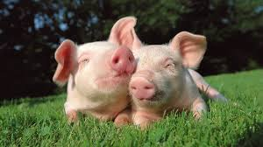
AFRICAN SUINE FEVER

Slide 2
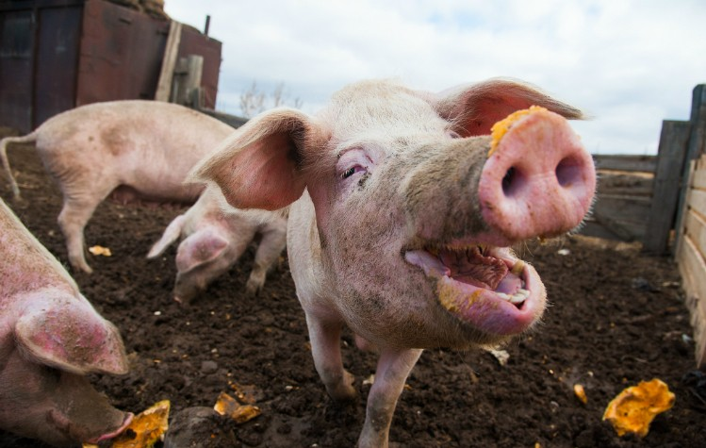
African Suine Fever is included among the transboundary animal diseases (TADs) which are notifiable to the World Organisation for Animal Health (OIE) according to the Terrestrial Animal Health Code.
TADs are defined as diseases that are of significant economic, trade and food security importance with potential for rapid international spread, and that require international cooperation for control and management
ASF is one of the most serious transboundary swine diseases because of its high lethality for pigs, its socioeconomic consequences, its rapid and international spread and the absence of either treatment or vaccine.

Slide 3
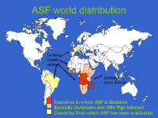
WORLD DISTRIBUTION
After being described for the first time 1921 in Kenya, ASF was subsequently reported in most sub-Saharan countries in Africa. In 1957 the disease spread to Portugal, most likely by swill feeding from airports.
A second introduction during the 1960´s resulted in spread throughout the Iberian peninsula to several other countries in Europe, including France, Italy, Belgium, Malta, and the Netherlands.
It is suspected that the disease was spread through the transportation and distribution of infected pig products via airports and harbours.
In June 2007, ASF was reported again in Europe,
starting in Georgia and spreading to Armenia, Azerbaijan
and to Russia. In 2012 it is endemic in Russia,
representing a threat to the European Union
ASF has been reported from most of the eastern and
southern African countries, and is endemic in Uganda.

Slide 4
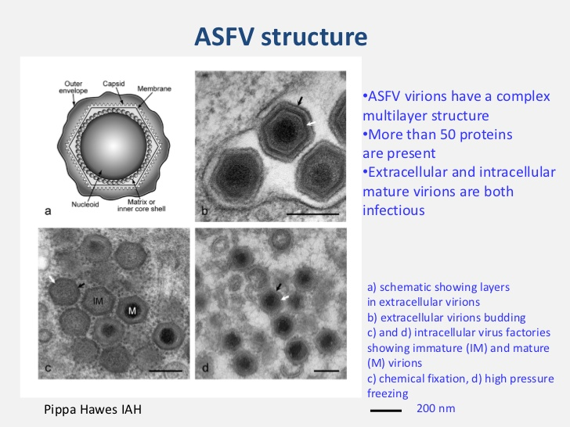
AFRICAN SUINE FEVER VIRUS
ASFV is an icosahedral double stranded DNA Asfivirus that is presently the sole member of the family of Asfarviridae . ASFV replicates mainly in the cytoplasm of the infected cells, and is the only known DNA virus to be an arbovirus (arthropod-borne virus), able to multiply in both vertebrate and invertebrate hosts. Although there is only one serotype, more than 20 genotypes and numerous subtypes of ASFV of varying virulence have been identified.

Slide 5
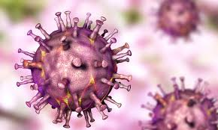
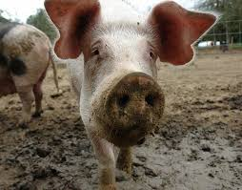
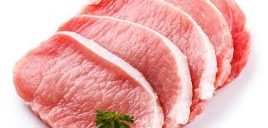
ASF VIRUS
In a suitable environment the ASFV is stable over a wide range of temperatures and pH values. It may remain infectious in:
-serum for 18 months when kept at room temperature,
-in refrigerated blood for 6 years and
-in blood at 37° C for one month.
It is necessary to heat serum at 60° C for 30 minutes to inactivate the virus.
Sunlight and desiccation rapidly inactivates the ASFV.
The virus may remain infective in raw, smoked or frozen pork for at least 15 weeks up to several months, which means that undercooked pork, blood or carcass meal derived from pigs must be regarded as dangerous if fed to pigs.
In pig faeces ASFV can persist over 100 days.

Slide 6
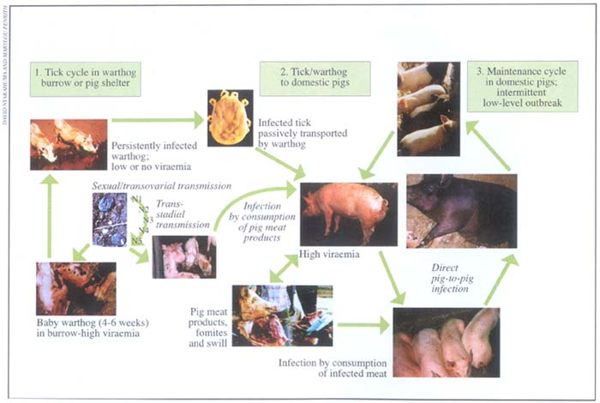
Transmission of ASFV infection
ASFV infects only species within the pig family (Suidae), where the virus is spread through two different cycles:
the domestic and
the sylvatic one.

Slide 7
DOMESTIC CYCLE
In the domestic cycle the virus is spread between domestic pigs through direct or indirect contact. The most important route of transmission is the direct contact between domestic pigs with a predominantly oronasal infection route. Transmission also occurs through indirect contact with aerosols, faeces, and urine or other body fluids. After infection with ASFV, domestic pigs may shed infective amounts of virus for 24 to 48 hours before clinical signs appear.
Pigs that survive the acute disease may shed high amounts of virus for about 30 days, even though the infection may persist longer. The exact length of time over which infective levels of virus are maintained in lymphoid tissues is unknown, but does not appear to exceed three to four months. Current studies indicate that vertical transmission of ASFV is not possible.
Pigs that recover from acute or subacute ASF may become subclinical persistent carriers of the virus. The virus levels in recovered pigs are considered to be too low for the pig to transmit the virus to other pigs by direct contact, unless the virus becomes reactivated by stress.
Other routes of transmission, especially important for spreading to new areas, are spread through contaminated fomites and swill feeding with uncooked pork.

Slide 8
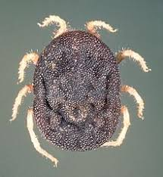
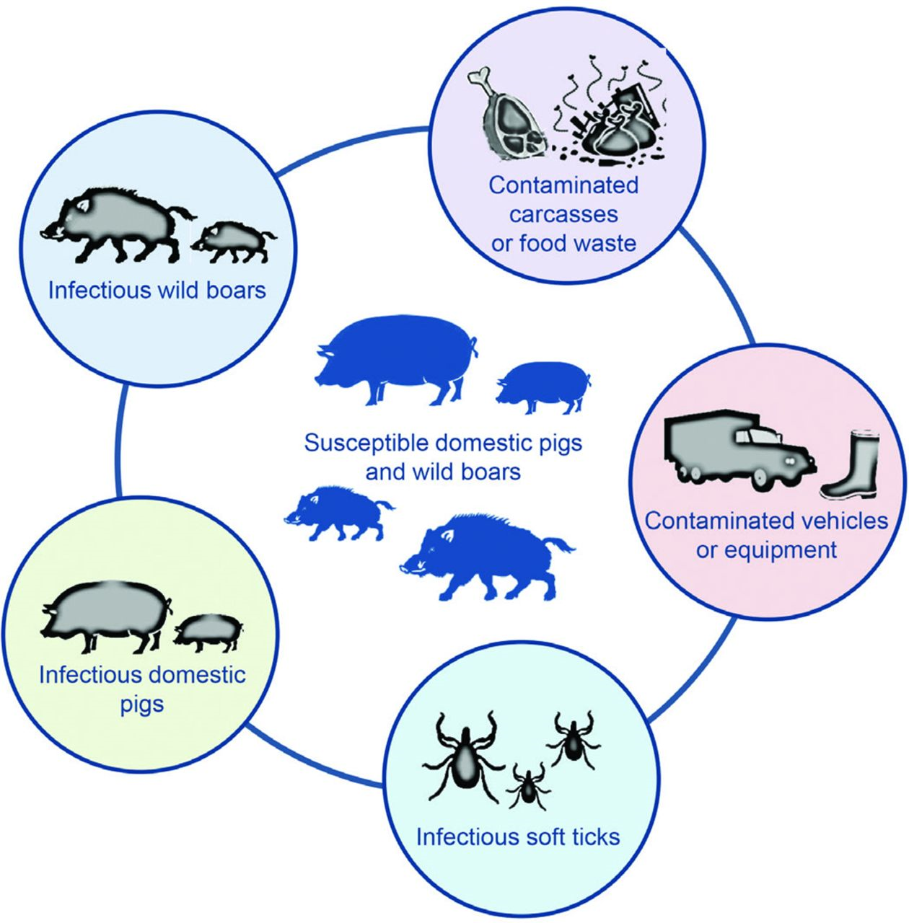
SYLVATIC CYCLE
The sylvatic cycle involves wild species of swine spreading the virus by soft ticks of the Ornithodoros moubata complex. Infected wild pigs are believed to have an infective virus level in other tissues than the lymph nodes for about two months after infection, but stay infected for life.
The spread of ASFV between wild and domestic pigs occur when wild and
domestic pigs share the same feeding area and tick from the wild pigs bites
the domestic pigs.
Carcasses from wild pigs, brought by humans, are also considered to play a role of introducing ticks to the domestic pigs. Direct contact between infected warthogs and domestic pigs has not been shown to cause transmission, and experiments with domestic pigs fed with carcasses from infected warthogs did not lead to infection.

Slide 9
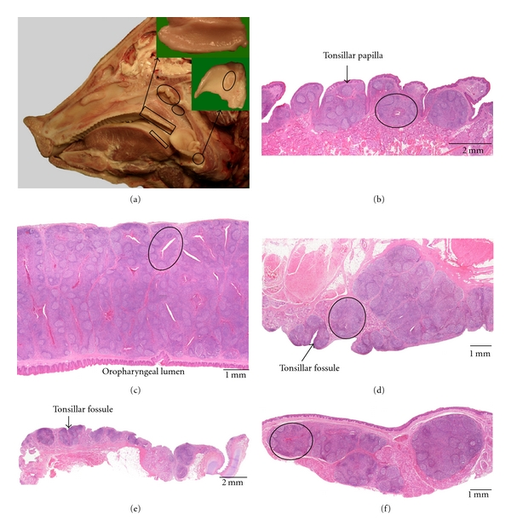
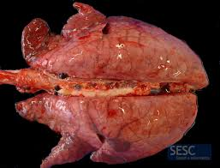
PATHOGENESIS
The main infection route is via the upper respiratory tract, and initial virus replication occurs within 24 hours of infection in the pharyngeal tonsil and in the lymphoid tissue draining the nasal mucosa.
Viremia follows, and the virus affects the vascular endothelium and causes lymphopenia, followed by thrombocytopenia.
After a few days the endothelial lesions involve basement membranes and death usually follows due to pulmonary oedema

Slide 10
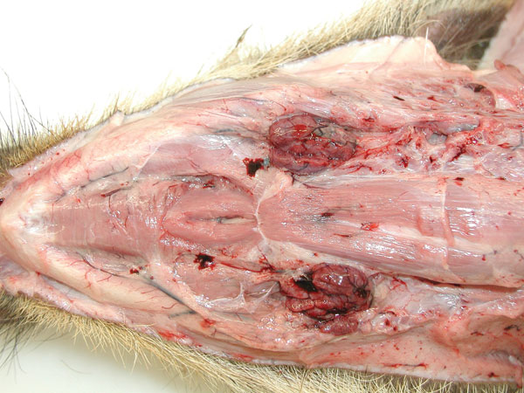
ASFV replicates primarily in monocytes and macrophages but replication has also been described in a range of other cells such as:
megakaryocytes,
endothelial cells,
glomerular mesangial and tubular epithelial cells,
hepatocytes,
thymus reticulum-epithelial cells,
fibroblasts,
smooth muscle cells of venules and arterioles,
neutrophils and lymphocytes.
The most striking histopathological feature of ASF is massive karyorrhexis in lymphoid tissues, often accompanied by haemorrhage and disseminated intravascular coagulation (DIC).

Slide 11
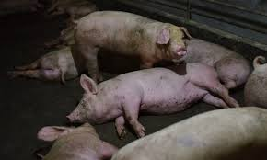
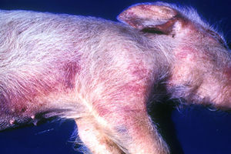
Pigs infected with ASF generally suffer severe lymphopenia, which occurs during the initialmiddle phase of the disease . The lymphopenia is attributed to apoptosis of lymphocytes while haemorrhage is caused by cytokines and other mediators released by infected macrophages, resulting in the activation of the clotting cascade and DIC.
Endothelial necrosis from viral replication in endothelial cells is another possibility. The thrombocytopenia has been attributed to consumption of platelets due to coagulopathy or as a direct effect of the virus on megakaryocytes and is generally observed in the final phase of acute disease.
The massive destruction of macrophages also plays a major role in the impaired haemostasis.

Slide 12
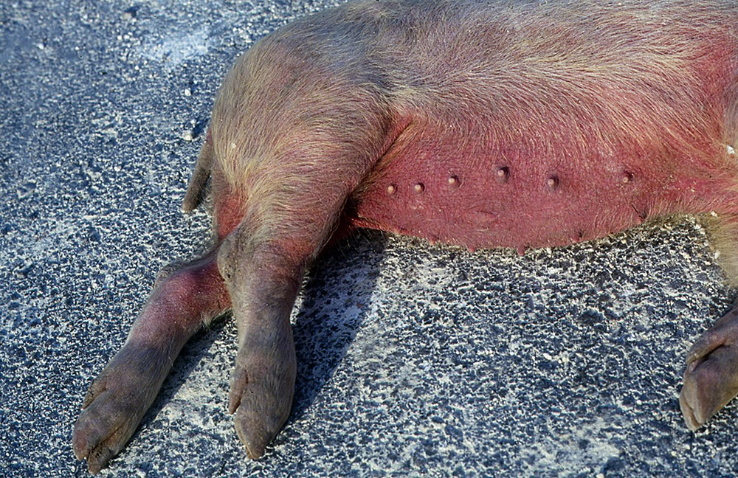
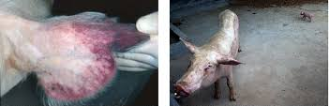
CLINICAL SIGNS
The incubation period is from 3 to 15 days, and clinical signs vary depending on the virulence of the strain.
In Acute ASF infected pigs develop a persistent fever of up to 42 C, become listless and anorexic, and erythema of the ears, tail, distal extremities and ventral areas of chest and abdomen is common. Vomiting, bloody diarrhoea and ataxia due to hind-limb weakness usually develops, followed by difficult breathing indicative of the lung oedema that is often the primary cause of death. Pigs that survive longer than 6 up to 20 days may develop neural symptoms. Abortion may occur in pregnant sows. Low virulent isolates produce mainly subclinical and nonhaemorrhagic infection with seroconversion.
Chronically infected pigs usually get more diffuse symptoms like emaciation, joint ill, respiratory distress and skin lesions. Viremia can reoccur with periods of fever, and secondary bacterial infections are common. The mortality is approximately 30 %, and pigs usually die within a couple of months

Slide 13
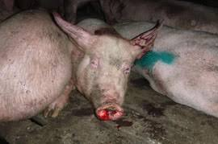
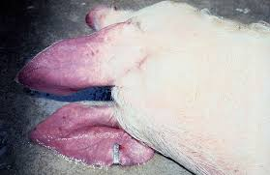
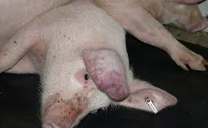
MACROSCOPIC LESIONS (acute ASF)
Pigs that die peracutely often do so before any lesions develop, but skin flushing of the ventrum and extremities may be seen in white-skinned pigs.
Also a general congestion of organs with fluid in body cavities and fibrin strands on organ surfaces may be present.
The lesions of acute ASF may depend on the virus isolate, but most common are:
-cyanosis of the extremities and the ventral surface in white-skinned pigs,
-areas of cyanosis in hairless parts,
-cutaneous ecchymosis on the legs and abdomen and
-mucosal congestion and haemorrhage.

Slide 14
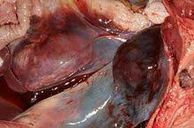
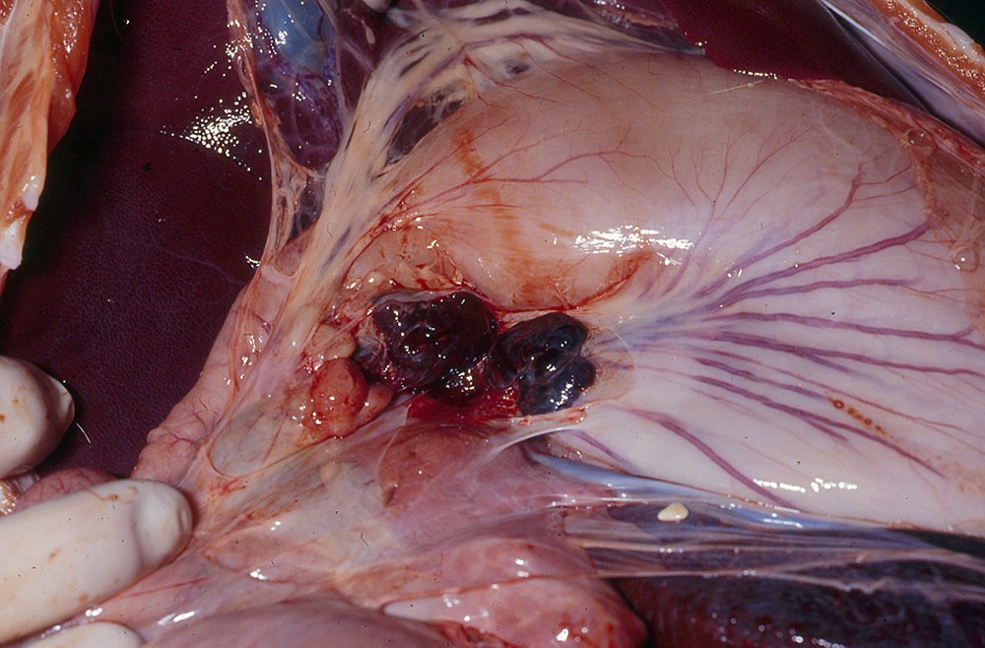
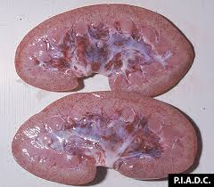
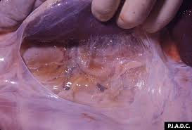
Several internal organs are congested and oedematous.
There is often accumulation of straw-coloured fluid in pleural, pericardial and peritoneal cavities and widespread haemorrhages in the renal cortex, spleen and the lungs, and on parietal surfaces.
Petechiae in the larynx, bladder mucosa and on visceral surfaces of organs are common as a congestive splenomegaly.
Oedema may be present in the mesentery of the colon and in the gall bladder. In particular, hepatogastric and mesenteric lymph nodes may be swollen and haemorrhagic.
The mucosa of the stomach is often congested to haemorrhagic, sometimes necrotic.
Hydropericardium and epi- to endocardial haemorrhages are described in both acute and chronic cases.

Slide 15
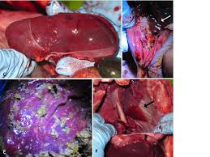
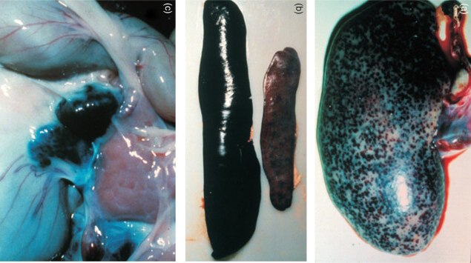
MACROSCOPIC LESIONS (subacute and chronic ASF)
In the subacute form, serofibrinous pleuritis and pericarditis are frequently observed. The lymph nodes are often enlarged and haemorrhagic to fibrous, and joint and tendon sheath effusions with oedema of periarticular tissues may be present.
In the chronic form, there may be local or generalized skin eruptions. Oedema, lobar consolidation and necrosis of the lungs may develop. Fibrinous pericarditis and purulent to serofibrinous arthritis may occur as in the subacute form. Regional lymphadenopathy, with enlarged and firm lymph nodes often accompanies visceral lesions, but haemorrhages are rare. The spleen may show varying lesions including splenomegaly, haemorrhage and necrosis.

Slide 16
MICROSCOPIC LESIONS (acute ASF)
Acute ASF affects mainly lymphoid tissues, lungs, kidneys and the liver and brain. Pathologic characteristics of the lymphoid tissues, particulary the lymph nodes, tonsil and spleen, is massive necrosis with prominent karyorrhexis.
The tonsils in both acute and chronic cases may have infiltrates of necrotic mononuclear cells and reticular cells in the sinus stroma and in the germinal centres.
General hyperaemia with oedema and haemorrhages is common, and necrosis of the squamous epithelium that overlies the tonsil and lines the crypts has been observed.
The lymph nodes are often hyperaemic with peripheral or diffuse oedema.
The blood vessels and sinus stroma are usually infiltrated by mononuclear cells, which often are necrotic, as well as the reticulate cells of the sinus stroma and germinal centre cells. These lesions are often observed in all of the lymphoid tissues.

Slide 17
Acute spleen lesions are also diffuse degeneration of lymphoid tissue and vascular walls combined with severe congestion or haemorrhage in the red pulp.
Lung oedema is common, and is often accompanied by necrotic mononuclear cells in the alveolar septa and lumina in which necrosis may also involve. Vascular endothelial damage in the lung may cause thrombosis of vessels and thickening of the alveolar walls.
Acute proliferative glomerulonephritis may occur, and prominent oedema and macrophage infiltration may be seen in the renal interstitium.
Lesions described in the liver include degeneration and focal necrosis of hepatocytes, Kupffer´s cell degeneration, and mononuclear cell infiltrates in the sinusoids.
In the myocardium, few lesions are reported, mainly intramural haemorrhage and hyperaemia. In both acute and chronic cases, serosal petechiae may appear both in the stomach and in the intestines.

Slide 18
MICROSCOPIC LESIONS (chronic ASF)
Spleen lesions in the subacute and chronic ASF are characterized by diffuse occurrence of myeloid cells in the red pulp.
Lymphoid degeneration and atrophy may be present, but less intense compared with the acute form.
Chronic hyperplastic changes usually involve visceral and parietal lymph nodes.
There may be mild lung oedema, and interstitial pneumonia is common.
Various types of glomerulopathy occur, associated with immunemediated phenomena. The interstitium of the kidney may show lymphohistiocytic and plasmacytic infiltrates.

Slide 19
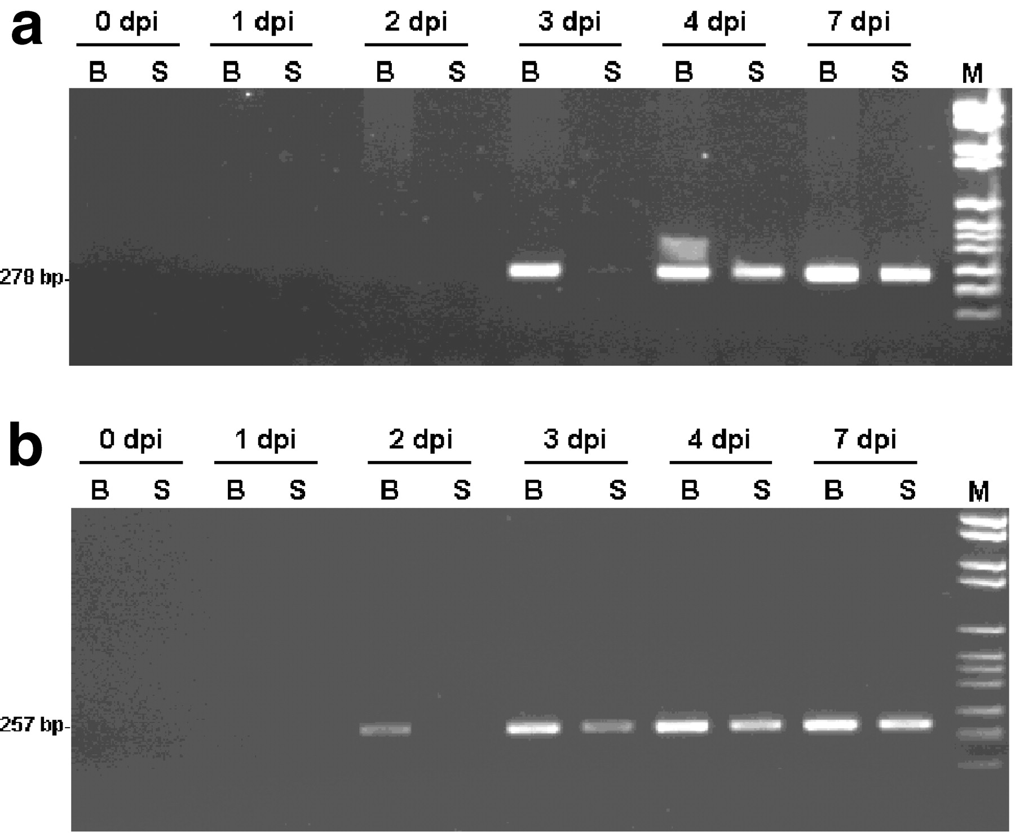
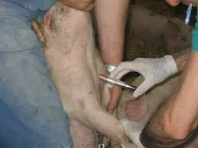
DIAGNOSIS
According to the OIE Manual of Standards for Diagnostic Tests and Vaccines, preferred samples for virus isolation/ antigen detection for ASF are tissue samples from lymphatic tissues, or whole blood from febrile pigs up to five days after the onset of fever.
Polymerase chain reaction (PCR) is recommended for the identification of ASFV DNA because of its high sensitivity and specificity.
Histopathological examination and detection of virus by immunohistochemical methods are also carried out.
Serological tests such as ELISA are recommended in endemic areas or where a primary outbreak is caused by a strain of low virulence.

Slide 20
THANKS FOR YOUR ATTENTION

