Slide 1
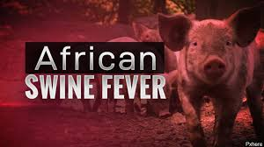
PATHOMORPHOLOGY III

Slide 2
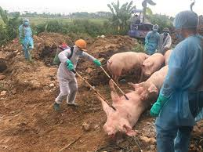
INTRODUCTION
Is a highly contagious hemorrhagic disease that
affects domestic and wild pigs, causing serious
economic and productive losses.
It is caused by a DNA virus of the Asfarviridae
family, which also infects ticks of the genus
Ornithodoros.
While the signs of African swine fever and those of classical swine fever may be similar, there is no relationship between the viruses.
AFS is a disease referred to in the Terrestrial Animal Health Code of the World Organization for Animal Health (OIE), mandatory declaration.
Is present in domestic and wild pigs in regions of Asia, Europe and Africa.

Slide 3
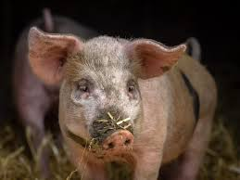
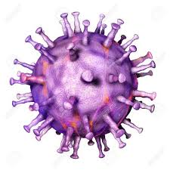
ETIOLOGY
Causal Agent Classification
Caused by a double-stranded DNA virus with envelope and icosahedral symmetry, unique member of the Asfarviridae family, genus Asfivirus, from which they differ genotypes.
Different strains of African swine fever virus present differences in their virulence.
It is the only known DNA arbovirus.

Slide 4
Resistance to physical and chemical action
Temperature: Very resistant to low temperatures. Heat inactivated at 56°C/70 min; 60°C/20 min.
pH: Inactivated at pH <3.9 or >11.5 in a serum-free medium.
The serum increases the resistance of the virus.
Chemicals: Sensitive to ether and chloroform.
Disinfectants: Inactivated by 8/1,000 sodium hydroxide (30 min), hypochlorites - 2.3% chlorine (30 min), 3/1,000 formalin (30 min), 3% orthophenylphenol (30 min) and iodine compounds.
Survival: It remains viable for a long time in the blood, feces and tissues. It can be multiplied in vectors of the genus Ornithodoros or by oronasal route.

Slide 5
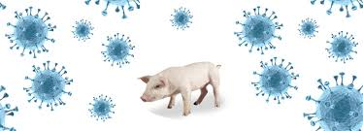
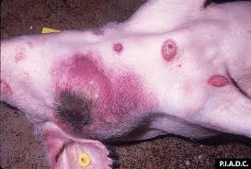
PATHOGENESIS
After infection, there is a multiplication in lymphoreticular organs, producing a viremia that will cause death or will be oscillating in the event that it recovers. It is eliminated by different routes and will cause lesions in lymphoreticular tissue, serious vascular lesions and frequently secondary infections.

Slide 6
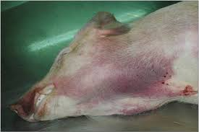
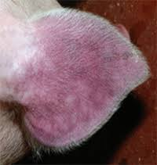
Clinical signs
The mortality rate and clinical signs may vary depending on the virulence of the virus and the type/species of pig. African wild pigs can be infected without showing any clinical signs, which transforms them into reservoirs.
Acute form: high fever, depression, anorexia and loss of appetite, bleeding (redness of the skin of the ears, abdomen and legs), abortions in pregnant sows, cyanosis, vomiting, diarrhea and death after 6-13 days (or up to 20 days). The mortality rate can reach 100%.
Subacute and chronic forms: are caused by moderate or less virulent viruses, which produce less intense clinical signs that may manifest themselves over longer periods. Mortality rates are lower, but can range between 30 and 70%. Symptoms of chronic disease include weight loss, intermittent fever, respiratory problems, chronic skin ulcerations and arthritis.

Slide 7
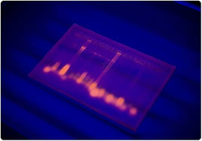
DIAGNOSIS
Identification of the agent
a) Haemadsorption test (HAD) in primary leukocyte cultures
b) Antigen detection by fluorescent antibody test (FAT)
c) Detection of virus genome by the polymerase chain reaction – PCR
Serological tests
a) Enzyme-linked immunosorbent assay
b) Indirect fluorescent antibody (IFA) test – should be used as a confirmatory test for sera from areas that are free from ASF and are positive in the ELISA
c) Immunoblotting test or immunoperoxidase staining – used as an alternative to the IFA test to confirm equivocal results with individual sera

Slide 8
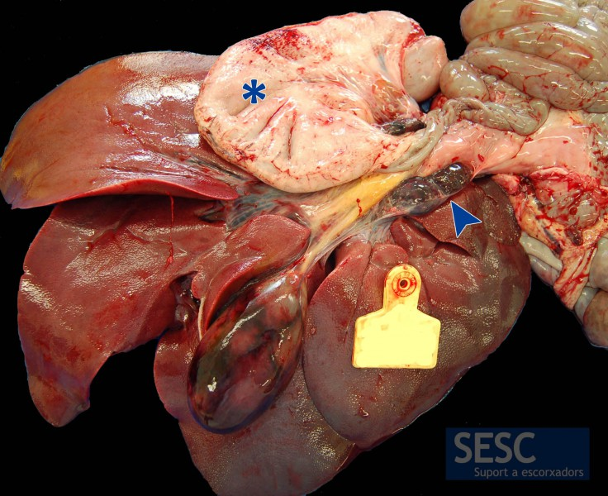
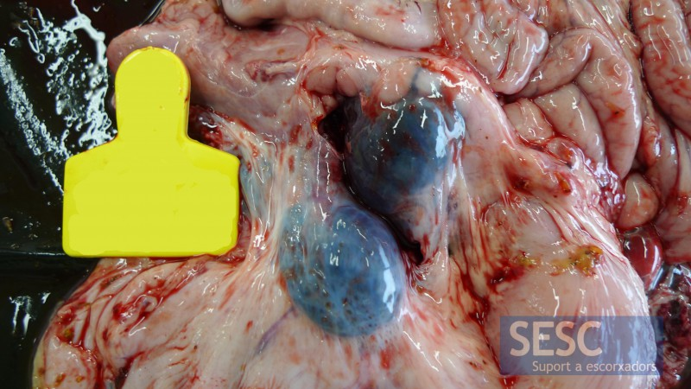
NECROPSY AND HISTOPATHOLOGICAL CHANCE
Hemorrhage of the gastrohepatic lymph node (arrow and right picture), is a very characteristic lesion. The gallbladder shows areas of bleeding in its wall. In the digestive tract petechiae can be seen in the serosa, as is the case of the stomach (asterisk).

Slide 9
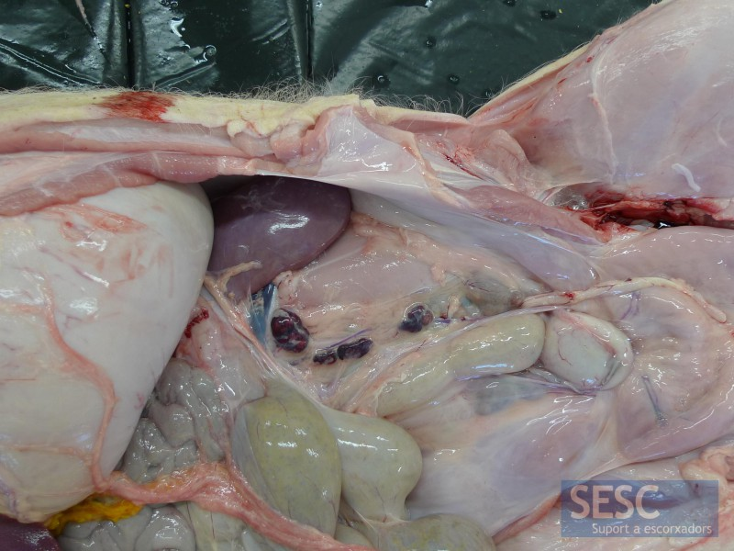
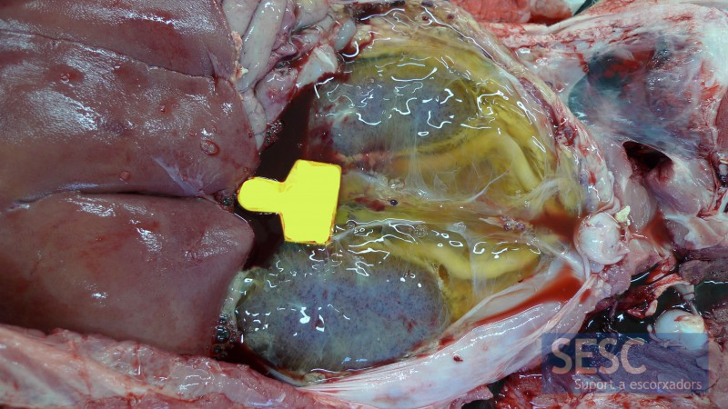
In more severe cases, perirenal edema is observed, in the image we have removed the peritoneum. The kidneys have multiple petechial hemorrhages.
Renal lymph nodes also tend to bleed.

Slide 10
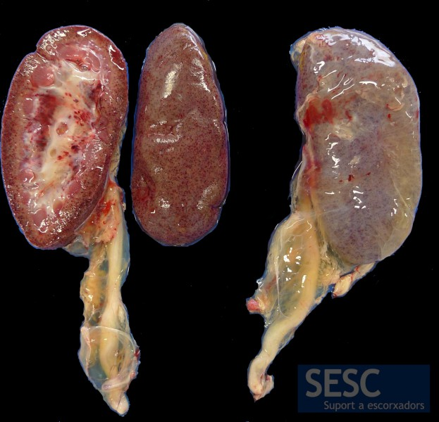
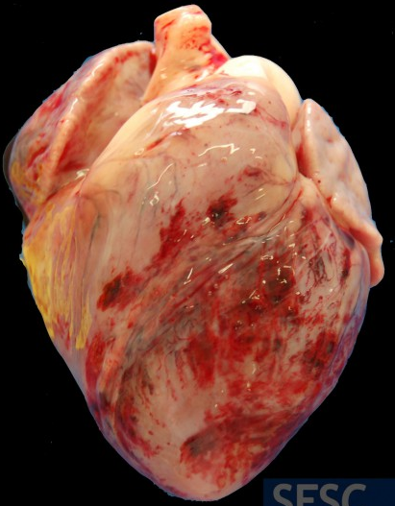
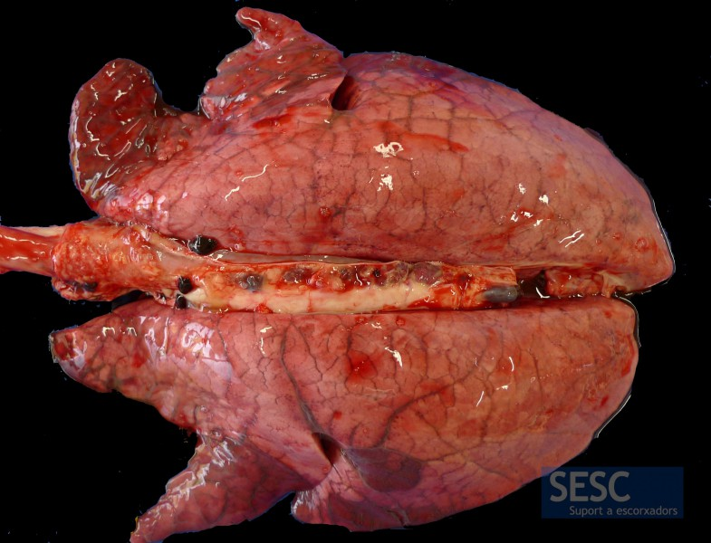
Petechial hemorrhages (<3mm in diameter) of miliary distribution in the cortex and renal pelvis.
Epicardial hemorrhages
Pulmonary edema, evidenced by the lack of collapse of the lungs with evident interstitial edema between pulmonary lobules. (no especific)

Slide 11
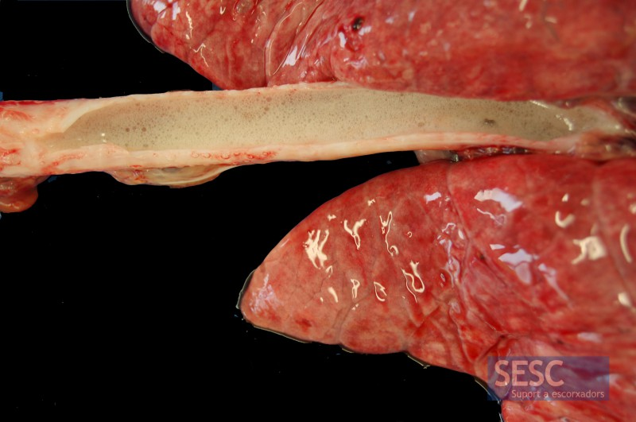
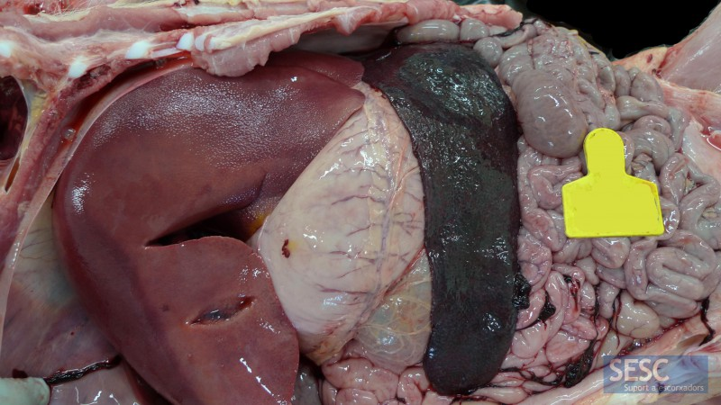
Marked pulmonary edema, evidenced by the presence of foam inside the trachea (open longitudinally).
Marked increase in spleen size (splenomegaly). (No especific)

Slide 12
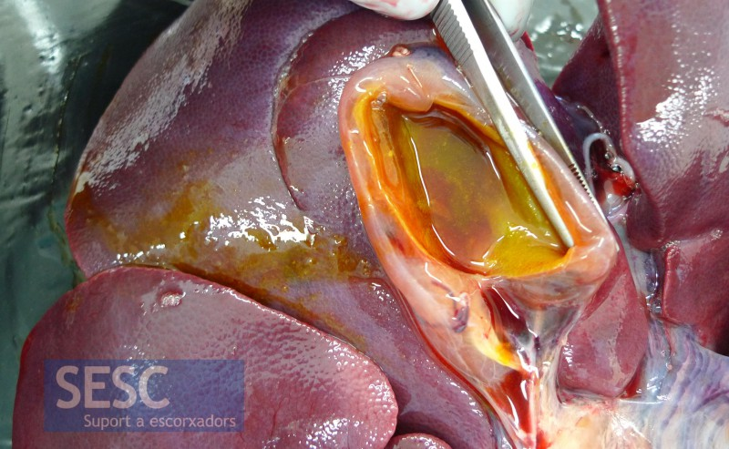
Edema of the bladder wall.

Slide 13
TREATMENT
There is no authorized vaccine against African swine fever.
Prevention in disease-free countries depends on the adoption of appropriate import policies and biosafety measures, which prevent the introduction of live pigs and infected pig products in areas free of African swine fever.
During outbreaks and in affected countries, control of African swine fever can be difficult and should be adapted to the specific epidemiological situation.
Classic sanitary measures can be used, including early detection and humanitarian killing of animals (with the corresponding elimination of canals and wastes); cleaning and disinfection; zoning / compartmentalization and movement control; surveillance and detailed epidemiological research and strict biosecurity measures on farms.

Slide 14
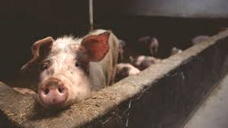
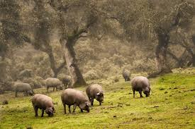
In Europe and in regions of Asia, the transmission of African swine fever seems to depend largely on the population density of wild boars and their interaction with pig production systems with low levels of biosafety.
The knowledge and good management of the wild boar population, and good coordination between the Veterinary Services and wildlife and forestry authorities are necessary to prevent and control African swine fever successfully.
Depending on the epidemiological situation, in the control programs, the participation of the soft tick as a vector should also be considered.

Slide 15
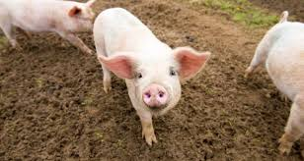
END

