Slide 1
BOVINE TUBERCULOSIS

Slide 2
Index
Introduction
Etiology
Transmission
Pathogenesis
Symptoms
Diagnosis
Lesions
Treatment

Slide 3
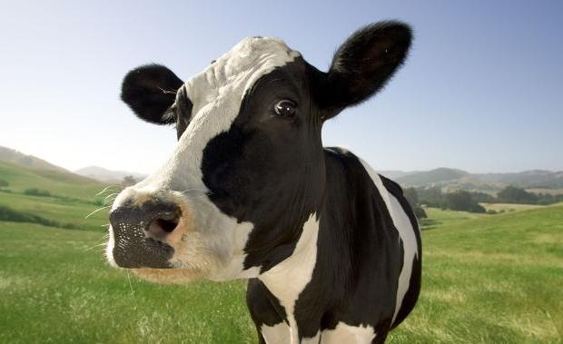
Introduction
Bovine tuberculosis is an infectious disease caused by M. bovis (a zoonotic organism) that affects cattle, other domesticated animals and certain free or captive wildlife species.
It is usually characterised by formation of nodular granulomas known as tubercles.
Although commonly defined as a chronic debilitating disease, bovine tuberculosis can occasionally assume a more progressive course.
Any body tissue can be affected, but lesions are most frequently observed in the lymph nodes (particularly of the head and thorax), lungs, intestines, liver, spleen, pleura, and peritoneum.
The development of lesions and clinical signs depends on:
Way of contagion
Infective dose
Pathogeneticity
Host resistance
It is a zoonosis, so there is a plan of eradication in some countries→ clinical evidence of tuberculosis in cattle is seldom encountered because the intradermal tuberculin test that enables presumptive diagnosis and elimination of infected animals before signs appear.
Epidemiology: this disease is spread all over the world, especially in Africa, parts of Asia and of the Americas; but it’s spread also in Europe even if the prevalence is not so high.

Slide 4
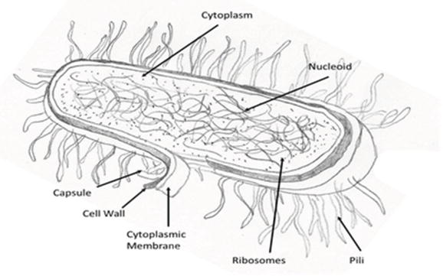
Etiology
The etiology is based on a type of bacteria belonging to the genus Mycobakterium, type tuberculosis. There are two different groups:
Mycobacterium tuberculosis complex; MTC: including: Myc. tuberculosis, bovine - Myc. bovis, Myc. canetti, Myc. Caprae, Myc leprosy (Mycobacterium leprae),
Nontuberculous mycobacteria ,NTM: - bird - Myc. avium, Myc. marinum, Myc. Ulcerans
Characteristics:
It is a resistant alcoholic acid bacteria
Often colorless
Strict aerobic.→ Its growth is subordinated to the presence of oxygen and the surrounding pH value.
Asporigenous
Rod-like and without flagella
It is very resistant to cold, PH changes, lots of disinfectants, and freezing and drying conditions because of its structure.
On the contrary, it is very sensitive to heat, sunlight and ultraviolet light.
Structure
Mycobacterium tuberculosis has a particular structure that is an intermidiate between gram + and gram - bacteria.; and also, its wall has 3 stratum:
Membrane
Thin layer of peptidoglycan
Lipidic part with acid fats and sugars

Slide 5
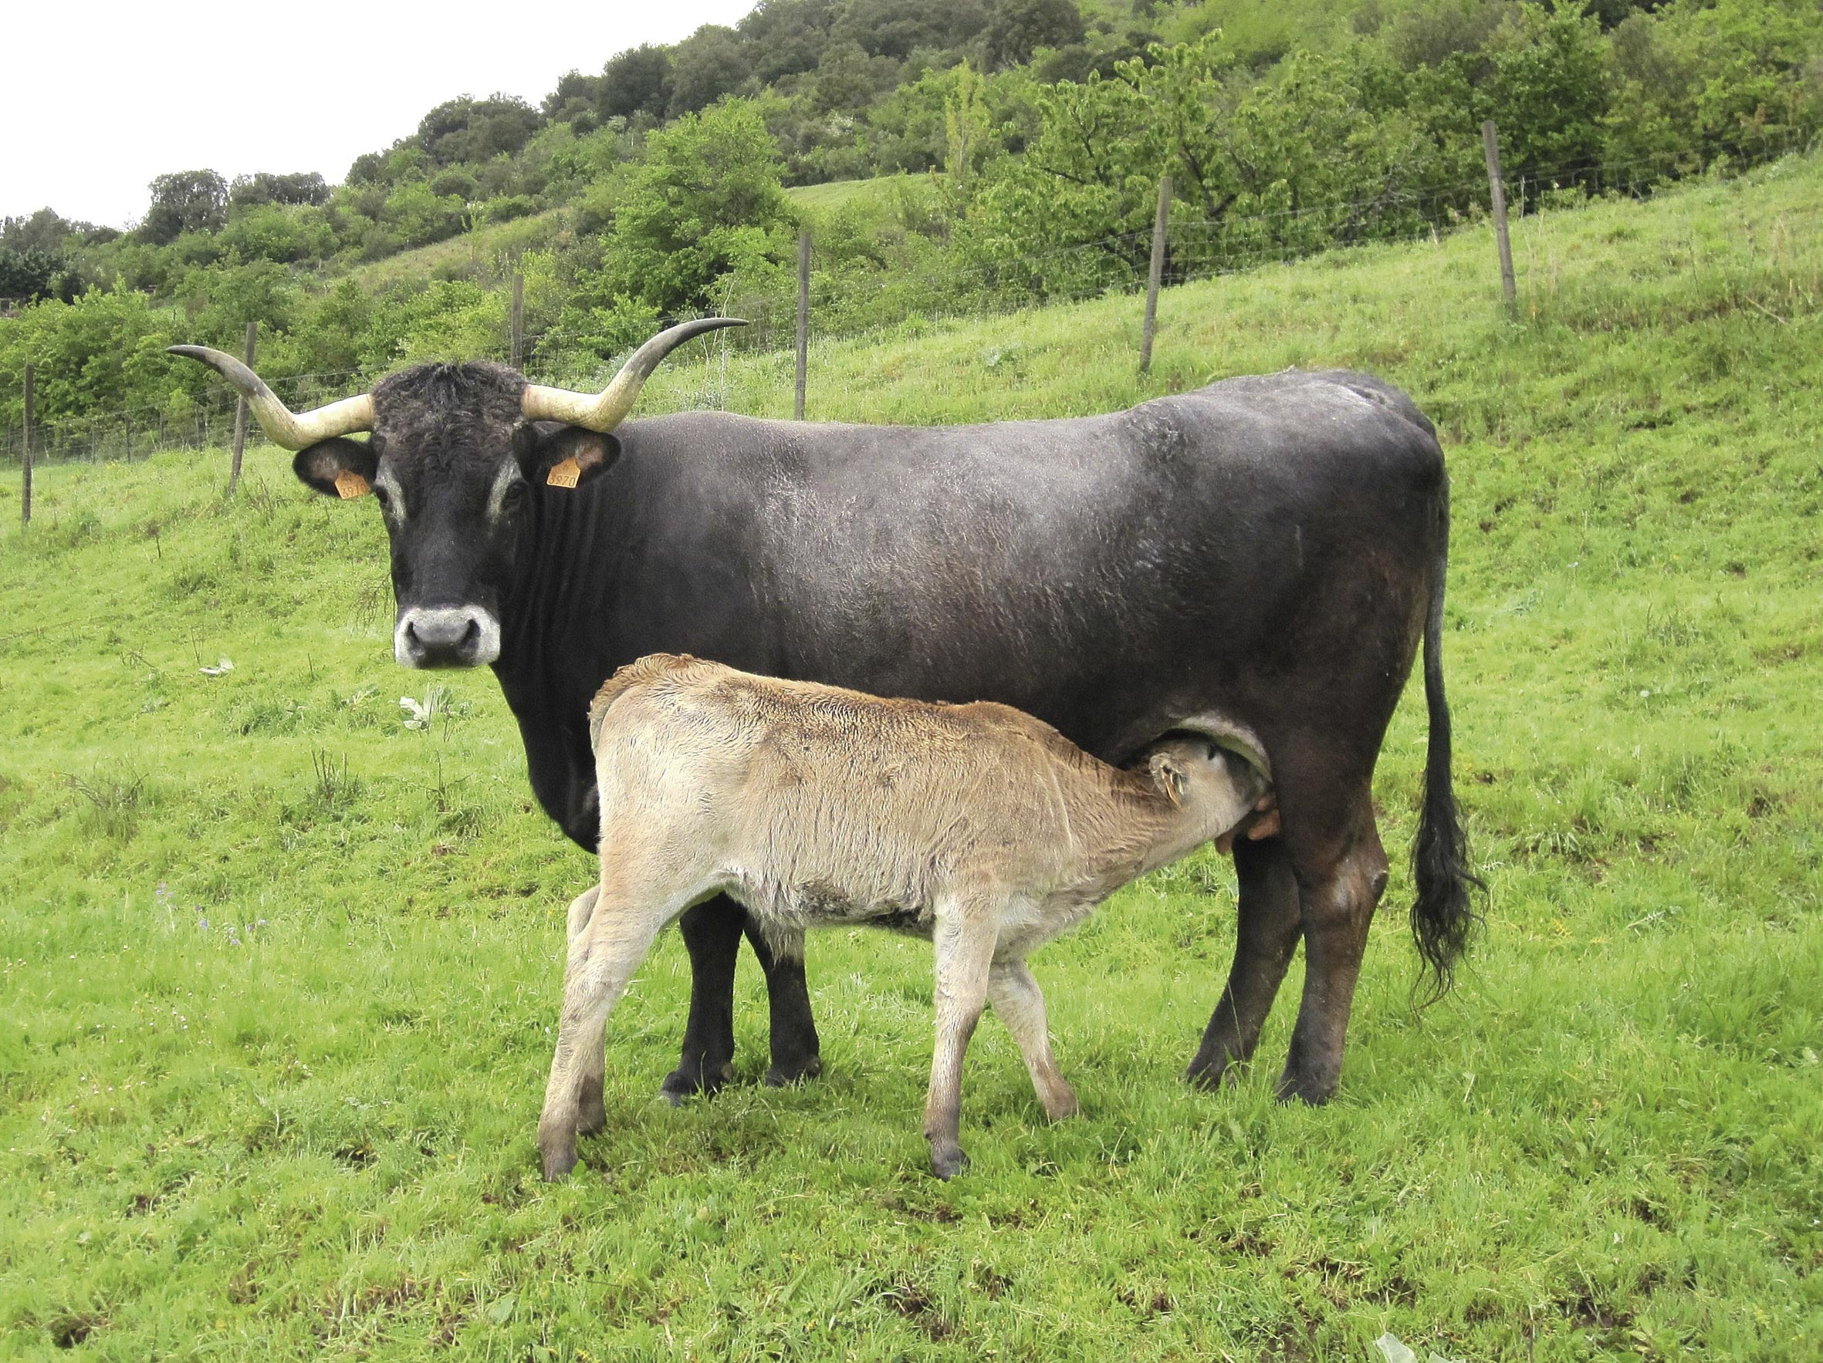
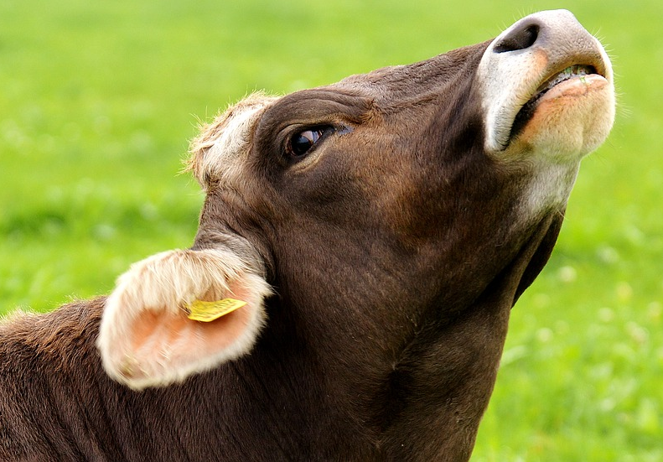
Transmission
The disease is contagious and is transmitted mainly by infected animals, even sub-clinical ones:
Directly: by contact with infected domestic or wild animals
Indirectly: by ingestion of contaminated feed
The elimination of M.bovis is through:
Cough
Milk
Colostum
Faeces, urine, vaginal discharge, sperm
Although these are the possible transmission routes, the usual route of infection in bovine herds is INHALATION
The disease is slowly developed and it may take months or even years until the infected animal dies→a single infected animal can spread the bacteria inside the herd before manifesting clinical signs. That´s because displacement of infected domestic animals is one of the main ways of spreading the disease.

Slide 6
Pathogenesis
Symptoms
Entrance of the bacterium through the respiratory tract
Bovine tuberculosis can be subacute or chronic, with a variable progression rate (a small number of animals can be severely affected in a few months of infection, while other animals take several years to develop clinical signs)
The bacteria can also remain dormant in the host without causing disease for long periods.
Dendritic cells and macrophages in lungs
Regional lymph nodess→ primary complex
The usual clinical signs are non-specific:
Low grade fever
Chronic intermittent hacking cough and associated pneumonia
Difficult breathing
Diarrhea
Weakness and loss of appetite
Emaciation
Swelling superficial body lymph nodes
Large and prominent lymph nodes
Immunitary system response:
Elimination of pathogen
Generalization till the collapse of resistance (usually after the stadium of caseous granuloma)

Slide 7
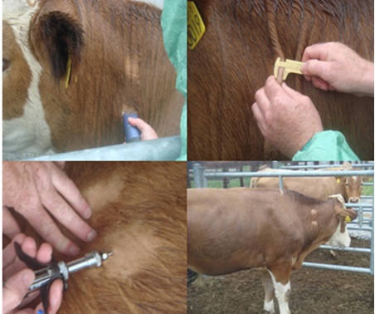
Diagnosis
Due to clinical signs of bovine tuberculosis are non-specific is impossible to establish a definitive diagnosis only based on them
TUBERCULINE TEST
The tuberculin skin test is the standard method of diagnosis in domestic animals. It consists of injecting bovine tuberculin intradermally (a purified extract of protein derived from M. bovis) and then measuring the thickness of the skin at the injection site 72 hours later to detect any subsequent inflammation at the site of infection (sign of delayed hypersensitivity associated with infection).
OTHER DIAGNOSIS
As in vitro blood test (IGRA, interferon-gamma) and identification in laboratory(definitive but takes 7-8 weeks or more) are available

Slide 8
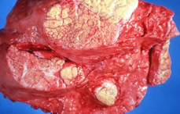
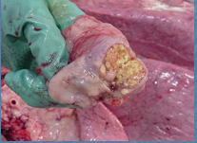
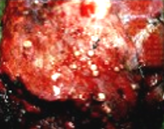
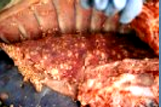
Lesions
Pulmonary Tuberculosis
Cough: Short, dry, after the effort. Goes into more frequent, moist, a painful
Dyspnoea
Anatomical changes
Tuberculous granuloma in the lymph nodes of the head, lungs, intestine and carcass. These have usually a well defined capsule enclosing a caseous mass with a calcified centre. They are usually yellow.
Active lesions may have a reddened periphery and caseous mass in the centre of a lymph node.
Inactive lesions may be calcified and encapsulated

Slide 9
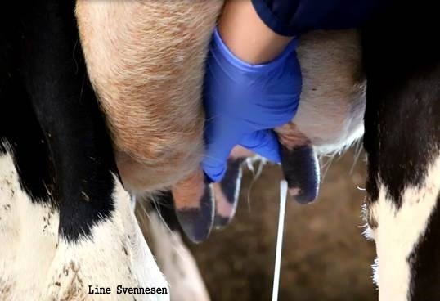
Lesions
Udder Tuberculosis
It is difficult to diagnose on the basis of clinical trial.
Militant thicklings are usually are not palpable
In the advanced form:
Hard, painful swelling quarters of the udder
Asymmetricity and irregular teat setting
In the parenchyma of udder palpable nodules and tumors
Udder lymph nodes enlarged, hard
Watery milk, contains whitish conifer
Tuberculosis of the Central Nervous System
Anxiety
Unsteady step
Involuntary movements
Clinic seizures
General dementia or excitement
Blindness

Slide 10
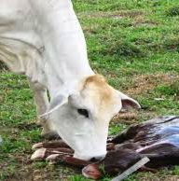
Lesions
Genitalia Tuberculosis
FEMALES
Muco-purulent effluence from the vagina
Abortions in the last month of pregnancy
Tumors in the uterus, fallopian tubes and ovaries
The vaginal labias – nodules and ulceration on the border between skin and mucous membrane
MALES
Hard, painless tumors of the testes and epididymis
Nodules and ulceration of penis

Slide 11
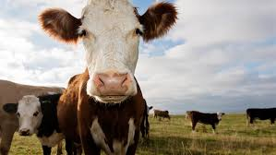
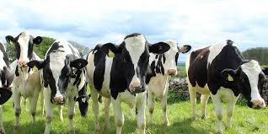
Treatment
Infected animals are rarely treated, because, in addition to the danger of contagion, it is very expensive and prolonged, and because the ultimate goal is erradicate the disease.
Infected animals are sacrificed.
Pasteurization of the milk of infected animals at a temperature enough to kill bacteria prevents the disease from spreading to the man.

Slide 12
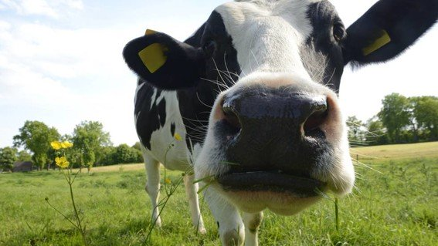
THANK YOU!

