Slide 1
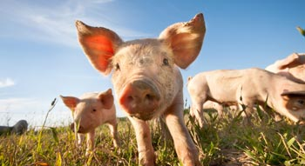
BRUCELLA SUIS

Slide 2
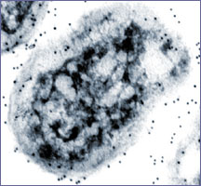
Introduction
Brucellosis is a disease caused by
infection with a type of bacteria
(Brucella).
Brucella species are small, gram-negative, nonmotile, nonspore-forming, rod-shaped (coccobacilli) bacteria.

Slide 3
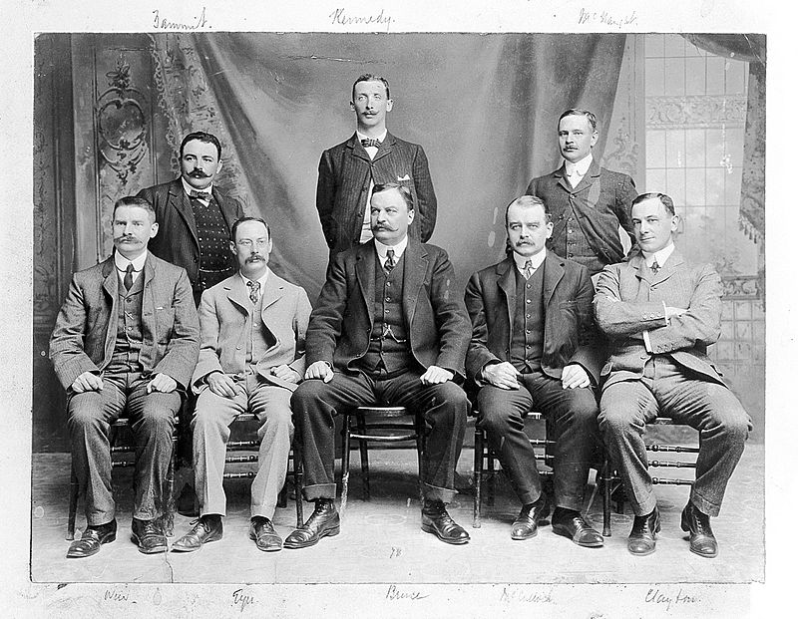
History
Brucellosis has been recognized in animals and humans
since the 20th century.
The germ is named after David Bruce, a Scottish doctor
who first insulated in 1887.

Slide 4
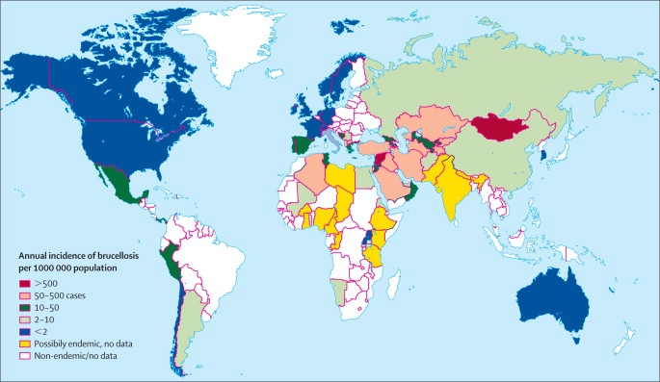
BRUCELLA
This disease is common in many parts of the world.

Slide 5
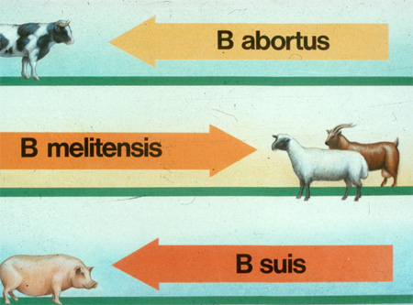
They function as facultative intracellular parasites, causing chronic disease, which usually persists for life.
Brucella bacteria infect a range of animals.

Slide 6
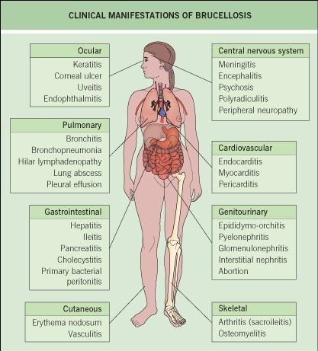
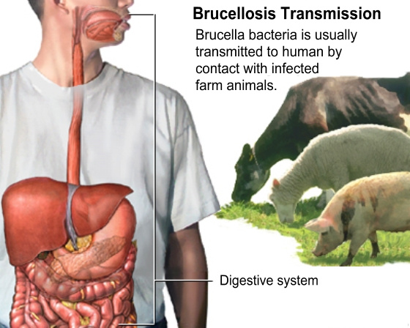
Four species infect humans:
B. abortus,
B. canis,
B. melitensis,
B. suis.

Slide 7
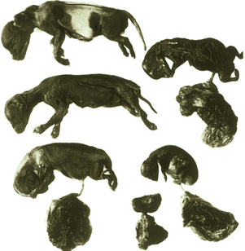
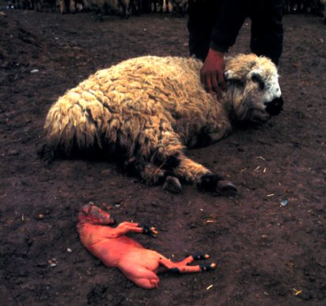
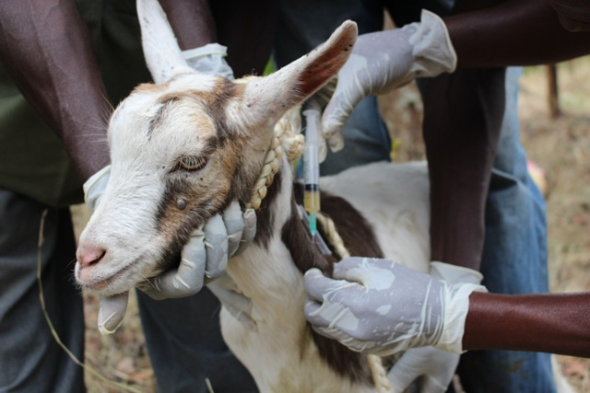
Brucella canis affects dogs.
Brucella melitensis is the most virulent and invasive species.
It usually infects goats and occasionally sheeps.

Slide 8
Brucellosis caused by Brucella suis
Br. suis is of intermediate virulence and infects pigs.
Brucellosis caused by Br. suis is a chronic disease of pigs manifested by sterility and abortion in sows, heavy piglet mortality and orchitis in boars.

Slide 9
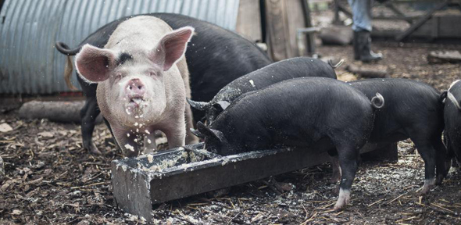
Etiology and Epidemiology
The disease is caused by Br. Suis.
The organism Br. suis is more resistant to adverse ambiental conditions than Br. abortus.
It is known to survive in feces, urine and water for 4-6 weeks.

Slide 10
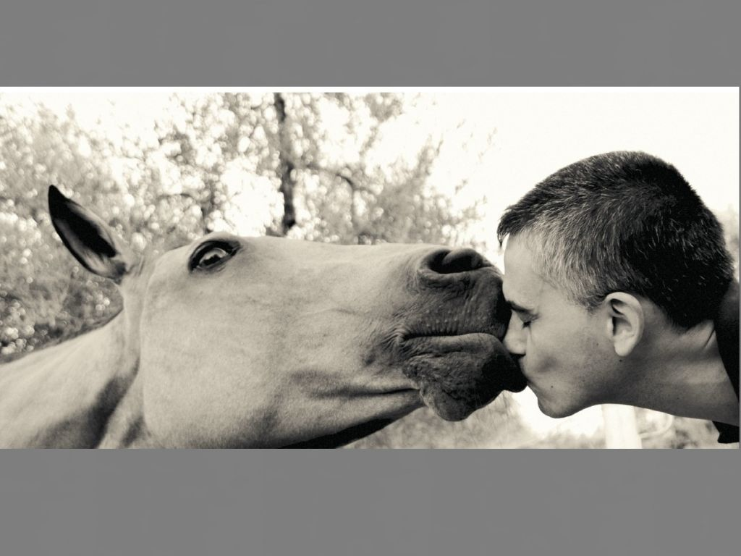
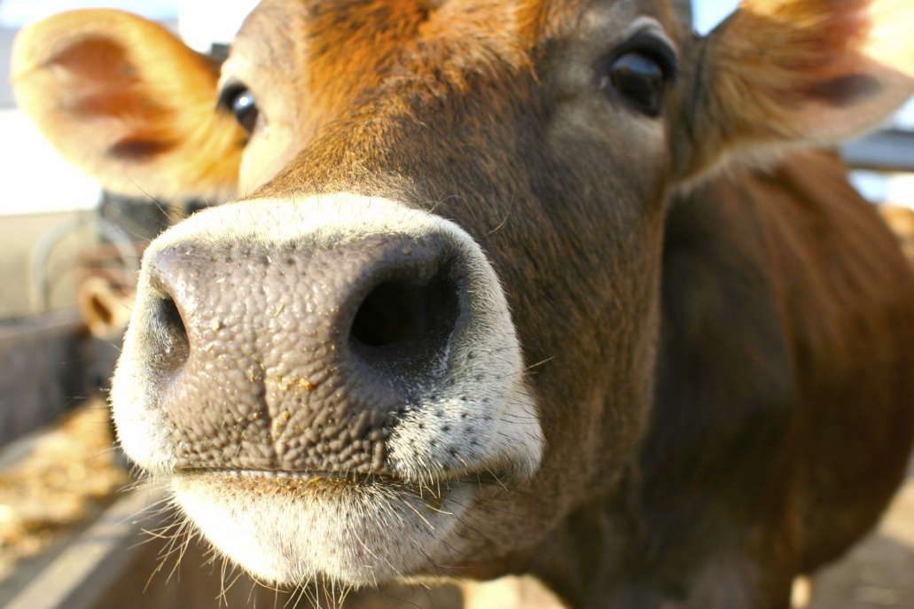
The organism is pathogenic only for pigs and man although other species, including cattle and horses, may be infected.

Slide 11
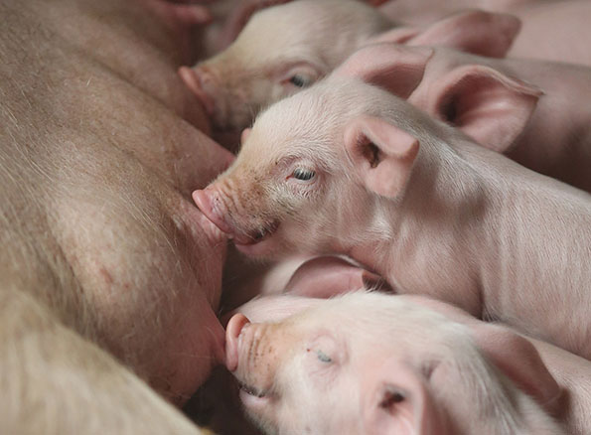
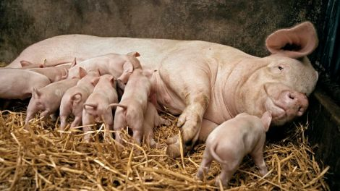
The incidence of infection in pigs is higher in adults than in young pigs.
Although infection before weaning is uncommon, sucking pigs on infected sows may become infected.
The susceptibility is much greater in the postweaning periods and is the same for both sexes.

Slide 12
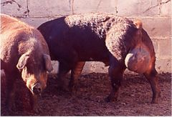
Under field conditions the disease is spread by ingestion and by coitus.
Although ingestion of food contaminated by infected semen and urine and discharges from infected sows is probably the commoner method of spread, the localization of infection in the genitalia of the boar makes veneral tranmission important in the disease.

Slide 13
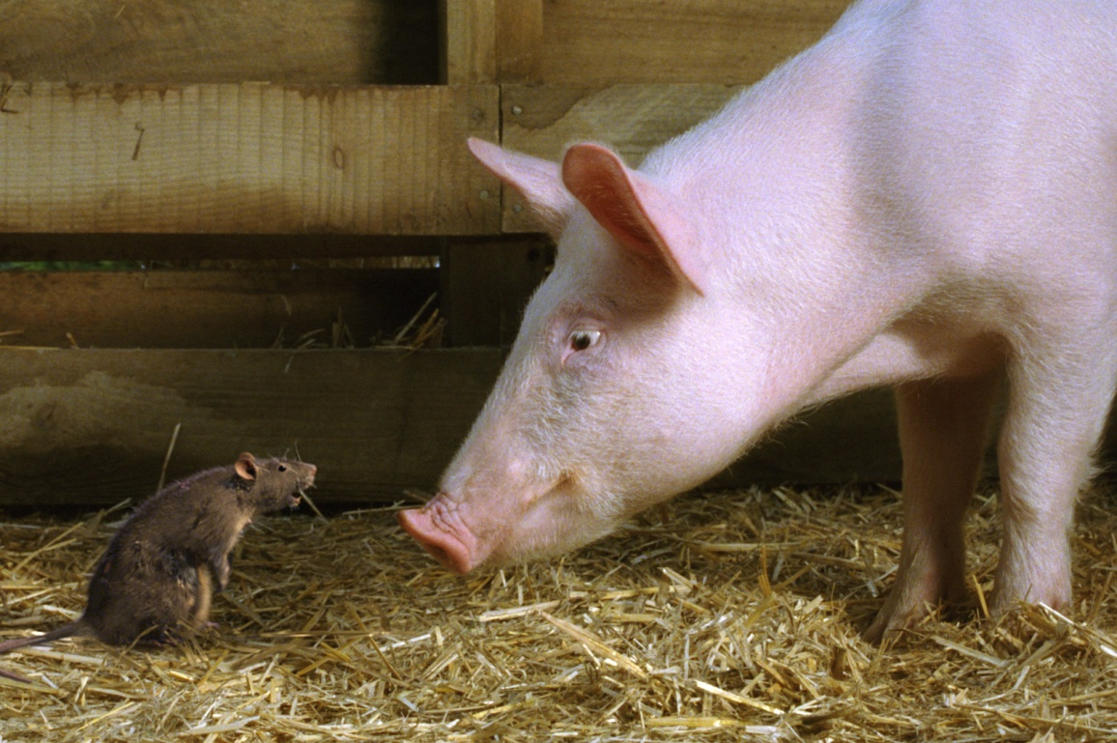
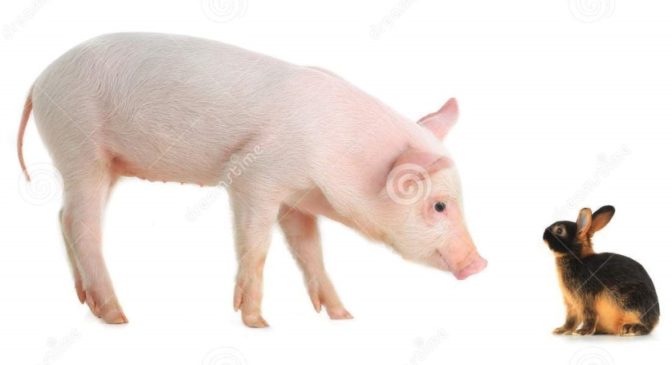
Introduction into a piggery is usually effected by the introduction of infected pigs.
Less commonly the infection may be brought in by other species or on inanimate objects.
Wild animals, including hares and rats, may provide a source of infection and ticks are also suspected of transmitting the disease.

Slide 14
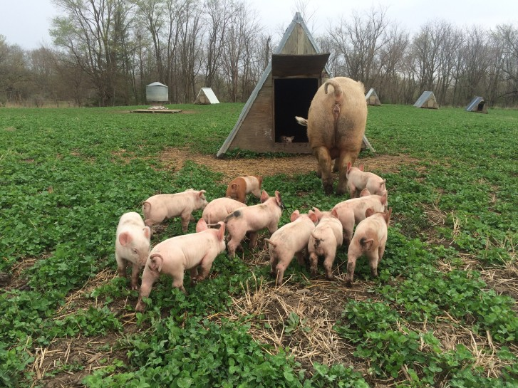
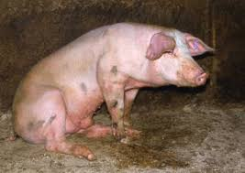
The disease owes its economic importance to the infertility.
The mortality occurs during the first month of life may be as high as 80%.
The mortality rate is negligibile in mature animals but sows and boars may have to be culled because of sterility, and occasional pigs because of posterior paralysis.

Slide 15
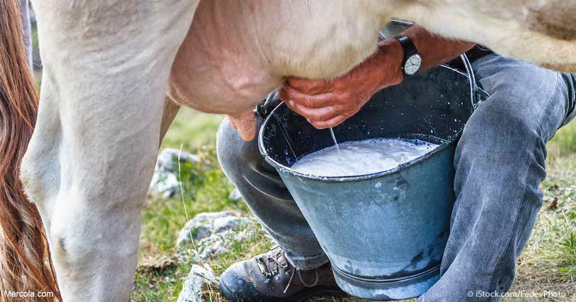
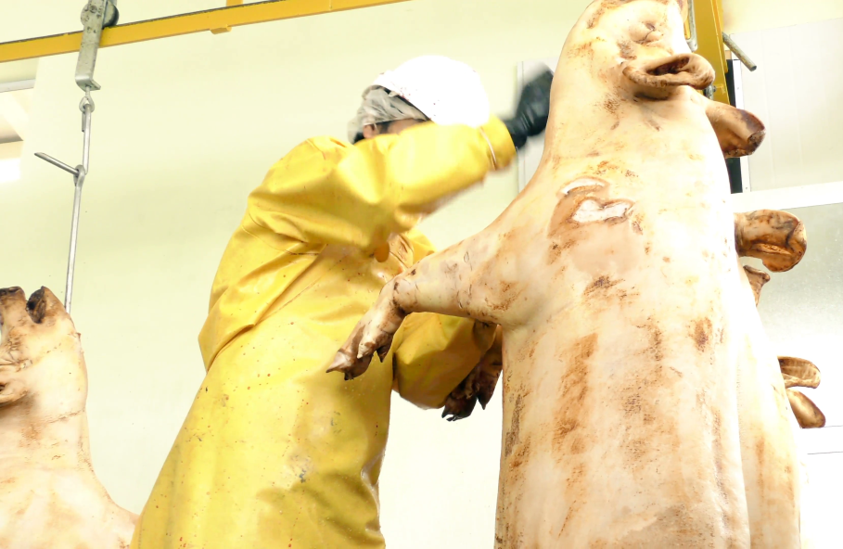
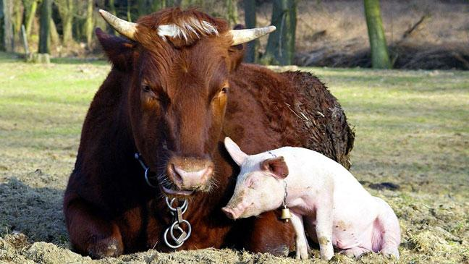
Br. suis presents a public health hazard particularly to abattoir workers, and to a less extent to farmers and veterinarians.
Br. suis may also localize in the mammary gland of cattle without causing clinical abnormality, and where cattle and pigs are run togheter, the hazard to humans drinking unpasteurized milk may be serious.

Slide 16
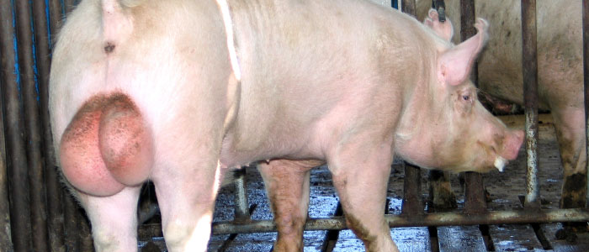
Pathogenesis
The more common manifestations of localization are abortion and infertility due to localization in the uterus;
Lymphadenitis, especially of the cervical lymph nodes;
Arthritis and lameness due to bone and joint localization, and posterior paralysis due to osteomyelitis.
In boars, involvement of testicles often leads to clinical orchitis.

Slide 17
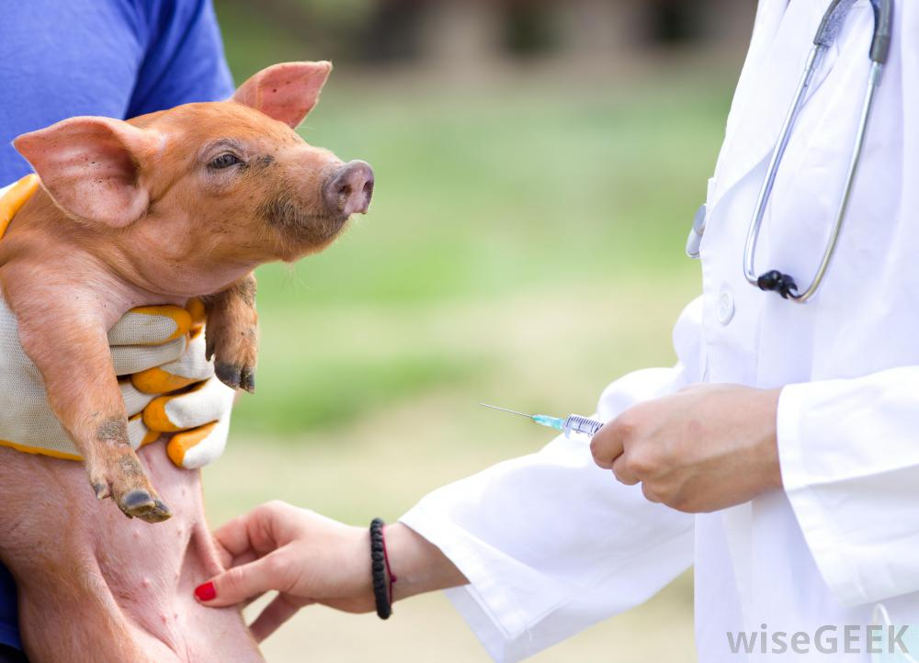
Clinical Findings
The clinical findings in swine brucellosis vary widely, depending upon the site of localization. The signs are not diagnostic and in many herds a high incidence of reactors is observed with little clinical evidence of disease.

Slide 18
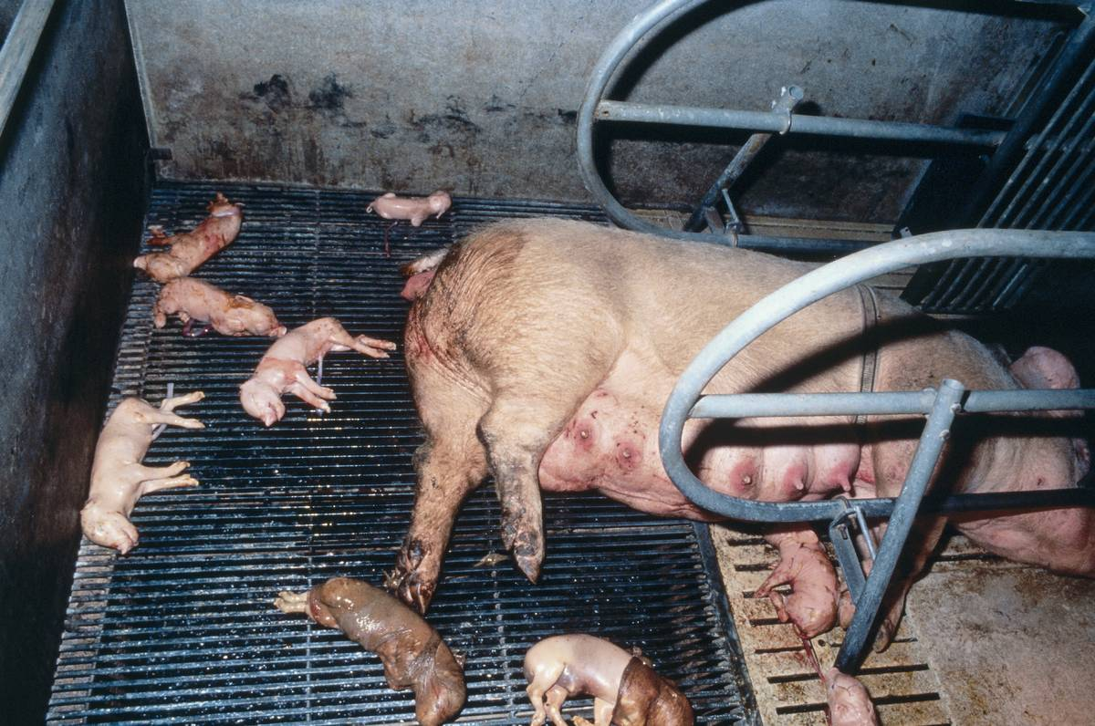
Most prominent are signs of genital tract involvement.
In the sow, infertility, which may be temporary, irreglar estrus, small litters and abortion occur.
The incidence of abortion varies widely between herds but is usually low.
Sows abort only once as a rule, and although abortion is most common during the third month, it may occur earlier.

Slide 19
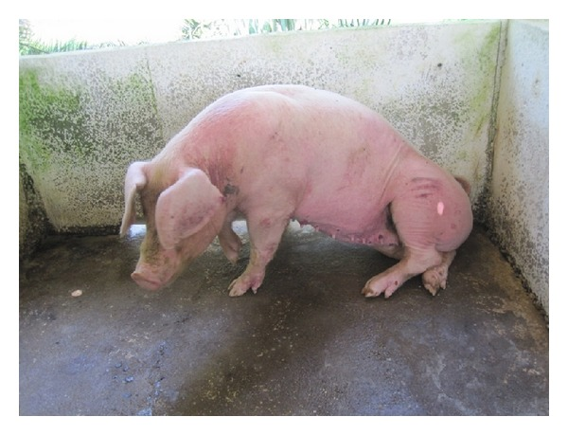
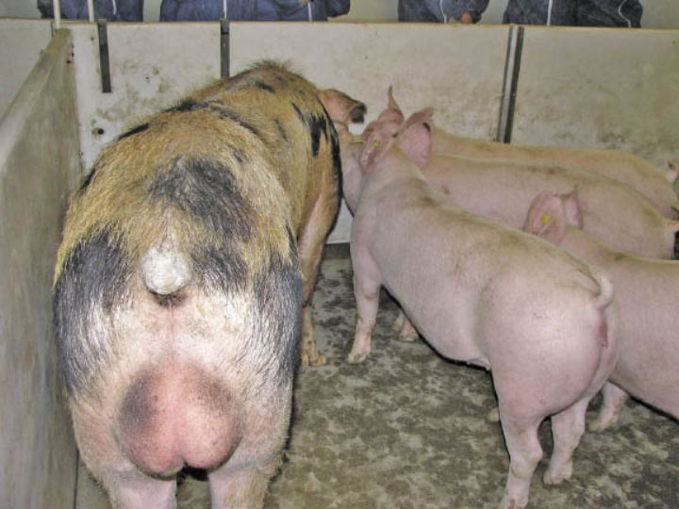
In boars, orchitis with swelling and necrosis of one or both testicles is followed by sterility.
Lameness, incoordination and posterior paralysis occur fairly commonly.
They are usually gradual in onset and may be caused by arthritis, or more commonly, osteomyelitis of lumbar and sacral vertebral bodies.

Slide 20
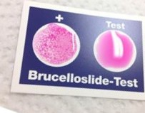
Clinical Pathology
Laboratory identification of the disease is difficult.
Isolation of the organism should be attempted if suitable material is available.
Such material for culture inoculation includes aborted fetuses, testicular lesion, abscesses and blood.
An agglutination test carried out on serum is the simplest diagnostic aid but in this disease it has serious limititions.
A positive titer does not arise until 8 weeks after infection.

Slide 21
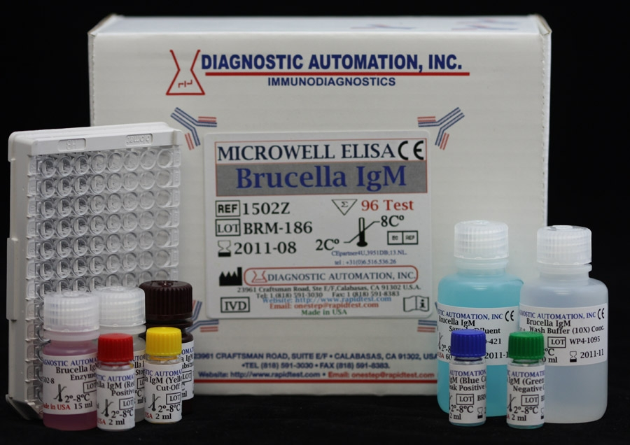
Brucellosis suis can be detected by the enzyme-linked immunoabsorbent assay (ELISA).

Slide 22
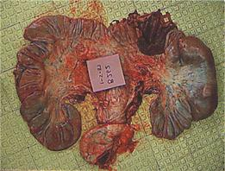
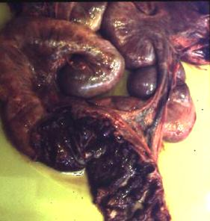
Necropsy Findings
Many organs may be involved with chronic changes being most apparent.
Chronic metritis manifested by nodular inflammatory thickening and abscessation of the uterine wall is characteristic.

Slide 23
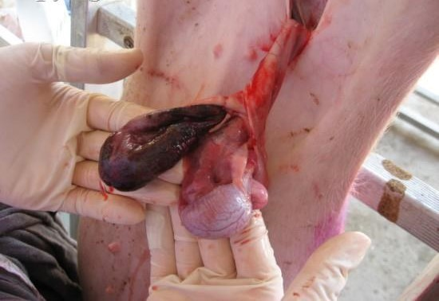
Arthritis and necrosis of vertebral bodies in the lumbar region may be found in lame and paralyzed pigs. The clinical orchitis of boars is revealed as testicular necrosis, often accompanied by lesions in the epididymis and seminal vesicles.

Slide 24
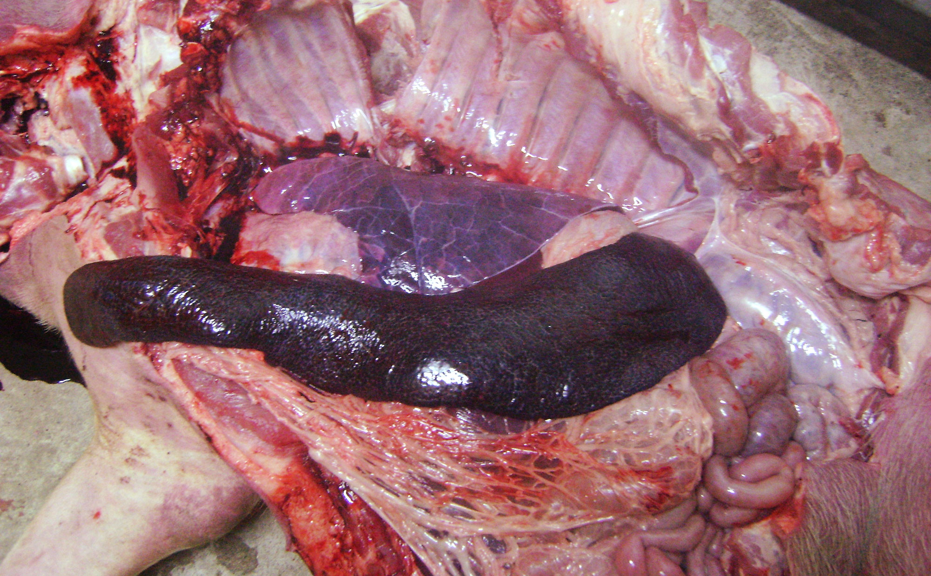
Pronounced lymphadenopathy, due to reticuloendothelial hyperplasia, and splenic enlargement occur in some cases.
Nodular splenitis, in the absence of other lesions, justifies a presumptive diagnosis of Brucellosis in pigs.

Slide 25
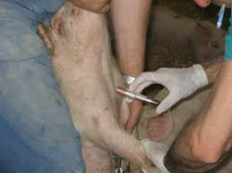
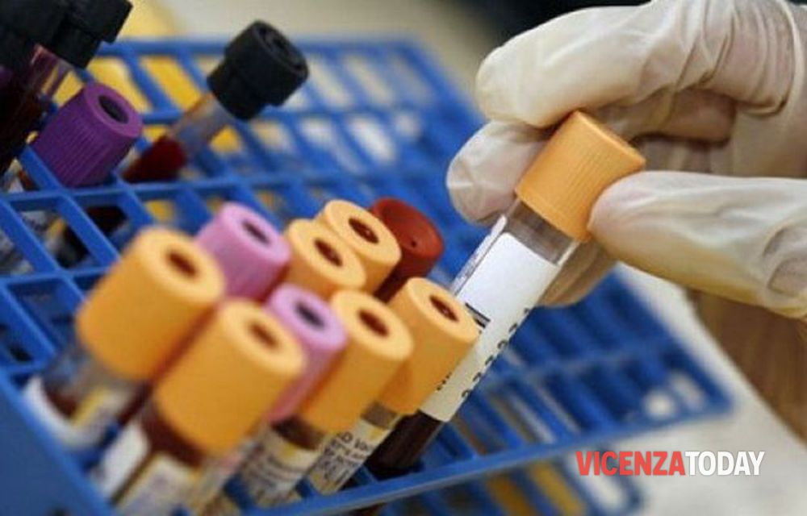
Diagnosis
The mutable character of this disease makes it difficult to diagnose.
The routine serological examinations of herds is a diagnostic method for this disease.
Individual animals with posterior paralysis present a major problem in diagnosis since there are so many causes in pigs, incluiding hypovitaminosis A, deficiency of vitamin B complex factors, and fractures of the lumbar vertebrae in osteomalacia.
Many poisonings such as organic arsenicals, mercury and organophosphatic insecticides may cause postirior paralysis among other things.

Slide 26
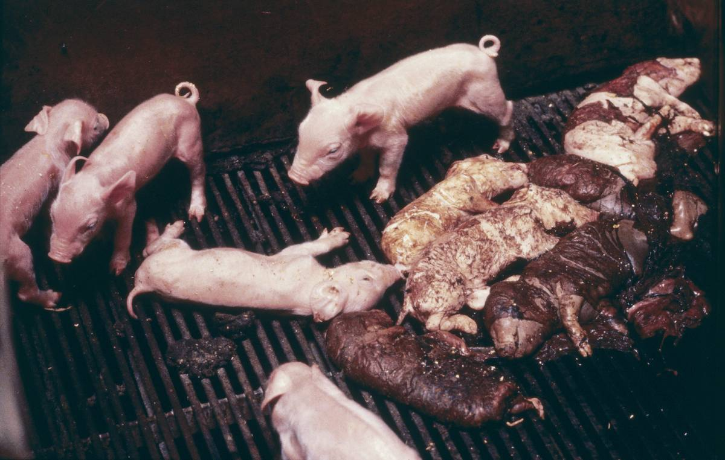
Abortion “storms” are common in piggeries but in most instances the cause is not determined.
Known now causes include leptospirosis and acute infectious diseases.
Other bacteria commonly isolated from aborted porcine fetuses include Staphylococcus, Streptococcus and Corynebacterium spp., and occasionally Salmonella abortus-ovis.
Mortality in young sucking pigs is also caused by many agents.

Slide 27
Treatment
Exhaustive trials of treatment with a combination of streptomycine parelenterally and sulfadiazine orally for long periods failed to reduce the infection rate in pigs.
Chlortetracycline is also ineffective. It is unlikely that the treatments available at present will ever be attempted on a commercial scale.

Slide 28
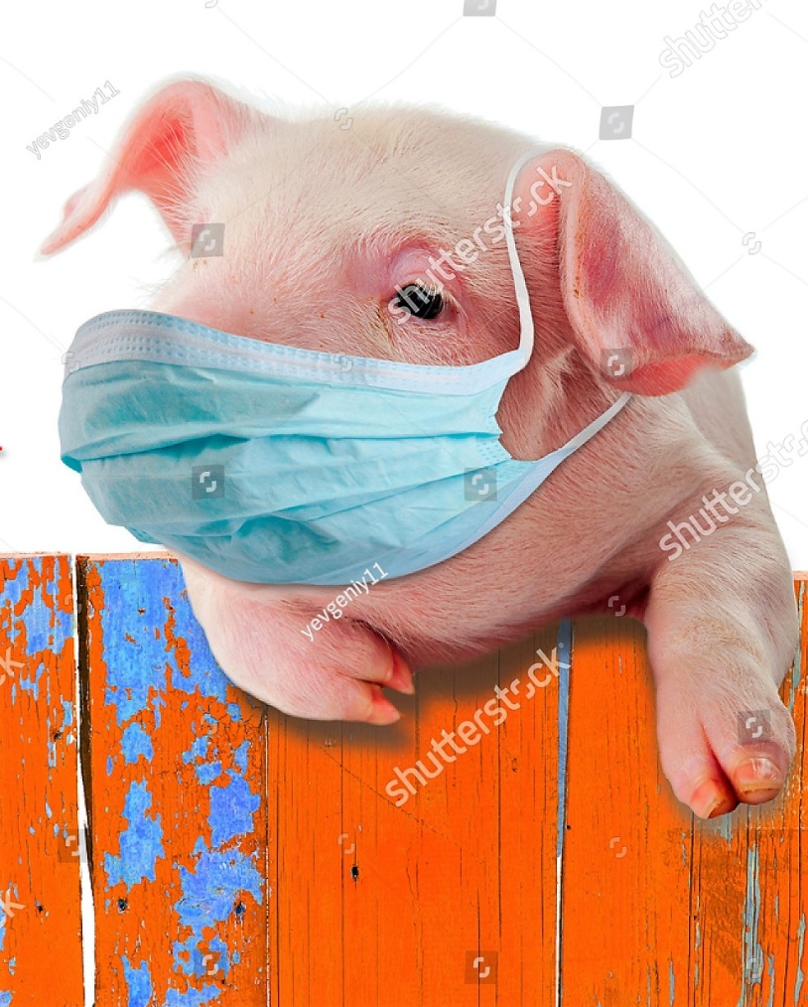
Prevention and Control
Pigs should be buyed from herds known to be free of brucellosis, or they should be tested and isolated for 3 months and retested before being added to the herd.

Slide 29
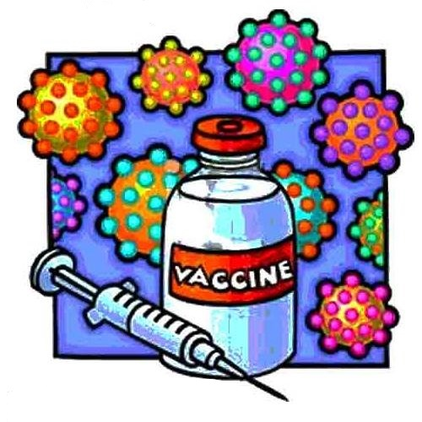
There isn’t vaccine for brucellosis in swine,
Strain 19 Br. abortus, Br. abortus ‘M’ vaccine, and phenol and ether extracts of Br. suis are all ineffective.
No practical recommendations can be made for treatment. Control is based on test.
Brucellosis remains a problem in feral swine and is a potential source of infection for domesticated herds and people.

Slide 30
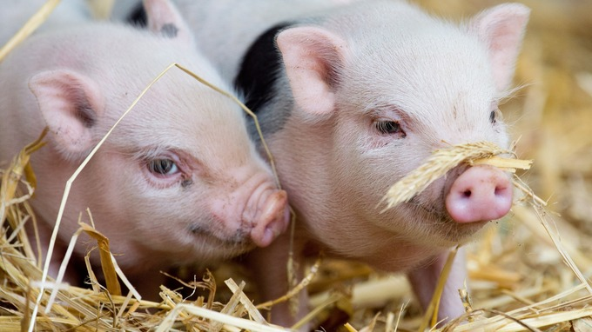
Thanks for the attention!

Slide 31
BIBLIOGRAFIA
Veterinary Medicine. Blood Radostits Henderson, Baillière Tindal
https://www.dpi.nsw.gov.au/animals-and-livestock/pigs/health/a-z-pig-diseases/brucellosis
http://www.cfsph.iastate.edu
https://vetmed.iastate.edu/vdpam/FSVD/swine/index-diseases/brucellosis
http://www.msdvetmanual.com/reproductive-system/brucellosis-in-large-animals/brucellosis-in-pigs

