Slide 1



Brucella

Slide 2
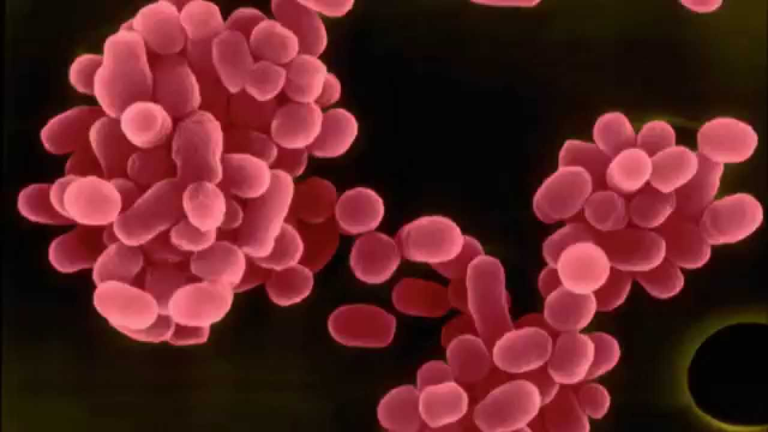
Brucella species are small, gram-negative, nonmotile, nonspore-forming, rod-shaped (coccobacilli) bacteria.
Brucellosis, also known as “undulant fever”, “Mediterranean fever” ,“Malta fever”,” Bang's disease”, ”Crimean fever” or ”Gibraltar fever”, is a zoonosis and the infection is transmitted by direct or indirect contact with infected animals or their products.

Slide 3
Brucella’s charachteristics
Rod-shaped (cocchi e bacilli)
Gram-
size:0,3-0,5 x 0,6-2,0 micron
motionless
asporogenous
without caps but with proteic material similcaps
aerobics
Ideal t°: 37°C
pH :6,6-7,4

Slide 4
Principal species:
Brucella cetaceae
Brucella melitensis
Brucella m. biovar Abortus
Brucella m. biovar Canis
Brucella m. biovar Melitensis
Brucella m. biovar Neotomae
Brucella m. biovar Ovis
Brucella m. biovar Suis
Brucella pinnipediae
Brucella melitensis, abortus, suis e canis are dangersous also for humans.

Slide 5
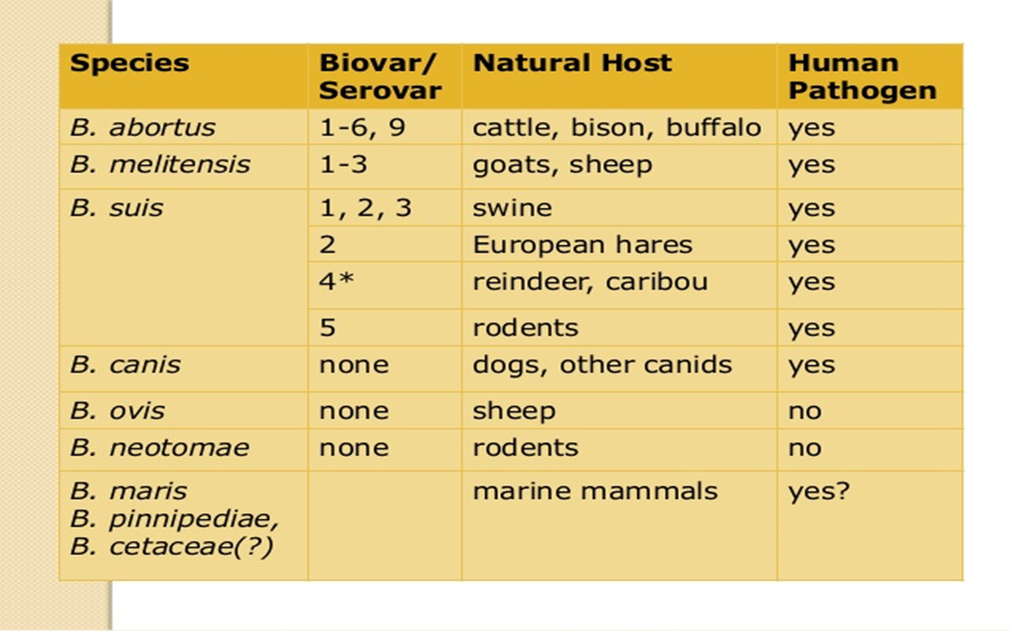
Brucellosis

Slide 6
Brucellosis
B.abortus. Widespread, that mostly affects bovines.
B.melitensis. Responsible for 80/90% human cases, and is the most pathogen. It affects sheep and goats.There are 3 biovar
B.suis. 5 biovar exist but only three are responsible in swine.
B.ovis. His target organs are male reproductor organs (epididymitis of rams) .
B.neotomonae. Isolated in the rat and in the desert dogs.
B.canis. High contagiousness and transmissible to man.

Slide 7
Brucellosis
Brucellosis is a serious debilitating disease, leading to problems at the professional, social and economic systems.
It’s a zoonosis, cosmopolitan, with generally chronic course, mostly serious in the Mediterranean zone.

Slide 8
Brucellosis
Brucellosis was found also in American Bison, lamas, camels,reindeer,deer,foxes,rodents,hares,minks,mooses, in arthropods such as ticks, and in 153 death animals on the beach (dolphins and seals).
Eradication plans exist only for bovine, buffalos, sheep and goats.

Slide 9
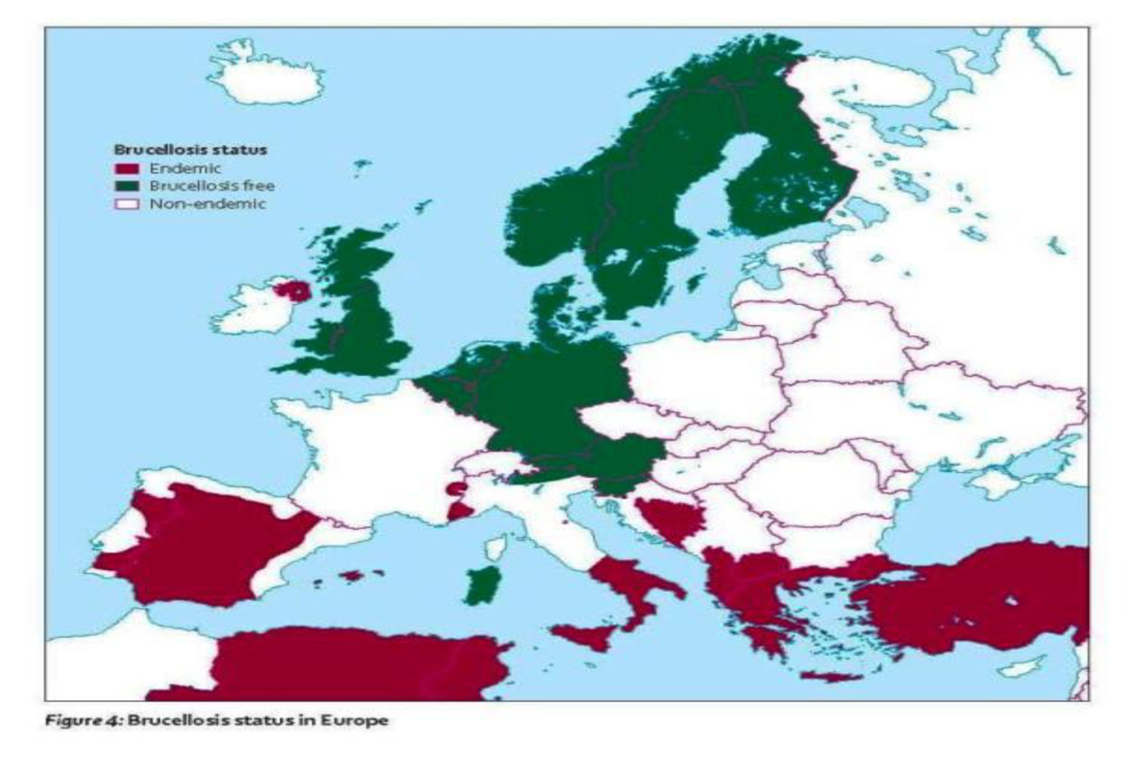
Geographic distribution

Slide 10
Resistance
Where? | How long?
Blood | 17 days
Ground | 20 days
Vegetables | 15 days
Placenta | 135 days
Meat beef | 3°-5°C 14 days, -27°C one year
Butter | 142 days
Pecorino cheese | 90 days

Slide 11
Milk resistance
60°: 10’-20’
63°: 30’’
51°: 30’
Pasteurization :few seconds
Presence in milk: 25-70% after abortus

Slide 12
Brucellosis
In cattle, sheep, goats, other ruminants and pigs the initial phase following infection is often not apparent.
In sexually mature animals the infection localizes in the reproductive system and typically produces placentitis followed by abortion in the pregnant female, usually during the last third of pregnancy, and epididymitis and orchitis in the male .
Calves are insensitive because immature sexually, but can be if fed with infected milk.

Slide 13
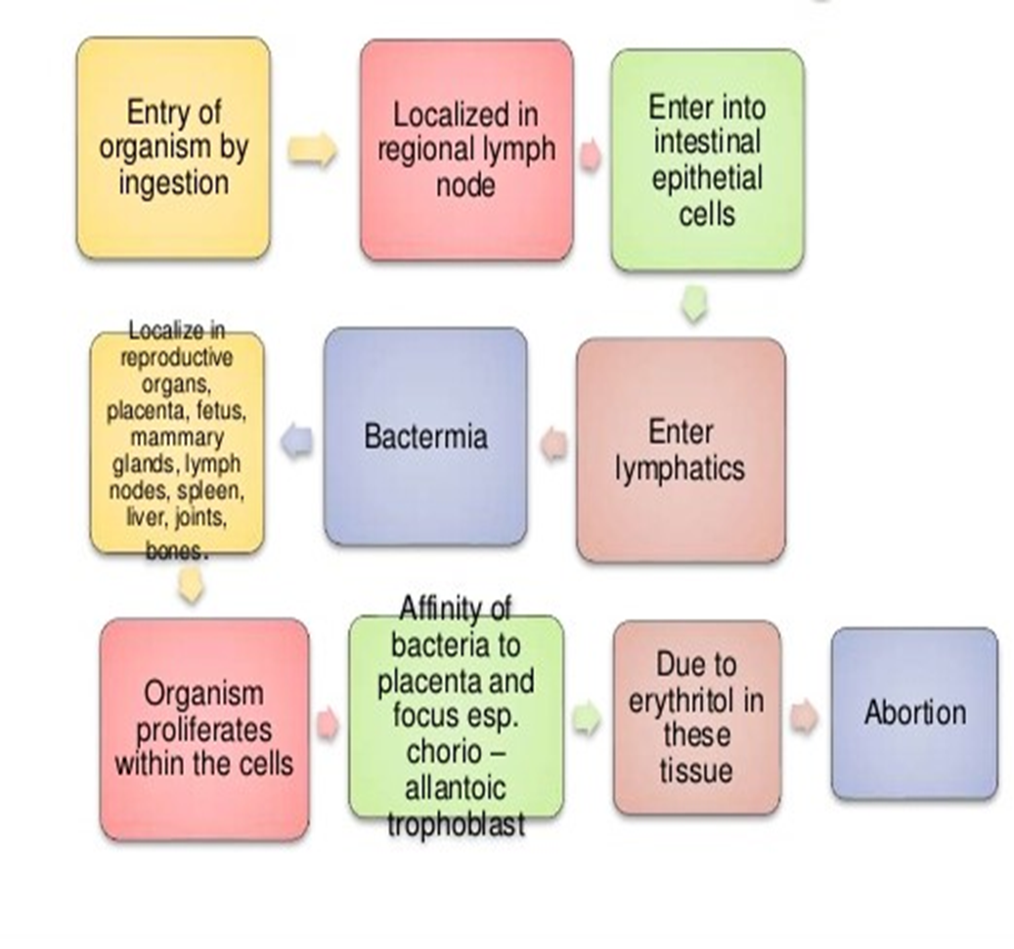
Patogenesis

Slide 14
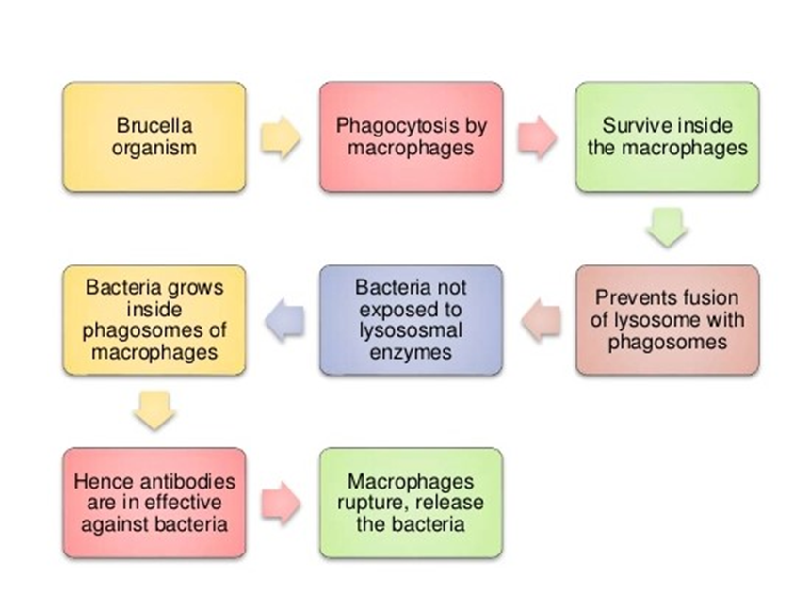
Patogenesis

Slide 15
Patogenesis
In non-pregnant females, Brucella localize in lymph nodes.
after insemination, Brucella migrate to recall hormone (erythritol, used by Brucella as an energy source for its metabolism), and colonize the uterus, causing placentitis, necrosis, abortion and retention placenta (special at the last third of gestation).

Slide 16
Simptoms
Ondulant fever
Abortus
Mastitis
Ipofertility
Placenta ritention
Metritis
orchitis

Slide 17
Sources of infection
Aborted fetous
Placenta
Milk
Urine
Uterine discarge
Also seronegative and asimptomatic animals can eliminate the bacterias in feces , milk and urine.

Slide 18
Routes of infection
digestive
vaginal
inhalatory
conjunctival
through contact with:
animals infected
Environment infected
mating
contaminated food
Other animals / man

Slide 19

Brucellosis in dogs
Canine brucellosis is caused by Brucella canis,. Brucella abortus, Brucella melitensis, and Brucella suis occasionally cause canine infections but are comparatively rare.
B. canis infections are zoonotic.

Slide 20
Geographic distribution
B. canis appears to be widely distributed. Locations where it has been reported include the United States (particularly the southern states), Canada, Central and South America (including Mexico), some European countries, Tunisia, Nigeria, South Africa, Malaysia, India, Korea, Japan, Taiwan and China.
New Zealand and Australia appear to be free of this organism.

Slide 21
Transmission
Brucellosis is the primary contagious infectious venereal disease of concern in canine reproduction.
Transmission of B. canis occurs through direct exposure to body fluids that contain sufficient numbers of bacteria to cause infection ,most often semen, aborted fetuses/placentas, milk, and/or urine.
Transmission is therefore primarily oral, nasal, or conjunctival and secondarily venereal (i.e., through the mucous membranes).

Slide 22
Transmission
Oronasal and conjunctival exposure follows the ingestion or aerosolization of infectious materials. The aerosol route is especially important in crowded kennel conditions.
Transplacental transmission and direct cutaneous inoculation can also occur .

Slide 23
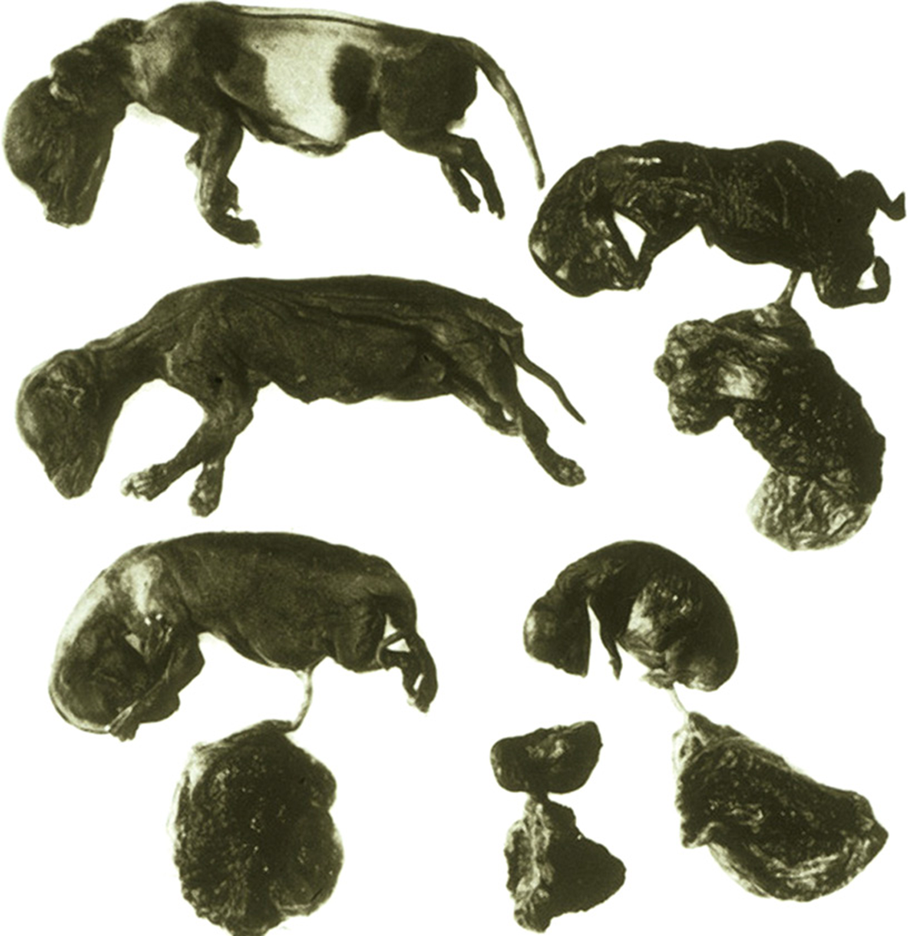
Clinical signs
The primary clinical sign of canine brucellosis in the breeding bitch is pregnancy loss, which can occur early (day 20) in gestation resulting in fetal resorption, or more commonly (75% of dogs) later in gestation (generally 4 to 59 days), which results in abortion.

Slide 24
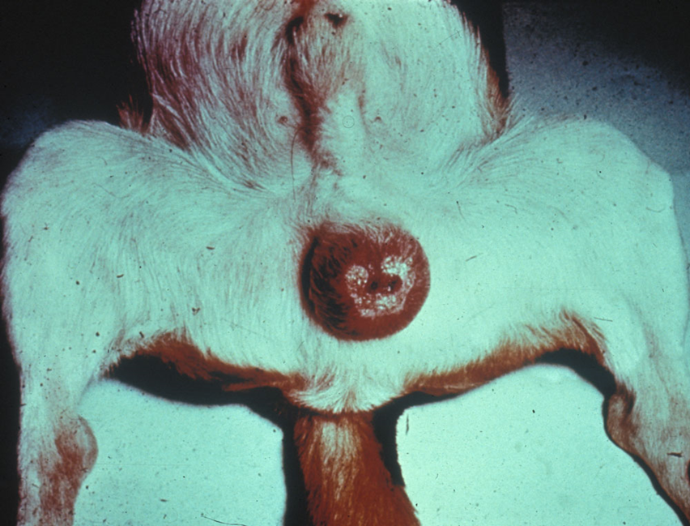
Clinical signs
The primary acute clinical signs of canine brucellosis in the male dog involve the portions of the reproductive tract that participate in the maturation, transport, and storage of spermatozoa. Epididymitis is common, with associated orchitis and scrotal dermatitis, and resultant deterioration of semen quality and fertility. Chronically, testicular atrophy and infertility can occur.

Slide 25
Diagnosis
The diagnosis of canine brucellosis is based on suggestive clinical signs and the results of serology; culture of blood, urine, or tissues; histopathology; and/or PCR assays.
Because no single antemortem test has 100% sensitivity, and serologic assays lack specificity, a combination of diagnostic assays is often required to make a diagnosis.

Slide 26
Post-mortem lesions
The lymph nodes are often enlarged in affected animals. The retropharyngeal and inguinal lymph nodes are often involved, but generalized lymphadenitis also occurs.
The spleen is frequently enlarged, and may be firm and nodular.
Hepatomegaly may also be seen.

Slide 27
Post-mortem lesions
Scrotal edema, scrotal dermatitis, epididymitis, orchitis, prostatitis, testicular atrophy and fibrosis are common in males, and metritis and vaginal discharge may be seen in females.
Less commonly reported lesions include discospondylitis, meningitis, focal non-suppurative encephalitis, osteomyelitis, uveitis and abscesses in various internal organs.

Slide 28
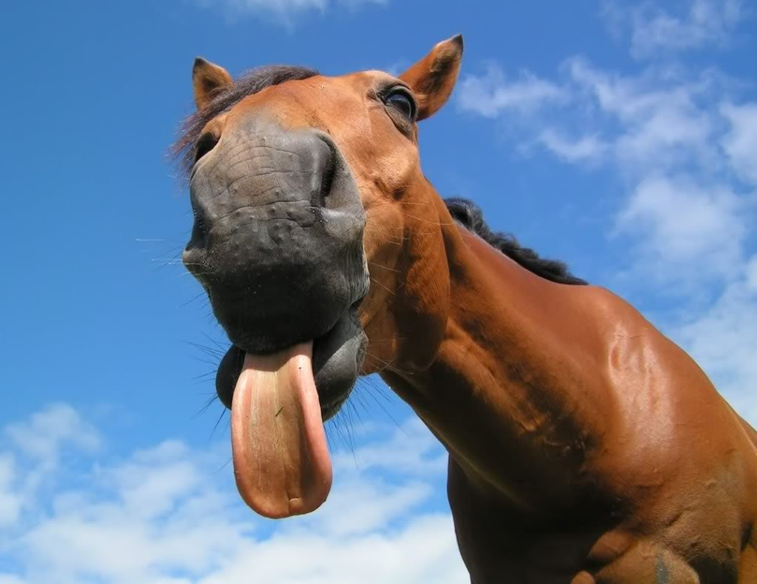
Brucellosis in horses
Equine brucellosis is caused by Brucella abortus and most commonly manifests as fistulous withers in horses, which can be a source of exposure to humans.

Slide 29
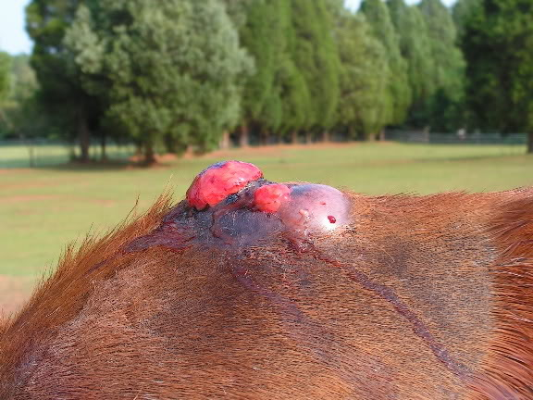
Clinical signs
In horses, B. abortus and occasionally B. suis can cause inflammation of the supraspinous or supra-atlantal bursa; these syndromes are known, respectively, as fistulous withers or poll evil. The bursal sac becomes distended by a clear, viscous, straw-colored exudate and develops a thickened wall. It can rupture, leading to secondary inflammation. In chronic cases, nearby ligaments and the dorsal vertebral spines may become necrotic. Brucellaassociated abortions are rare in horses.

Slide 30
Diagnosis
Although no brucellosis eradication program exists specifically for equine, standards for diagnosis and treating B.abortus associated fistulous withers have been established as means to monitor possible bovine brucellosis and to help protect the public from exposure to this zoonotic path­ogen.

Slide 31
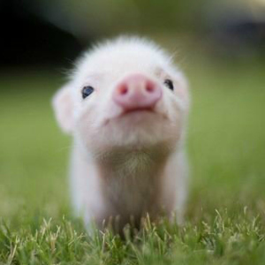
Brucellosis in pigs
Brucellosis caused by Brucella suis rarely occurs in domestic animals other than pigs. Epidemics of brucellosis in people have been reported among packing-house workers, and the usual source is infected pigs.

Slide 32
Etiology
Other Brucella species rarely found in pigs include Brucella abortus and B. Melitensis.

Slide 33
Geographic distribution
In the past, B. suis was found worldwide in swine-raising regions. This organism has been eradicated from domesticated pigs in the U.S., Canada, many European countries, and other nations.

Slide 34
Transmission
Swine brucellosis is transmitted by direct contact with recently aborted sows, by ingestion of contaminated food or exposure to a contaminated environment. However, sexual transmission is particularly important.

Slide 35
Clinical findings
after exposure to B suis, pigs develop a bacteremia that may persist for as long as 90 days. During and after the bacteremia, localization may occur in various tissues.
Common manifestations are abortion, temporary or permanent sterility, orchitis, lameness, posterior paralysis, spondylitis, and occasionally metritis and abscess formation.

Slide 36
Diagnosis
The principal means of diagnosis in pigs is the brucellosis card (rose bengal) test; however, other serum agglutination tests or complement fixation tests have been used.
The card test is usually more accurate than conventional agglutination tests. Supplemental tests designed for cattle may also be used for pigs.

Slide 37
Post mortem lesions
At necropsy, abscesses, other purulent or inflammatory lesions, or calcified foci may be seen in the testes and male accessory sex organs, particularly the epididymis and seminal vesicles .In boars, lesions tend to be unilateral.

Slide 38
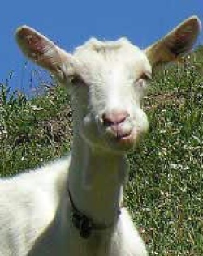
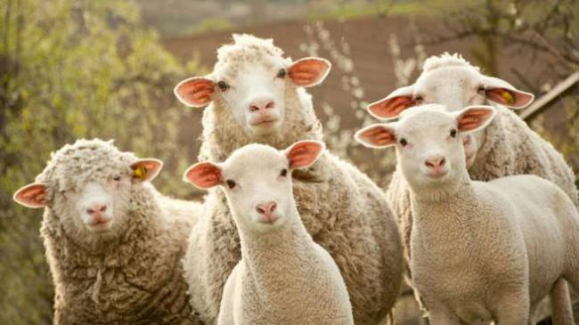
Brucellosis in Goat and Sheep
Caprine and ovine brucellosis, caused by the zoonotic bacterium Brucella melitensis, is an economically important cause of abortion in small ruminants.

Slide 39
Etiology
B. melitensis contains three biovars (biovars 1, 2 and 3). All three biovars cause disease in small ruminants, but their geographic distribution varies.

Slide 40
Geographic distribution
B. melitensis is particularly common in the Mediterranean. It also occurs in the Middle East, Central Asia, and in some countries of Central America. This organism has been reported from Africa and India, but it does not seem to be endemic in northern Europe, North America (except Mexico), Southeast Asia, Australia, or New Zealand.

Slide 41
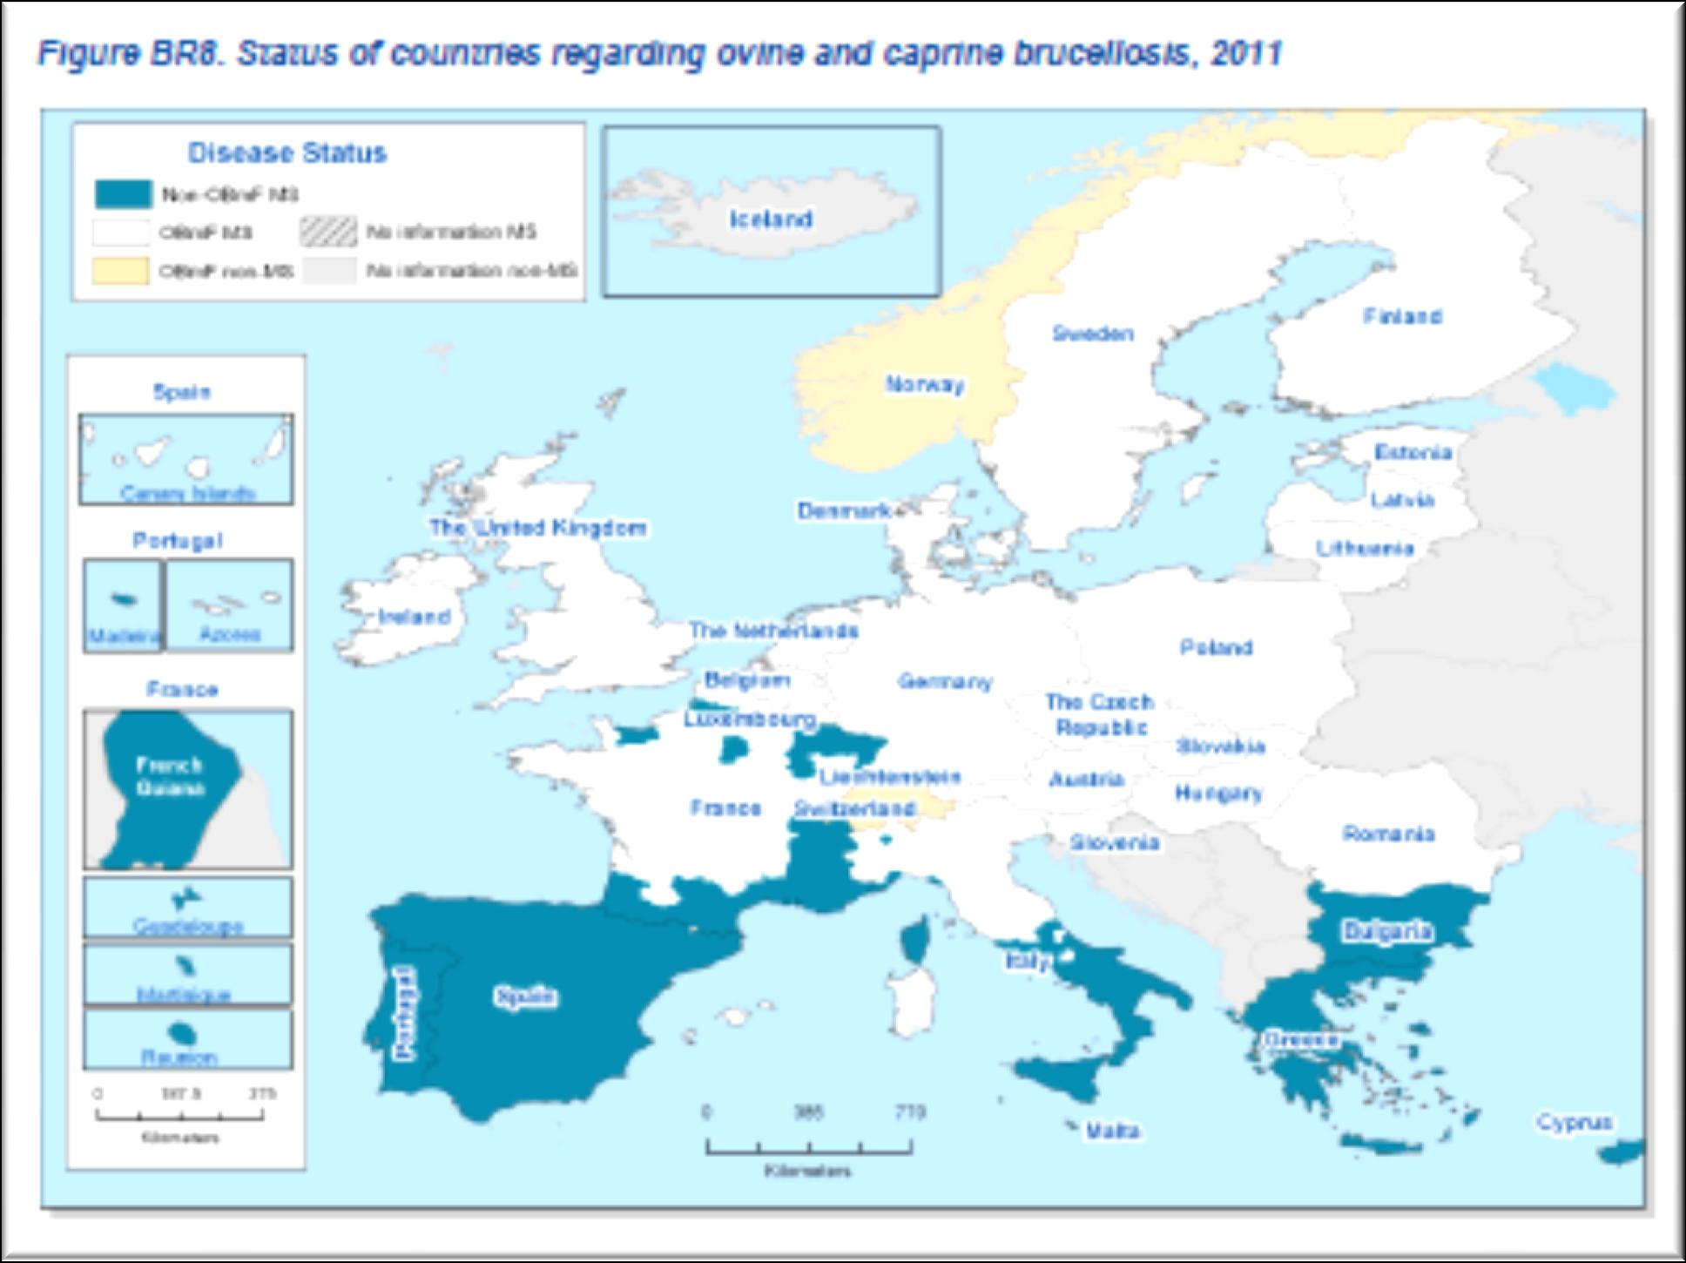
Geographic Distribution

Slide 42
Transmission
In animals, B. melitensis is usually transmitted by contact with the placenta, fetus, fetal fluids and vaginal discharges from infected animals.
Small ruminants are infectious after either abortion or full-term parturition.
Goats usually shed B. melitensis in vaginal discharges for at least 2 to 3 months, but shedding usually ends within three weeks in sheep.

Slide 43
Transmission
This organism can also be found in the milk and semen; shedding in milk and semen can be prolonged or lifelong, particularly in goats.
Kids and lambs that nurse from infected dams may shed B. melitensis in the feces.

Slide 44
Transmission
Most animals become infected by ingestion or through the mucous membranes of the oropharynx, upper respiratory tract and conjunctiva, but Brucella can also be transmitted through broken skin.
Although the mammary gland is usually colonized during the course of an infection, it can also be infected by direct contact, with subsequent shedding of the organisms in the milk.
In utero infections also occur.

Slide 45
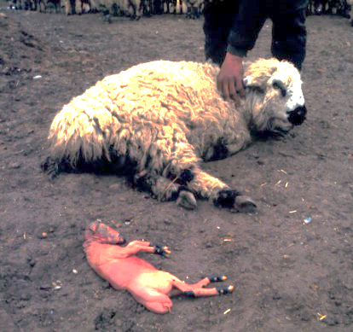
Clinical signs
The predominant symptoms in naturally infected sheep and goats are abortions, stillbirths and the birth of weak offspring.
Animals that abort may retain the placenta. Sheep and goats usually abort only once, but reinvasion of the uterus and shedding of organisms can occur during subsequent pregnancies.
Some infected animals carry the pregnancy to term, but shed the organism.

Slide 46
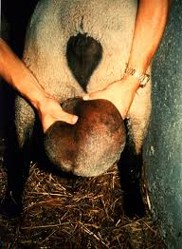
Clinical signs
Acute orchitis and epididymitis can occur in males, and may result in infertility.

Slide 47
Post mortem lesions
At necropsy, granulomatous inflammatory lesions may be present in the reproductive tract, udder, supramammary lymph nodes, other lymphoid tissues, and sometimes in the joints and synovial membranes.
Necrotizing orchitis, epididymitis, seminal vesiculitis and prostatitis have been reported.

Slide 48
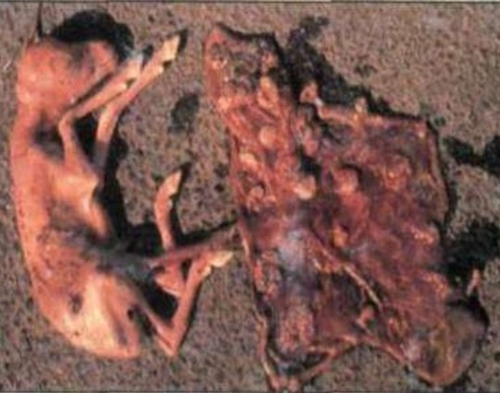
Post mortem lesions
The fetus may be autolyzed, normal or have an excess of bloodstained fluid in the body cavities and an enlarged spleen and liver.

Slide 49
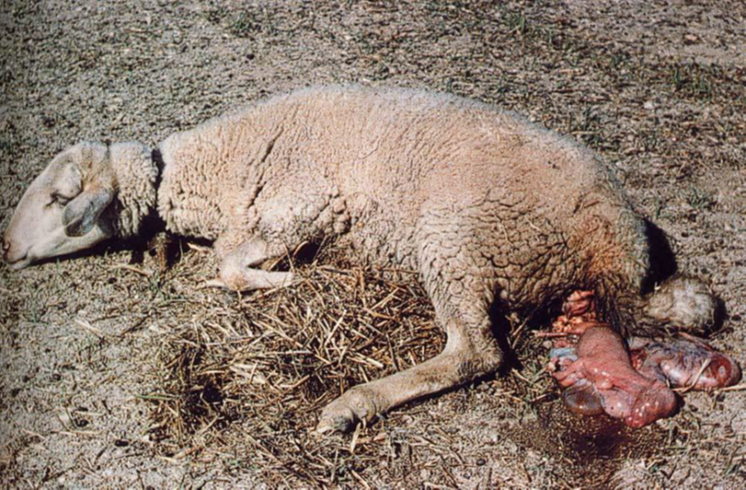
Brucellosis in Goat and Sheep

Slide 50
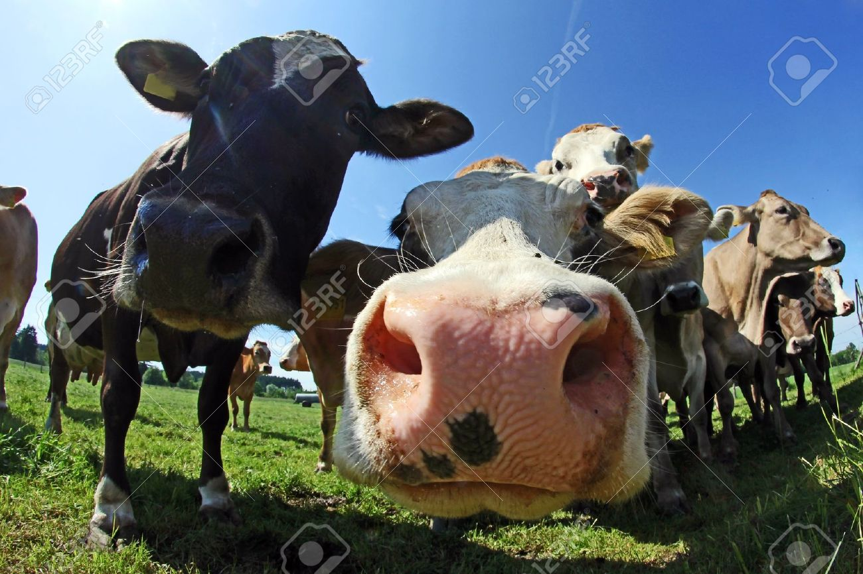
Brucellosis in cattle
Bovine brucellosis, caused by the bacterium Brucella abortus, is an economically important cause of abortions in cattle.
B. abortus is a human pathogen.

Slide 51
Geographic distribution
B. abortus is found worldwide in cattle-raising regions, except in Japan, Canada, some European countries, Australia, New Zealand and Israel, where it has been eradicated.

Slide 52
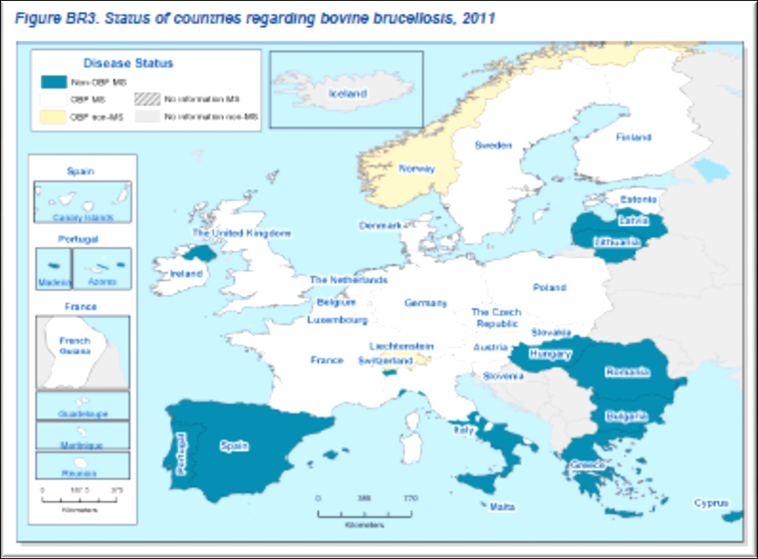
Geographic distribution

Slide 53
Transmission
In animals, B. abortus is usually transmitted by contact with the placenta, fetus, fetal fluids and vaginal discharges from infected animals.
Animals are infectious after either abortion or full-term parturition.

Slide 54
Transmission
B. abortus may also be found in the milk, urine, semen, feces and hygroma fluids.
Shedding in milk can be prolonged or lifelong, and may be intermittent.
Many infected cattle become chronic carriers.

Slide 55
Routes of infection
Infection usually occurs by ingestion and through mucous membranes, but B. abortus can be transmitted through broken skin.
Although the mammary gland is usually colonized during the course of an infection, it can also be infected by direct contact, with subsequent shedding of the organisms in the milk.
In utero infections also occur.

Slide 56
Patogenesis
When B. Abortus comes in an animal, it multiplies in the place of entry,
where polymorphonuclears, phagocytizing them try to block the infection.

Slide 57
Patogenesis
Brucella are intracellular parasites
optional capable of multiplying in many cells (macrophages and cells epithelial).
Following this Multiplication, leukocytes undergo to karyorrhexis.
The germs and cellular residues are to be phagocyted by mononuclear cells. The mononuclear migrate to the lymph nodes transferring the infection in this seat.

Slide 58
Patogenesis
There will be a hyperplasia of the SRE level cell In lymph node with production of granulomas like reaction of organism.
If microorganisms are able to overcome this barrier, gain the bloodstream causing primary bacteremia (Brucella Localize in the spleen, bone marrow and whit granuloma formation in the lymph nodes so-called Brucellaris ) and general location of Brucella throughout the body, especially in the udder, lymph nodes supramammary, gravid uterus in late gestation, the testis, seminal vesicles, epididymis, because in these sites there is a high rate of erythritol.

Slide 59
Patogenesis
Erythritol is a carbohydrate capable of strongly stimulate the activity metabolic and multiplication of Brucella,who prefer it to glucose.

Slide 60
Prepubescent Animals
(Female and male)
The germs in these animals are
rapidly inactivated by the immune reactions resulting healing
etiological, but they are receptive to a any subsequent infection.
in males we’ll see: orchitis and
epididymitis is a chronic,
swelling of the scrotum symmetric
with increase of testicular volume,
collection of exudate, changes in inflammation purulent.

Slide 61
Females 4°-5° months of pregnancy
the Brucella remain quiescent in the seats in which they are received at the stage of primary bacteremia.
TO From the 5th month of pregnancy there will be a mobilization of Brucella with a second phase bacteremic.
These reach the pregnant uterus,
multiplying in the fetus and placenta, giving abortion.
this sometimes It occurs without over involvement general, in the following may provide a retained placenta and metritis.

Slide 62
Females over
5° months of pregnancy
There will be a primary bacteremia with localization of Brucella in uterus pregnant.
Sometimes abortion is preceded by swelling vulvar, vaginal discharge, relaxation of sacroischiatics ligaments, swelling udder.
to abortion follows placenta retention and metritis.

Slide 63
Females sexually mature but not pregnant
Germs reach with the primary bacteremia.
in the udder they cause outbreaks of micromastite.

Slide 64
Patogenesis
In cattle, abortions and stillbirths usually occur two weeks to five months after infection.
Reproductive losses typically occur during the second half of gestation; thus, the incubation period is longer when animals are infected early in gestation.

Slide 65
Patogenesis
Brucella are localized and reproduce itself in the placental corium or in the fetal placenta, resulting in a fibrinous necrotic purulent-inflammatory process ,
With interruption of maternal-fetal exchanges and formation of adhesions, with abortion.

Slide 66
Symptoms in Males
Epididymitis, seminal vesiculitis, orchitis or testicular abscesses are sometimes seen in bulls. Infertility occurs occasionally in both sexes, due to metritis or orchitis/epididymitis.

Slide 67
Post-mortem lesions
At necropsy, granulomatous inflammatory lesions may be present in the reproductive tract, udder, supramammary lymph nodes, other lymphoid tissues, and sometimes in the joints and synovial membranes. Mild to severe endometritis may be seen after an abortion.

Slide 68
Post-mortem lesions
The placenta is usually thickened and edematous, and may have exudate on its surface.
The intercotyledonary region is typically leathery, with a wet appearance and focal thickening.

Slide 69
Post-mortem lesions
The regional lymph nodes can be enlarged, and the mammary gland may contain lesions.
Some aborted fetuses appear normal; others are autolyzed or have variable amounts of subcutaneous edema and bloodstained fluid in the body cavities.
The liver may be enlarged and discolored, and the lungs may exhibit fibrous pleuritis and pneumonia.

Slide 70
Post-mortem lesions
In bulls, one or both sacs of the scrotum may be swollen due to orchitis, epididymitis or abscesses. The tunica vaginalis may be thickened and fibrous, and adhesions may be present.

Slide 71
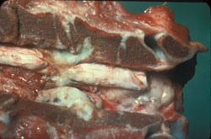
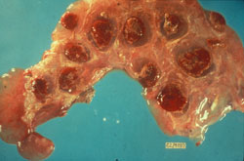
Post-mortem lesions
Bovine, vertebrae. Purulent exudate within a vertebra extends into the adjacent spinal canal.
Bovine, placenta. The placenta contains numerous hemorrhagic cotyledons.

Slide 72
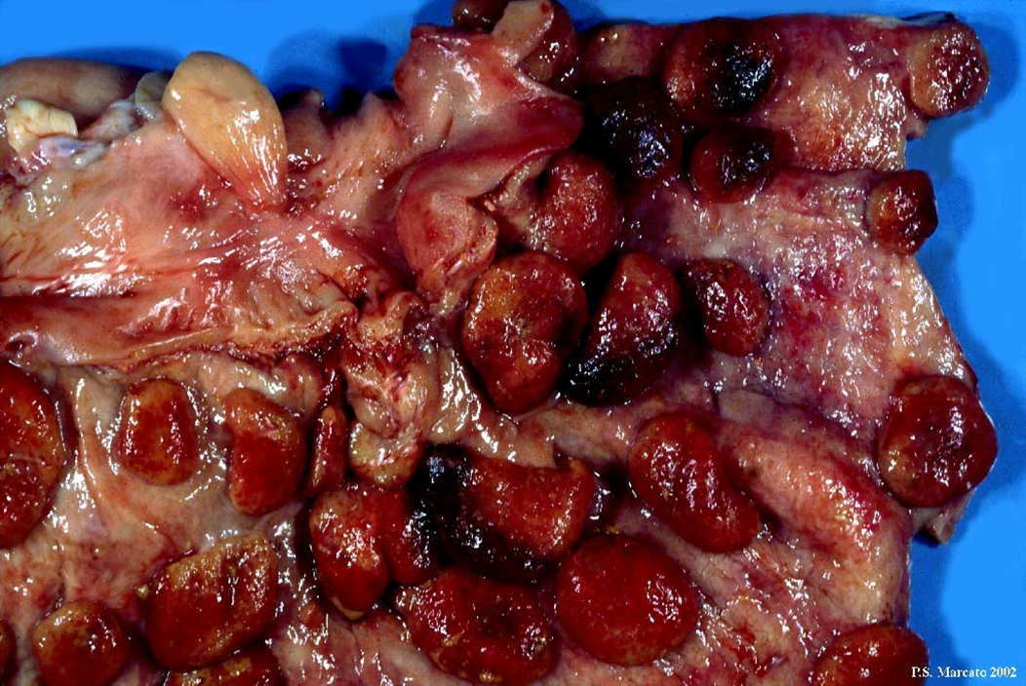
Placentitis Brucellaris
The cotyledons are enlarged, highly congested and necrotic-hemorrhagic.

Slide 73
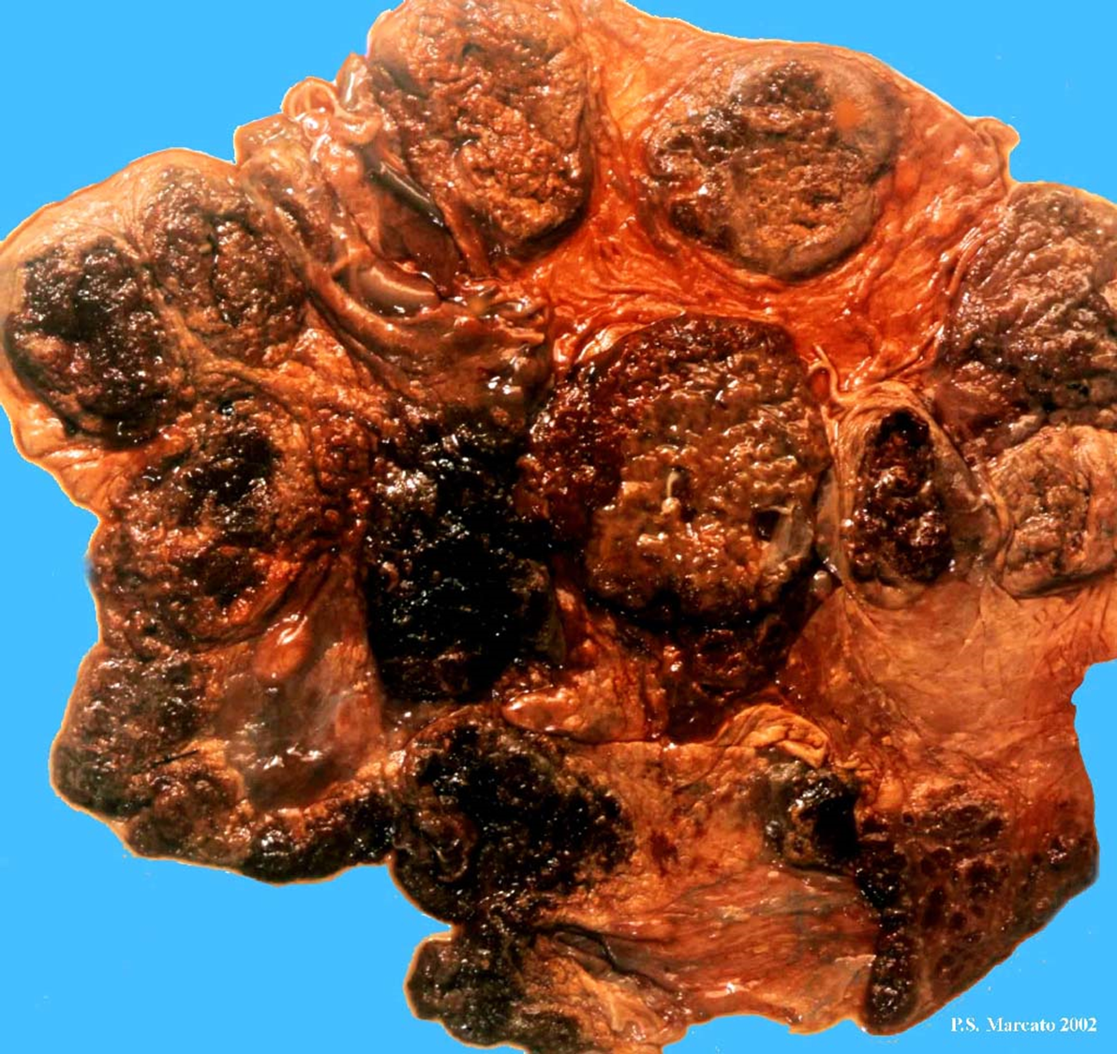
Placentitis Brucellaris
Lesions of cotyledons are most serious.

Slide 74
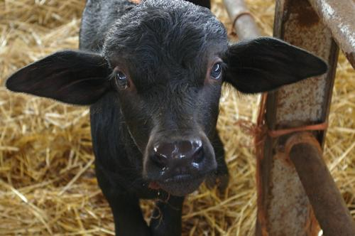
Brucellosis in Mediterranean Buffalo
infection with a chronic course, with clinical symptoms sometimes occurs (abortion, metritis, orchitis epididymitis, male and female infertility), more often concealed by a state unapparent infection (asymptomatic or latent brucellosis).

Slide 75
Geographic distribution
Brucellosis is present throughout the world, and particularly in the Mediterranean countries, in India, in Middle Eastern countries, Central Asia and Latin America.
In the European Union it is imperative to check all farms regularly cattle, buffalo and sheep and goats with a blood test.

Slide 76
Situation in Italy
In Italy, from 1998 to 2010, were notified to the SIMI 8,483 cases of human brucellosis, 89% of all reported cases between 1998 and 2010 occurred in Campania, Puglia, Calabria and Sicily.

Slide 77
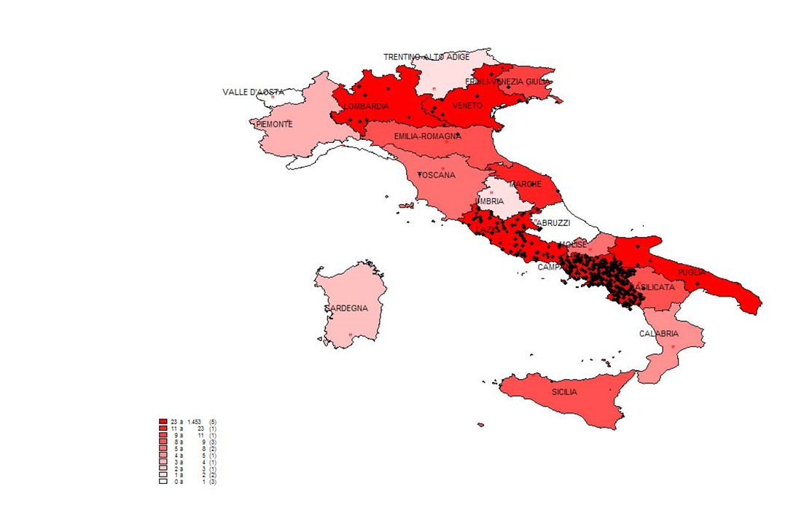

Waterbuffalo farms in Italy

Slide 78
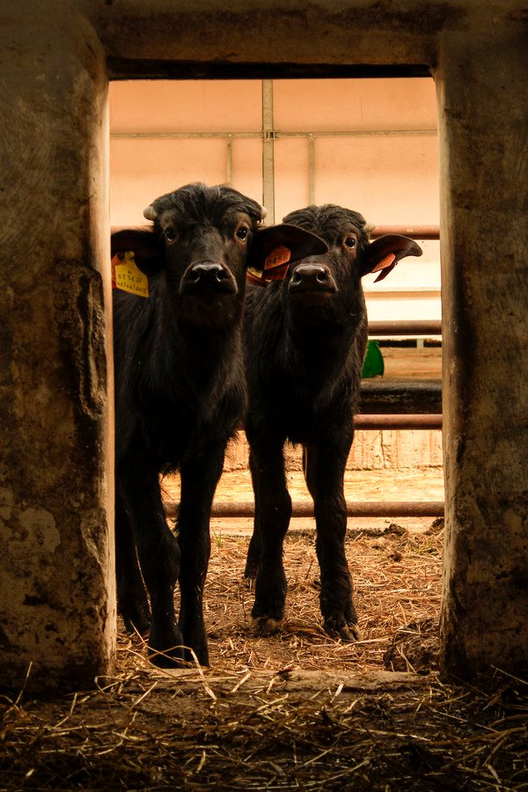
Situation in Italy
the buffalo population in Italy is about 294,000 heads.

Slide 79
Situation in Italy
In 2009 Of a total of 942 farms in the province of Caserta and surrounding areas, the 69.53% is negative serological surveys; 2.55% currently infection intracompany greater than 50%;
the class most representative among those infected is constituted by herds with infection between 20% and 50% with a percentage of 12.63%.

Slide 80
Situation in Italy

Slide 81
Situation in Italy
The Campania Region and the European Commission have approved a specific three-year plan and a operational program for the eradication of brucellosis buffalo farms in the territory of the province of Caserta and surrounding area.

Slide 82
Control measures
In the case of positive feedback in a herds (outbreak),brucellosis must be eliminated as soon as possible, through the reduction compulsory of positive animals and their progeny, given the high infectivity for humans and other animals seronegative present in the farm.
The official test used in Italy for the diagnosis of brucellosis in animals is the SAR (serum rapid agglutination), confirmed by CFT (Complement Fixation).

Slide 83
Control measures
periodic monitoring of cattle, by the age of 12 months onwards, and sheep and goats, as 6 months of age and older, through SAR and FdC; in particular in the Italian regions not officially free two annual audits are provided in all the cattle and buffaloes officially free and an annual inspection in all the sheep and goat farms officially free
slaughter of cattle and sheep and goats positive
exclusion from human consumption of milk from positive animals
pasteurization of milk from negative animals belonging to herds positive

Slide 84
Control measures
application of biosecurity measures in the positive holdings (isolation the positive animals, waiting to be sent to the slaughter, from the rest of the herd, disinfections, reclamation of pastures etc.).
The implementation of all the measures listed above also guaranteed in Italy considerable lowering of the level of infection in both animals and humans

Slide 85
Patogenesis
The patogenesis in waterbuffalos is the same as the bovine.

Slide 86
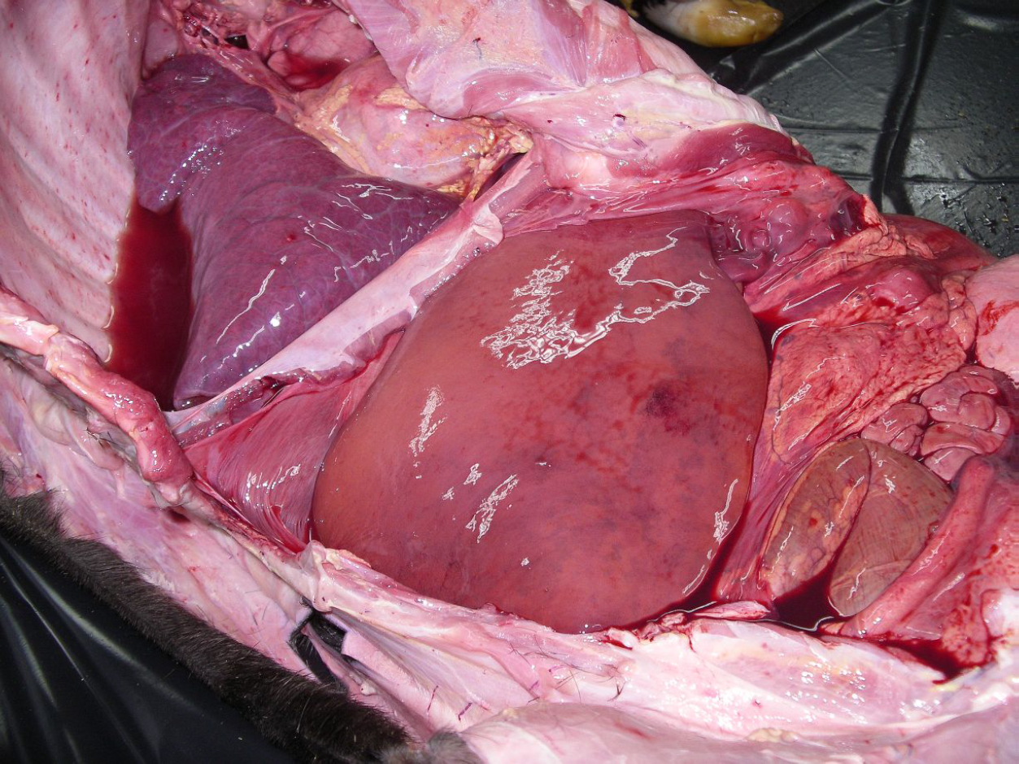
Brucellosis in Buffalo

Slide 87
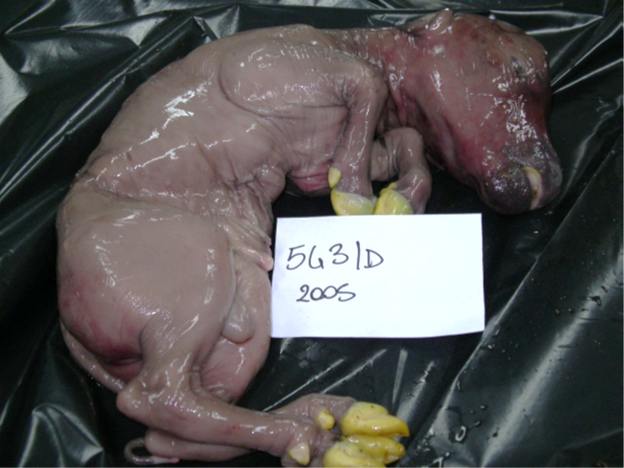
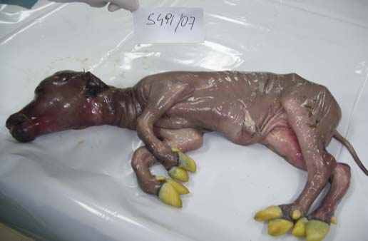
Buffalo Fetus aborted

Slide 88
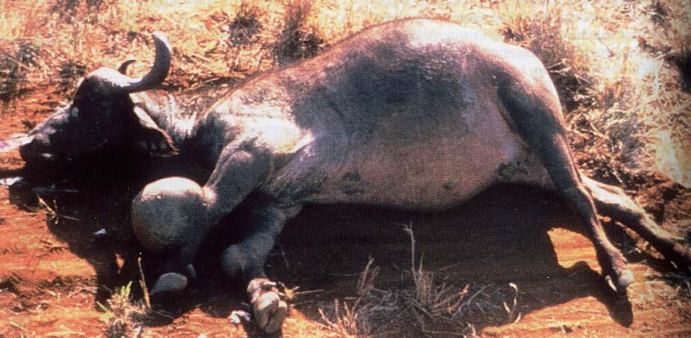
Joint location
Hygroma unilateral or bilateral (carpal joint): 66% of chronic animals

Slide 89

Brucellosis in camels
Camels are highly susceptible to brucellosis caused by Brucella melitensis and Brucella abortus.
Difficulties can arise in diagnosis of camel brucellosis, especially as this disease provokes only few clinical signs in contrast to its clinical course in cattle.

Slide 90
Brucellosis in Camels
Because none of the commonly used serological test can be perceived as a perfect test for Brucella diagnosis in camel and most serological tests used for camels have been directly transposed from cattle without adequate validation, an incorrect diagnosis may occur when diagnosis is based on serology alone.

Slide 91
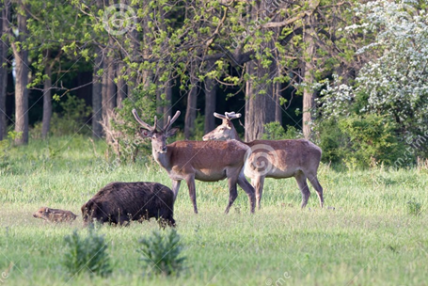
Brucellosis in Wild animals
Brucella infections have been documented word-wide over the years in a great of terrestrial wildlife species.
Recently brucellae infections have also been reported in a wide variety of marine mammals.

Slide 92
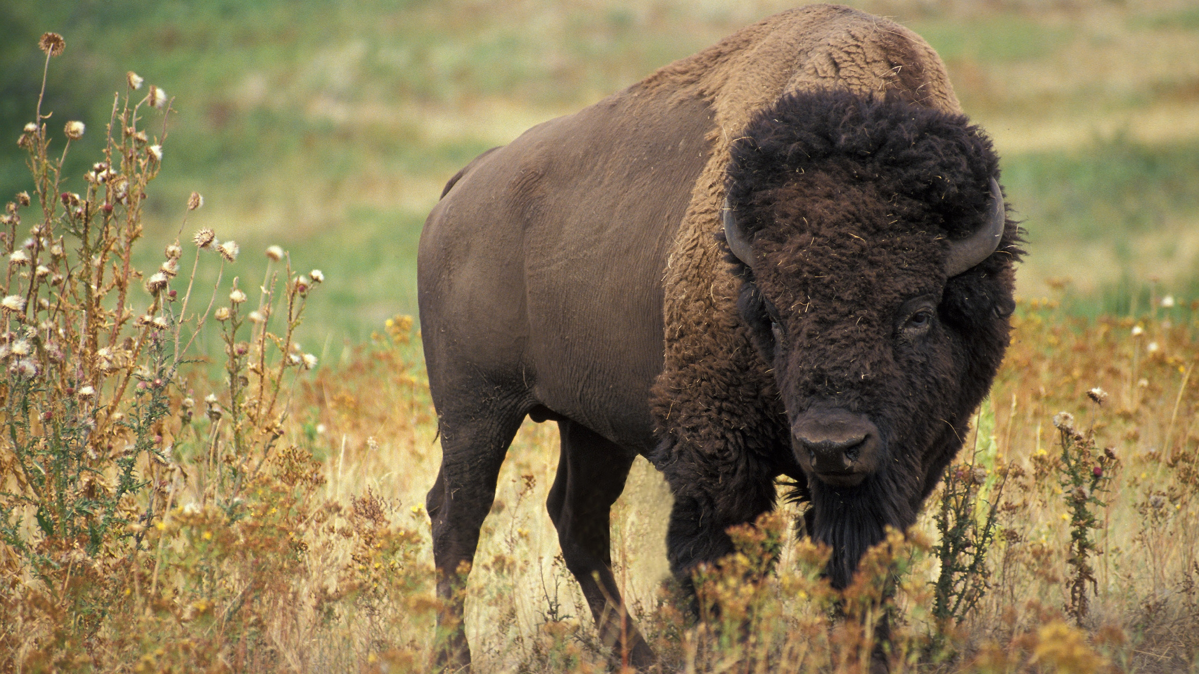
Brucellosis in Bison
Brucellosis is thought to have been transmitted to the different bison herds in the National Parks of the Greater Yellowston area of Wyoming, Montana and Idaho in the early 1900s by cattle providing milk for park employees.
Although serological evidence of brucellosis and abortion were reported as early as 1917, B. abortus was isolated for the first time from an aborted female bison in 1993.

Slide 93
Brucellosis in Bison
The distribution of B. abortus in bison was found to be similar to the distribution of the pathogen in cattle.
Arthritis and hence lameness may also contribute to emaciation as observed in chronic bovine
brucellosis .
bison can be considered to be maintenance hosts of infection, as confirmed by experimental studies.
transmission between bison and cattle has also been experimentally documented.

Slide 94
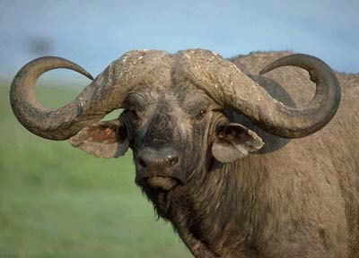
Brucellosis in African Buffalo
the African buffalo is considered to be a reservoir of B. abortus in southern Africa.

Slide 95
Brucellosis in African Buffalo
In South Africa, several species of wildlife (African buffalo,
hippopotamus,zebra, eland, waterbuck and impala)
have tested serologically positive for brucellosis, but these species are probably of minor importance in the epidemiology of bovine brucellosis in southern Africa.
This is possibly due to the relatively infrequent contact between cattle and wildlife.

Slide 96
Brucellosis in African Buffalo
As with bison, few records exist of abortions due to brucellosis in wildlife in southern Africa, although B. abortus biovar 1 has been isolated from the cotyledons of pregnant buffalo at slaughter.
and experimental infection of
pregnant buffalo resulted in late term abortion.

Slide 97
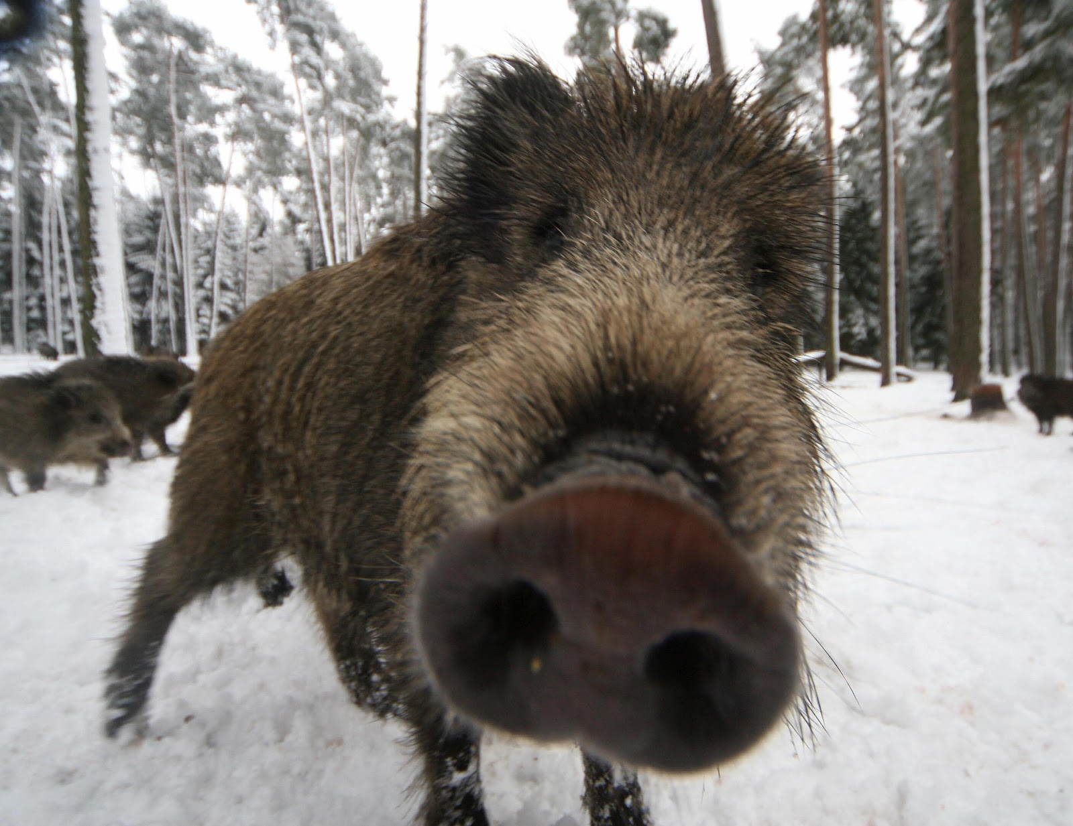
Brucellosis in wild boar
In 1994, an outbreak of enzootic brucellosis (B. suis biovar 2) in wild boar was reported in Belgium.

Slide 98
Brucellosis in Wild Boar
One of the most striking features of brucellosis in wild boar is that a very high percentage of infected animals can be detected in all age categories by bacteriological isolation,often in the absence of gross lesions.
No definitive explanation has been provided, but this may be due to a lower pathogenicity of B. suis biovar 2 for wild boar compared to domestic pigs, or because of the lack of baseline work on the ecology of the infection.

Slide 99

Brucellosis in Caribou,Reindeer and Moose
Rangiferine brucellosis is enzootic in Siberia, Canada and Alaska in caribou and reindeer, and B. suis biovar 4 was isolated in both species in the 1960s.
When clinical signs are present,
abortions and metritis are seen in females and orchitis in males.
In both sexes, abscess-formation in joints and often bursitis and
lameness are observed.

Slide 100

Brucellosis in Caribou,Reindeer and Moose
Experiments demonstrated that cattle exposed to reindeer infected with B. suis biovar 4 can become infected, but the pathogenesis in cattle has yet to be studied.
A recent serological study concluded that brucellosis was not present in reindeer in Finnmark, northern Norway.

Slide 101
Brucellosis in Caribou, Reindeer and Moose
In Canada, a natural B. suis 4 infection was confirmed in moose, for the first time, in 1993.
Carpal pathology and osteomyelitis of subjacent bone was observed. Experimental infection and serological evidence of B. suis biovar 4 in moose have been described in Alaska.

Slide 102
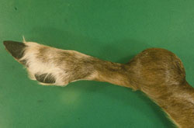
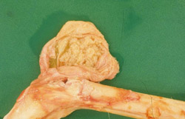
Brucellosis in Caribou, Reindeer and Moose
Caribou, carpus, B. suis biovar 4. The carpal bursa is markedly swollen and fluctuant.
Caribou, carpus, B. suis biovar 4. The carpal bursa contains purulent exudate.

Slide 103
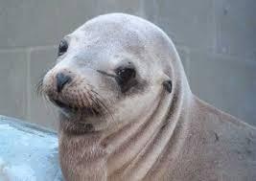
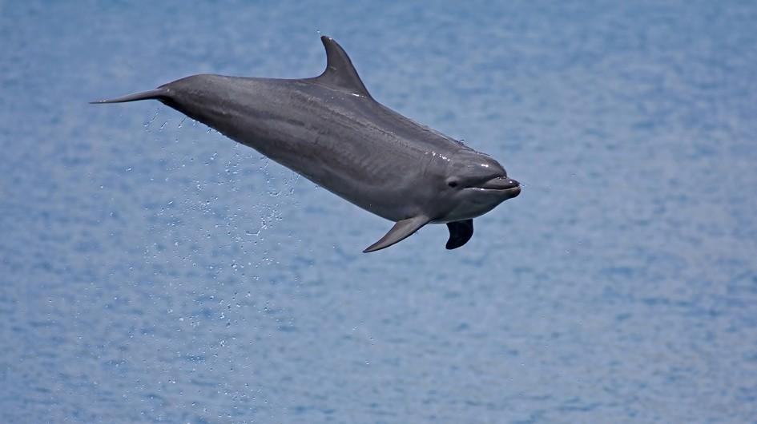
Brucellosis in Marine Mammals
Prior to the first reports, in 1994, of brucellae isolations from stranded harbour seals (Phoca vitulina), harbour porpoises (Phocoena phocoena) and common dolphins (Delphinus delphis) on the coast of Scotland and from an aborted foetus of a captive bottlenose dolphin (Tursiops truncatus) in California ,brucellosis was not only unrecognised, but was not even suspected in marine mammals.

Slide 104
Brucellosis in Marine Mammals
In the 1990s, strains of brucellae which were biologically and genetically different from the classical six recognised species of Brucella were isolated from cetaceans and pinnipeds inhabiting seas and oceans of Europe and North America or kept in Captivity .

Slide 105
Brucellosis in Marine Mammals
Brucella infections have recently been recognized in seals, sea lions, walruses, dolphins, porpoises, whales and an otter. This organism appears to be widespread in marine mammals, and has probably been endemic in these populations for a long time.
The clinical significance is uncertain.
A few infections have been associated with placentitis,abortions, neonatal mortality, meningoencephalitis, abscesses or other syndromes, but Brucella has also been isolated from normal tissues and asymptomatic animals.

Slide 106
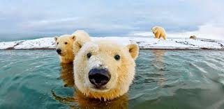
Brucellosis in Marine Mammals
Marine mammal isolates of Brucella can infect terrestrial mammals, but the frequency of this event is unknown.
Some polar bears, which feed on marine mammals, are seropositive for Brucella, and there are concerns about possible impacts on this species.

Slide 107
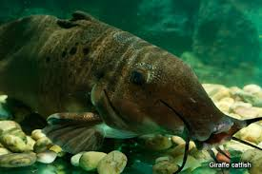
Brucellosis in Marine Mammals
The high number of sero- or culture-positive marine mammals raises the possibility of a common source of brucellae in the marine food chain.
In a recent study concerning experimental infections of Nile catfish with B. melitensis biovar 3, the bacteria were successfully cultured from visceral organs, suggesting that these fish are susceptible to brucellae.

Slide 108
Brucellosis in Marine Mammals
Infections may also be acquired from contact with infected material in areas where birth takes place.
The spread of bacteria may also be venereal,or the calves/pups may be infected congenitally or as neonates by infected milk, as seen in other mammals.

Slide 109
Brucellosis in Marine Mammals
Clinical symptoms, if presents, may be cryptic, gross pathology may be absent, and as a rule, mortality and morbidity are low.
crucial observation was recently
made in stranded dolphins on the coast of Scotland.
Three animals showed meningo-encephalitis at necropsy and
brucellae were cultured from the brains.

Slide 110
Brucellosis in Marine Mammals
in one case, exposure of a laboratory worker to a marine mammal brucellae revealed that such bacteria may also be pathogenic to humans.

Slide 111
Post-mortem lesions
In dolphins with meningoencephalitis, the lesions were described as severe, chronic, widespread, nonsuppurative meningitis most severe in the brainstem.
The meningitis was accompanied by periventricular encephalitis.
Moderate to severe fibrosis, inflammatory infiltrates of lymphocytes, plasma cells and macrophages, and vascular damage was reported.

Slide 112
Post-mortem lesions
in these animals, lesions in organs other than the brain were mild and nonspecific, and consisted of pulmonary congestion and edema, a blubber abscess, gastric erosions, and multiple fractures that may have been the result of terminal trauma.

Slide 113
Post-mortem lesions
In various marine mammals, Brucella has also been associated with subcutaneous abscesses, placentitis/abortion, epididymitis, lymph-adenitis, mastitis, spinal discospondylitis, peritonitis, a mineralized lung granuloma, hepatic abscesses, hepatic and splenic necrosis, and macrophage/histiocytic cell infiltration in the liver, spleen and lymph nodes. In some cases, Brucella has been recovered from apparently normal tissues.

Slide 114
Post-mortem lesions
Microscopic examination identified the lesions as chronic purulent or granulomatous orchitis. Similar nodular lesions were reported in the uterine endometrium of one female minke whale and the ovary of a pregnant Bryde's whale

Slide 115
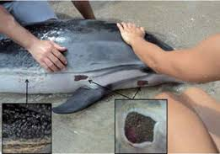
Living striped dolphin (Stenella coeruleoalba) with neurobrucellosis, also showing lesions of unknown cause, handled by inhabitants of Playa Guiones, Costa Rica (24 August 2011)

Slide 116
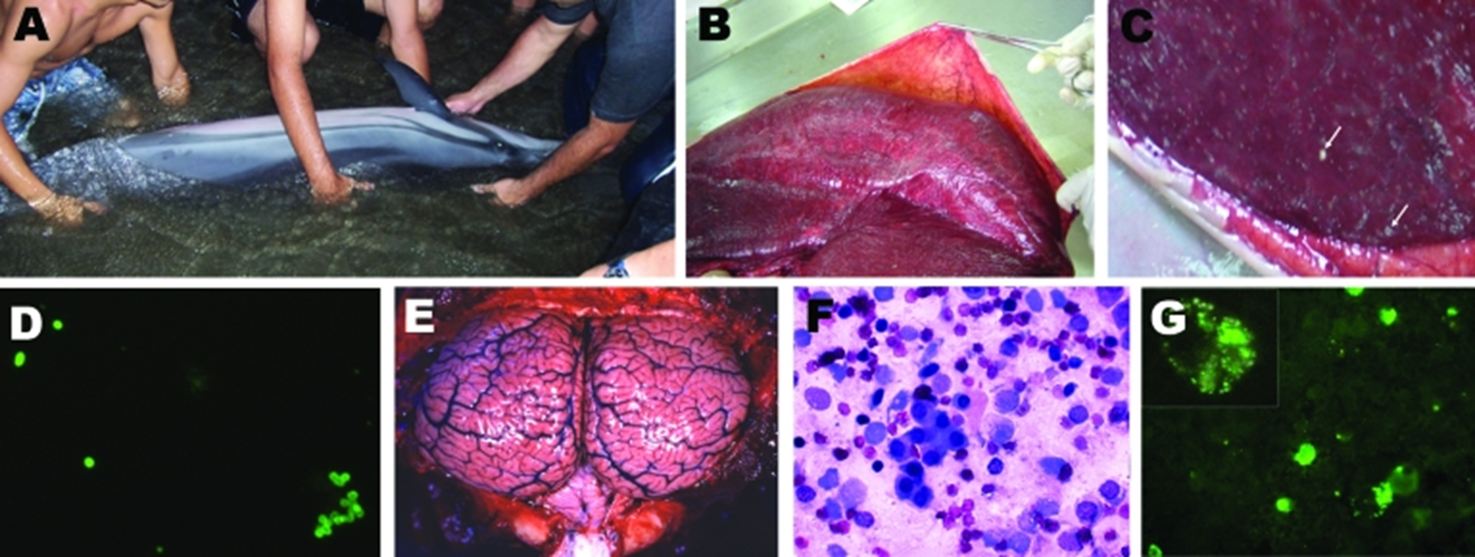
Clinical, pathologic, and immunofluorescence findings in stranded striped dolphin, Stenella coeruleoalba. A) Striped dolphin displaying swimming disorders being assisted by local persons; B) dolphin fetus within placenta; C) punctuated placental abscesses (arrows); D) immunofluorescent brucellae in impressions of placenta tissues; E) congested and hyperemic brain and cerebellum; F) Wright-Giemsa–stained mononuclear cell infiltrate in cerebrospinal fluid; G) immunofluorescent green Brucella spp. and Brucella debris within phagocytic cells infiltrating cerebrospinal fluid; the inset corresponds to an amplified phagocytic cell with fluorescent Brucella spp. and debris.

Slide 117
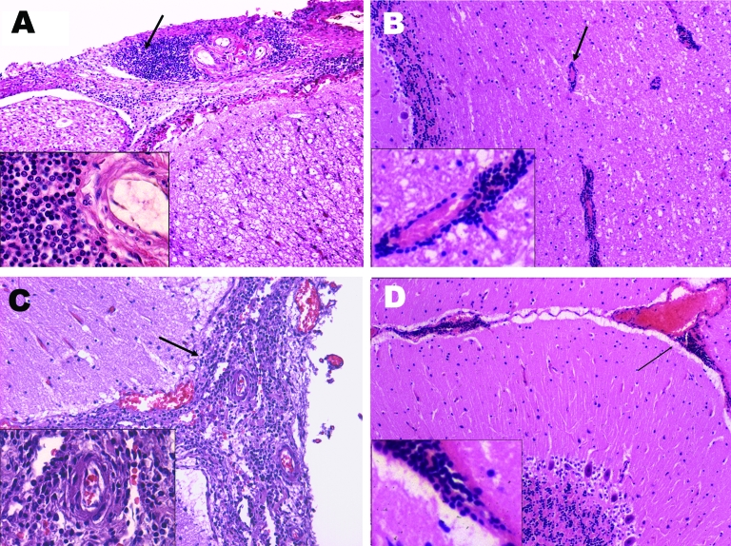
Main histopathologic finding of neurobrucellosis in Stenella coeruleoalba.
Mononuclear infiltrates in the meninges (arrow) surrounding the spinal cord;
B) mononuclear infiltrate around vessels (arrow) of the cerebellum;
C) mononuclear infiltrate (arrow) in the meninges around the brain;
D) hyperemic vessels and mononuclear cell infiltrate in the meninges around the cerebellum (arrow). The insets correspond to amplified sections of each figure demonstrating the mononuclear cell infiltrate.

Slide 118
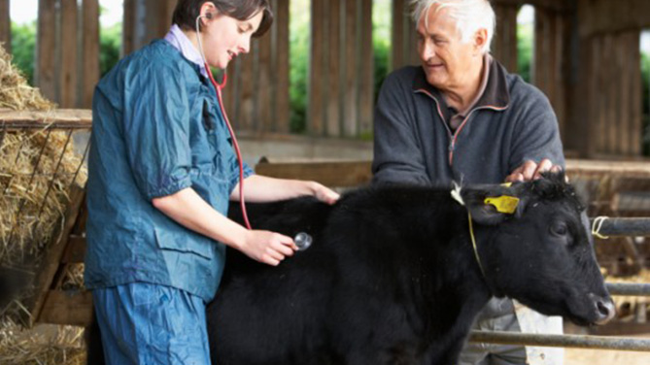
Brucellosis in Humans
It’s considered a occupational disease (veterinarians,farmers,
slaughterers and laboratory technicians).

Slide 119
Routes of infection
Ingestion (milk and dairy products, vegetables and contaminated water)
Contact skin and conjunctiva (the fetus, vaginal exudate, milk,urine, feces, carcasses, viscera and blood cultures)
Inhalation (dust slaughterhouse, admissions, laboratories,antigen production ...)
Inoculation accidental

Slide 120
Brucellosis in Humans
Mostly asymptomatic
incubation: 5-30 days-a few months
Prodromal period: headache, fatigue, depression, insomnia, arthralgia, abdominal pain, fever
Invasion Period: accentuation prodromal symptoms; Fever (40-41° C) remitting, but sometimes constant; splenomegaly and hepatomegaly
Localization Period: chills, intense sweating, fatigue,prostration, arthritis, neuralgia; orchitis, epididymitis one or both sides

Slide 121
Brucellosis in Humans
Acute infections flu-like
• Chronic infections: variable symptoms, nerve complications, localized abscesses, hip osteoarthritis, ankylosing fleeting rash, endocarditis, aortic stenosis, vomiting, diarrhea, nausea

Slide 122
Clinical Diagnosis
• abortions
• premature birth, stillbirth
• placental retentions
• fetal injury
• metritis, infertility,
• orchitis, epididymitis

Slide 123
Laboratory
Diagnosis
Direct with identification of etiologic agent
Indirect with specific antibodies or cell-mediate response

Slide 124
Differential
Diagnosis
Trichomonas foetus;
Campylobacter foetus;
Leptospira pomona;
Listeria monocytogenes;
Coxiella burnetii;
Aspergillus;
BVD;
IBR.

Slide 125
Direct Diagnosis
Microscope exam
Colture exam
Biologic proof
PCR, DNA probes

Slide 126
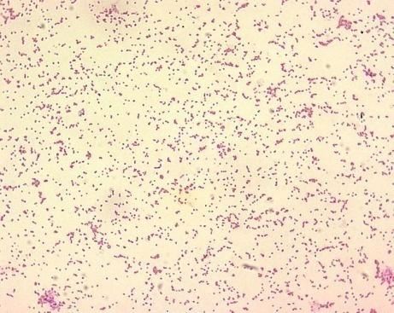
Microscope exam
Smear obtained from:
Placental cotyledons vaginal secretions ,lung, liver and fetal abomasal contents
Colours:
Stamp, Köster, Macchiavello, Gram
IF POSITIVE:
Cellular aggregates

Slide 127
Colture exam
Samples to be sown
Ante-mortem: fetal entice, fetus (lung, brain, stomach IV,spleen), milk, vaginal swabs, semen
Post-mortem: parotid, mandibular and retropharyngeal lymph nodes;breast, uterus, iliac lymph nodes in female; testicles,epididymis, seminal vesicles, in the male accessory glands
• Selective media, any enrichment for material abortive

Slide 128
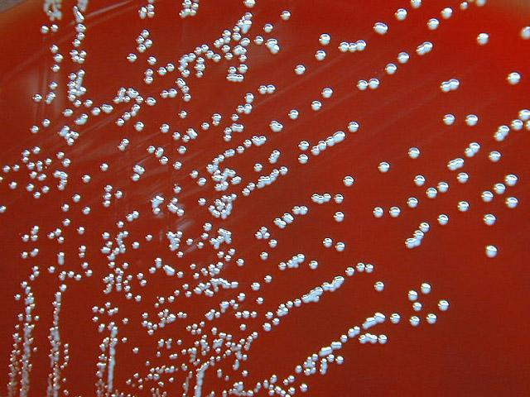
Colture exam
COLONY SUSPECT slow growth, circular,transparent / translucent

Slide 129
Biological Proof
Small amounts of brucella
Cavy: sc/Im injection
Chronic infection with necrotic lesions liver, splenomegaly, nodular spleen

Slide 130
Pcr,Dna Probes
Genetic characterization on Pcr
Pcr gene-specific: when identification of brucella spp. is enough (Human brucellosis or foodstuffs contamination)
Pcr species-specific: When is necessary the species identification of brucella spp.

Slide 131
Indirect diagnosis
It is based on the immunitary response against Brucella
presence of Th0 with
production IFN-g And IL-4

Slide 132
Serological test
agglutination tests
• Complement fixation
• precipitation test
• Enzyme immunoassays
• Fluorescence polarization assay (Canada;Latin America)
Elisa direct and indirect

Slide 133
References
Patologia sistematica veterinaria. Marcato Paolo S.,2002. Edagricole
Brucellosis in wildlife.J. Godfroid, Department of Bacteriology and Immunology, Veterinary and Agrochemical Research Centre, Groeselenberg 99,1180 Brussels, Belgium.
Study material of Prof. Giuseppe Iovane, department of Infectious disease of Veterinary medicine University of Naples ‘Federico II’
Brucellosis in camels.Gwida M¹, El-Gohary A, Melzer F, Khan I, Rösler U, Neubauer H. Res Vet Sci. 2012 Jun;92(3):351-5. doi: 10.1016/j.rvsc.2011.05.002. Epub 2011 May 31.
CDC, center for disease control and prevention, http://www.cdc.gov/.

Slide 134
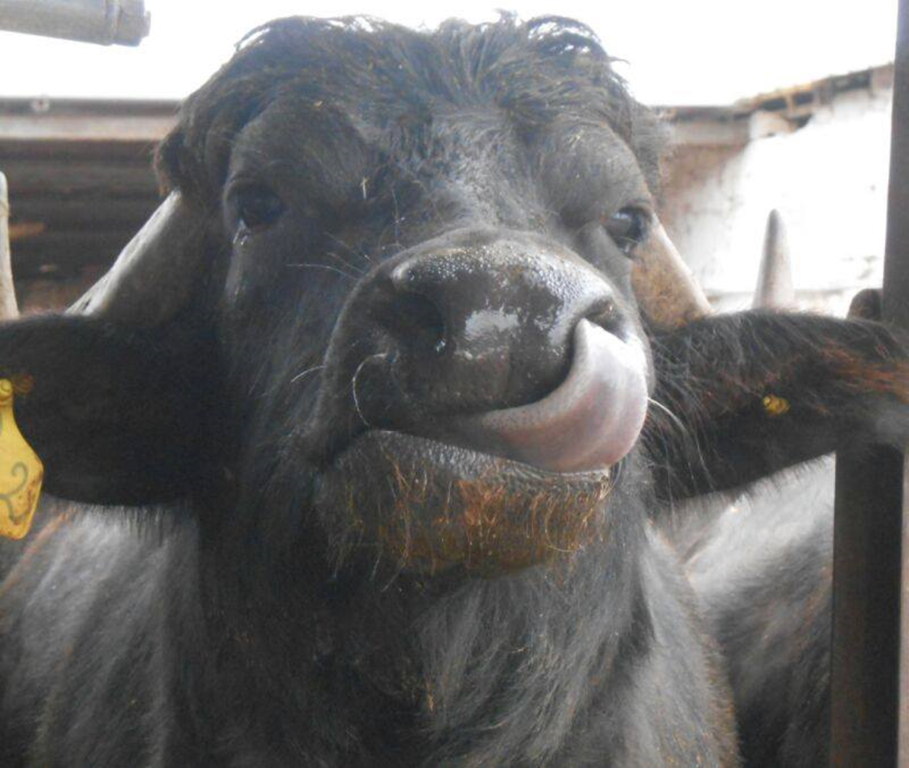
Thank you for the attention!

