Slide 1
Canine Distemper

Slide 2
What is canine distemper?
Canine distemper is an infectious disease caused by the Canine Distemper Virus CDV, which is a paramyxovirus closely related to the measles and rinderpest viruses
It is a fragile single strand RNA virus
It is extremely contagious and potentially lethal, as the virus attaks multiple body systems resulting in a widespread infection that is difficult to treat

Slide 3
How is canine distemper spread?
Direct contact with infected animal or object
Airborne exposure
Placenta
When an infected dog or wild animal coughs, sneezes or barks it releases aerosol droplets in the envirnoment infecting nearby animals and surfaces including food and water bowls
Vertical transmission from mother to son

Slide 4
Pathogenesis
Infection via aerosol
Replication of virus in the lymphoid tissue of the respiratory tract and location in local macrophages, which then migrate to tonsils and brochial lymphnodes
Primary viremia leads to the spread into distant lymphoid and hematopoietic tissues such as spleen, thymus, lymph nodes, gastro intestinal tract and bonemarrow resulting in lymphopenia and immunosuppression which may contribute in the development of secondary bacterial infections.
Further spread in urogenital epitelium, central nervous system (encephalitis) and optic nerves can be observed (secondary viremia)
The degree of viremia and the extend of viral spread to various tissues changes according to the level of specific humoral immunity in the host during the viremic period

Slide 5
Symptoms and Clinical Findings
Due to the presence of primary and secondary viremia, there are two stages of symptoms
The first symptom is a watery to pus-like discharge from the dog’s eyes followed by fever (which develops 3 – 6 days after the dog is infected), loss of appetite and clear nasal discharge
These symptoms depend on the severity of the case and on the reaction of the patient
Other symptoms commonly associated with distemper in dogs during the first stages
Stage One

Slide 6
Symptoms and Clinical Findings
Stage One
Other symptoms commonly associated with distemper in dogs during the first stages are:
Fever
Clear nasal discharge
Purulent eye discharge
Lethargy
Anorexia
Coughing
Vomiting
Diarrhea
Inflammation of the brain and the spinal cord
Pustular dermhatitis (rare)
If a dog survies the acute stage of the illness he may also develop hyperkeratosis of the paw pads and nose: this gives distemper the nickname «hard pad disease» as it causes the dog’s pads to harden and enlarge

Slide 7
Symptoms and Clinical Findings
Stage One
Secondary bacterial infections that attack the dog’s immunitary system when it is already compromised usually cause respiratory and gastro intestinal symptoms which include:
Vomiting
Diarrhea
Difficult breathing
Change in respiratory rate
Pneumonia

Slide 8
Symptoms and Clinical Findings
Stage Two
As the disease progresses and attacks the nervous system, some dogs develop neurological signs which include:
Head tilt
Circling
Partial or full paralysis
Nystagmus (repetitive eye movement)
Muscle twitching
Convulsions with drooling and chewing motions
Death
At this stage the disease is often fatal and dogs who survive usually have permanent and irreparable nervous system damage

Slide 9
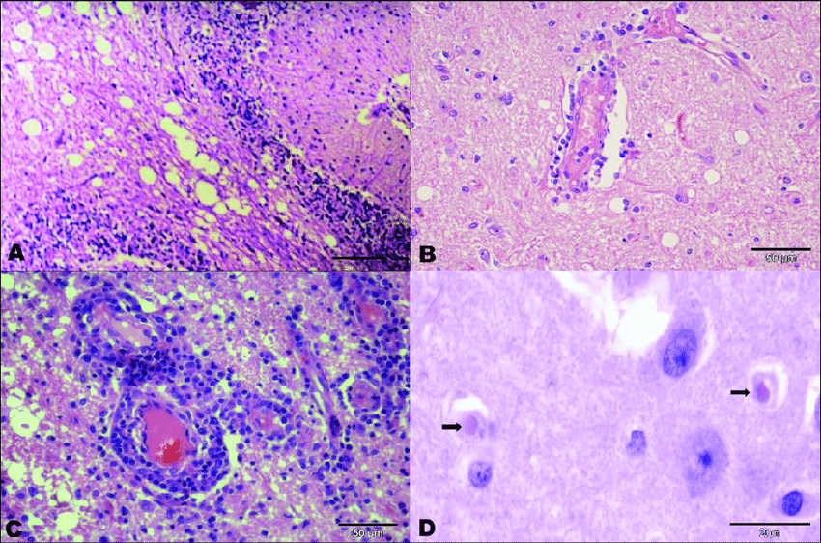
Lesions given by Canine Distemper
Microscopical Lesions
Demyelination of myelinated portion of brain and spinal cord (A)
Perivascular cuffing, hemorrhages,vasculitis (B)
Round or ovoid intra cytoplasmic or intranuclear inclusion acidophilic bodies. These inclusion bodies can be found in respiratory, urogenital, digestive and nervous systems (C, D)

Slide 10
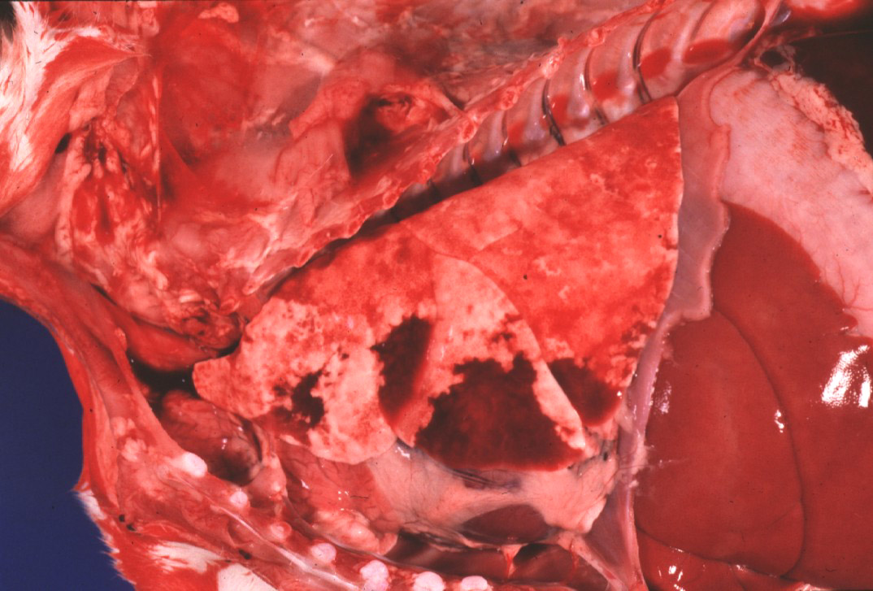
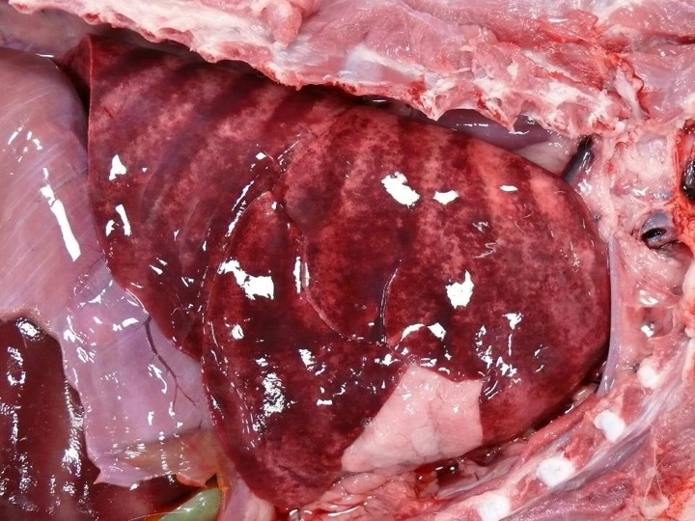
Lesions given by Canine Distemper
Macroscopical Lesions
Thymic Atrophy
Acute pneumonia and edema

Slide 11
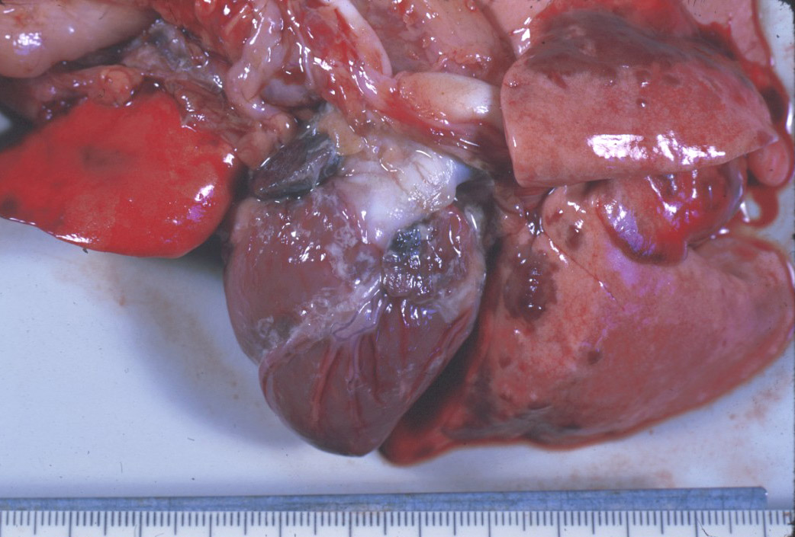
Lesions given by Canine Distemper
Macroscopical Lesions
GI tract: Acute catarral gastroenteritis, swelling of Peyer’s patches and limphnodes
Heart : Hydropericardium, fatty degeneration and small haemorrhages of myocardium, epicarditis
Parenchimatous degeneration of liver

Slide 12
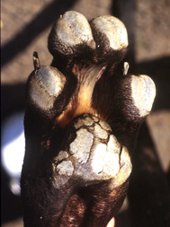
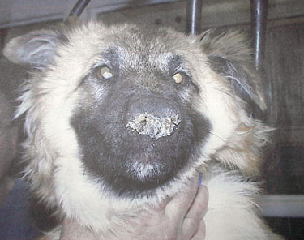
Lesions given by Canine Distemper
Macroscopical Lesions
Hypercheratosis of pads and nose

Slide 13
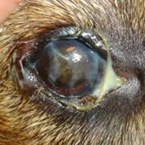
Lesions given by Canine Distemper
Macroscopical Lesions
Muco purulent conguinctivitis, lesions to cornea and optic nerve, atrophy of the retina

Slide 14
Bibliography
http://ecoursesonline.iasri.res.in/mod/page/view.php?id=65511
https://www.msdvetmanual.com/generalized-conditions/canine-distemper/canine-distemper-overview
https://www.researchgate.net/figure/Principal-histological-patterns-of-canine-distemper-virus-induced-encephalitis-Observe_fig3_278721027
https://noahsarkive.cldavis.org/cgi-bin/show_image_info_page.cgi?_submitted=2&no_items=100&Species=2&System=-1&Organ=-1&Genpath=-1&Rating=&Keywords=distemper
https://noahsarkive.cldavis.org/cgi-bin/show_image_info_detail.cgi?image=F12906

