Slide 1
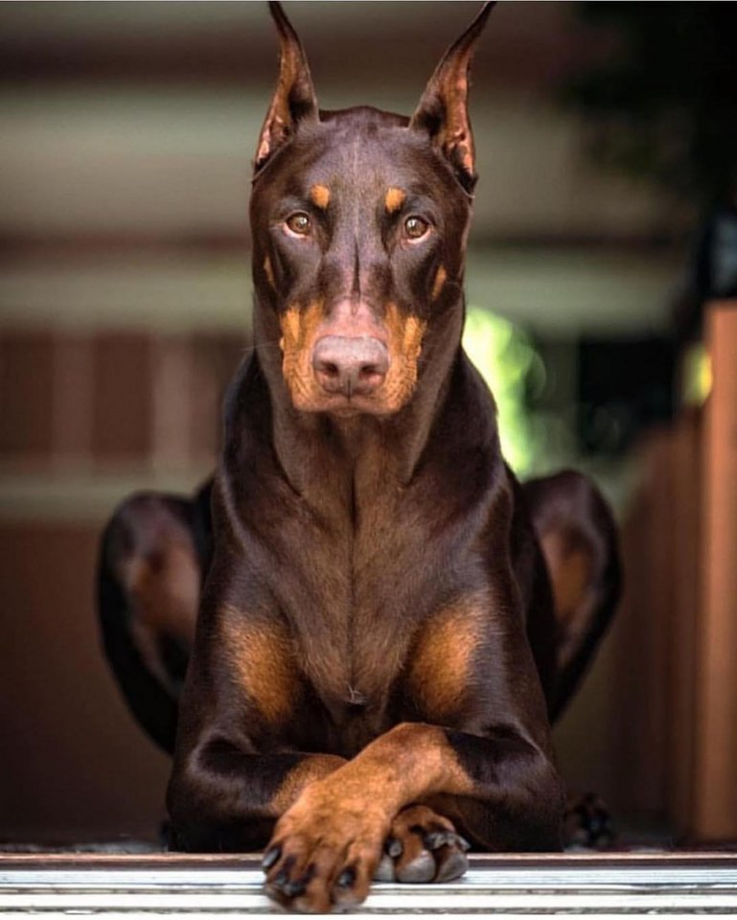
Canine IBD

Slide 2
Content:
Introduction
Definition
Etiology
Treatment
Prevention
Prognosis
Anatomic and histological organization of intestine
Pathogenesis
Canine IBD
Types
Clinical signs
Diagnosis
Conclusions
References

Slide 3
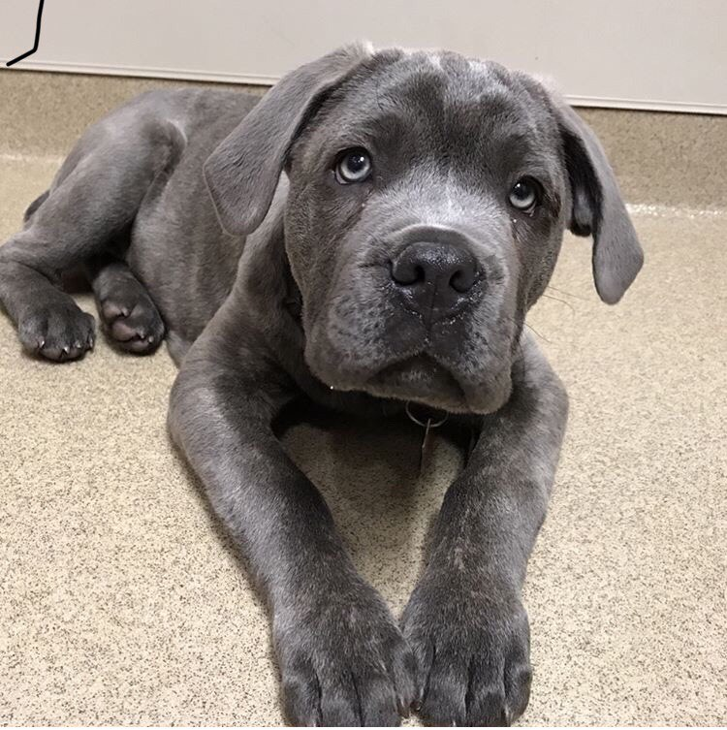
INTRODUCTION
The group of gastrointestinal diseases known as inflammatory bowel disease (IBD) results in the inflammation of the intestines and chronic symptoms related to gastrointestinal system.

Slide 4
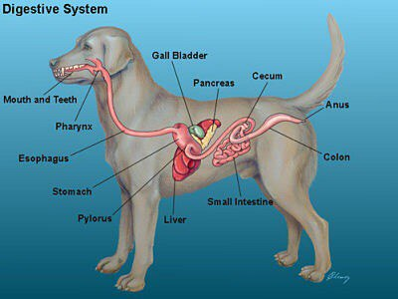
Anatomic and histological organization of the intestine
The small intestine is a tube-like structure which extends between the stomach and large intestine. It is the longest portion of the intestinal tract and is about two and a half times the animal's total body length. An animal twenty-four inches long would have about sixty inches of small intestine.
Intestine
The small intestine

Slide 5
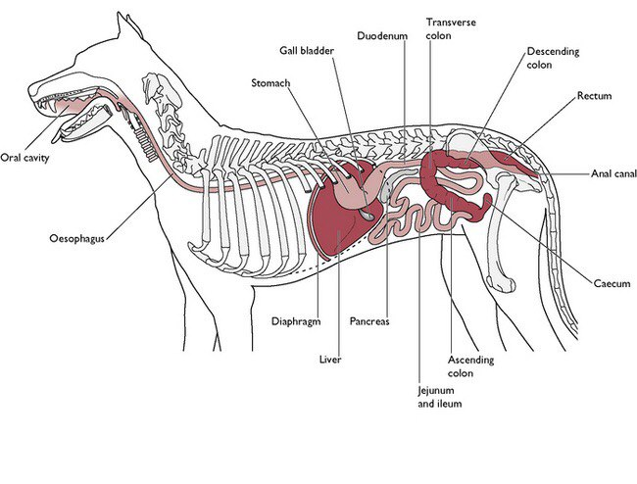
The small intestine
the duodenum
the jejunum
the ileum
The first portion, which attaches to the stomach
The shortest part which connects to the large intestine.
The middle (and longest) portion

Slide 6
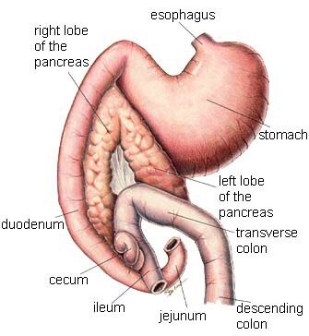
1. Attaches to the stomach and is relatively short.
The duodenum
2. It has very important functions:
The gallbladder and pancreas connect to the duodenum by the bile and pancreatic ducts respectively. Enzymes and other secretions that are important for digestion are produced by the liver and pancreas and pass through these ducts to mix with the food in the duodenum.

Slide 7
1.is the longest area of the small intestine and is rich in small, finger-like projections called villi
The jejunum
2.Villi:
protrude inward into the food contents and provide a large surface area to absorb nutrients.
from there pass into the large intestine.
Intestinal contents of the jejunum
empty into the ileum

Slide 8
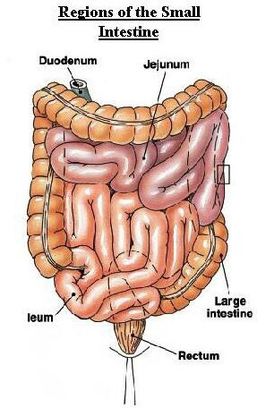

Slide 9
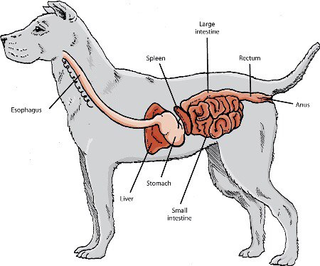
of the dog basically connects the small intestine to the anus. The large intestine is about sixteen inches in length in a forty-pound dog and is larger in diameter than the small intestine.
Intestine
The large intestine
Its primary functions:
1.is to absorb water from feces as needed, thus keeping the hydration level of the body constant.
2.Its other function is to store fecal matter awaiting passage from the body.

Slide 10
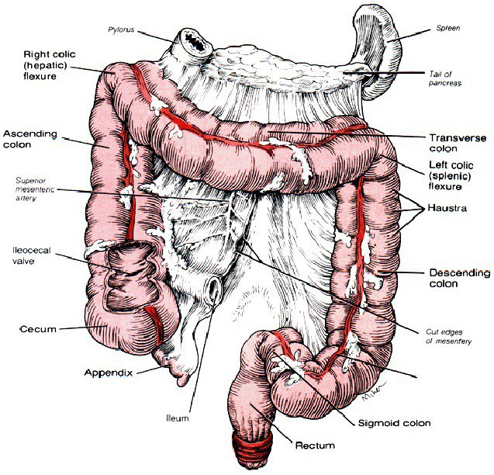
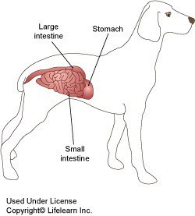
The large intestine
the cecum
the colon
the rectum
is a small, finger-like projection near the junction with the small intestine.
The colon terminates just inside the anus to the final portion of the large intestine called the rectum.
is the longest portion of the large intestine

Slide 11
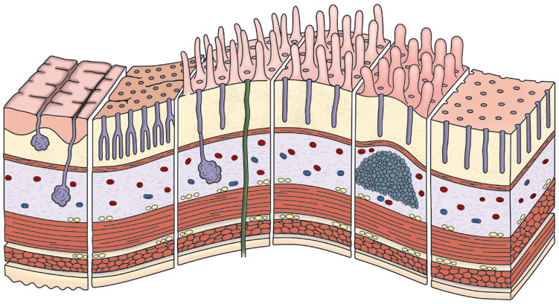
Histologic Organization of the Digestive Tube
The intestines might be thought of as a tube within the body cavity that carries material (ingesta/digesta) through the body. The overall anatomic and histologic organization of this digestive tube.
Esophagus Stomach Duedenum Jejunum Ileum Colon
Fold
Pit
Villi
Gland opening
Epithelium
Lamina
propria
Mucosa
Muscularis
mucosae
Submucosa
Circular
muscle layer
Muscularis
Longitudinal
muscle layer
Adventitia
Pancreatic
and bile
duct
Peyer’s
patch
Esophageal
submucosal gland
Gastric
gland
Adventitia
Meissner’s plexus
(submucosal)
Serosa
Brunner’s
glands
Crypt of
Lieberkühn
Auerbach’s plexus
(myenteric)
Anatomic and Histologic Organization of the Digestive Tube. A, Entire digestive tube.

Slide 12
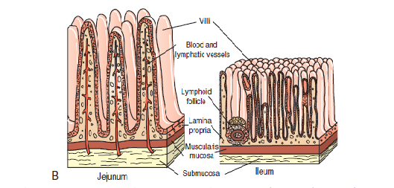
Anatomic and Histologic Organization of the Digestive Tube. B, Higher magnification of the jejunum and ileum.
Herbivores have longer intestines than carnivores or omnivores and need a fermentation vat, either the rumen or cecum, to digest cellulose. Within the smooth muscle layers and villi are the neural network of the enteric nervous system.
1.a singlecell-thick layer of epithelial cells lining the intestinal lumen,
The intestinal mucosa is composed of three layers:
2.mesenchymal cells of the lamina propria
3.mesenchymal cells of the lamina propria, and the muscularis mucosa.

Slide 13
Histology. Small intestine of puppy (dog)

Slide 14
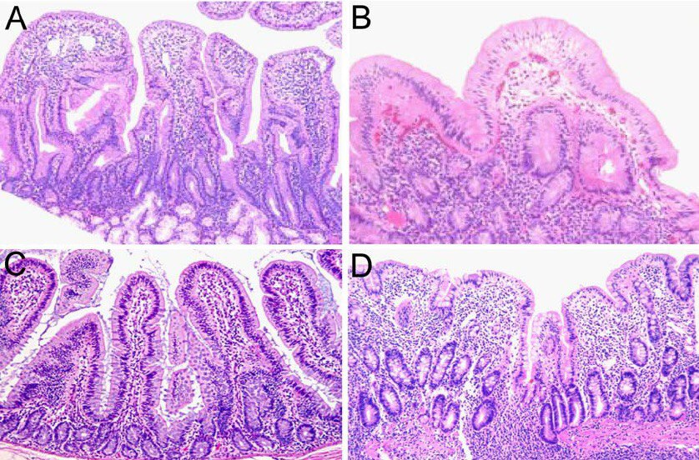
Histopathology of the small intestine. H&E-stained tissue sections of duodenum and proximal jejunum from rhesus macaques with idiopathic diarrhea. ( A ) Normal control duodenum from an age-matched rhesus macaque illustrating characteristic morphology of the villi. 100 6 magnification. ( B ) Enteropathy of duodenum. Diffuse enteritis characterized by shortening of villi, severe lymphocytic and plasmacytic infiltration of the lamina propria, and vacuolar degeneration of the epithelium. 100 6 magnification. ( C ) Normal control jejunum from an age-matched rhesus macaque. 100 6 magnification. ( D ) Enteropathy of jejunum. The mucosa appears flat with marked blunting of villi and dense infiltration of lamina propria by mononuclear cells.

Slide 15
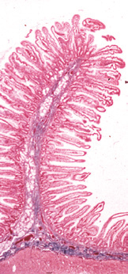
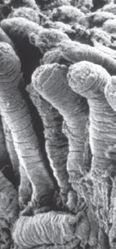
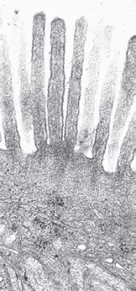
By the action of enzymes, resident flora, and added secretions from the liver and pancreas, ingesta are broken down, nutrients are absorbed into the body, and waste products are excreted. To perform these functions the intestine needs a very large surface area, which is accomplished by the following three means:
1. The intestine is coiled in the abdomen.
2. Numerous intestinal folds contain villi that notably increase the
number of cells contacting the ingesta (Fig. A and B).
3. Each enterocyte has a microvillous border, further increasing the
surface area available for digestive and absorptive processes (see
C).
A
B
C
Organization of the Intestine. The digestive and absorptive surfaces of the intestine are markedly increased by the presence of villi and microvilli on the enterocytes. A, Intestinal villi. Villus epithelial cells are present on a basement membrane (not seen) on a core of lamina propria.
Hematoxylin and eosin (H&E) stain. B, Small intestine, intestinal villi, scanning electron microscopy. Carbon sputter coat. C, Enterocyte microvilli.Transmission electron microscopy (TEM). Uranyl acetate and lead citratestain.

Slide 16
Epithelial cells
enterocytes
goblet cells
Paneth cells
undifferentiated or crypt epithelial cells
microfold (M) cells
enterochromaffin
(neuroendocrine, argentaffin) cells
The epithelial cells function as a selectively permeable barrier allowing nutrient, electrolyte, and water absorption, while excluding pathogens, toxins, and other antigens.
There are six major types of polarized epithelial cells lining the intestine, all of which are produced by progenitor cells in the crypts via notch signaling.

Slide 17
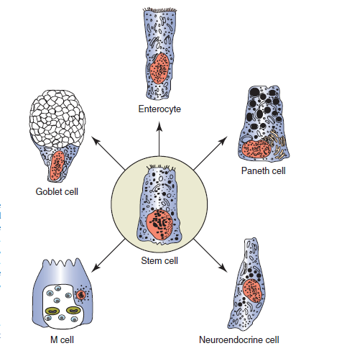
Epithelial cells
An understanding of these cell types and their functional roles in digestion and absorption is important in understanding the mechanisms of intestinal disease. Similarly, an understanding of the biology of these cell types is important in predicting clinical outcomes and designing therapeutic strategies for treating intestinal disease.

Slide 18
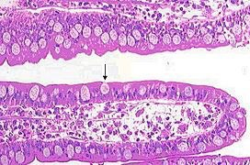
Goblet cells in the wall of an ileum villi. Dog

Slide 19
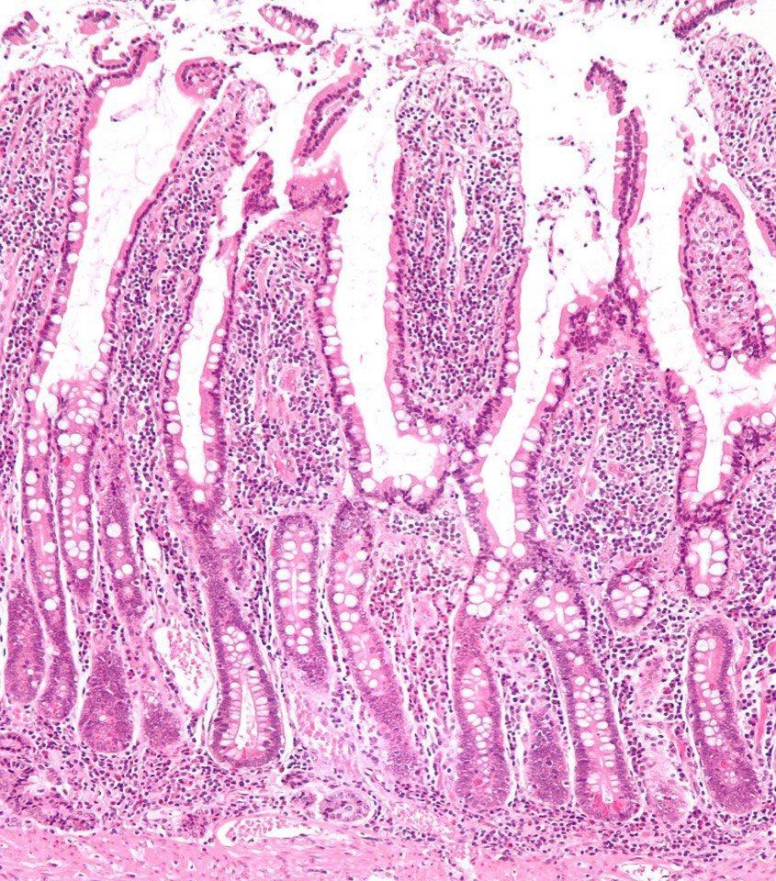
Intestinal villus. Dog

Slide 20
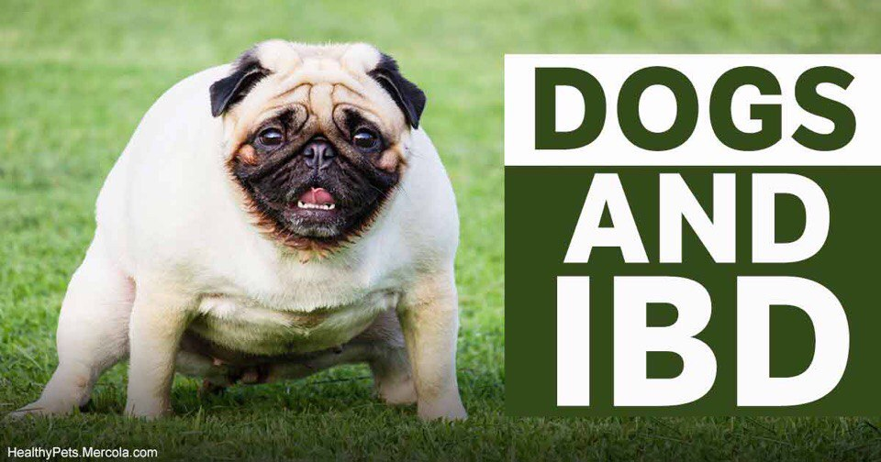
WHAT IS CANINE IBD?
Inflammatory Bowel Disease (IBD) in dogs is a group of idiopathic, chronic gastrointestinal disorders characterized by mucosal inflammation.
Inflammatory bowel disease (IBD) occurs when a dog’s stomach and/or intestine becomes home to an unusually high number of inflammatory cells.
IBD can affect dogs at any age but is more common in middle-aged and older dogs.

Slide 21
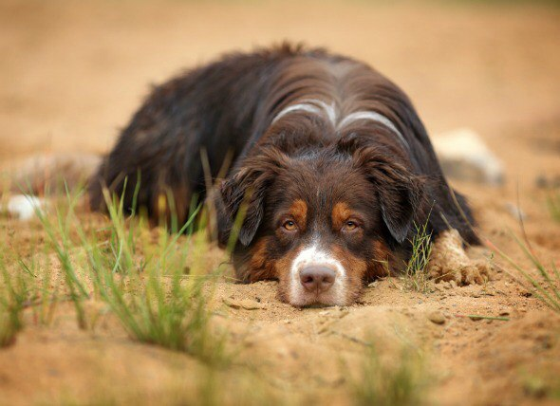
WHAT CAUSES IBD IN DOGS?
The cause of inflammatory bowel disease is not well understood. Any number of variables may contribute to the development of IBD in dogs, including:
Genetics
Nutrition
Infection agents
Abnormalities of the immune system

Slide 22
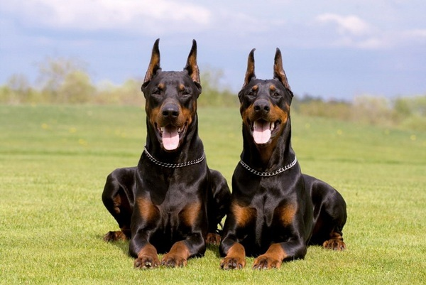
Genetics
You might be more likely to develop IBD if you have a sibling or parent with the disease. This is why scientists believe IBD may have a genetic component.
The immune system may also play a role in IBD. Normally, the immune system defends the body from pathogens (organisms that cause diseases and infections). A bacterial or viral infection of the digestive tract can trigger an immune response. As the body tries to fight off the invaders, the digestive tract becomes inflamed. When the infection is gone, the inflammation goes away. That’s a healthy response.
The immune system

Slide 23
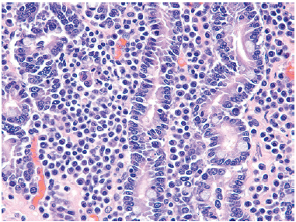
In dogs there are increased numbers of both B and T lymphocytes in the
Lamina propria of the small intestine
Lymphoplasmacytic Enteropathy, Intestine, Dog. The lamina propria is widened with lymphocytes and plasma cells. H&E stain.(Courtesy Dr. H. Gelberg, College of Veterinary Medicine, Oregon State University.)

Slide 24
THE TYPES OF IBD
Many diseases are included in this IBD umbrella term. The two most common diseases are
Crohn’s disease
ulcerative colitis
can cause inflammation in any part of the digestive tract. However, it mostly affects the tail end of the small intestine.
involves inflammation of the large intestine

Slide 25
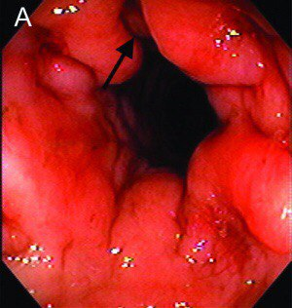
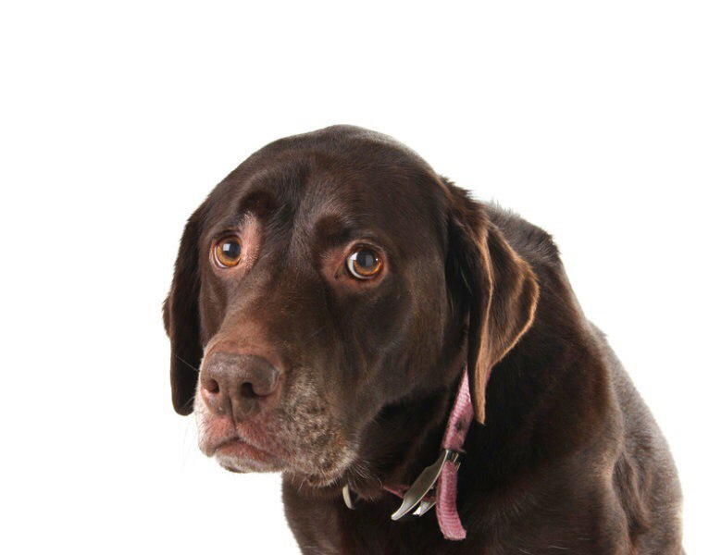
Endoscopic appearance of inflamed and ulcerated colonic mucosa

Slide 26
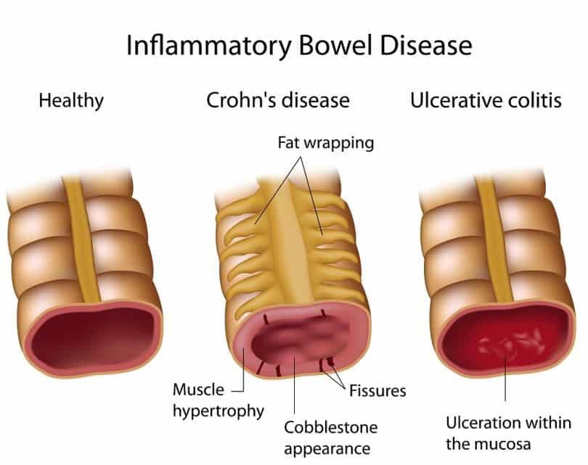
THE TYPES OF IBD

Slide 27
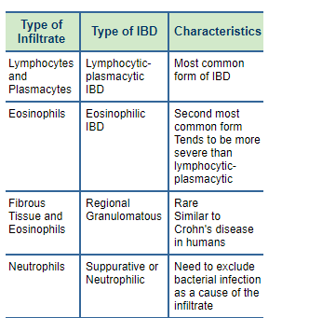
THE TYPES OF IBD
Inflammatory cells include lymphocytes and plasmacytes which are directly responsible for the body's immune response. Eosinophils are another cell commonly present in inflammation. Other inflammatory cells called neutrophils are responsible for the actual destruction of foreign invaders such as bacteria or clean up of damaged tissue. Finally, in chronic inflammation, normal tissue may be replaced by fibrous (scar-like) tissue.
The types of cells infiltrating the intestine determine the type of inflammatory bowel disease that is present.

Slide 28
SYMPTOMS OF CANINE IBD
Long-term diarrhea that may contain blood or mucus may be
due to inflammation of the colon.
Weight loss
Fatigue
Depression
Chronic vomiting is a common sign if the inflammation is
affecting a dog’s stomach and/or upper intestine.
Gas (flatulence)
Abdominal pain
Rumbling and gurgling
abdominal sounds
Bright red blood
in stool
Distressed coat hair

Slide 29
Pathogenesis
Homeostasis inside the digestive tract is maintained by the equilibrium between the reactions to pathogens and to commensal bacteria or other inoffensive luminal antigens (tolerance) that are mediated by different molecules. The presence of mucosal tolerance to harmless antigens is very important, because depending on its absence the subsequent inflammatory response can be exaggerated and even detrimental. Such tolerance is probably based on the fact that the antigen is presented or not, contextually to other danger signals. The difference between tolerance and reaction is also based on pattern recognition receptors (PRRs), which are able to recognize microflora according to their pathogen-associated molecular patterns or microbe-associated molecular patterns.

Slide 30
HOW IS IBD DIAGNOSED?
Diagnosing IBD begins with a thorough physical examination and tests to rule out other possible causes of the diarrhea and/or vomiting.
These tests may include the following:
Chemistry tests to evaluate kidney, liver, and pancreatic function as well as
sugar levels
A complete blood count to assess for inflammation, infection, anemia or
other blood-related conditions
Electrolyte tests to ensure your dog is neither dehydrated nor suffering from an electrolyte imbalance
An ultrasound to evaluate the integrity of your dog’s digestive tract and other
organs
X-rays of the abdomen to assess organ size and position and rule out obstruction,
foreign body, or masses
Specific tests to rule out viral infections, such as parvovirus
Fecal tests to identify potential fecal parasites
Special fecal tests, such as cultures and polymerase chain reaction (PCR) testing
Endoscopy or surgery to obtain biopsies of the stomach and small intestine for
definitive diagnosis

Slide 31
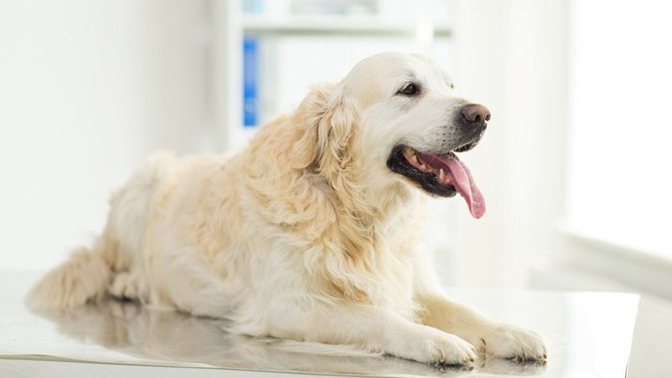
HOW IS IBD DIAGNOSED?
To be called inflammatory bowel disease, the condition must be chronic, infiltrates of inflammatory cells must be present, and other causes of these infiltrates (e.g., cancer, food intolerance, bacterial infections, parasites) have been excluded.
Only definitive way to diagnose inflammatory bowel disease is through a biopsy. This is usually is performed only after other conditions that might be causing the dog’s symptoms, like parasites or organ diseases, are ruled out. The biopsy can reveal the quantity and type of inflammatory cells in the intestinal wall.

Slide 32
Complete blood examination
The results of these routine laboratory tests are often normal. In some patients, anemia and abnormally high number of white blood cells (as in infections) may be present. In dogs with IBD, abnormally levels of proteins and liver enzymes may also be found.

Slide 33
Radiography(X-rays) and Ultrasound
There is no consistent radiological finding in dogs with inflammatory bowel disease. The intestines may appear thickened and there may be more gas than normal in the intestines, but these signs can occur in many conditions.
Routine X-rays are usually normal in these patients. Barium Contrast Studies for a more detailed evaluation. Barium enhances the visibility of organs. It is usually given orally, followed by a series of X-rays as barium moves downward in gastrointestinal tract. Intestine wall abnormalities, like increased thickness, may be visible through barium contrast studies. Similarly, ultrasound can be of help in determining the changes in the intestine wall. More specific testing to rule if any food allergen may be the cause of this condition is conducted. Taking a small tissue sample from the dog's intestine by surgical means can confirm the diagnosis, too.

Slide 34
Biopsy
The biopsy can reveal the quantity and type of inflammatory cells in the intestinal wall. The only definitive way to diagnose inflammatory bowel disease is through a biopsy. The biopsy will demonstrate increased numbers of inflammatory cells in the intestinal wall. The types of cells which are present will denote what type of inflammatory bowel disease is present. Biopsies can be obtained through use of an endoscope or exploratory surgery. The intestines may appear normal to the naked eye, but microscopically the changes can be seen. In other cases, the lesions of the gastrointestinal tract are quite apparent.

Slide 35
HOW IS IBD TREATED?
Antibiotics,if a secondary bacterial infection is suspected
Anti-inflammatory medications, such as steroids (prednisone), and other medications to suppress inflammation
There are three main ways to treat IBD:
Dietary modification, which may include a prescription diet specific for treating IBD
When treating IBD, it is very important to administer all medications prescribed by your veterinarian, as well as to follow any dietary guidelines he/she suggests.

Slide 36
PREVENTION
Since the exact cause of IBD is unknown prevention is difficult. However, feeding a good quality diet as recommended by your veterinarian and avoiding exposure to table scraps, garbage, plants and other foreign material is the best way to minimize gastrointestinal disease in your pet.

Slide 37
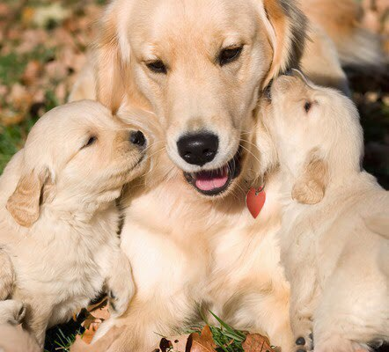
CONCLUSIONS
Canine IBD induced a wide range of changes in metabolic profile, especially for the plasma concentrations of short-chain acylcarnitines and amino acids, which could have evolved from tissue damage and alteration in host metabolism. In addition, dogs with more severe IBD were characterised by a decrease in faecal proportion of Lactobacillus.

Slide 38
REFERENCES:
James F. Zachary DVM PhD-Pathologic Basis of Veterinary Disease Expert Consult, 6e-Mosby (2016)
Pathologic basis of veterinary disease. Fifth edition. James F. Zachary, M. Donald McGavin
https://m.petmd.com/dog/conditions/digestive/cdginflammatoryboweldisease
https://ahdc.vet.cornell.edu/docs/equine-influenza.pdf

Slide 39
Thank you for your attention!

