Slide 1
CANINE PARVOVIRAL ENTERITIS
PATHOMORPHOLOGY III

Slide 2
INDEX
ETIOLOGY
SOURCES OF INFECTION
TRANSMISSION
PATHOGENESIS
SYMPTOMS
PATHOLOGICAL CHANGES
HISTOPATHOLOGY
DIAGNOSIS
TREATMENT
PREVENTION
BIBLIOGRAPHY

Slide 3
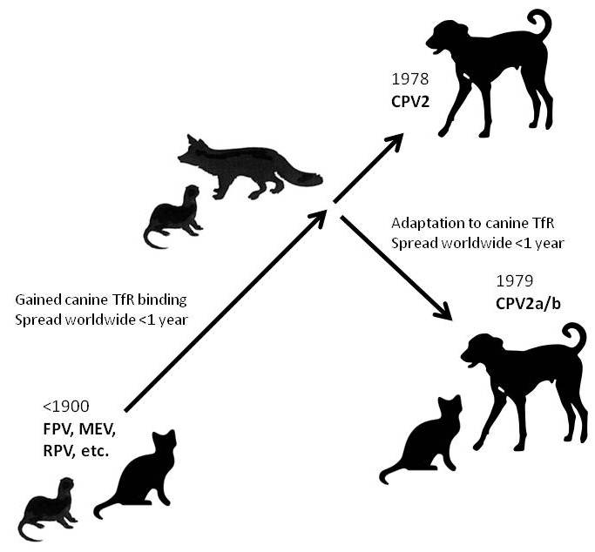
ETIOLOGY
Canine parvovirus type 1: discovered in 1967 and different to type 2. Asymptomatic enteric infection. Also associated with abortions and mortality in puppies.
Canine parvovirus type 2: in 1978 caused outbreaks of diarrhea and sudden deaths.
0RIGIN OF CANINE PARVOVIRUS TYPE 2
CPV is believed to have originated as a host range variant from feline panleucopenia virus (FPV), include a direct mutation from FPV, a mutation from a FPV vaccine virus and the adaptation to the new host dog via non-domestic carnivores, like mink and foxes.

Slide 4
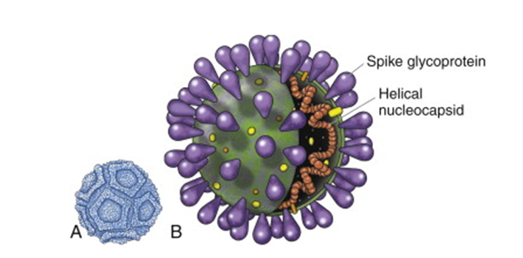
ETIOLOGY
Canine parvovirus type 2 dissapeared in 1981 but variants 2a (1980) and 2b (1984) appeared.
In 2000 the variant 2c was described.
Canine parvovirus 2a, 2b and 2c:
Genus Parovirus
Family Parvoviridae
- CPV-2 has icosahedral symmetry, 25 nm in diameter and nonenveloped with a linear, single stranded DNA genome.
General structure of canine parvovirus.
Structure of coronavirus.

Slide 5
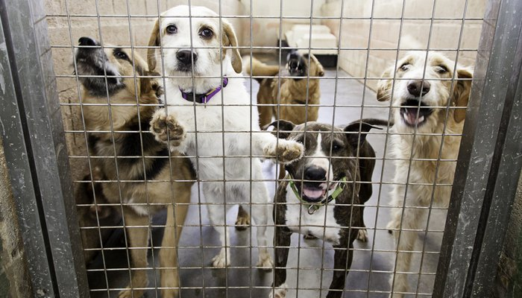
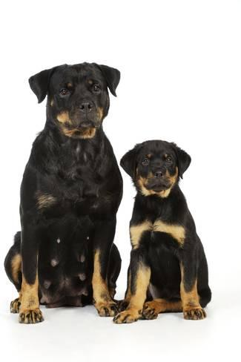
SOURCES OF INFECTION
Canine parvovirus infection occurs worldwide in domestic dogs and other members of the dog family. Incidence is higher in:
animal shelters
pet stores
breeding kennels.
parks ad playgrounds
dog shows
Veterinary hospitals
CPV can affect dogs at any age. Severe infection is most common in puppies between 6 weeks and 4 months old.
All breeds of dogs are susceptible. The crossbreds are less susceptible in comparison to pure breeds like Rottweilers, Doberman Pinchers, English Springer Spaniels and German Shepherd.
CPV affects only dogs, and cannot be transmitted to humans or other species.
All infected dogs may not necessarily exhibit clinical manifestations but they may shed the virus in feces during the acute phase of enteric fever and show significant rise in the serum antibody titers.

Slide 6
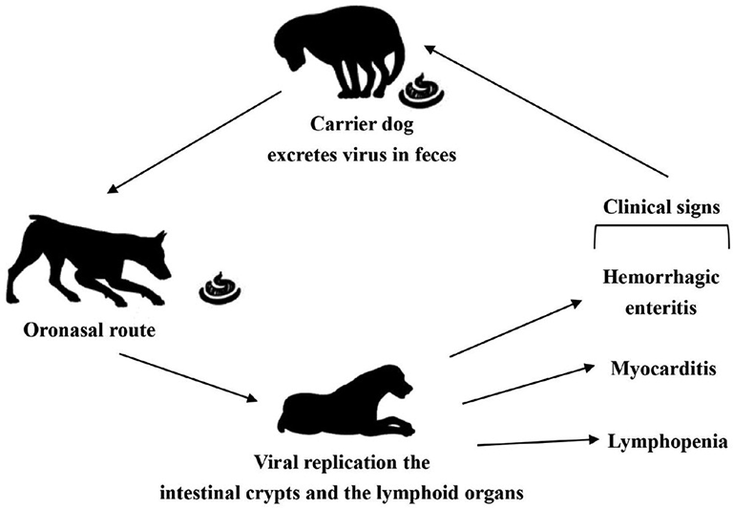
TRANSMISSION
Canine parvovirus spreads through oral contact with infected faeces or contaminated surfaces (e.g., soil, shoes, dog toys etc.). The source of CPV infection is faecal waste from infected dogs.
Dogs that are confined to a house or yard and are not in contact with other dogs have much less chance of exposure to CPV. It’s easily transmitted via the hair or feet of infected dogs and also by contaminated objects such as cages or shoes.
CPV is hardy and can remain in faeces-contaminated ground for 5 months or more if conditions are favorable.

Slide 7
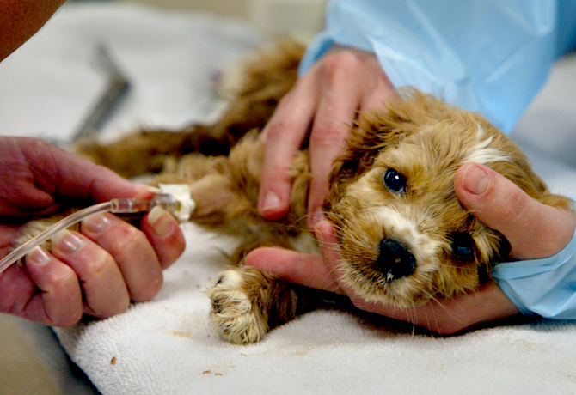
PATHOGENESIS
The virus enters the body through the mouth as the puppy cleans itself or eats food off the ground or floor. There is a 3–7 day incubation period before the puppy seems obviously ill.
Upon entering into the body, it replicates to large numbers in the lymph nodes.
After a couple of days, significant amounts of virus have been released free into the bloodstream.
Over the next 3–4 days, the viruses go to new organs containing the rapidly dividing cells like the bone marrow and the delicate intestinal cells and form large eosinophilic intranuclear inclusion bodies.
Within the bone marrow, the virus is responsible for destruction of young cells of the immune system and then knocking out the body’s best defense mechanism.
The virus causes most devastating effects in the gastro-intestinal tract.
Canine parvoviral infections are characterized by a drop in white blood cell count due to the bone marrow infection.

Slide 8
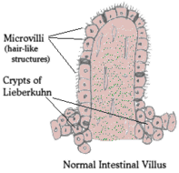
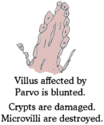
Pathogenesis
It is in the GI tract where the heaviest damage occurs.
The normal intestine possesses little finger-like protrusions called “villi.” To make the surface area available for absorption, the villi possess “microvilli” which are microscopic protrusions. The cells of the villi are relatively short-lived and are readily replaced by new cells. The source of the new cells is the rapidly dividing area at the foot of the villi called the Crypts of Lieberkuhn.
It is right at the crypt where the parvovirus strikes. Without new cells coming from the crypt, the villus becomes blunted and unable to absorb nutrients and diarrhea results.
The barrier separating the digestive bacteria from the blood stream breaks down.
The diarrhea becomes bloody and bacteria can enter the body causing widespread infection.
The virus kills one of two ways:
diarrhea and vomiting lead to extreme fluid loss and dehydration until shock and death result.
loss of the intestinal barrier allows bacterial invasion of potentially the entire body.

Slide 9
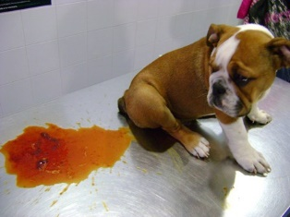
PARVOVIRAL ENTERITIS: SYMPTOMS
Sudden and intensive vomiting.
Loss of appetite.
Depression.
Increase of body temperature.
After 6-48h watery diarrhea, usually with blood.
Loss of weight.
Disorders of the levels of electrolites.
Methabolic acidosis.
Increase in respiratory rate.
Decrease of body temperature (below normal).
Hypoglycemia and hypokalemia- muscular weakness.

Slide 10
PATHOLOGICAL CHANGES
The macroscopic lesions of CPV infection are highly variable and relatively non-specific. In the enteric disease, lesions may be distributed segmentally in the gastrointestinal tract.
The lesions usually affect the jejunum and ileum but not the duodenum and colon.
Affected segments may be somewhat flaccid with subserosal hemorrhage or congestion.
The lumen of the intestine is often empty but may contain variable watery ingesta.
The mucosal surface is often congested but devoid of exudates.
Mesenteric lymph nodes are frequently enlarged and edematous.
Multifocal petechial hemorrhages are often seen within the cortex of a cut section of affected lymph nodes during acute stage of the disease and leucopenia is also common.
Thymic cortical necrosis and atrophy are common findings in young dogs.

Slide 11
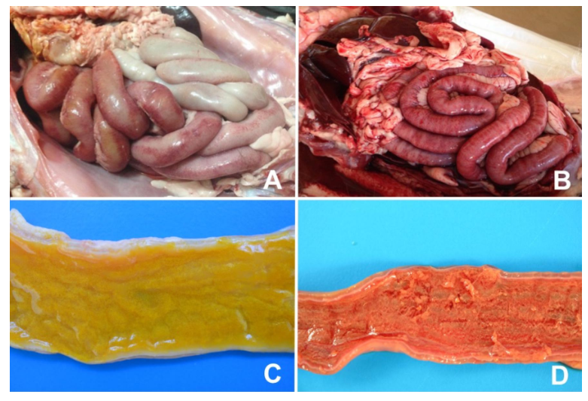
Segmental hiperemia of jejunum.
Diffuse lesions covering all segments of the small intestine.
Yellowish and translucent intestinal content.
Fibrinous plaques.
Segmental subserosal hemorrhage and mild fibrinous exudation on intestinal serosa in CPV-2.

Slide 12
HISTOPATHOLOGY
Microscopic lesions associated with CPV infection are initially confined to areas of proliferating cell population.
In the enteric form of the disease, the early lesions consist of necrosis of the crypt epithelial cells.
Crypt lumenae are often:
Dilated
lined by attenuated epithelium
filled with necrotic debris.
There may be occasional intranuclear eosinophilic inclusion bodies in intact crypt epithelial cells.
The villi and lamina propria may collapse completely as a result of the loss of crypt epithelium and the failure to replace sloughed villous epithelial cells. These lesions may be extensive or diffuse.
Loss of digestive epithelium and absorptive surface area presumably results in diarrhoea caused by combined effect of maldigestion and malabsorption.
Necrosis and depletion of small lymphocytes is seen in Peyer’s patches, the germinal centers of mesentric lymph nodes, and in splenic nodules early in the course of infection.
Diffuse cortical necrosis of the thymus occurs in young dogs, with an associated loss in thymic mass.
Later in the disease, there is evidence of regenerative lymphoid hyperplasia.
The regeneration of intestinal epithelial cells has been reported even in fatal cases. The remaining intestinal crypts are elongated and lined by hyperplastic epithelium with a high mitotic index.
The shortened villi are covered by immature epithelial cells and adjacent villi are often fused.

Slide 13
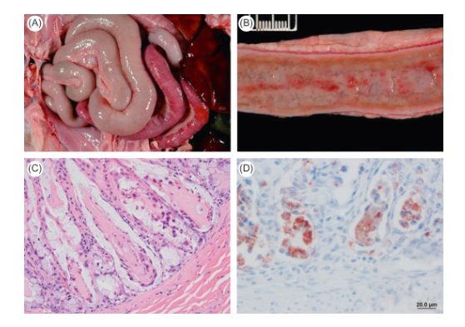
CPV-2 infection in a dog: Loss and dilatation of crypts of Lieberkühn and collapse of propial stroma in small intestine. Remnants of crypt lining epithelium persist Deep in lamina propia.
Serosal hemorrhage.
Mucosal hemorrhage.
Crypt necrosis.
Immunohistochemical staining of parvovirus antigens in crypt epithelium.

Slide 14
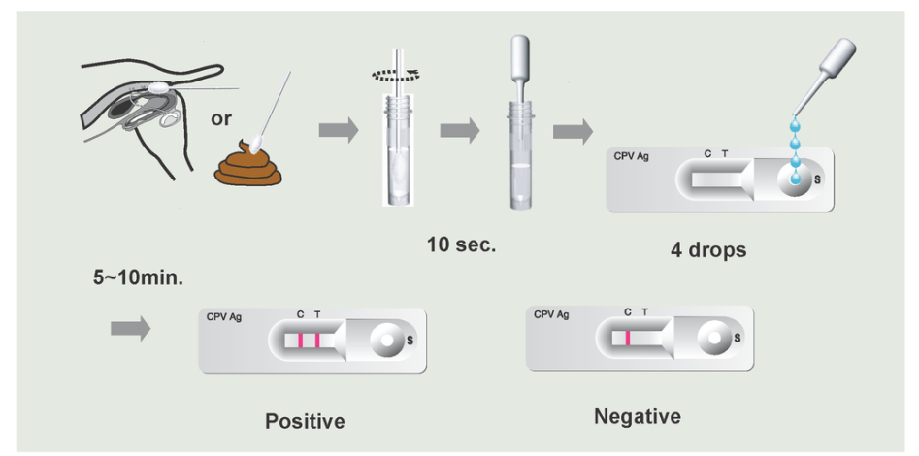
DIAGNOSIS
A presumptive diagnosis of CPV enteritis can be made based on the clinical signs such as depression, vomiting, diarrhoea, anorexia and fever.
The tests should be done in any dog with diarrhoea that is also exhibiting signs of systemic disease:
Lethargy
Vomiting
Fever
loss of appetite
dehydration
unusually copious, smelly/bloody diarrhea
any dog with known exposure to parvovirus within the preceding 14 days of developing diarrhoea.
The diagnostic tests include:
HA (Haemagglutination)
Electron Microscopy (EM)
virus isolation using in MDCK, CRFK or A 72 cell line
Enzyme Linked Immunosorbent Assay (ELISA)
Latex Agglutination Test (LAT)
Fluorescent Antibody Test (FAT)
CIE test
Virus neutralization test
PCR and RE digestion
Real time PCR
Loop-mediated isothermal amplification (LAMP), nucleic acid hybridization or dot blot, in situ hybridization, nucleic acid sequencing etc.
They have varying degree of sensitivity and specificity and sometimes yielding false positive cases.

Slide 15
TREATMENT
NO SPECIFIC ANTIVIRAL AGENTS ARE APPROVED FOR TREATING CPV-INFECTION.
Treatment of CPV-2 infection mainly consists of supportive care:
The restoration of fluid volumen and electrolyte balance is very important, especially in puppies that had severe vomiting and diarrhoea and that present in hypovolemic shock.
The largest posible intravenous carheter should be placed, IV fluids should be started immediately.
Fluid deficits may be replaced in the first 1 or 2 hours to help prevent further deterioration of the patient’s condition as well as death.
The patient’s temperature should be monitored closely during administration of a fluid bolus.
Vomiting and diarrhoea can cause a large loss of GI protein.
This can lead to a decrease in plasma colloid oncotic pressure (COP), and fluif resuscitation reduces the COP even more.
When the COP decreases fluid leaks into the intestinal space causing EDEMA.

Slide 17
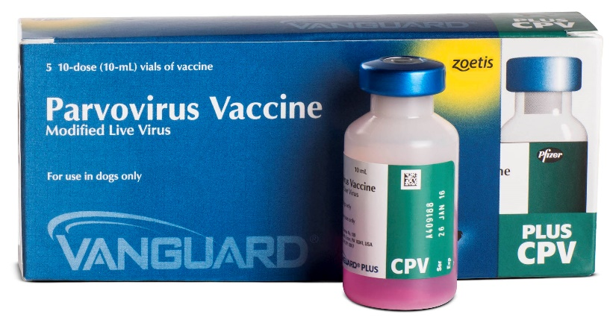
PREVENTION
The most effective prevention of CPV-2 infection is IMMUNIZATION.
The age at which immunization is most effective depends on several factors, including the antibody titer of the bitch and the immunogenicity and antigen titer of the vaccine.
Interference by maternal antibodies is the main reason for vaccine failure.
Puppies from a bitch with low antibody titer can be effectively immunized at 6 weeks of age, whereas vaccination of puppies from a bitch with a high titer should be delayed because the maternal antibodies may persist.
If the immune status of the puppies is unknown, they can be vaccinated with a high-titer, attenuated live CPV-2 vaccine at 6, 9 and 12 weeks of age, followed by anual revaccination.
Antibody titers can be checked before revaccination. The titer level verifies immunologic response to infection but does not guarantee protection against infection.

Slide 18
BIBLIOGRAPHY
Canine parvoviral enteritis: an update on the clinical diagnosis, treatment, and prevention. Mathios E Mylonakis, Iris Kalli, Timoleon S Rallis.
Companion Animal Clinic, School of Veterinary Medicine, Faculty of Health Sciences, Aristotle University of Thessaloniki, Thessaloniki, Greece.
Canine Parvovirus: vetlearn.com
Epidemiological, clinical and pathological features of canine parvovirus 2c infection in dogs from southern Brazil- Pablo S.B. de Oliveira, Juliana F. Cargnelutti2, Eduardo K. Masuda, Rafael A. Fighera, Glaucia D. Kommers, Marcia C. da Silva4, Rudi Weiblen2 and Eduardo F. Flores.
Canine Parvovirus: Current Perspective S. Nandi, Manoj Kumar.
Vaccination of dogs with canine parvovirus type 2b (CPV-2b) induces neutralising antibody responses to CPV-2a and CPV-2c. Wilson S, Illambas J, Siedek E, Stirling C, Thomas A, Plevová E, Sture G, Salt J.
https://www.intechopen.com/books/canine-medicine-recent-topics-and-advanced-research/canine-parvovirus-type-2
http://www.scielo.br/scielo.php?script=sci_arttext&pid=S0100-736X2018000100113

