Slide 1
Caprine pox

Slide 2
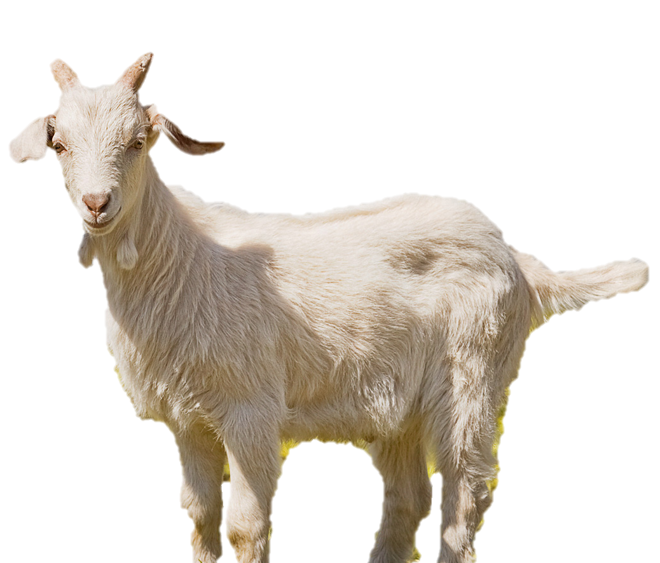
INTRODUCTION
Goat pox is a contagious viral disease, also known as variola caprina. The virus is spread by the respiratory route and is most likely to occur with crowding and gathering of stock. Virus in dried scabs can be infective for up to 6 months. In susceptible populations mortality may be high among young animals, in some cases up to 100%.

Slide 3
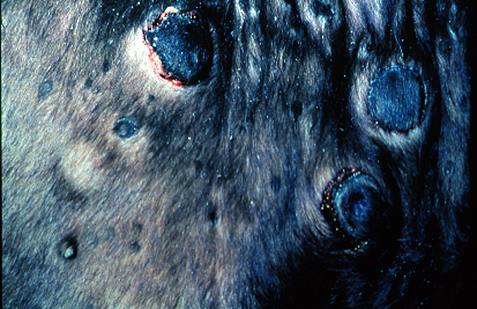
ANIMAL TRANSMITION
Close contact
Fomites
Inahalation of aerosols
Infectious virus present in all secretions, excretions, and scabs
Abraded skin
Insects
(mechanical)

Slide 4
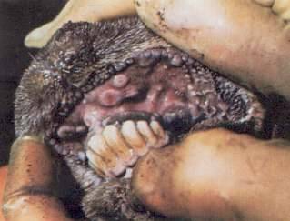
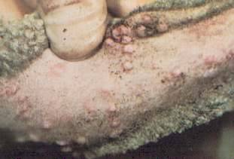
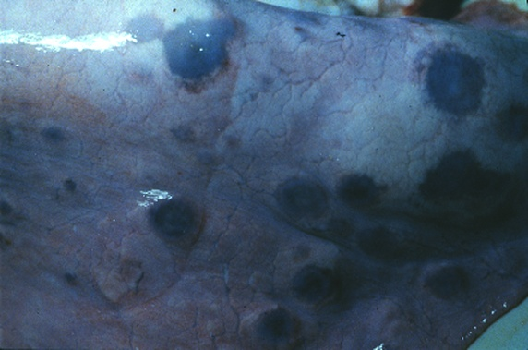
CLINICAL SIGNS
Incubation period
Usually 1 to 2 weeks
Fever
Depression
Lungs lesion can cause dyspnea
Followed by erythematous macules that develop into hard papules forming dark, hard scabs.
Skin lesions may cover body or be retricted to axila, perineum and groin, ears or tail.

Slide 5
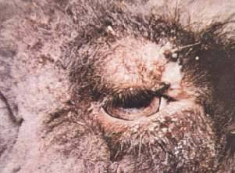
CLINICAL SIGNS
All ages of goats can be affected, however, disease is more severe in young animals
Death may occur at any stage of the disease.
The mucous membranes can become necrotic, and animals may develop a mucopurulent nasal or ocular discharge
Conjunctivis
Rhinitis
Anorexia

Slide 6
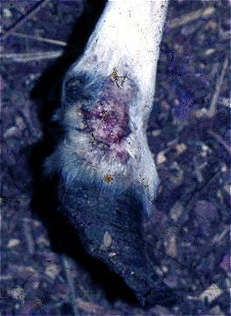
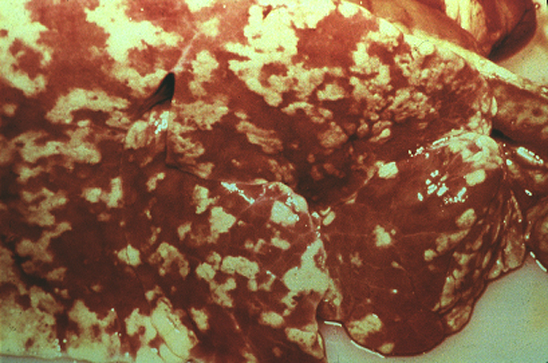
POST MORTEM LESION
Skin macules and papules, with areas of edema, hemorrhage,congestion, necrosis and vasculitis
Papules penetrates through the dermis and epidermis; in severe cases they may extend into the musculature
Mucous membranes of eye, nose, mouth, vulva and prepuce may be necrotic or ulcerated
Abomasal mucosa, rumen and large intestine may also be affected
Lungs often contain disceted congested or edematous or hard white nodules
The lymph nodes are usually swollen

Slide 7
DIAGNOSIS
Clinical
Suspect in animals with characteric skin lesions, fever and lymphadenitis
Laboratory
Virus isolation, electron microscopy
PCR
Viral antigen detection
Serology
Characteristic histopathologic lesions

Slide 8
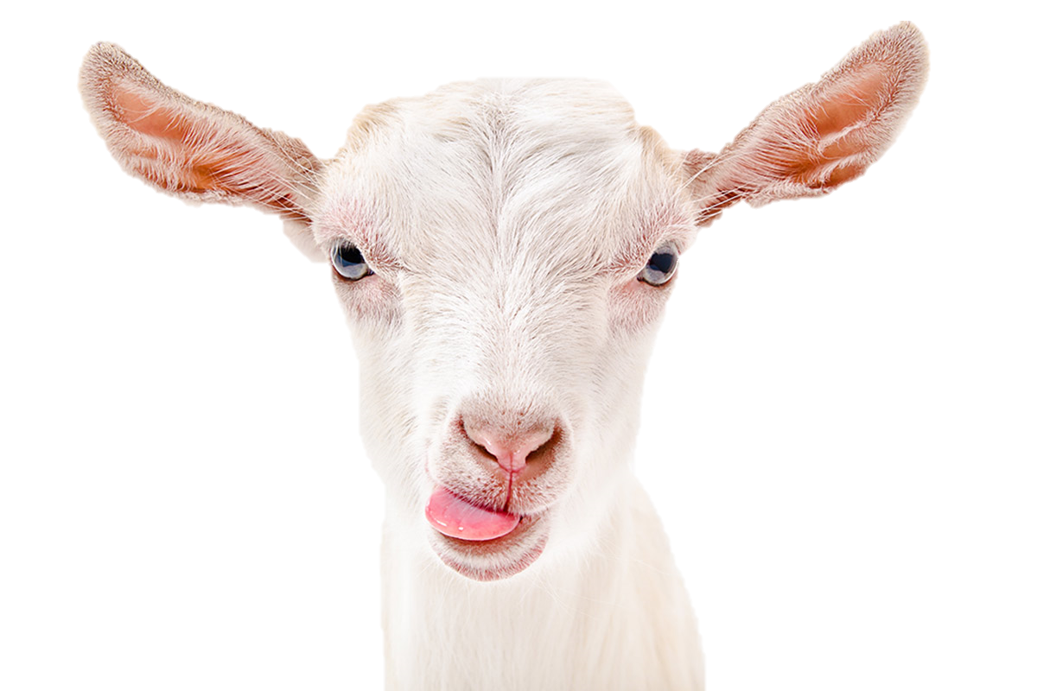
DIFFERENTIAL DIAGNOSIS
Contagious exthyma
Bluetongue
Mycotic dermatitis
Mange
Caseous lymphadenitis
Parasitic pneumonia

Slide 9
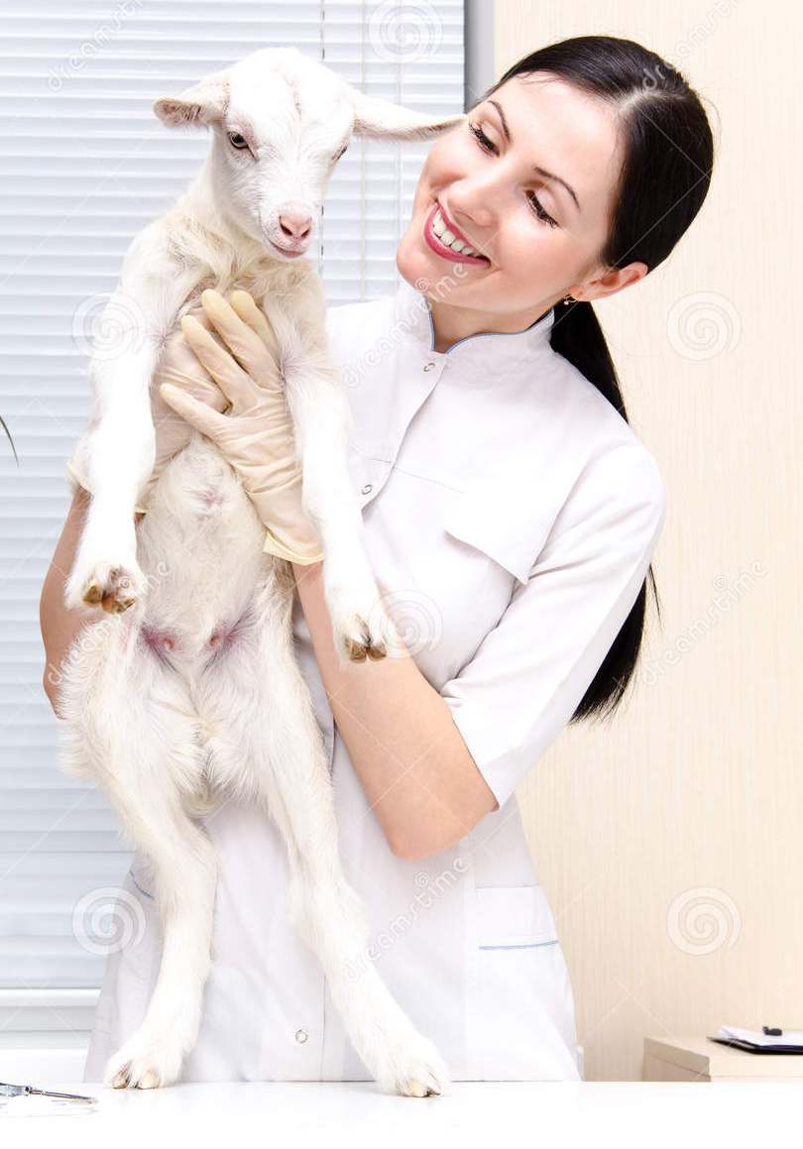
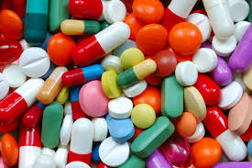
TREATMENT
Antibiotics for secondary infection
Good nursing care

Slide 10
CONTROL AND PREVENTION
Sanitary prophylaxis
Slaughtering of infected herd if posible
Medical prophylaxis
Inactives vaccines give, at best, only short-term immunity
Proper disposal of cadavers and products
Quarantine of new animals before introduction into herds
No recombinant vaccines for capripoxviruses are commercially available
There are several attenuated virus vaccines delivered by subcutaneorus or intradermal route; conferred immunity lasts up to 2 years.

