Slide 1
Colitis X Equine

Slide 2
Colitis X
Colitis X is an acute fulminant disease of horses that occurs sporadically is characterized by:
Abdominal pain
Severe watery to hemorrhagic diarrhea
Dehydration
Electrolyte imbalances
Toxic shock
Usually diagnosed postmortem
Is often fatal
Etiology is likely multifactorial
Causative organism → has not been definitively identified

Slide 3
What we should do...?
History Clinical signs
Postmortem Findings
1. Necropsy
2. Microscopical examination
3. Laboratory tests
Exclusion of other causes
Peracute Salmonellosis
Clostridium Perfringens type C
Clostridium difficile enterocolitis
Oclussive verminous arteritis
Aeromonas Spp colitis
Coronavirus
Toxicology
Differential Diagnosis

Slide 4
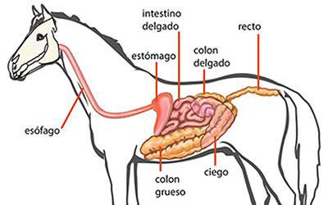
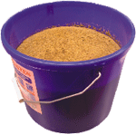
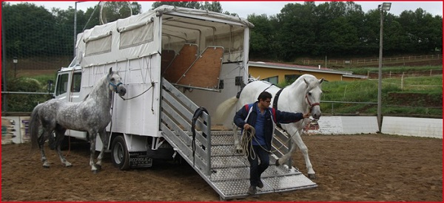
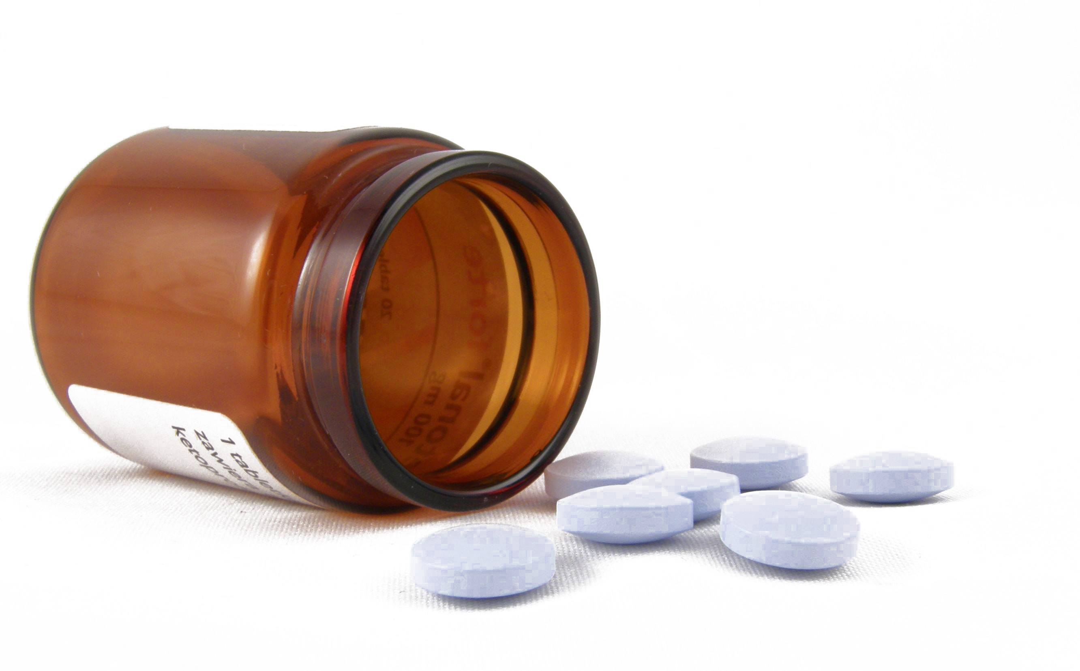
Factors affecting disease
Age – hipomotility -
Immunocompetence
Diet→ high Protein- Low cellulose diets
STRESS
Transport
Concurrent illness
Surgery
Antimicrobial Therapy
-tetracyclines- lyncomycin- erythromycin
→ predisposition

Slide 5
Clinical Signs
SIMILAR to other forms of acute-preacute colitis
Marked depression
Abdominal pain
Signs relating to hypovolaemic or endotoxic shock
Congested, muddy, cyanotic mucous membranes
prolonged capillary refill time
cold extremities
Weak and thread peripheral pulses + peripheral vasoconstriction
Tachycardia (> 100 bpm) + Tachypnea
Acute onset watery to haemorrhagic diarrhea?→Dehydration
Dilated pupils
Collapse
Temperature → pyrexic to subnormal
Borborygmi are absent + abdominal tympany may be heard on percussion
Rectal examination → often normal
Rapid onset of weakness, staggeringm and trembling commonly precedes death .
DEATH in
4-24h!!
Notes:
Borborygmi are usually absent and abdominal tympany may be heard on percussion, secondary to ileus.
Moderateto- severe colic may accompany ileus. Severe diarrhea may accur, but death may occur before diarrhea is evident.
Multiorgan failure from DIC is not unusual.
Rapid onset of weakness, staggering, and trembling commonly precedes death. The syndrome may cause death in 4 to 24 Hours.

Slide 6
Adults → dissorder of colon
Acute onset watery to haemorrhagic diarrhea
– water
- electrolytes
- Plasma Proteins
Systemic and local → inflamatory Respones
COLITIS
Diarrhea
Afection cardio-pulmonary function
Coagulopathy
Activation of Cascade of mediators of inflammation
SEPTICEMIA

Slide 7
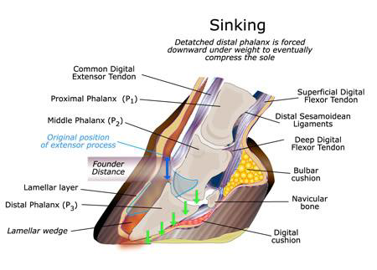
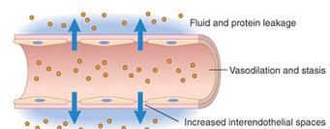
Complications
Sepsis
Permeability alteration
- petechia -Ecchymosis -Hemorrhages
Colonitation of the organs by bactery
Endotoxemy
CID
Immunosupression
Infart of colon
Thrombosis (yugular)
Lameness

Slide 8
Blood analysis
HEMATOLOGIC ABNORMALITIES
Severe neutropenia
Leukopenia
Thrombocytopenia
Ht (%) + PT (gr/dl)
SEVERE COAGULOPATHIES ARE COMMON:
Prolonged coagulation times
Elevated fibrinogen
Decreased antithrombin III activity
Elevated plasma concentration of fibrin degradation products
SERUM BIOCHEMICAL ALTERATIONS:
Hypokalemia
Hypocalcemia
Severe metabolic acidosis
HEPATIC ALTERATIONS:
Hepatocellular enzyme activity may be elevated in the serum from endotoxemia
RENAL ALTERATION.
BUN and creatininne → Elevated form prerenal or renal azotemia.
Acute renal failure accompanies → hyperkalemia may result

Slide 9
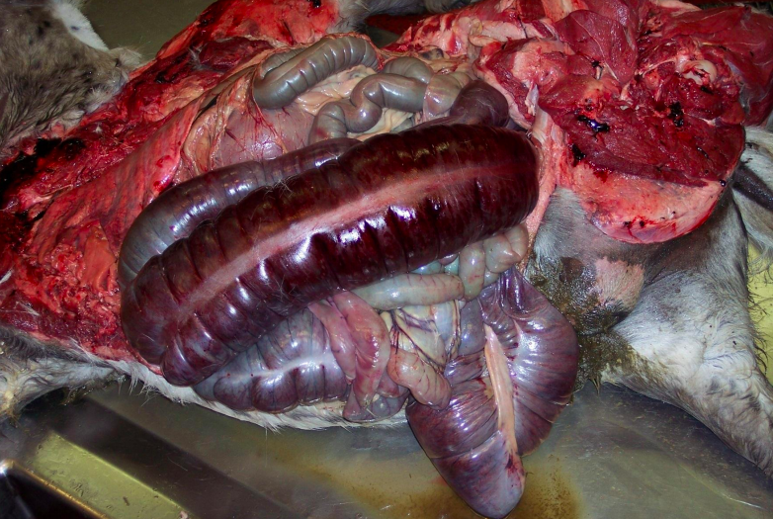
Etiology? Hypothesis…
The search for a microbial etiologic component has focused on…
Clostridim perfringens type C
Clostridium difficile
Salmonella sp.
Similars injuries
Definitive diagnosis??
History
Epidemiology
Clinical symptoms
Macro/ micro injures

Slide 10
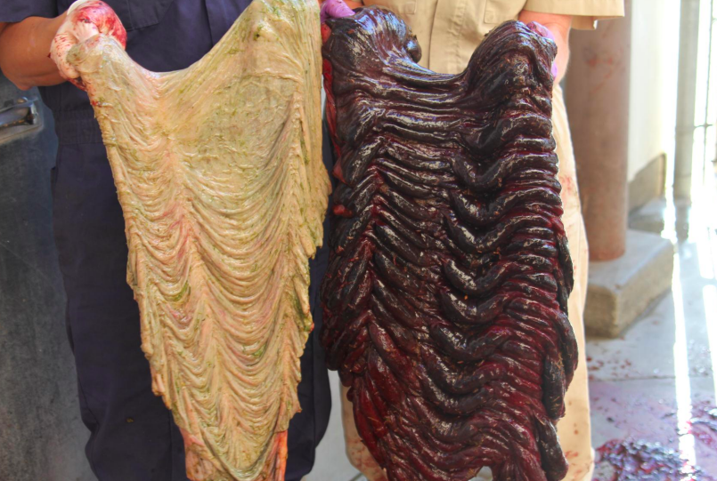
Necropsy- Postmortem Diagnosis
Cecal and colonic mucosal edema and hemorrhagic necrosis
Thinckening of the intestinal wall
Watery to bloody intestinal contents
Disseminated intravascular coagulation
Colonic mucosal necrosis
Anarchic multiplication of bacteria in devitalized intestinal segments are seen microscopically and are considered pathognomonic.
Samples for diagnosis:
-Intestinal tissues
- Colonic and cecal contents
Notes:
Colitis x is a diagnosis of exclusion. The above examination findings may be reported combined with an increased plasma urea concentration (greater than 10 mmol/l), increased PCV, leucopaenia, metabolic acidosis, hypokalaemia and hyponatraemia.
Diagnosis is often made post-mortem, where a hyperaemic or oedematous caecum and ventral colon may be seen with necrosis of the intestinal in the later stages of the disease.
Numerous gram negative bacteria may be identified in the mucosa and submucosa. The intestinal tract may be filled with a foul smelling and watery content. Macroscopic and microscopic findings include signs of disseminated intravascular coagulation and large numbers of bacteria in the devitalized parts of the intestine. A green diphtheritic membrane may cover the mucosal surface.
Treatment

Slide 11
Microscopical examination- Postmortem Diagnosis
Colonical edematous submucosa separation of the tissues
Infiltration of primarily monnonuclear inflammatory cells Trhoughout the submucosa
Vascular congestion is common throughtout the colonical tissue
Hemorrhages Focals
Diffuse and extensive
Numerous large Gram + were observed on the mucosa
extendign in the lamina propia
Multiplication of bacteria in devitalized intestinal segments are considered pathognomonic.
Samples for diagnosis:
-Intestinal tissues
- Colonic and cecal contents
Notes:
Colitis x is a diagnosis of exclusion. The above examination findings may be reported combined with an increased plasma urea concentration (greater than 10 mmol/l), increased PCV, leucopaenia, metabolic acidosis, hypokalaemia and hyponatraemia.
Diagnosis is often made post-mortem, where a hyperaemic or oedematous caecum and ventral colon may be seen with necrosis of the intestinal in the later stages of the disease.
Numerous gram negative bacteria may be identified in the mucosa and submucosa. The intestinal tract may be filled with a foul smelling and watery content. Macroscopic and microscopic findings include signs of disseminated intravascular coagulation and large numbers of bacteria in the devitalized parts of the intestine. A green diphtheritic membrane may cover the mucosal surface.
Treatment

Slide 12
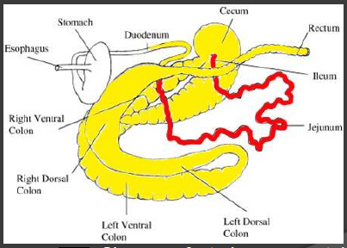
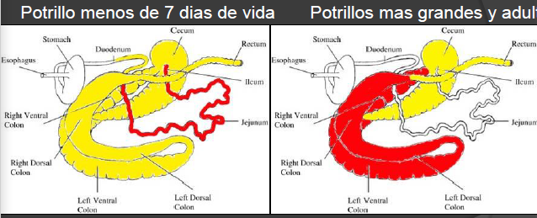
Pathology
Pathology of Clostridium Perfringens C:
History of GI disease + acute death
Positive: ELISA test for CPB toxin
Negative: TcdA and TcdB, culture or Salmonella PCR
Pathology of Clostridium Difficile:
History of GI disease + acute death
Positive: ELISA test for A and B
Negative: CPB toxin, culture or Salmonella PCR
Always injured
Sometimes injured → Focal or difusse

Slide 13
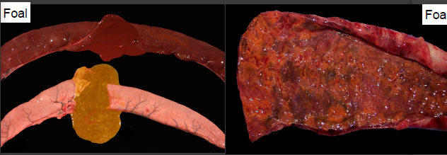
Pathology –C.Perfringens C:
Cecal and colonic mucosal edema and hemorrhagic necrosis
Thinckening of the intestinal wall
Watery to bloody intestinal contents
DIC
Colonic mucosal necrosis
Anarchic multiplication of bacteria in devitalized intestinal segments are seen microscopically and are considered pathognomonic.

Slide 14
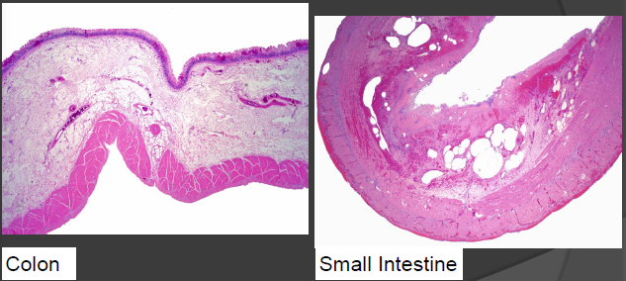
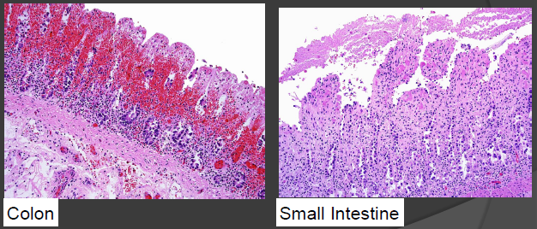
Pathology -Clostridium Perfringens C:
Colonical edematous submucosa
Infiltration of primarily monnonuclear inflammatory cells→ Trhoughout the submucosa
Vascular congestion is common throughtout the colonical tissue
Hemorrhages Focals
Diffuse and extensive
Numerous large Gram were observed on the mucose and extendign in the lamina propia

Slide 15
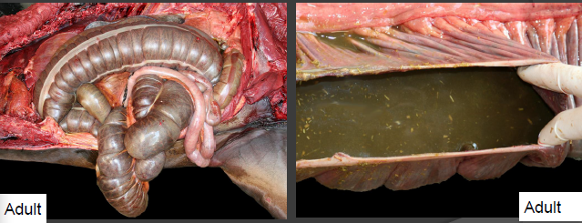
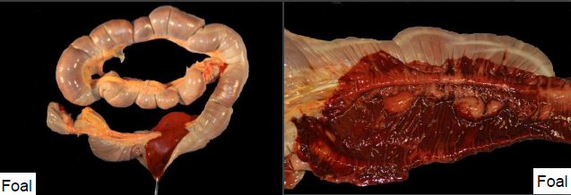
Pathology –C.Difficile
Cecal and colonic mucosal edema and hemorrhagic necrosis
Thinckening of the intestinal wall
Watery to bloody intestinal contents
DIC
Colonic mucosal necrosis
Anarchic multiplication of bacteria in devitalized intestinal segments are seen microscopically and are considered pathognomonic.

Slide 16
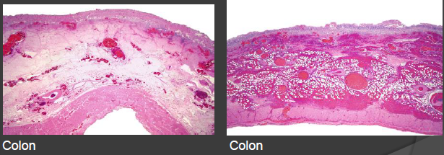
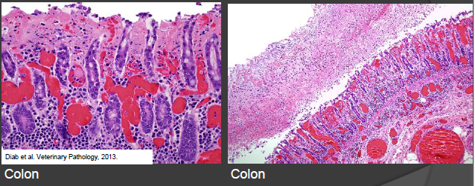
Pathology -Clostridium Difficile
Colonical edematous submucosa
Infiltration of primarily monnonuclear inflammatory cells→ Trhoughout the submucosa
Vascular congestion is common throughtout the colonical tissue
Hemorrhages Focals
Diffuse and extensive
Numerous large Gram were observed on the mucose and extendign in the lamina propia

Slide 17
Pathology -Clostridium Difficile -Clostridum Perfringens type C
Macro/micro injured are too similiar
Epidemiology
Clinical Symptoms
Pathology injures
C. Difficile and C.Perfringens type C → CAN NOT be differenced only by →
Intestinal conten:
C. Difficile Tcd A/B toxin ELISA
Cperfringens type C toxins ( CPA, CPB,ETX) → ELISA
Small intestine, colon
Aerobic and anaerobic Culture
C.Difficile Culture
Salmonella culture and/or PCR
Definitive LABORATORIAL Diagnosis

Slide 18
Laboratory tests-Postmortem Diagnosis
Diagnosis Critery C. Perfringens Type C
Diagnosis Critery C.Difficile
CPB | CULTURE | RESULT
Positive | Positive | Positive
Positive | Negative | Positive
Negative | Positive | Genotyping
Toxine A/B | CULTURE | RESULT
Positive | Positive | Positive
Positive | Negative | Positive
Negative | Positive | Very suggestive
COMBINED INFECTION
Notes:
Colitis x is a diagnosis of exclusion. The above examination findings may be reported combined with an increased plasma urea concentration (greater than 10 mmol/l), increased PCV, leucopaenia, metabolic acidosis, hypokalaemia and hyponatraemia.
Diagnosis is often made post-mortem, where a hyperaemic or oedematous caecum and ventral colon may be seen with necrosis of the intestinal in the later stages of the disease.
Colonical edematous submucosa → separation of the tissues
Infiltration of primarily monnonuclear inflammatory cells
Trhoughout the submucosa
Vascular congestion is common throughtout the colonical tissue
Hemorrhages → Focals
→ diffuse and extensive
Numerous large Gram + were observed on the mucosa
extendign in the lamina propia
Numerous gram negative bacteria may be identified in the mucosa and submucosa. The intestinal tract may be filled with a foul smelling and watery content. Macroscopic and microscopic findings include signs of disseminated intravascular coagulation and large numbers of bacteria in the devitalized parts of the intestine. A green diphtheritic membrane may cover the mucosal surface.
Treatment

Slide 19
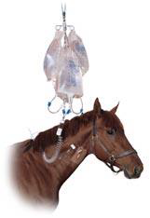
Treatment
Similar to the other forms of colitis
Often unsucceful → rapidly progressive natures of the syndrome
Inmediatly!!!!
Supportive care
Steps:
Replace water losses, electrolyte losses and acid-basics problems
Control of mural inflammation and fluid secretion
Control of endotoxemia and sepsis
Recovery of normal GI floraControl of complications

Slide 20
Treatment
Blood analysis
Replace water losses, electrolyte losses and acid-basics problems
Fluidotherapy + cardiovascular support
Value necesity of the pacient→ DH? ( HT,PT,K+;Na)
Large volumes of IV Fluid !!!→ DH
Fluidotherapy IV
Isotonic solution RL or SSF
K+ (20-30 mmol/L)
Ca (125 ml borogluconato of calcioum) 23%/ 5L)
progressive correction
nerve injury
Hiponatremia + several DH
1-2L /20-30 min saline hipertonic solution Post: Saline Isotonic solution
Hipernatremia + several DH
Dextrosa
Notes:
If the Htc is 50 → probably is gonna dead for oxygenation defect → isotonics:
o Ringer lactacto → if the K is OK o Cloruro potásico + Ringer si está hipokalémico. o Si las PT son bajas, pongo plasma. o Glucosalino si la glucosa está baja. o Es decir, debemos ir mirando qué análisis tenemos y decidir así la fluidoterapia

Slide 21
Treatment
Blood analysis
Hipoproteinemia <4-5 g/dl
Plasma-therapy 6-8 L
Proteins: hipoproteinemia correction
Coagulation factors ↓ Coagulophaty risk
Problems Economic
Another animal: Tests
Synthetic Coloids
Hyperinmune Plasma
Glucose
Large volume of Fluid!!!
↑Volumen ↓Proteins
SECONDARY EDEMA
IV Fluidotherapy → BASIC
Attention to the catheter→ tromboflevitis
Notes:
If the Htc is 50 → probably is gonna dead for oxygenation defect → isotonics:
o Ringer lactacto → if the K is OK o Cloruro potásico + Ringer si está hipokalémico. o Si las PT son bajas, pongo plasma. o Glucosalino si la glucosa está baja. o Es decir, debemos ir mirando qué análisis tenemos y decidir así la fluidoterapia

Slide 22
Treatment
Blood analysis
2. Control of mural inflammation and fluid secretion
Additional analgesic → Abdominal Pain
Flunixin
Dipirona
Detomindina
Xylazine
Romifidina
Buthorphanol
Morfina, metadona, fentanil, meperidina
Bromuro de hioscina
Combination of bowh or other narcotic
AINE – Fluixine Meglumine
Antiendotox 0,25 mg/kg
Analgesic 1,1 mg/kg
Attention: nephrogenic + ulcerogenic
After the Rehidratation: DMSO
0,1 – 1 g/kg IV → 12-24h
Efficacy has not been demonstrated
Notes:
If the Htc is 50 → probably is gonna dead for oxygenation defect → isotonics:
o Ringer lactacto → if the K is OK o Cloruro potásico + Ringer si está hipokalémico. o Si las PT son bajas, pongo plasma. o Glucosalino si la glucosa está baja. o Es decir, debemos ir mirando qué análisis tenemos y decidir así la fluidoterapia

Slide 23
Treatment
Blood analysis
3. Control of Endotoxemy and sepsis
AINE – Fluixine Meglumine IV
Antiendotox 0,25 mg/kg
Analgesic 1,1 mg/kg
Helps in secondary lameness
Inhibits the synthesis of eicosanoids
Attention: nephrogenic + ulcerogenic
Antibiotic
Polimixina B IV
6000 UI/kg
Antibiotic → they bind with toxins preventing their action in the cell
Penicilin IV : 20-40000 UI /kg
Gentamicine 6,6 mg/kg - nephrotoxigenic
Metronidazol IV 15-30 mg/kg → anaerobic bacteria
Salmonella→ Rsistence→ Sulfamides + trimetropin or cefalosporine 3º generation
Notes:
If the Htc is 50 → probably is gonna dead for oxygenation defect → isotonics:
o Ringer lactacto → if the K is OK o Cloruro potásico + Ringer si está hipokalémico. o Si las PT son bajas, pongo plasma. o Glucosalino si la glucosa está baja. o Es decir, debemos ir mirando qué análisis tenemos y decidir así la fluidoterapia

Slide 24
Treatment
Blood analysis
4. Control of CID
It is recommended before the hemorrhage
Heparine 20-80 UI/kg IV →Prenvents vascular thrombosis
only usefull when [Trombina III]
Aspirine low dose
Plasma-theraphy → coagulation factors
5. Recovery of normal GI floraControl of complications
Probiotics
6. Control of lameness
Notes:
If the Htc is 50 → probably is gonna dead for oxygenation defect → isotonics:
o Ringer lactacto → if the K is OK o Cloruro potásico + Ringer si está hipokalémico. o Si las PT son bajas, pongo plasma. o Glucosalino si la glucosa está baja. o Es decir, debemos ir mirando qué análisis tenemos y decidir así la fluidoterapia

Slide 25
Thanks for your attention!!!

