Slide 1
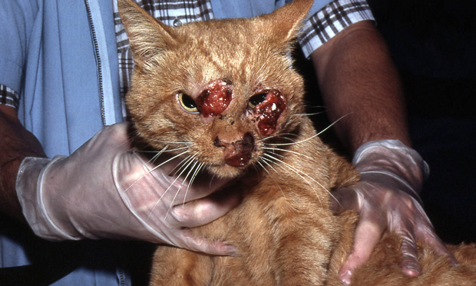
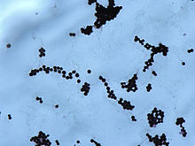
CRYPTOCOCCOSIS
PATHOMORPHOLOGY II
UWM 2019

Slide 2
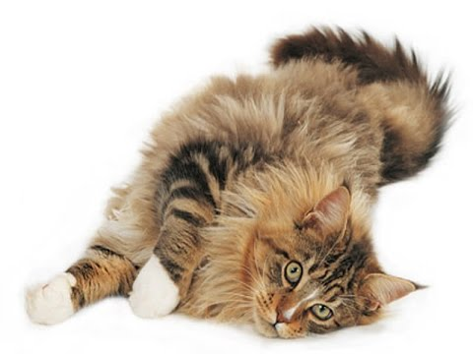
INDEX
AETIOLOGICAL AGENT
EPIDEMIOLOGY
SPECIES AFFECTED
TRANSMISSION
PATHOGENESIS
CLINICALS SIGNS
CATS
DOGS
OTHER SPECIES
MACROSCOPIC LESIONS
HISTOPATHOLOGY
DIAGNOSIS
TREATMENT
PREVENTION AND CONTROL
BIBLIOGRAPHY

Slide 3
AETIOLOGICAL AGENT
Cryptococcosis is nearly always caused by Cryptococcus neoformans:
Division Basidiomycota
Encapsulated yeast.
Four serotypes based on capsular antigens: A, B, C and D.
Three varieties:
C. neoformans var neoformans
C. neoformans var gattii
C. laurentii
C. neoformans var neoformans | C. neoformans var gattii | C. laurentii
Serotypes A and D Ubiquitous Causes most cases of cryptococcosis in humans, especially in immunocompromised cases. | Serotypes B and C Less common in environment Mostly in immunocompetent hosts | Rarely causes disease in humans Immunocompromised hosts
Cryptococcus species other than C. neoformans are, with rare exceptions, considered to be saprophytic and nonpathogenic.

Slide 4
EPIDEMIOLOGY AND IMPORTANCE
C. neoformans var neoformans:
Found worldwide in the soil
C. neoformans var gattii:
Found around eucalyptus trees in tropical and sub-tropical areas including Australia, California and parts of South and Central America.
IMPORTANCE OF CRYPTOCOCCOSIS
C. neoformans and C. gattii are very common in some environments BUT most people and animals do not become ill after exposure.
In a minority of cases, however, fungal infections become symptomatic in:
the respiratory tract
central nervous system (CNS)
Other organs.
Some infections are contained but not eliminated by the immune system, and can recur later in life.
Cryptococcosis is sometimes fatal despite treatment.

Slide 5
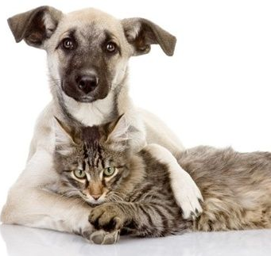
SPECIES AFFECTED
Clinical cryptococcosis is most often found in cats.
Outbreaks of cryptococcal mastitis and pneumonia have been described in cattle.
Clinical cases have also been reported in dogs, ferrets, guinea pigs, horses, sheep, goats, pigs, llamas, foxes, mink, cheetahs, gazelles, koalas, wallabies, porpoises, non-human primates and other animals.
C. neoformans can be isolated from asymptomatic mammals.
C. neoformans can be found in the feces of birds. The presence of this organism in the feces can be due to a transient asymptomatic intestinal infection, or to the inoculation of the feces with organisms carried on the beaks or feet. Clinical infections in birds are very rare.
Cats
Cattle
Dogs
Ferrets
Guinea Pigs
Horses
Sheep
Goats
Llamas
Foxes
Mink
Cheetahs
Gazelles
Koalas
Wallabies
Porpoises
Non-human Primates
Humans

Slide 6
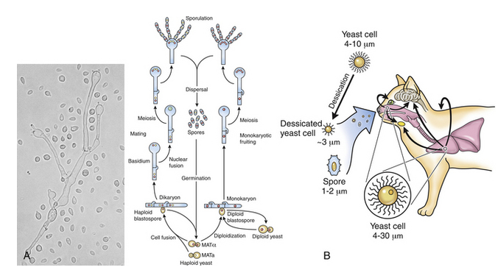
TRANSMISSION
Inhalation
Via environment
Reactivation of latent infection
Fomites
Mastitis in cattle
Contaminated syringes, cannulas, antibiotic preparations.
It can also enter the mammary gland if not cleaned adequately before treatment.
Animal-to-human and human-to-human transmission very rare

Slide 7
PATHOGENESIS
Cryptococcus is primarily an airborne pathogen, and the nasal cavity is usually the primary site of infection in cats and dogs.
In most cases there is only a subclinical colonization without the invasion of the epithelium.
When invasion of mucosal tissues occurs, progression to disease occurs locally and/or systemically.
In both people and cats, the infection may follow ingestion of desiccated yeast cells or, more rarely, cutaneous inoculation of fungal forms.
The incubation period varies from months to years, and the source of infection often remains unknown.
The virulence (genotype) of the inhaled organisms influence the outcome of infection.
From the upper respiratory tract the infection may spread locally to the CNS through the ethmoid bone, and rarely also to the lower respiratory tract or systemically.
There are temperature-sensitive strains which are unable to grow at temperatures > 37.0°C and may cause infections only at body sites where the temperature is lower (skin, nose, scrotum).
Antibodies produced against capsular antigens are not protective.
Persistent infections can occur because the capsule of Cryptococcus yeast forms inhibits phagocytosis, and other virulence factors such as melanin production protects the yeast cells from oxidative damage.
It is able to survive inside phagocytic cells such as macrophages and neutrophils and can be disseminated with these cells.

Slide 8
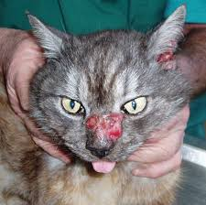
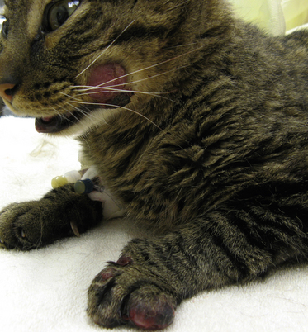
CLINICAL SIGNS IN CATS
Upper respiratory disease (unilateral or bilateral chronic rhinitis or sinusitis) is the most common form of cryptococcosis in cats. The symptoms may include:
Sneezing, snoring or snorting, dyspnea, mucopurulent or serosanguineous nasal discharge, Polyp-like masses may protrude from one or both nostrils, pulmonary symptoms are uncommon.
Cats affected with criptococcosis
C. neoformans can cause skin lesions, particularly on the face.
Typically, there are one or more firm, nodular, cutaneous or subcutaneous swellings on the head, particularly bridge of the nose, side of the face, upper lip or nostril.
Some lesions may ulcerate. There is little or no pruritus.
Disseminated cryptococcosis: fluctuant or firm papules and nodules may also occur on other parts of the body.

Slide 9
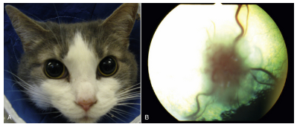
CLINICAL SIGNS IN CATS
C. neoformans can also invade other organs and less common presentations, including osteomyelitis, may be seen.
Central nervous system (CNS) disease due either to:
a focal mass lesion
diffuse neurologic disease.
Neurologic signs may be mild or severe, and can include:
change in temperament
depression
disorientation
ataxia
paresis or paralysis
seizures
circling
abnormal pupillary responses
anisocoria and blindness
Ocular abnormalities in cats with disseminated cryptococcosis.
A. Bilateral mydriasis in an 8-year-old male with cryptococcal meningoencephalitis.
B. Granulomatous chorioretinitis and retinal detachment in another cat with cryptococcosis.

Slide 10
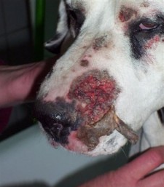
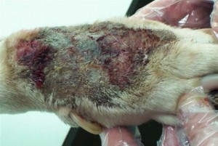
CLINICAL SIGNS IN DOGS
Most dogs have severe disseminated disease.
Neurologic disease is the most common form in dogs and resembles the disease in cats.
Ocular lesions are also common and may include:
granulomatous chorioretinitis
optic neuritis.
Disease can also occur in other organs, but cryptococcosis rarely affects the nasal cavity in dogs.

Slide 11
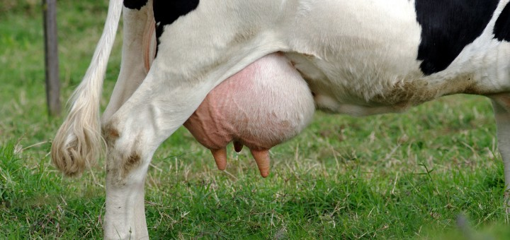
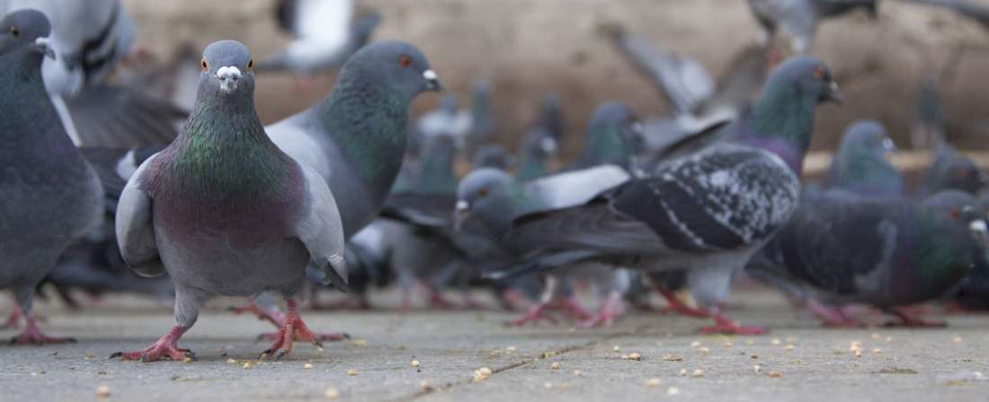
CLINICAL SIGNS IN OTHER ANIMALS
Cows: mastitis
Sheep and goats: pulmonary disease
Horses: CNS, pulmonary, other
Birds
Disease rare
Rhinitis and sinusitis may occur
Shed organism in feces

Slide 12
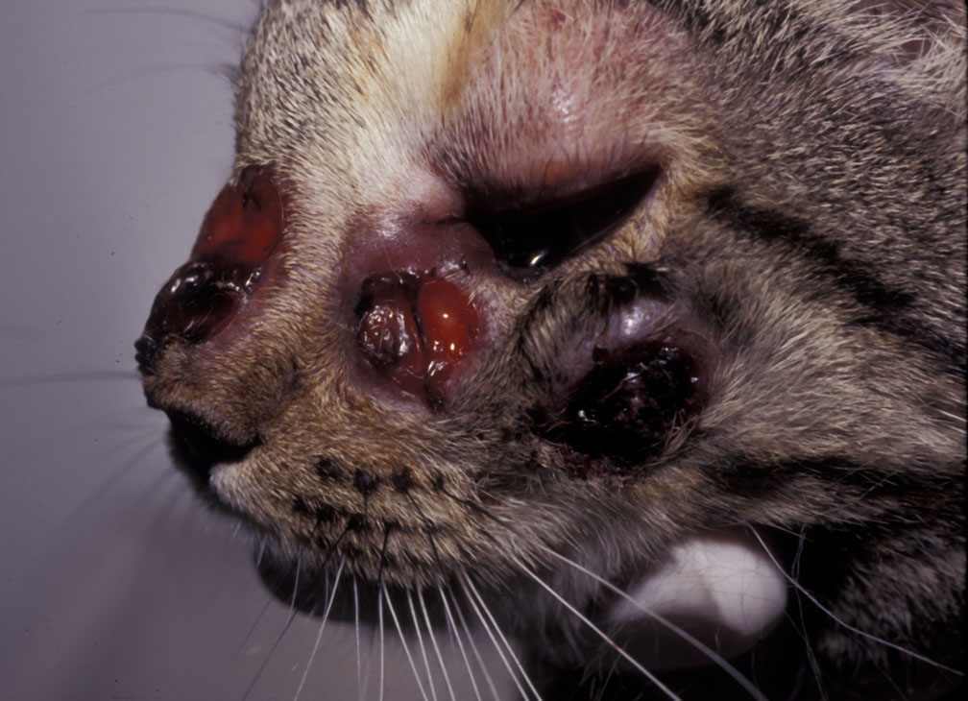
MACROSCOPIC LESIONS
The gross lesions may appear either as granulomas or as gelatinous masses with minimal inflammation.
In cats, lesions can occur in any organ system.
Viscous exudate in the nasal passages and sinuses, and/or small gelatinous nodules scattered on the viscera of the abdominal and thoracic cavities.
In cases with CNS involvement the meninges may:
be congested and thickened.
sometimes have a cloudy, gelatinous appearance
be covered by a scant mucoid exudate.
Abscesses may be found in the brain or spinal cord.
Ocular lesions including chorioretinitis or panophthalmitis can also be seen.
Cat with multiple foci of ulcerative dermatitis; the rostral lesion likely resulted from extension of cryptococcal rhinitis through the facial bones.

Slide 13
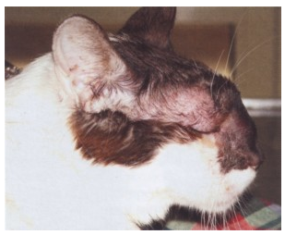
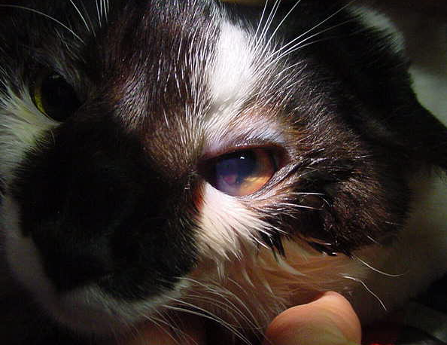
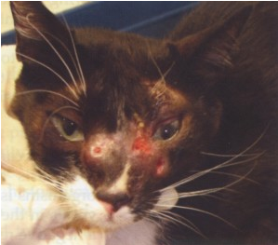
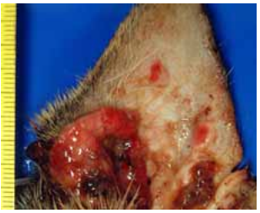
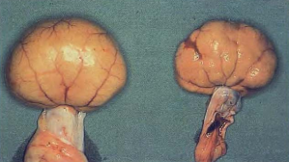
Severe naso-facial swelling and deformity.
Kerato-uveitis and cryptococcoma in the anterior chamber.
Ulcerated skin nodules on the face.
Kidneys of a cat affected with cryptococcosis.
Ulcerated node located in the ear of a cat affected with cryptococcosis.

Slide 14
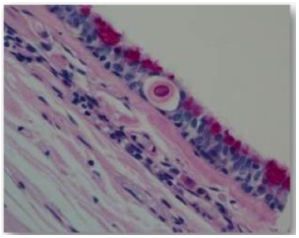
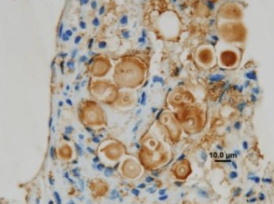
HISTOLOGY
Biopsy samples for histology of:
nasal mucosa
lymph nodes
skin nodules
they may also provide impression smears for cytology and material for culture and PCR.
Haematoxylin-eosin stained sections show eosinophilic bodies surrounded by a clear halo and a pyogranulomatous reaction.
Mayer’s mucicarmine method specifically stains the capsule of Cryptococcus.
Immunohistochemistry on tissue sections is used for species differentiation, using monoclonal antibodies.
Early invasion of Cryptococcus gattii into the respiratory epithelium of a koala.
Eosinophilic body surrounded by a clear halo.
Immunohistology.
Brown precipitates highlight both the yeast cell body and its capsule.

Slide 15
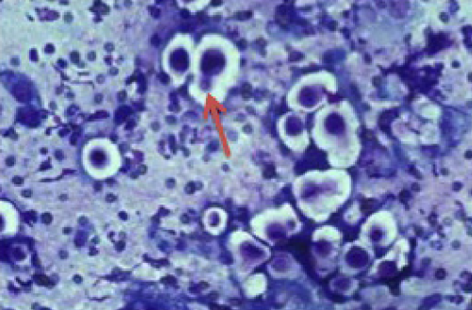
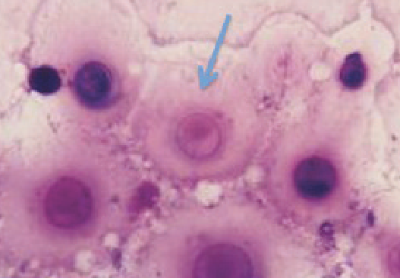
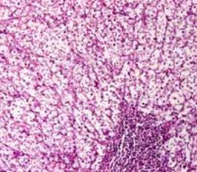
Diff Quick stained smear of nasal exudate from a cat with C neoformans.
Diff Quick stained smear of fine needle aspirate of a cryptococcal lesion.
Mesenteric lymphatic node from a cat with cryptococcosis.

Slide 16
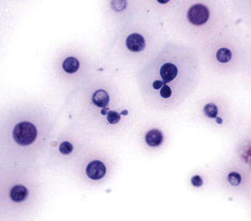
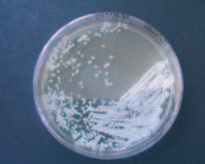
DIAGNOSIS IN ANIMALS
Cryptococcosis is usually diagnosed by detecting C. neoformans in biopsies, impression smears, aspirates, or swabs of nasal secretions or skin exudates.
In cases of CNS disease, C. neoformans may be found in the cerebrospinal fluid (CSF).
C. neoformans can sometimes be found in clinical samples by:
Direct observation
Culture: definitive diagnosis can be obtained.
Serology
Serologic tests used in cats include complement fixation, immunodiffusion, indirect immunofluorescence and tube agglutination.
Yeast characteristics
Encapsulated, roud to oval, clear halo.
CSF cytology from an 8-year-old male cat with cryptococcal meningitis.
Large numbers of budding cryptococcal yeasts are present.

Slide 17
TREATMENT
Cryptococcosis can be treated with:
Amphotericin B
Flucytosine
Itraconazole
Fluconazole.
Amphotericin B and flucytosine are often used in combination.
A combination of ketoconazole and itraconazole has been effective in some experimentally infected cats, including animals with neurologic disease.

Slide 18
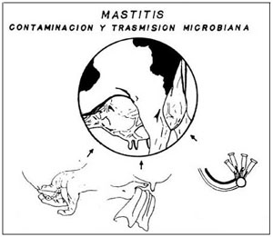
PREVENTION AND CONTROL
Cryptococcal mastitis
Usually associated with treatment of mammary gland for another condition
Take care not to contaminate syringes, cannulas, or antibiotic preparations
Clean teat ends before treatment
Environmental exposures
Difficult to prevent
C. neoformans var neoformans
Avoid pigeon droppings: carefully remove from environment
C. neoformans var gattii
Avoid eucalyptus trees
Animal-associated exposures
C. neoformans var neoformans carried by pet birds in intestinal tract: care when cleaning cages.
No mammal-to-human cases reported: be careful when handling infected animals.
Immunosuppressed people most at risk: Anti-fungals may be used for prophylaxis.

Slide 19
BIBLIOGRAPHY
Pathologic Basis of Veterinary Disease. James F. Zachary; M. Donald McGavin.
European Advisory board on cat diseases. Cryptococcosis.
Maria Grazia Pennisi, Katrin Hartmann; Cryptococcosis in cats: ABCD guidelines on prevention and management.
Dermatology in Dogs and Cats. Elisa Bourguignon, Luciana Diegues Guimarães, Tássia Sell Ferreira and Evandro Silva Favarato.
Criptococosis y animales de compañía. Gemma Castellá, M. Lourdes Abarca y F. Javier Cabañes.

