Slide 1
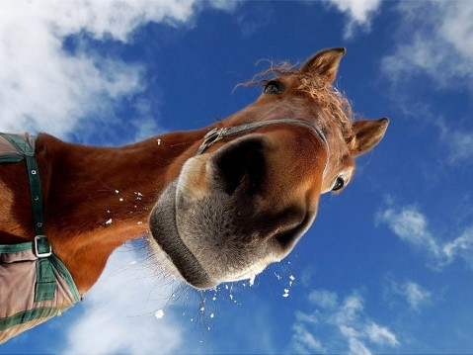
EQUINE POX

Slide 2
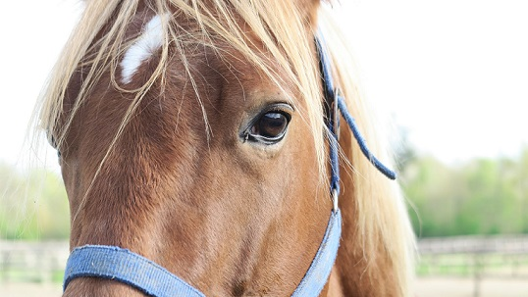
EQUINE POX
Also Known As:
Equine Coital Exanthema
ECE
Genital Horsepox
Equine Venereal Balanitis

Slide 3
Introduction
Equine coital exanthema is caused by a specific herpes virus, namely herpesvirus – 3. Equine Herpesvirus 3 (EHV-3), a member of the large Herpesviridae family, causes the highly contagious viral venereal disease, equine coital exanthema (ECE), which causes genital lesions on both stallions and mares.

Slide 4
Etiology and Epidemiology
It is relatively common, occurs worldwide, and in most cases is a self-limited and benign disease.
It affects the genital area of the horse, and does not cause any permanent damage to the reproductive organs. It is a localized infection that does not spread systemically.

Slide 5
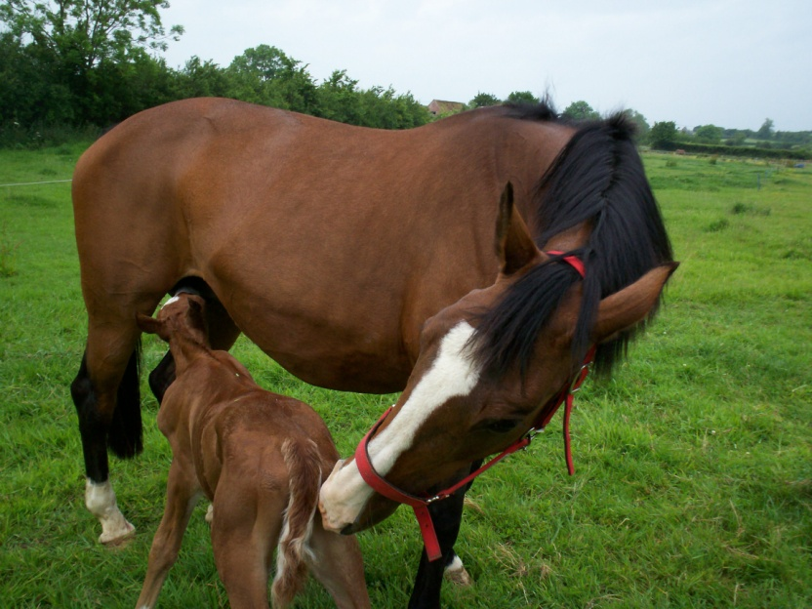
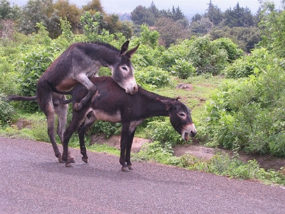
Transmission
Although it is primarily considered a sexually transmitted disease, has also been seen on foals feeding from dams affected, presumably transmitted by direct contact with mucous membranes
or it's also possible the Iatrogenic transmission through contaminated veterinary supplies including equipment, gloves, and breeding materials.

Slide 6
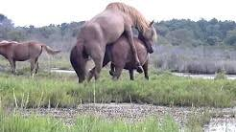
In most cases, the disease spreads during sexual contact, in fact, horses of reproductive age are usually affected.
The incubation period may be less than 2 days.

Slide 7
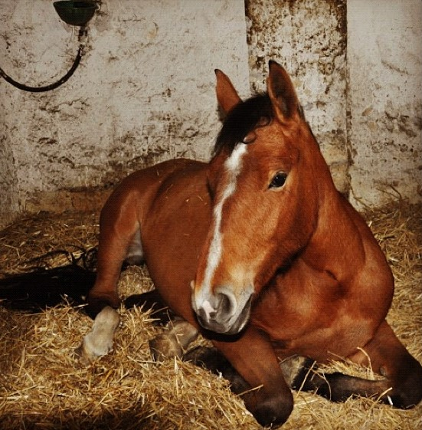
Clinical Signs
Equine Pox causes vesicular lesions on the penis and prepuce of stallions and vulva of mares which can be extremely painful, especially to males. These lesions often suppress breeding comportment but have no direct impact upon fertility.

Slide 8
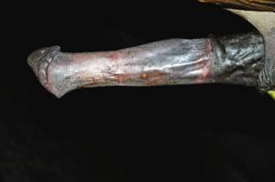
The initial vesicles begin on the penis, spreading onto the prepuce and develop into pustules which then slough leaving ulcerated areas up to 1.5cm in diameter.
These ulcers heal within a few weeks but leave depigmented scars.

Slide 9
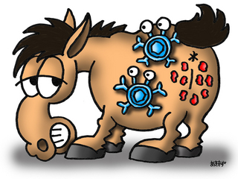
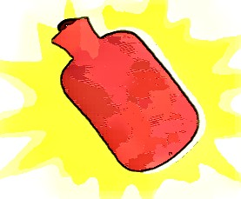
Systemic signs develop occasionally in stallions,
affected animals exhibiting an apathetic and depressed comportment and hyperthermia.

Slide 10
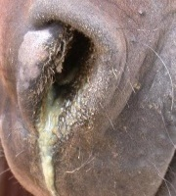
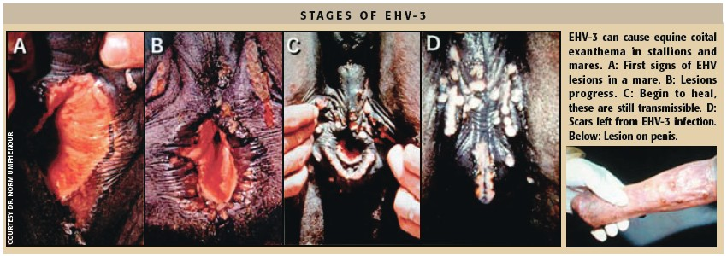
In mares, small red nodules appear on the vulva, vaginal mucosa, clitoral sinuses and perineal skin 4-8 days after breeding.
Ulcers can occasionally be found on
the teats, lips, nasal and oral mucosae.

Slide 11
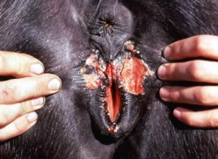
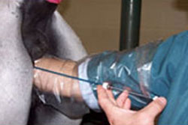
These develop into pustules and then vulval erosions which form scabs and then heal leaving depigmented scars.
While the lesions heal, 3 weeks of sexual rest are recommended.
If the mare is ready for reproduction, artificial insemination is recommended.

Slide 12
The margins of ulcers can be viewed under electron microscopy revealing viral particles within the cells. Biopsies of lesions can also be histologically examined for viral inclusion bodies.

Slide 13
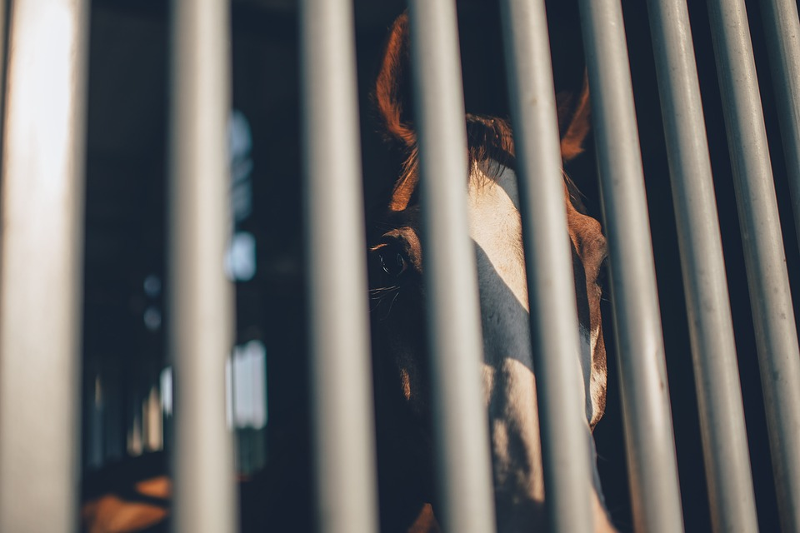
There does not appear to be any correlation between infection and abortion. Prevention is crucial to limit contact between individuals with isolation.

Slide 14
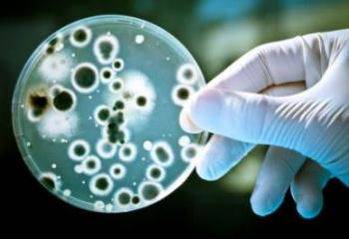
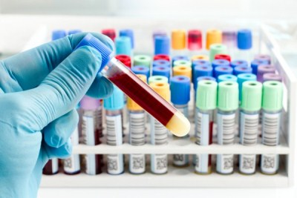
Diagnosis
There are two laboratory methods of confirming the diagnosis:
sequential serology testing and
isolation of the virus from cultures of the genital lesions.

Slide 15
Mares usually develop small red bumps in the vulva within 4-8 days after breeding. These bumps then develop into fluid filled vesicles that will rupture leaving excoriated lesions.
If secondary infection develops, the lesions become purulent and drain pus.

Slide 16
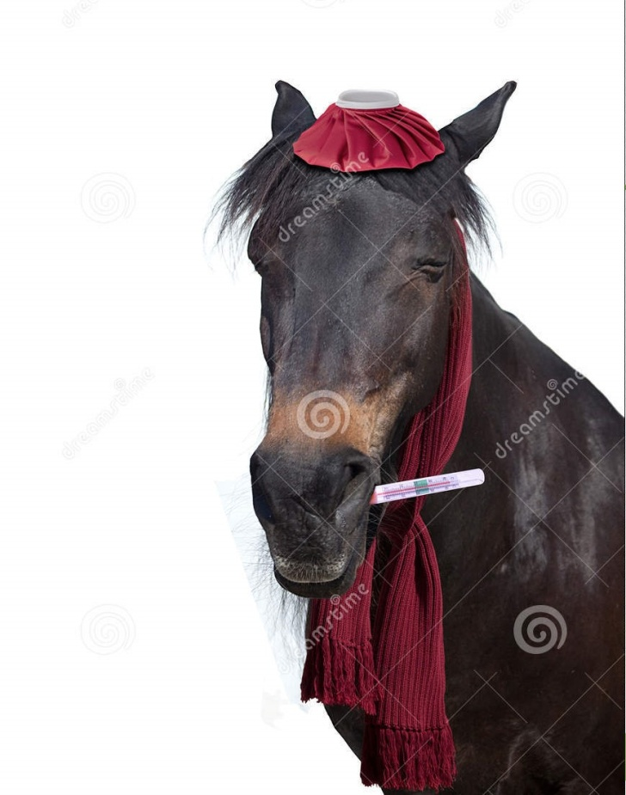
At times, the mares will develop fever with secondary infection. Uncomplicated lesions will usually heal within three weeks, although lesions of the vagina and clitoris may heal somewhat slower.

Slide 17
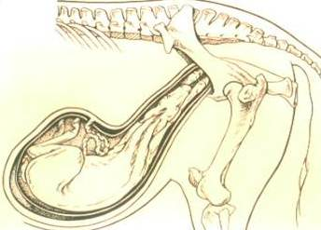
Scarring may remain at the site of the lesions, but they will not interfere with future pregnancies or future fertility.

Slide 18
Lesions on the stallions are similar in appearance, but are very painful. The stallion may refuse to copulate when he has active lesions, and sperm count may be affected by the bleeding of the vesicles.

Slide 19
Treatment
ECE resolves spontaneously within a few weeks, requiring no treatment but three weeks of sexual rest is recommended.

Slide 20
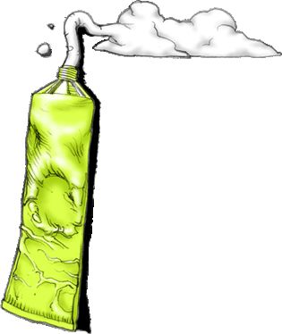
A short-lived immunity then develops. Recurrence within the same breeding season is uncommon.
Topical antibiotics may be used to prevent secondary infections while lesions are open and ulcerated.

Slide 21
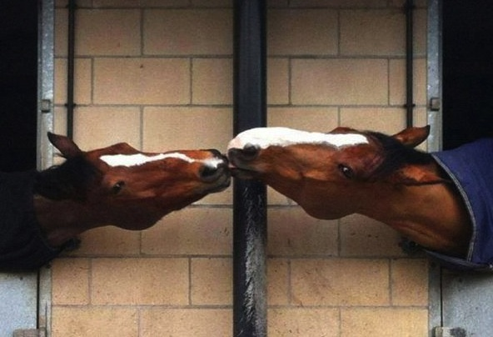
Control
Affected stallions should be rested for at least 3 weeks after cessation of clinical signs to prevent spread to mares.
Semen from such individuals may be collected and delivered via artificial insemination if permitted

Slide 22
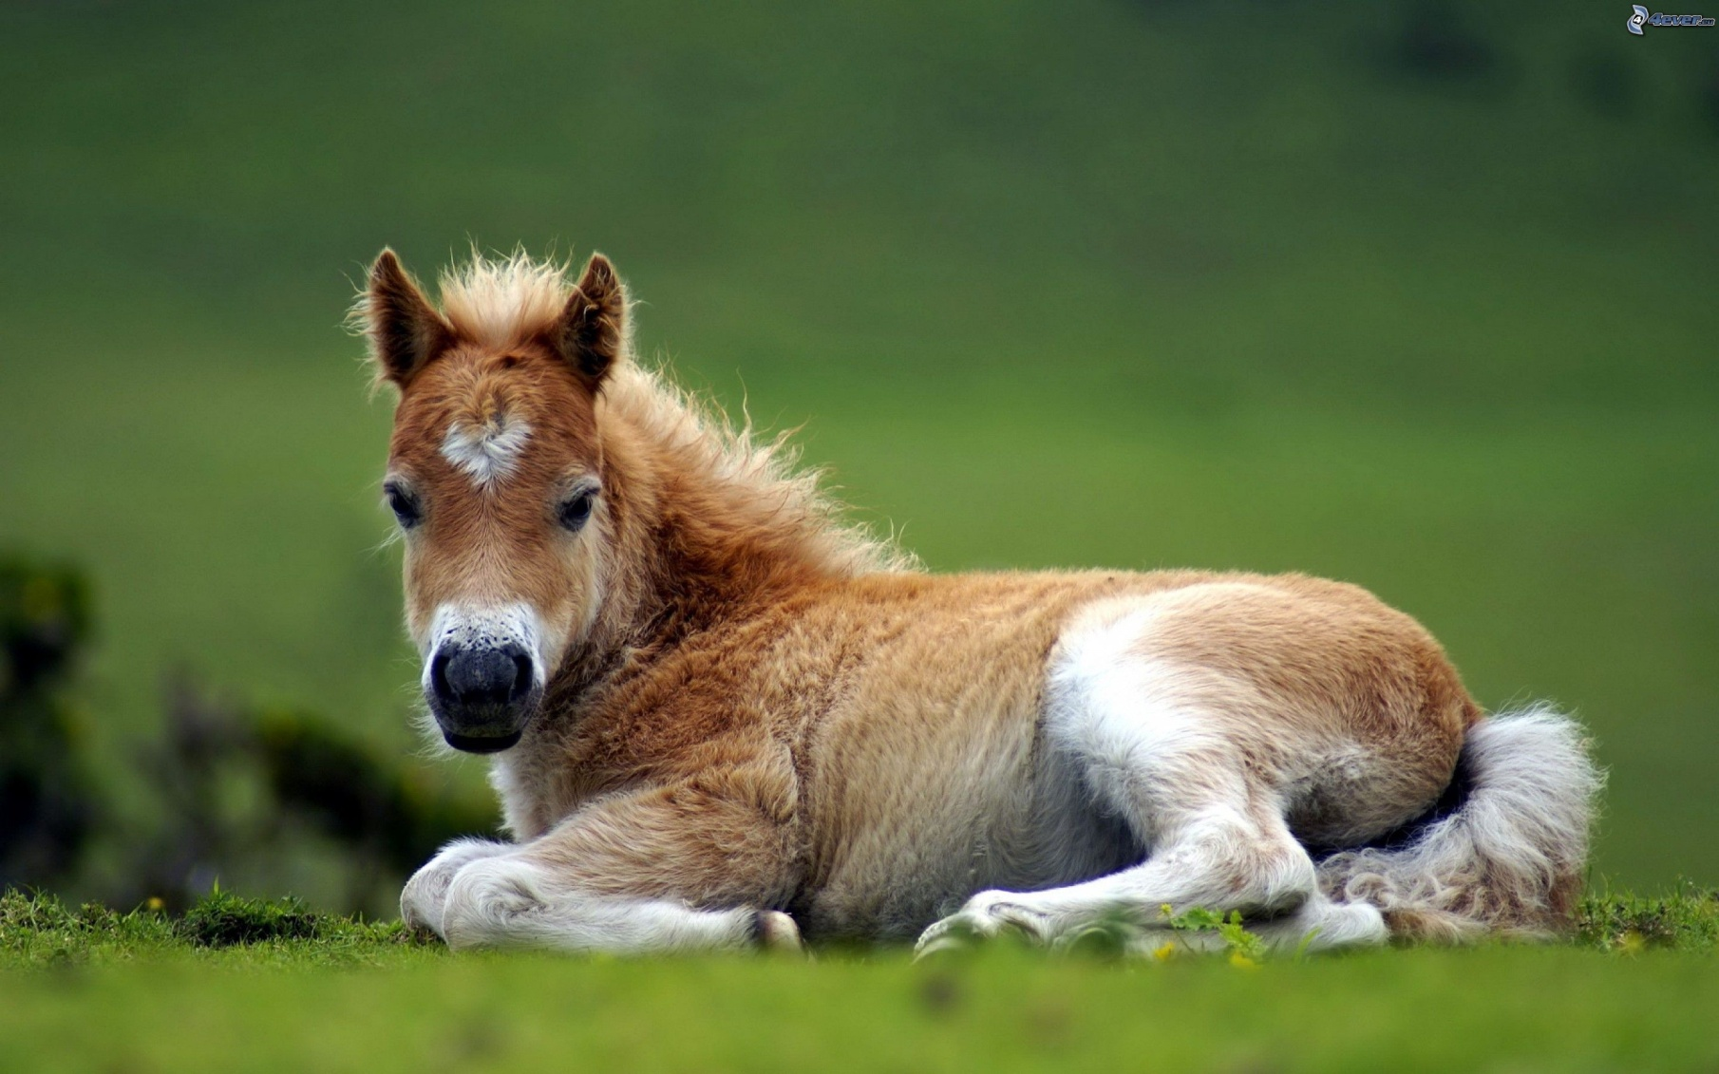
Thanks for the attention!

Slide 23
BIBLIOGRAFIA
Veterinary Medicine. Blood Radostits Henderson, Baillière Tindal
www.wagwalking.com
www.wikivet.net

