Slide 1
Erysipela Swines

Slide 2
Swine erysipelas
Up to 50% of animals
It is always present in either the pig or in the environment
It is also found in many other species
Thus it is impossible to eliminate it from a herd.
Infected faeces is probably the main source of infection
The bacterium alone can cause the disease
is caused by a bacterium, Erysipelothrix rhusiopathiae that is found in most if not all pig farms.
may carry it in their tonsils.
because it is excreted via saliva, faeces or urine.
including birds and sheep and can survive outside the pig for a few weeks and longer in light soils.
particularly in growing and finishing pens.
but concurrent virus infections, such as PRRS or influenza, may trigger off outbreaks.

Slide 3
Disease is relatively uncommon in pigs under 8-12 weeks of age due to protection provided by maternal antibodies from the sow via the colostrum.
The most susceptible animals are growing pigs, non vaccinated gilts and up to 4th parity sows.
The organism multiplies in the body, and invades the bloodstream to produce a septicaemia.
The rapidity of multiplication and the level of immunity in the pig then determines the clinical symptoms.

Slide 4
Clinical Findings:
The acute and chronic forms of swine erysipelas may occur in sequence or separately.
Pigs that succumb to the acute septicemic form may:
die suddenly without previous clinical signs.
Acutely infected pigs:
are depressed
febrile (104°–108°F [40°–42°C]) and reluctant to stand and move.
squeal excessively when handled
require assistance to stand
and prefer to lie down soon after being forced to stand
Affected pigs may also walk stiffly on their toes and shift weight from limb to limb when standing.
Anorexia and thirst are common
and febrile pigs will often seek wet, cool areas to lie down.
Skin discoloration may vary from widespread erythema and purplish discoloration of the ears, snout, and abdomen, to diamond-shaped skin lesions almost anywhere on the body, but particularly on the lateral and dorsal regions.

Slide 5
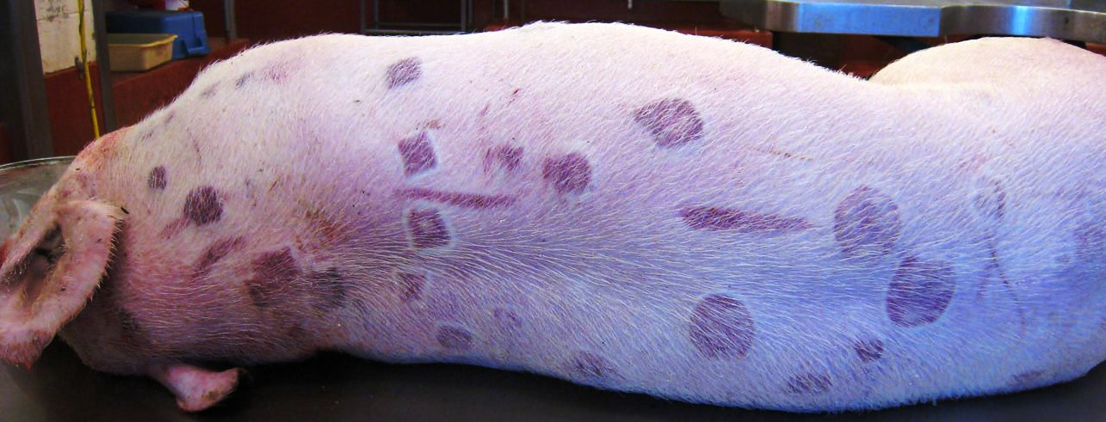
The lesions may occur as:
discrete
pink or purple areas of varying size that become raised
and firm to the touch within 2–3 days of illness.
They may disappear over the course of a week or progress to a more chronic type of lesion, commonly referred to as diamond skin disease.
If untreated, necrosis and separation of large areas of skin can occur, and the tips of the ears and tail may become necrotic and slough.
Mortality is variable (0–100%), and death may occur up to 6 days after the first signs of illness. Acutely affected pregnant sows may
abort, probably due to the fever
lactating sows may show agalactia.

Slide 6
Cronic from
Untreated pigs may develop the chronic form of the disease, usually characterized by:
chronic arthritis
vegetative valvular endocarditis, or both.
Such lesions may also be seen in pigs with no previous signs of septicemia.
Valvular endocarditis is most common in mature or young adult pigs and
Chronic arthritis, the most common form of chronic infection,
is frequently manifest by death, usually from embolism or cardiac insufficiency.
produces mild to severe lameness.
Affected joints may be difficult to detect initially
but eventually become hot and painful to the touch and later visibly enlarged.
Dark purple, necrotic skin lesions that commonly slough may be seen.
Mortality in chronic cases is low, but growth rate is retarded.

Slide 7
Lesions
At necropsy, acutely infected pigs may exhibit :
skin lesions
enlarged and congested lymph nodes
edematous and congested lungs
splenomegaly
and hepatomegaly.
Petechial hemorrhages may be seen on the kidneys and heart.

Slide 8
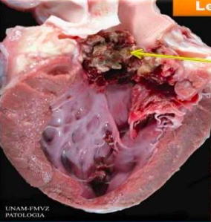
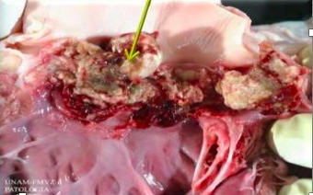
In chronic erysipelas:
valvular endocarditis is seen as proliferative, granular growths on the heart valves, and embolisms and infarctions may develop.
Arthritis may involve joints of one or more legs, and the intervertebral articulations may be involved.
Affected joints may be enlarged, with proliferative, villous synovitis and increased viscosity of synovial fluid, inflammatory exudates, and thickening of the joint capsule.
Proliferation and erosion of articular cartilage may result in fibrosis and ankylosis of the joint.
valvular endocarditis

Slide 9
Diagnosis
Clinical diagnosis is based on signs, typical lesions in several pigs and favorable response of acute cases to high doses of penicillin and/or hyperimmune serum.
In acute cases:
Signs of special value in diagnosis include exceptionally high temperatures, evidence of marked pain in multiple joints and typical skin lesions.
Diagnosis can be confirmed by bacterial culture of kidney, spleen, lymph nodes, blood, or other tissues and, where available, polymerase chain reaction (PCR).
Culture of E. rhusiopathiae is more likely from acute cases; failure to recover the organism should not rule-out a diagnosis of erysipelas.
Acute erysipelas must be differentiated from acute hog cholera and acute septicemia (salmonellosis, streptococcal infection).
Actinobacillus suis is also reported to cause cutaneous lesions that resemble those of acute SE.

Slide 10
A firm diagnosis is more difficult with chronic cases.
Culture attempts on multiple joints often fail.
However, the appearance of many cases of arthritis in growing pigs is more typical of erysipelas than of other diseases.
Vegetative, valvular endocarditis can be caused by many different organisms, most notably Streptococcus suis.
E. rhusiopathiae should be cultured from those vegetations before diagnosing chronic SE.
Erysipelothrix rhusiopathiae vegetative endocarditis lesion, showing the gram-positive filaments typical of this organism (Gram stain, high power).

Slide 11
Treatment
The treatment of choice is penicillin.
Treatment early in the course of disease usually produces a dramatic improvement within 24-36 hours.
There is no practical treatment for chronic swine erysipelas.
Prevention
All gilts and young boars should be vaccinated before entering the breeding herd.
Sows should be vaccinated 3-4 weeks prior to farrowing and boars should be vaccinated every 6 months.
Progeny may need vaccination if there is a high challenge.
If disease breakdown occurs despite a vaccination program, review hygiene and management practices and consider changing to all-in-all-out production systems in consultation with your veterinarian.
Autogenous (herd-specific) killed vaccines can be produced once the serotypes in a herd have been identified.

