Slide 1
FIP- feline infectious peritonitis

Slide 2
What is FIP?
Feline infectious peritonitis (FIP) is a clinical important disease of cats caused by a virulent biotype of feline coronavirus.
That disease occurs worldwide in wild and domestic cats.

Slide 3
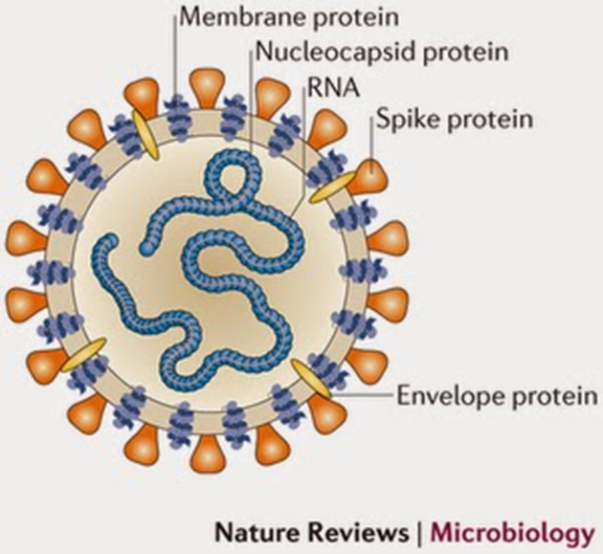
Is caused by a coronavirus, RNA virus with envelope.
There are 2 byotipe of feline coronavirus:
1)enteropathogenic strains - FECV
(felin enteric coronavirus)
– most common in the population
2)strains causing infectious peritonitis – FIP
There are not different about morphology or molecular;
They differ mainly for a deletion within FECV
7b gene.

Slide 4
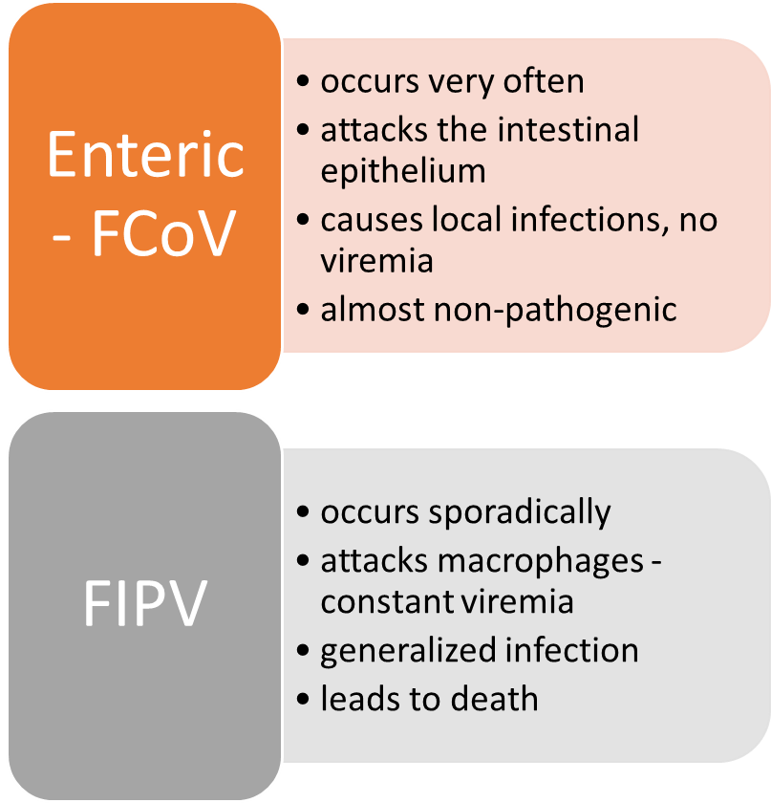
Slide Title
Product A

Slide 5
FIPV is a result of an individual mutation of the enteropathogenic virus in the host organism
RNA virus - a significant frequency of mutations
each virion is slightly different from the original one
gains the ability to multiply in macrophages of lymph nodes and spread in the body

Slide 6
Epidemiology
One of the most important cause of death for cats (mortality around 95%).

Slide 7
many cats are infected with FECV without clinical symptoms
therefore, the emergence of the disease is promoted by stress, immunosupression and young age
the more cats infected with FECV in the population, the more often the mutations
therefore, FIP occurs mainly in cats coming from clusters

Slide 8
Most cats affected with FIP are young, particularly between 3 months and 2 years of age. Other risk factors include:
Source: multi-cat home, shelter, cattery
Pedigreed breeds: Abyssinian, Bengal, Birman, Himalayan, Ragdoll, Rex.
Genetic susceptibility
Concurrent diseases, especially feline leukemia virus (FeLV) infection.
Stress factor: recent elective surgery, inter-cat conflicts, etc.

Slide 10
Trasmission
Oral-fecal transmission
Inalation
Transplacentar trasmission (rare)

Slide 11
Patogenesis
The virus colonizes macrophages and monocytes (viremia)
It reaches most of the tissues and organs (liver, kidneys etc)

Slide 12
Destruction of infected macrophages
release of pro-inflammatory mediators (citokines released for destroyed macrophages)
development of granulomas
antigen-antibody complexes
inflammation of small blood vessels – vasculitis
coagulopathy with the use of coagulation factors and vascular damage, DIC (disseminated intravascular coagulation)

Slide 13
The action of the virus depends on ...
Endogen factor of the virus
(for example patogenity)
Esogen factor of the virus
(for example age of the animal, genetic, immunity response etc)

Slide 14
Two different form

Slide 15
inflammatory granulomas,
peritoneum
generally not detectable in a clinical examination
progressive emaciation
Dehydration
Icterus
Dyspnoea
neurological symptoms:
orientation disorders,
paralysis,
behavior disorders,
neck twist,
nystagmus
changes in the eyes
inflammatory granulomas
varied size and quantity
distribution in various organs
spleen, liver, kidneys, CNS, eyeball, peritoneum
generally not detectable in a clinical examination
progressive emaciation
dehydration
icterus
dyspnoea
neurological symptoms - discomfort, orientation disorders, hyperahesiveness, paralysis, behavior disorders, neck twist, nystagmus
changes in the eyes

Slide 16
Granulomas are accompanied by the
accumulation of fluid in the body cavities.
Dispnea
Progressive emaciation
Glomerulonephritis
Liver damage
Effusive form

Slide 17
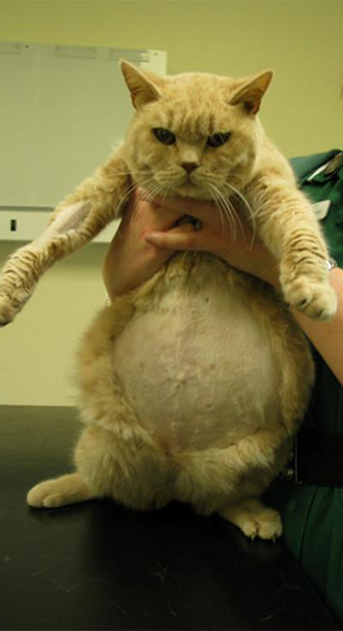
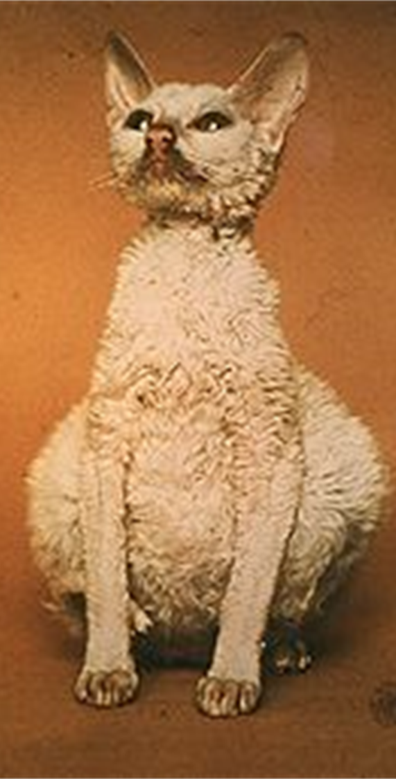
Ascitis

Slide 18
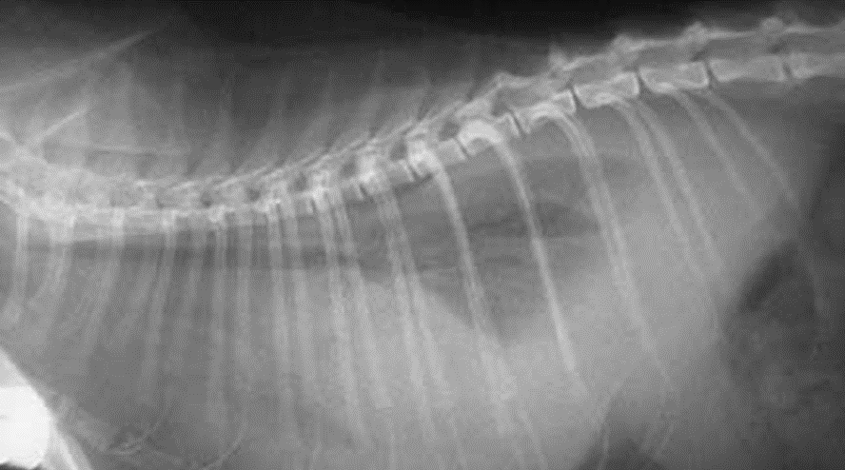
his is an x-ray of a normal cats thorax.
Fluid in chest cavity.

Slide 19
Diagnosis
Is so problematic.
We don’t have a blood test that tells us if the virus is present like we have with FeLV and FIV. The tests we do have tells us if antibodies have been made to the category of virus that FIP belongs to (coronavirus), but it does not tell us if it is the actual FIP virus or not.
The only way to be 100% certain of the diagnosis is to biopsy one of the abdominal lymph nodes, the kidneys, or the liver.

Slide 20
So… what can we see in a necropsy?

Slide 21
Kidney of a cat with non-effusive FIP. Granulomatous lesions.

Slide 22
Granuloma in kidney

Slide 23
Deposit in anterior chamber of eye

Slide 24
Diffusion in anterior camb of the eye

Slide 25
Intestines of a cat with effusive FIP. Pyogranulomatous foci are seen as punctate fibrinous plaques on the serosal surface of the intestines.

Slide 26
This autopsy picture shows a reaction on the surface of the liver. This reaction is called pyogranulomatous, and is the basis for the diagnosis.

Slide 27
Lymphoid tissues in cats with FIP often show lymphoid depletion caused by apoptosis.
This necropsy picture shows an enlarged mesenteric lymph node. Below it you can see the inflammation that has occurred on the outer surface of the intestines. This inflammation causes peritonitis (inflammation of the lining of the abdominal cavity). This is how the disease became to be known as Feline Infectious Peritonitis when it was originally discovered.

Slide 28
DIAGNOSIS

Slide 29
Treatment

Slide 30
Treatment

Slide 31
Prevention
Questioned about effectiveness.
This vaccine contains a live attenuated virus;
The action is to stimulates local mucosal responses and general cellular and humoral immunity.

