Slide 1
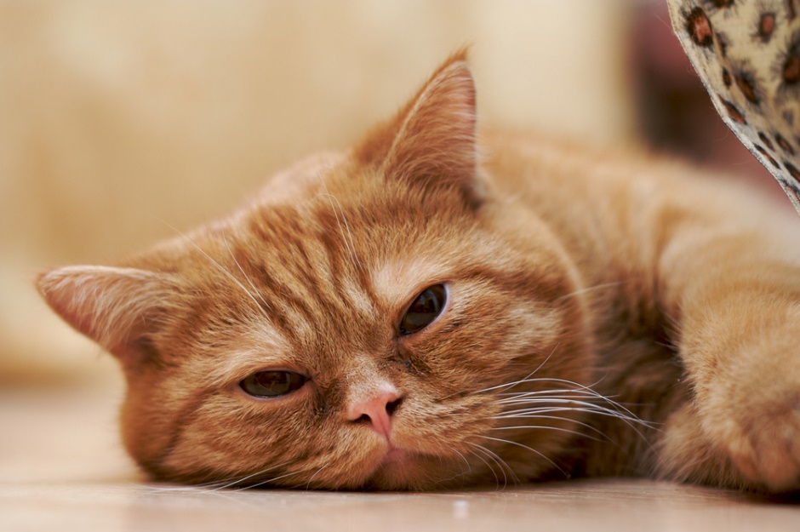
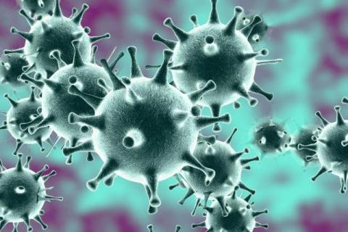
FELINE INFECTIOUS PERITONITIS
PATHOMORPHOLOGY II
UWM 2019

Slide 2
INDEX
AETIOLOGICAL AGENT: CORONAVIRUS
FIPV
INFECTION
PATHOGENESIS
DEVELOPMENT OF ONE OF TWO FORMS OF FIP
NONEFFUSIVE FORM OR DRY FORM
CLINICAL SIGNS
PATHOMORPHOLOGICAL FINDINGS
EFFUSIVE FORM OR WET FORM
EXAMPLES OF HISTOLOGICAL FINDINGS
DIAGNOSIS
TREATMENT AND PREVENTION
ERRADICATION OF CORONAVIRUS
BIBLIOGRAPHY

Slide 3
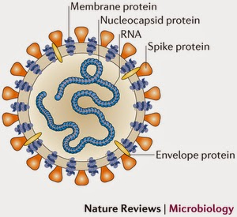
AETIOLOGICAL AGENT: CORONAVIRUS
Two biotypes of feline coronavirus:
Enteropathogenic strains: FCoV
Strains causing infectious peritonitis: FIPV
They differ mainly in the pathogenicity.
Family: Coronaviridae
Two serotypes
Closely related to coronaviruses of other species:
Human
Dog
Pig
Largest known RNA-viruses
Not very resistant to environmental factors
Enteric FCoV
FIPV
Occurs very often
Attacks the intestinal epithelium
Causes local infections, no viremia
Almost non-pathogenic
Occurs sporadically
Attacks macrophages-constant viremia
Generalized infection
Leads to death

Slide 4
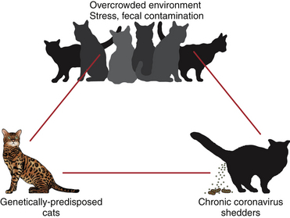
FIPV
FIPV arises as a result of an individual mutation of the enteropathogenic virus in the host organism.
Size of the coronavirus genome and its variability are important.
FIPV does not transfer to other cats.
Gains the ability to multiply in macrophages of lymph nodes and spread in the body.
Many cats are infected with FCoV without clinical symptoms. The more it multiplies in a given individual, the greater the possibilities of an individual FIP-genic mutation.
The emergence of the disease is promoted by stress, immunosuppression and young age.
The higher number of cats infected with FCoV in the population the more often the mutations to FIPV.
FIP occurs mainly in cats coming from clusters.

Slide 5
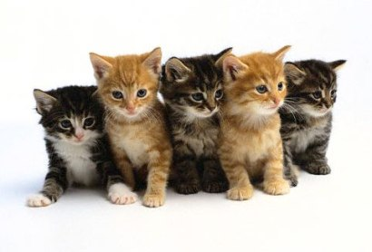
INFECTION
Asymptomatic carrier - usually
Enteritis - sometimes
transient, slight symptoms - young cats during weaning
FIP – feline infectious peritonitis – rarely
about 5% - 10% of cats
poorly expressed inflammation of the upper respiratory tract
diarrhea
vomiting
slight increase in body temperature
convalescent cats - the antibodies do not protect against FIP but contribute to its development!
At any age
They are very easy to spread
By direct contact- kittens from mothers
Per os
Aerosol
Transplacental
Most kittens have an infection at the age of 6-8 weeks.
Indirect way
Bowls, clothes, exhibitions.
COURSE OF INFECTION

Slide 6
PATHOGENESIS
Per os entrance (e.g) – intestinal biotype
Intestinal biotype mutation to FIPV
Replication in monocytes and macrophages – viremia
Destruction of infected macrophages
Release of pro-inflammatory mediators and viruses
Development of granulomas
Antigen-antibody complexes
Inflammation of small blood vessels – vasculitis
Cytokines released form destroyed macrophages
Coagulopathy with the help of coagulations factors and vascular damage, DIC.
Sufficient replicating virus is a prerequisite for the FIP mutation and following disease to occur.
If the cat is not infected with a high enough load of feline coronavirus, there is no real threat of FIP mutation.
Sufficient load is ensured via viral persistence and resurgence.
Viral persistence is maintained in the colon of infected cats.
Persistence can also be maintained in other tissues through macrophage infections.

Slide 7
DEVELOPMENT OF ONE OF TWO FORMS OF FIP
POLYSEROSITIS (EFFUSIVE FORM)
Accumulation of fluid in the body cavities
FORMATION OF INFLAMMATORY GRANULOMAS (NONEFFUSIVE FORM)
Cats with partial cellular immunity
Cats with an immune system capable of producing a humoral response but not capable of an efficient cellular response
macrophages
neutrophil granulocytes
lymphocytes
plasma cells
central necrosis
general symptoms
reccuring fever of unknown origin
lack of appetite
progressive emaciation
apathy
anemia
lack of care for the hair coat

Slide 8
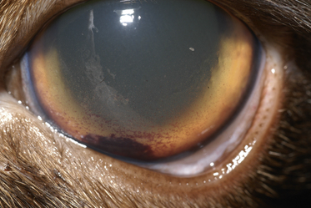
NONEFFUSIVE FORM OR DRY FORM
Inflammatory granulomas
Varied size and quantity
Distribution in various organs
Spleen, liver, kidneys, CNS, eyeball, peritoneum
Generally not detectable in clinical examination
Progressive emaciation
Dehydration
Icterus
Dyspnoea
Neurological symptoms: obtundation, twitching tremors, behavioural chanfes, nystagmus, hyperesthesia, exaggerated segmental reflexes, ataxia, urinary incontinence or cranial nerve defects.
Ocular signs: conjunctivitis, mucopurulent ocular discharge, thickening and hyperemia of the nictitans, uveitis with dyscoria or anisocoria, keratic precipitates, perivascular infiltrates, retinal detachment, blindness.
Keratic precipitates in 5 year old cat with FIP.

Slide 9
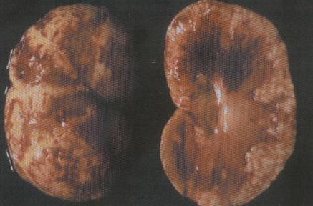
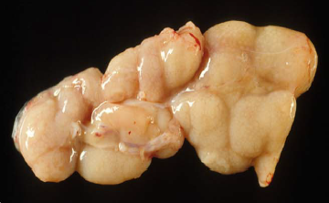
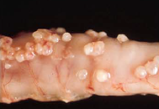
PATHOMORPHOLOGICAL FINDINGS
Dry FIP. Granulomas in kidney.
Dry FIP. Enlargement of mesenteric
lymph node due to granulomatous inflammation.
Dry FIP. Jejunum with multiple granulomas in the serosa.

Slide 10
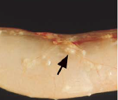
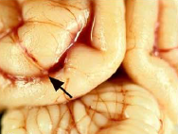
Dry FIP. Jejunum with small subserosal granulomatous lesions that follow the veins.
Dry FIP. Kidney with granulomatous ohlebitis and periphlebitis of a capsular vein.
Dry FIP. Brain with multifocal granulomatous phlebitis and periphlebitis of a cortical leptomeningeal vein.

Slide 11
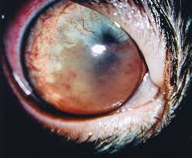
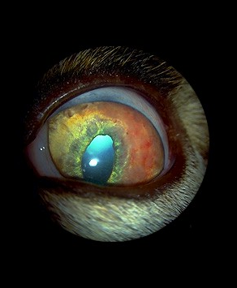
FIP-UVEITIS

Slide 12
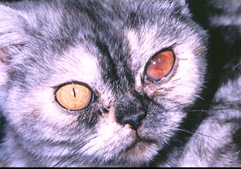
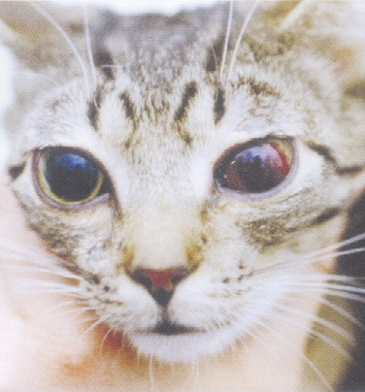
FIP – EFFUSION IN THE ANTERIOR CHAMBER OF THE EYE

Slide 13
EFFUSIVE FORM OR WET FORM
Granulomas are accompanied by the accumulation of fluid in the body cavities.
Ascites
Accumulation of fluid in the chest
Accumulation of fluid in the pericardium
Dyspnoea
Progressive emaciation
Glomerulonephritis
Liver damage: icterus.
Wet FIP, represented by a serofibrinous and
granulomatous serositis and granulomatous lesions in the liver (arrows).

Slide 14
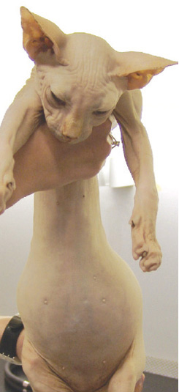
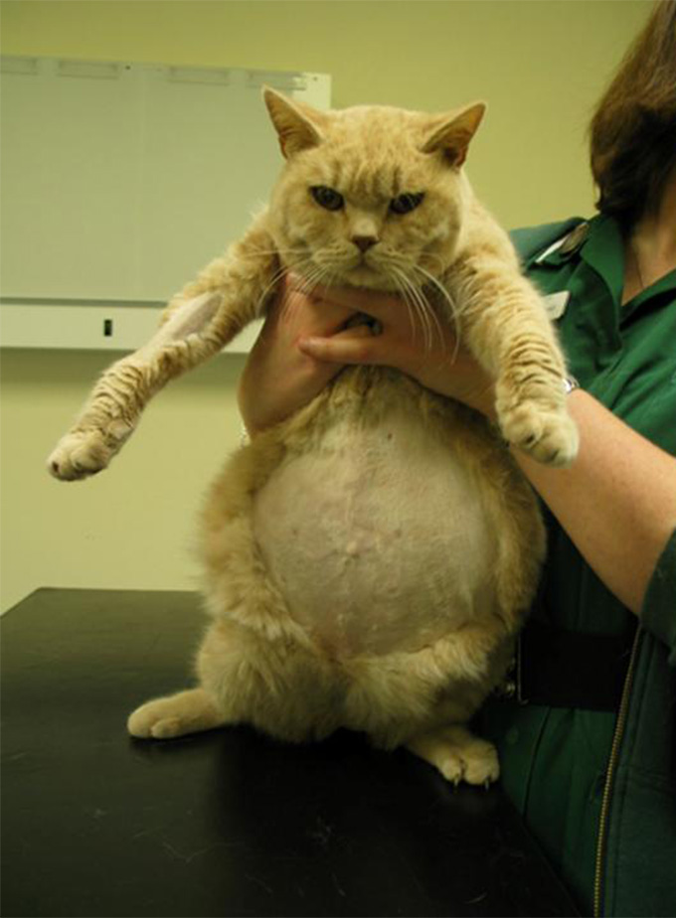
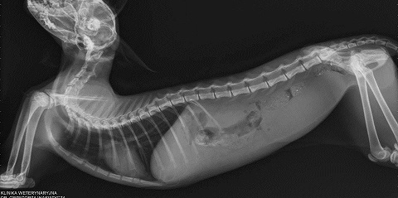
FIP – ASCITES

Slide 15
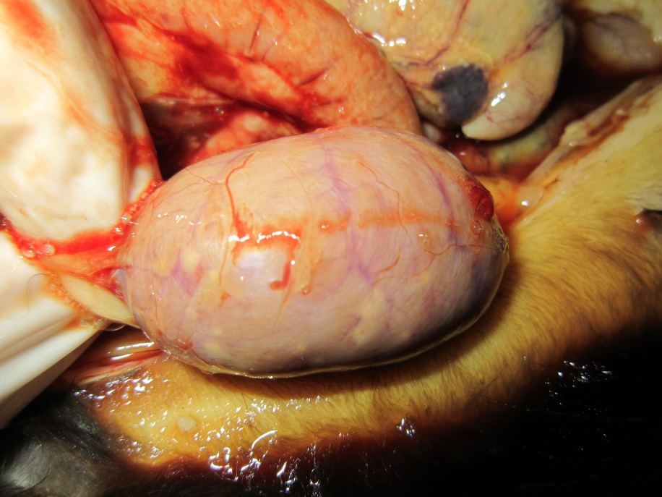
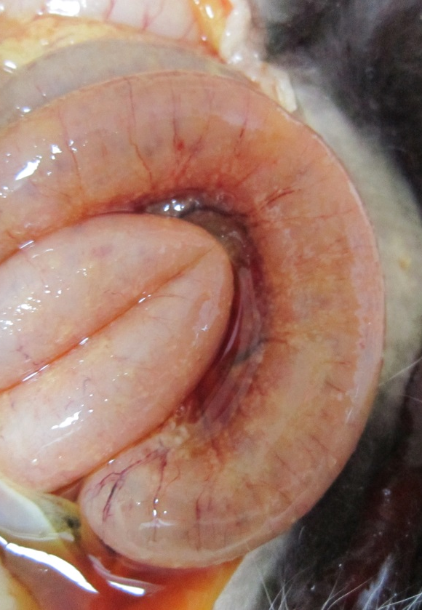
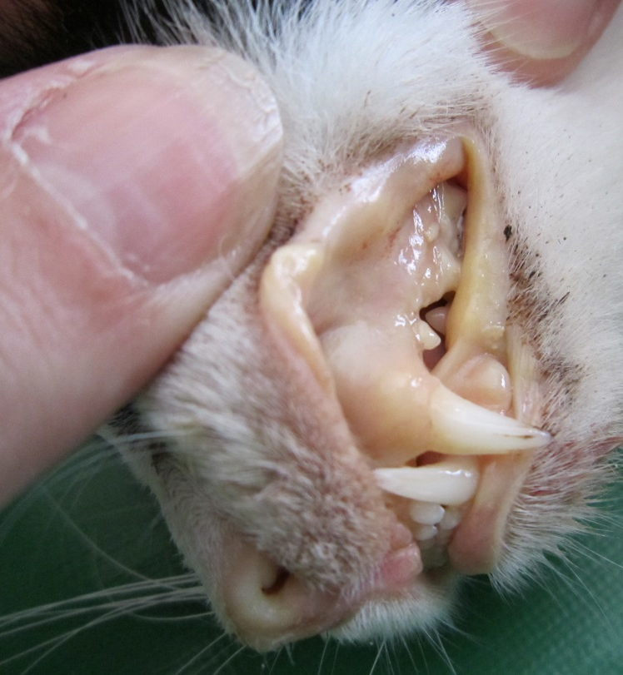
WET FORM OF FIP

Slide 16
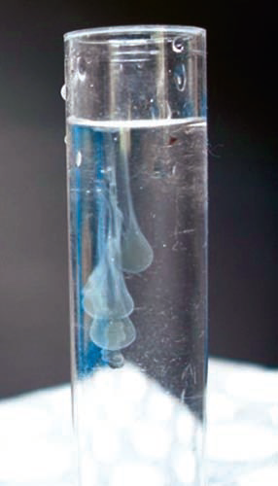
DIAGNOSIS
hematological examination
lymphopenia
biochemical examination
bilirubinaemia
electrophoresis of serum proteins
elevated level of globulins
↑ 0.8 – healthy cat
0,4 – 0,8 – FIP possibility
↓ 0,4 - high probability of FIP
neutrophilia
moving the white blood cell image to the left
anemia
microcytosis
increased ASPAT
reduced albumin ratio compared to globulins
RIVALTA TEST
test tube with distilled water (7-8 ml), add a drop of acetic acid (98%) or 10 drops of 10% vinegar, mix
apply a drop of peritoneal fluid
result (-) - the drop disappears, the fluid is still clear
correct in 97%
result (+) - the drop keeps on
surface or slowly descends - "jellyfish"
correct in 87%
also with lymphomas, bacterial peritonitis

Slide 17
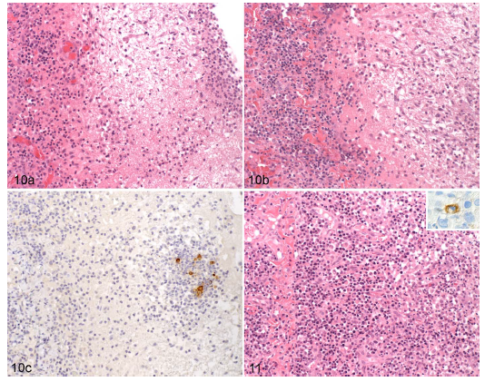
HISTOLOGICAL FINDINGS IN FIP (EXAMPLES OF DIFFERENT CASES)
10. Pleura, cat, natural feline infectious peritonitis (FIP) case with thoracic effusion and fibrinous and granulomatous pleuritis.
Dense basal layer of plasma cells (left), overlaid by a layer of granulation tissue with new vessels with embedded macrophage dominated infiltrates (center-left) and surface layer of fibrin with embedded inflammatory cells (right).
Loose granulation tissue (right) with new vessels and occasional fibroblasts.
Granulomatous infiltrate in the granulation tissue. Feline coronavirus (FCoV) antigen is present within several macrophages.
11. Diaphragmatic pleura, cat.
Chronic diffuse plasma cell–dominated pleuritis with new vessel formation, consistent with granulation tissue formation.
Toward the pleural surface (at the right of the photograph), an infiltrate of macrophages and neutrophils is observed.

Slide 18
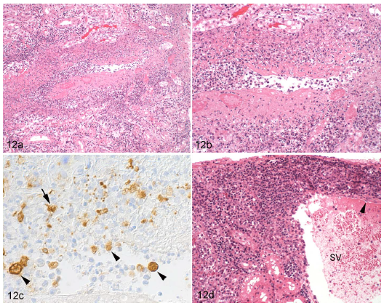
12. Kidney, cortex, cat, natural feline infectious peritonitis, dry form.
Stellate vein with fibrinoid necrosis and granulomatous inflammation, partly occluded by leukocytes.
Closer view of a, highlighting the necrosis of the vessel wall and the inflammatory infiltrate, dominated by often-degenerate macrophages.
The same vein shown in b. Feline coronavirus (FCoV) antigen is present within monocytes in the vascular lumen (arrowheads) and in the inflamed vessel wall (arrow). Immunohistology for FCoV, as above.
Stellate vein distant from that shown in a to c, exhibiting focal extensive perivascular plasma cell accumulation and activated endothelial cells (arrowhead).

Slide 19
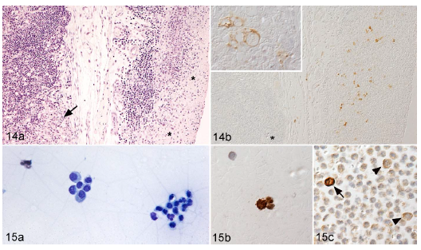
14. Mesenteric lymph node biopsy, natural feline infectious peritonitis (FIP) case, dry form.
Granulomatous lesions are present in the capsule (*) and occasionally within the lymph node in association with the cortical sinuses (arrow).
Viral antigen is expressed by macrophages in the capsular lesions and in parenchymal lesions.
15. Natural FIP case, wet form with abundant abdominal effusion.
Cytological preparation (smear) from the effusion, composed of macrophages/mesothelial cells and neutrophils.
Macrophages in the smear express viral antigen.
Macrophages in a formalin-fixed and paraffin-embedded cell pellet express abundant (arrow) to small amounts (arrowheads) of viral antigen.

Slide 20
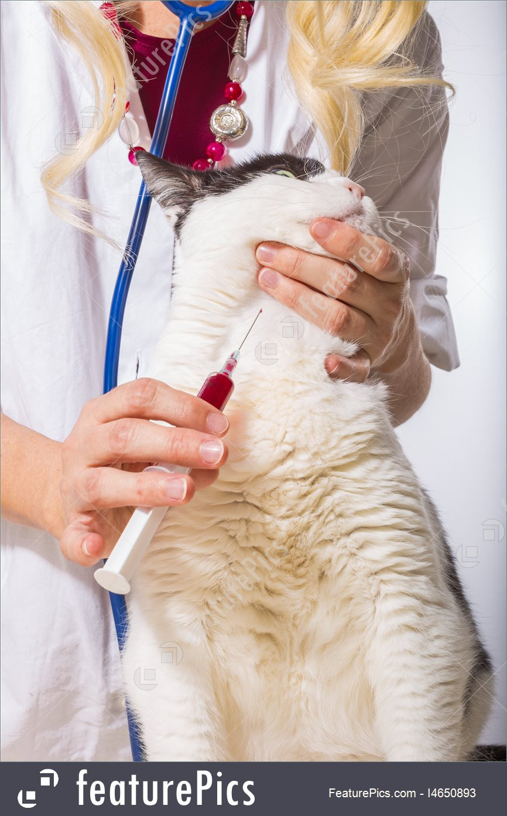
DIAGNOSIS
Detection of FCoV genetic material
from blood sample
only RT-PCR method allows to detect one of two FIP-genic mutations
fluid from body cavity and cerebro-spinal fluid
new tests - detection of mRNA presence
highly conserved M gene
is expressed only during virus replication
detection of FCoV genetic material in the feces - only confirmation of the shedding - does not indicate FIP!
Histopathological examination - thin-needle biopsy
Definitive confirmation – post mortem histopathological examination

Slide 21
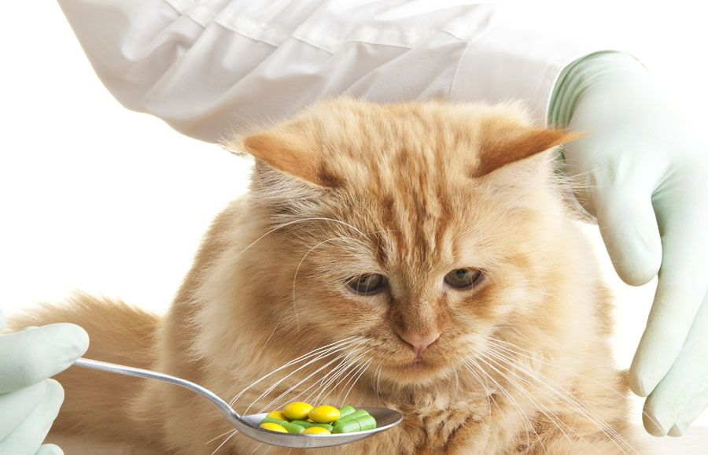
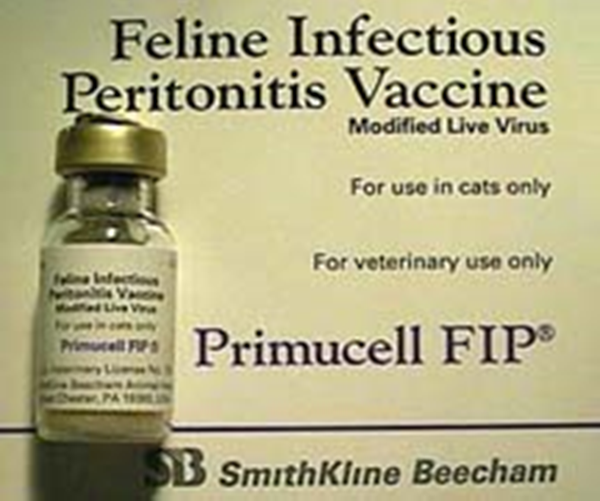
TREATMENT AND PREVENTION
TREATMENT
Unfavourable prognosis
PREVENTION
Primucell vaccine - FIP
The treatment in palliative
GLUCOCORTICOIDS
ANTIBIOTIC THERAPY COMBINED WITH STEROID THERAPY
CYTOSTATIC DRUGS
INTERFERON- low effectiveness
contains a live attenuated virus capable of replicating only at 31°C for nasal administration
stimulates local mucosal responses and general cellular and humoral immunity
questioned effectiveness

Slide 22
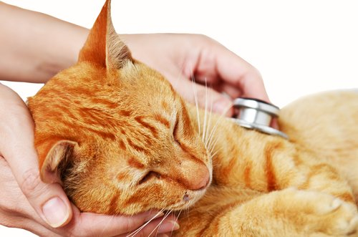
ERRADICATION OF CORONAVIRUS
Based on feces examination every 2-3 months by RT-PCR method, division of cats into 2 groups - coronavirus sheders and uninfected.
Tight isolation of non-infected carriers (rooms not adjacent to each other!).
Successive transfer to uninfected animals those cats that have freed themselves from the virus - at least in 2 fecal tests the result is negative.
Getting rid of long-term carriers, or cats who after 2-4 tests still have a virus in their feces.
Early weaning of kittens and isolation of mothers with kittens.

Slide 23
BIBLIOGRAPHY
Pathologic Basis of Veterinary Disease. James F. Zachary; M. Donald McGavin.
European Advisory Board on Cat Diseases: ABCD – Feline infectious peritonitis.
A. Kipar, M. L. Meli; Feline Infectious Peritonitis.
Addie DD, Jarrett O. A study of naturally occurring feline coronavirus infections in kittens.
Cornell University Feline Health Center; Feline Infectious Peritonitis (FIP).

