Slide 1
INFECTIOUS BOVINE RHINOTRACHEITIS

Slide 2
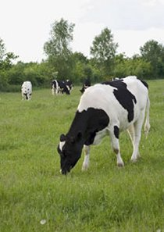
Infectious Bovine Rhinotracheitis (IBR or Red-Nose) was first recognized as a specific disease syndrome in Colorado feedlot cattle in the early 1950’s, and the first clinical description of the disease was published in 1955. The virus was among the first to be definitely associated with bovine respiratory disease. The origin of IBR is not definitely known. An IBR virus was first described as the causative agent in a mild genital infection (vesicular vaginitis) observed in eastern dairy cattle in the late 1940’s. Infectious Bovine Rhinotracheitis (IBR) is a highly contagious, infectious disease that is caused by Bovine Herpesvirus-1 (BHV-1) and it can occur in cattle of any age, but it is most commonly seen between the ages of 6 and 18 months. Cattle and some wild ruminants (cud- chewing animals) are the only known hosts.

Slide 3
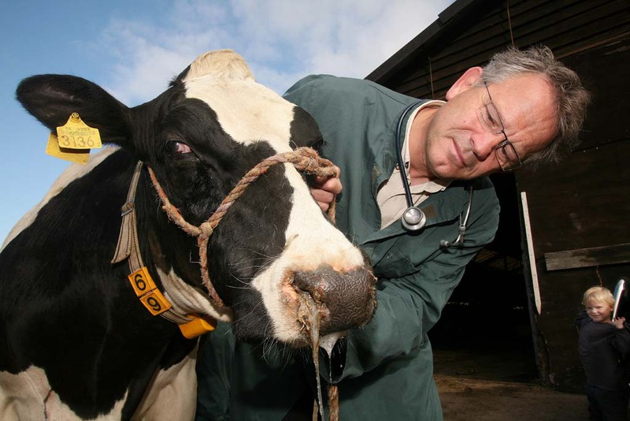
The clinical diseases caused by the virus can be grouped into:
Respiratory tract infections;
Eye infections;
Abortions;
Genital infections;
Brain infections;
Generalized infections of newborn calves.

Slide 4
ETIOLOGY
IBR is caused by Bovine Herpesvirus 1 (BoHV-1) that is a virus of the family Herpesviridae and the subfamily Alphaherpesvirinae, known to cause several diseases worldwide in cattle.
This virus can quickly spread through a group of calves and the secretions of affected calves are extremely infectious and appear to be highly attractive to other animals. With regard to pneumonia, two other viruses are commonly involved: bovine respiratory syncytial virus and parainfluenza 3 virus.
BoHV-1 is a DNA virus with several structural proteins among which at least 11 transmembrane glycoproteins. Glycoproteins play important roles such as virus-cell interactions and interactions with the immune system. Glycoproteins gB, gD, gH, gK, gL are essential for virus replication, while gC, gG, gI, gE, gM and gN are not essential.

Slide 5
TRANSMISSION
BoHV-1 enters the animal through the mucous membrane in the respiratory tract or genital tracts. The main mode of disease transmission is direct nose-to-nose contact between an infected and a susceptible animal. This is made possible because of the virus sloughing off into the mucus. Aerosols have to be exhaled, sneezed, or coughed from an infected animal during viral shedding in order for transmission to occur. Transmission also originates from contaminated semen through use of live breeding or AI ; bulls that have been affected genitally may shed the virus in their semen.
Once infected it is hard for the animal to get rid of BoHV-1 because it has many mechanisms to evade the hosts’ immune systems involved in both innate immunity and adaptive immunity. The virus degrades interferon regulatory factor 3 (IRF3), effectively halting transcription of interferon type 1. Interferons are a component of innate immunity involved in inhibiting viral replication in a host cell, as well as activating immune cells. BoHV-1 is also able to evade adaptive immune cells by inducing apoptosis in CD4+ cells, which assist in activating T cells when antigens are present. This down regulates the number of immune cells that recognize the virus, allowing the virus to evade detection and elimination. The virus has many other evasion strategies against the host’s immune system contributing to the virus being able to maintain lifelong infection in the animal.

Slide 6
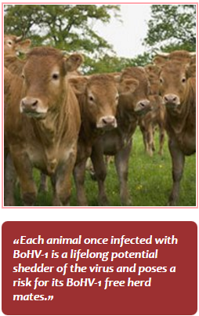
After primary infection of BoHV-1, the latent infection is quite often found in the trigeminal ganglion of the cow, although on occasion infection can enter the central nervous system. These latent infections can possibly reactivate, with or without clinical symptoms, under conditions of stress, corticosteroids or by experimental methods. Infected animals will be continuous shedders throughout their lifetime when the virus reactivates; therefore, successfully propagating the disease. The virus sheds in such high titers that it will spread rapidly throughout a herd. Even though cattle might not be showing clinical signs they can still spread the disease. Aside from cattle, studies experimentally infecting animals have shown that goats and buffalo can act as reservoirs for
BoHV-1, as well as red deer, sheep, swine, and reindeer. Shedding begins from the nasal mucosa as soon as infection occurs, and the virus has replicated in the upper respiratory tract. During replication in the respiratory tract cells of the epithelial will undergo apoptosis. The necrosis in the epithelial will result in an entry site for secondary infections that may result in shipping fever.

Slide 7
Direct transmission:
Contact with
Acutely infected animals;
Latently infected animals in which reactivation of the virus takes place.
Indirect transmission:
Contaminated semen;
Embryo transfer;
Humans;
Contaminated materials;
Airborne transmission.

Slide 8
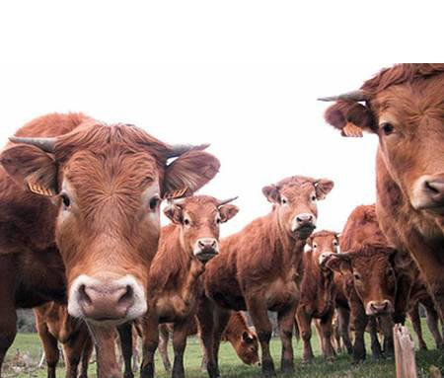
BoHV-1 infection in cattle is manifested as upper respiratory tract disease and disease of the reproductive tract. Clinical signs are influenced by:
age of the animal;
dose of virus;
route of infection;
concurrent infections with other pathogens.

Slide 9
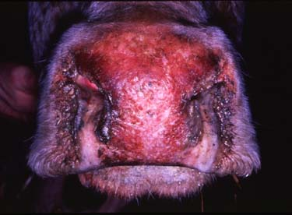
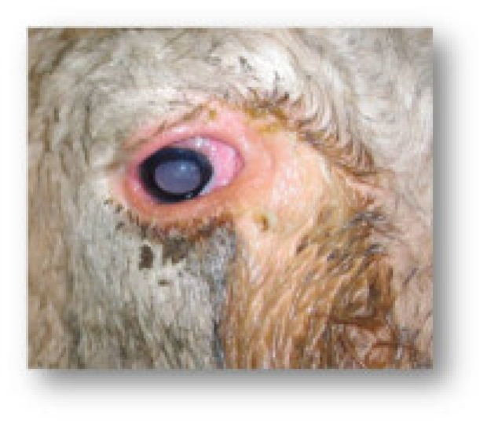
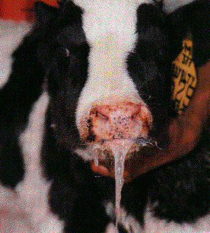
Respiratory tract
Infectious Bovine Rhinotracheitis (IBR)
Fever (as high as 42°C)
Depression
Loss of appetite
Hyperaemia of the mucosae
Mucosal lesions
Nasal discharge - Initially serous and later muco-serous to muco-purulent
Conjunctivitis
Drop in milk production
Infertility
Abortion

Slide 10
Respiratory symptoms were the first signs reported for this disease. The animal has difficulty inhaling, breathes rapidly, has a profuse watery nasal discharge becoming thicker and darker as the infection progresses, and stands with its head and neck extended. Depression, higher body temperature and decreased appetite accompany the respiratory signs. As the infection progresses, the animal’s nostrils become encrusted, it loses weight rapidly and may have diarrhea. If the crusts on the nostrils are rubbed off, the underlying tissue appears very red and inflamed, hence the term “red nose”. The respiratory form of the disease usually affects concentrated groups of cattle, such as in feedlot. The IBR virus is one of the most common agents involved in shipping fever pneumonia of feedlot calves. Keeping many cattle in close contact provides an ideal situation for the virus to spread rapidly. The first signs of the disease appear about a week after infection. Usually, several animals become sick about a week before a large number of animals show signs of illness. Fifteen to 100 percent of the herd may become ill, with a death rate of 0 to 5 percent of those affected. The respiratory form of this disease is the most frequently observed form under feedlot conditions.

Slide 11
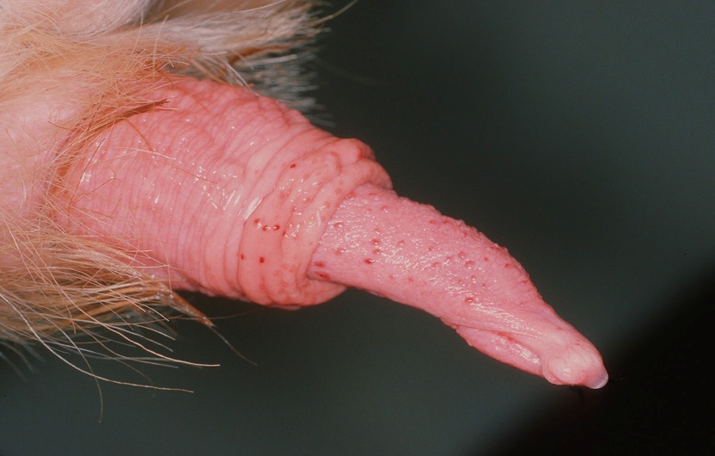
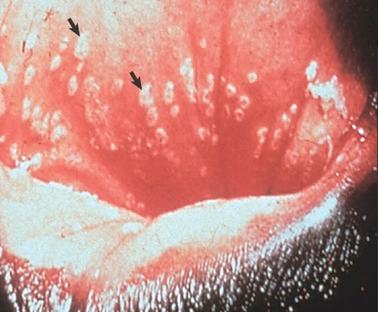
Reproductive tract
Infectious pustular vulvovaginitis (IPV):
Initially oedema of the mucosae of the vulva and vagina is seen. Pustules then form which often coalesce, giving rise to a yellowish-white membrane. Lesions usually heal within 10-14 days, in some animals a purulent discharge may persist.
Infectious pustular balanoposthitis (IPB):
The prepuce may be swollen and a mucopurulent discharge may be seen. Often lesions are only obvious on extrusion of the penis. Some bulls lose their libido and find erection and ejaculation painful.

Slide 12
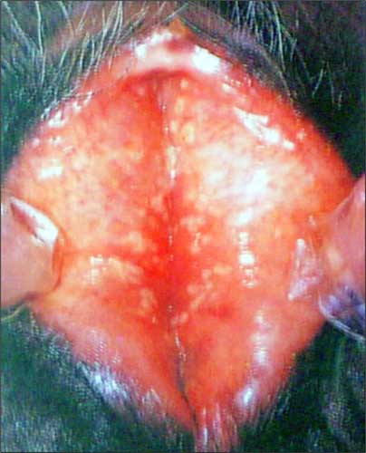
Cattle exhibiting the vulvovaginitis form of the IBR complex are sexually mature females that do not appear ill. Signs of IPV include a thick yellow to brown vulvar discharge that attaches to the vulvar tuft of hair. The vulva is swollen and the vulvar and vaginal lining is reddened, dying and/ or contains small whitish- colored pustules. The vaginal- vulvar infection causes irritation, exhibited by frequent tail- switching and urination. Temporary infertility accompanies this infection.
Lesions similar to those from IPV may appear on the bull’s penis and prepuce. This infection is believed to result from coitus with an IPV- infected female. The libido of infected males is usually decreased temporarily and the condition is known as balanoposthitis.

Slide 13
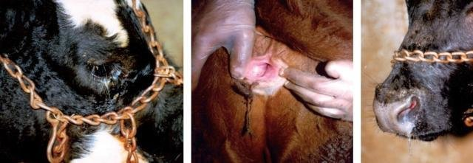
DIAGNOSIS
Clinical signs of IBR are indicative of BoHV-1 infection but laboratory tests are required for a definitive diagnosis.
Clinical signs and signalment (young cattle in a feedlot) are indicative of BoHV-1 infection. However many other respiratory diseases may cause the same or similar signs. Often respiratory disease in cattle is caused by multiple concurrent viral and bacterial infections (e.g.Pasteurella multocida, Mannheimia haemolytica etc).

Slide 14
Laboratory tests are required for a specific viral diagnosis.
Virus neutralization
Retrospective diagnosis of BoHV-1 infection can be made by measuring antibody titres in paired sera samples. First sample is collected during the clinical phase and a second sample is collected 4 weeks later.
ELISA
There are two types of BoHV-1 ELISA tests currently available. The use of marker vaccines is important in the differentiation of infected and vaccinated animals.
Post-mortem Examination
IBR infection is rarely fatal unless complicated by secondary bacterial infection;
Congestion of the tracheal mucosa with petechial haemorrhages;
Inflammatory lesions do not usually extend into airways contained within the lung;
Pustular lesions.

Slide 15
ANATOMOPATHOLOGY.
The gross changes associated with an uncomplicated BHV-1 infection usually consist of pustular formation and shallow ulceration of the epithelium of the upper respiratory tract (including larynx and trachea) and the genitalia. There can be severe necrotic ulceration of the epithelium of the larynx and trachea in some cases. When pneumonia occurs, the changes are not pathognomic and are due to a combination of the effects of the virus and secondary bacterial infections. Histological changes that occur in uncomplicated respiratory cases are those of acute catarrhal inflammation with rare inclusion bodies as well as lymphocytic infiltration in the mucosa, edema in the lamina propria, and type A eosinophilic inclusion bodies can be seen. There is destruction of the epithelium with necrotic foci in the laryngeal and epiglottal mucosa. Broncho-pneumonic lesions can result from bacterial complication. Intranuclear inclusions may be found in epithelial cells of the respiratory tract during the early stages of infection.

Slide 16
Bovine trachea necrotic plaques

Slide 17
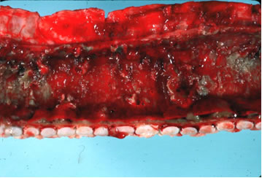
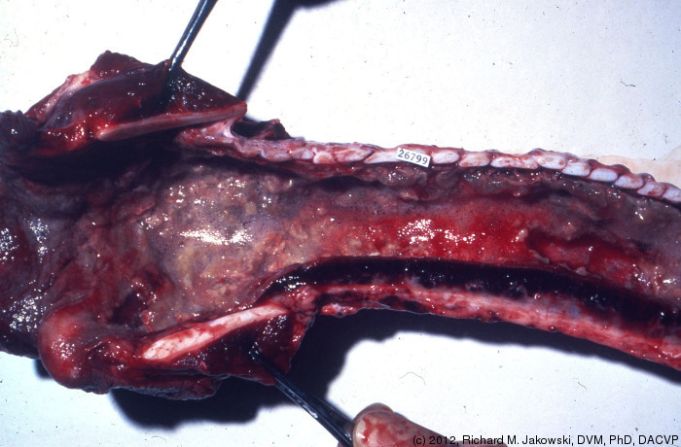

Slide 18
Bovine nasal turbinate fibrinouos rhinitis (Malignant Catarrhal fever).

Slide 19
Aborted fetuses
Necropsy findings
Over half of the aborted fetuses had no visible lesions on gross postmortem examination and, excluding autolysis and scavenged, the most common gross pathologic diagnoses reported by veterinarians were developmental anomalies.
Histologic examination findings
The most commonly reported histologic lesions involved the thyroid gland. The next most common lesions involved inflammatory processes, namely placentitis and subsequent lung changes induced by inhalation of bacteria and other debris associated with placentitis.

Slide 20
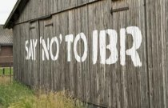
CONTROL
BoHV-1 negatively affects health and productivity of cattle (dairy and beef). It is thus necessary to establish a plan in order to not only control BoHV-1 but to eradicate it and then maintain the farm, region and/or country free of the disease and the virus.
Control measures should focus at the following levels:
Commercial farm
Artificial Insemination centre
Embryo transfer companies

Slide 21
Commercial farm
Reduce circulating virus in a herd.
The aim of any control program for BoHV-1 should aim to reduce the circulating virus in sero-positive herds by vaccination and prevent the introduction of the virus onto the farm through strict biosecurity. Reduction of circulating virus can be achieved with the introduction of a vaccination program and progressive culling of those animals that are identified as a potential source of the virus. In farms with a very low sero-prevalence culling without vaccination can be an option however in most farms due to the high sero-prevalence it is not economically feasible to test and cull al the sero-positive animals.
With the development of BoHV-1 marker vaccines, non-marker BHV-1 vaccines should not be used as it makes the process of control and eradication incompatible. Animals should be vaccinated twice a year. It is common practice to vaccinate at the beginning of autumn when housing of animals takes place and then at spring.
The use of live vaccines is preferred above the inactivated ones because of the superior efficacy in clinical protection and more importantly in reduction of the virus circulation.

Slide 22
Prevention the of introduction BoHV-1 onto a farm.
Biosecurity
It is extremely important to establish efficient biosecurity measures in particular adequate quarantine periods.
Quarantine
Effective quarantine prevents the introduction of animals that are infected with or incubating BoHV-1. Replacement animals for the farm should be sourced from herds that are free of the disease but nevertheless such animals should be submitted to a period of quarantine during which they should be tested for BoHV-1 and observed for the presence of any clinical signs. Animals that are sero-positive for BoHV-1 should never been introduced onto the farm as they must be regarded as lifelong potential shedders of the virus.
Visitors
Kept to a minimum
Should be provided with boots and overalls
Shower facilities
Foot baths
Cars/Feed lorries
Parking for vehicles outside the farm
Wheel-baths
Dead animals
Dead animals should be placed outside the farm if they are going to be collected by
a disposal service.

Slide 23
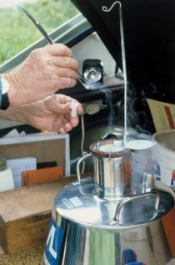
Control measures at the Artificial Insemination Centre.
Management of an artificial insemination centre should be directed towards ensuring that only healthy animals that do not shed or cannot potentially shed BoHV-1 are selected and introduced in the centre, and only BoHV-1 free semen is sold to the customers.
Approval for EU system
The Directive (EU Directive 88/407/EEG) indicates that all animals to be introduced into approved EU facilities must be negative to several diseases at an age of over 6 months before the acceptance. However, as only calves selected from farms officially negative to several diseases comprised in the OIE list A and B are introduced into the system at a very young age and venereal infections are highly unlikely, and they were individually proven negative to BoHV-1, BVD and leptospirosis, this action is meant to fulfill the EU legislation.
Therefore all calves are submitted to the prescribed tests at the age of 10 months before and subsequently during the so called EU quarantine. After proven negativity the
calves are accepted in the EU approved facilities.

Slide 24
IMMUNITY AND VACCINATION.
Infection leads to the development of humoral and cell- mediated immunity. The humoral immunity and not the cellular immunity can be transmitted to neonates via colostrum.
Both modified- live virus (MLV) and inactivated virus BHV-1 vaccines are on the market. The MLV vaccines are available as either a parenteral (intramuscular, IM or subcutaneous, SC) or intranasal (IN) vaccine. Use of MLV vaccines is not without risk due to persistence of the virus and its potential for reactivation.
Although conventional vaccines can prevent clinical signs of IBR, their use has not resulted in reduction of the prevalence of infection. The continued excretion of virus from vaccinated animals results in environmental contamination making the control of the disease more difficult. No vaccine has been shown to overcome viral latency.

Slide 25
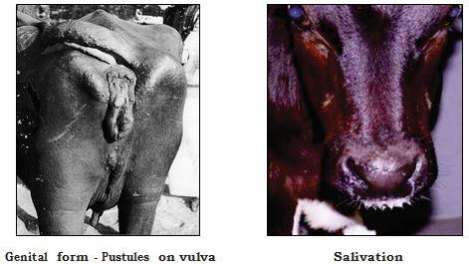
TREATMENT
There is no specific anti-BHV-1 therapy. The most appropriate treatment is antibiotic therapy designed to control secondary bacterial infection. Management practices designed to reduce stress, isolate infected animals, and provide adequate food and water will limit disease transmission and severity.
Nonsteroidal anti- inflammatory drugs may have some benefit to lessen the severity of BHV-1 disease and antimicrobial treatment is used to reduce secondary bacterial infections.

Slide 26
REFERENCES
Blackwell's Five-Minute Veterinary Consult: Ruminant
www.bovilis.com
www.ibr-marker.com
www.moredun.org.uk

Slide 27
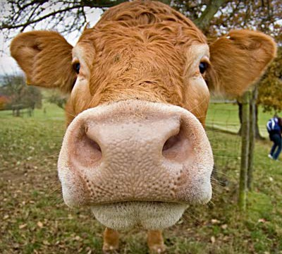
THANK YOU FOR THE ATTENTION!

