Slide 1
FELINE INFECTIOUS PANLEUKOPENIA
UNIVERSITY OF WARMIA AND MAZURY, OLSZTYN
PATHOMORPHOLOGY III

Slide 2
INDEX
INTRODUCTION
SYMPTOMS
MACROSCOPIC LESIONS
MICROSCOPIC LESIONS
TREATMENT
PREVENTION
BIBLIOGRAPHY

Slide 3
INTRODUCTION
Caused by feline parvovirus. Family Parvoviridae, gender Parvovirus.
Highly contagious viral disease
Kittens are most severly affected
It produces leukopenia = immunosuppressed cats
It is relatively frequent today
It is subject to vaccination
“The feline parvovirus infects and kills cells that are rapidly
growing and dividing, such as those in the bone marrow,
intestines, and the developing fetus”

Slide 4
Ways of infection:
Direct contact with urine, stool and nasal secretions
Infection by fleas as vectors
Transplacental
Infected cats shed the virus for a relatively short period of time (1-2 days)
The virus can survive for up to a year in the environment = infection without ever coming into direct contact with an infected cat.
It is very important to isolate infected cats. Any materials used on or for infected cats should not be used or allowed to come in contact with other cats, and people handling infected cats should practice proper hygiene to prevent spreading the infection.
The virus that causes FP is difficult to destroy and resistant to
many disinfectants.

Slide 5
SYMPTOMS
ENTERIC AND ACUTE FORM (KITTENS 2-4 months):
Vomiting and diarrhea = dehydration
Immunosupression
Injuries in small intestine
Posible subclinic infection
REPRODUCTIVE FORM:
Pregnant females with infection in the uterus
Animals that have been infected in the early neonatal period

Slide 6
MACROSCOPIC LESIONS
External evidence of diarrhea
The eyes may be sunken
The skin is usually inelastic, reflecting dehydration.
Rehydrated animals may have edema, hydrothorax, and ascites resulting from hypoproteinemia.
Pallor of mucous membranes and internal tissues in anemic animals.
Gross lesions of internal organs most consistently involve
the thymus and the intestine.
The thymus is markedly involute and reduced in
mass in young kittens.
Enteric lesions may be subtle and easily
overlooked.

Slide 7
Intestinal serosa may appear dry and nonreflective, with an opaque ground-glass appearance.
Petechiae or more extensive hemorrhage in the subserosa, muscularis, or submucosa of the intestinal wall.
The content is usually foul-smelling, scant, and watery, and yellow-gray at all levels of the intestine.
Lesions over Peyer's patches in the ileum.
Formed feces are not evident in the colon.
Lymph nodes may be prominent at the root of the mesentery.
Gross lesions elsewhere in the carcass are
usually restricted to pulmonary congestion
and edema in some animals.

Slide 8
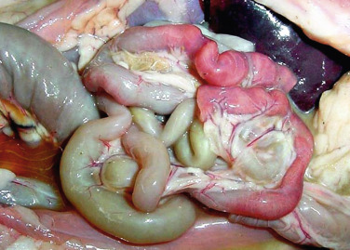
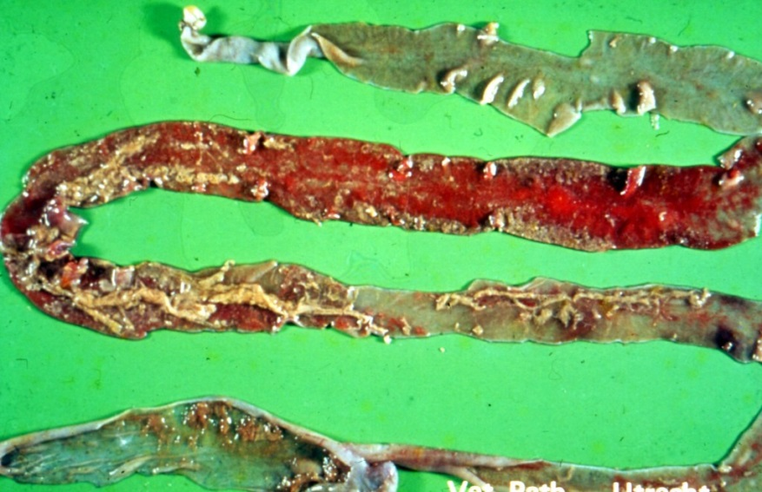
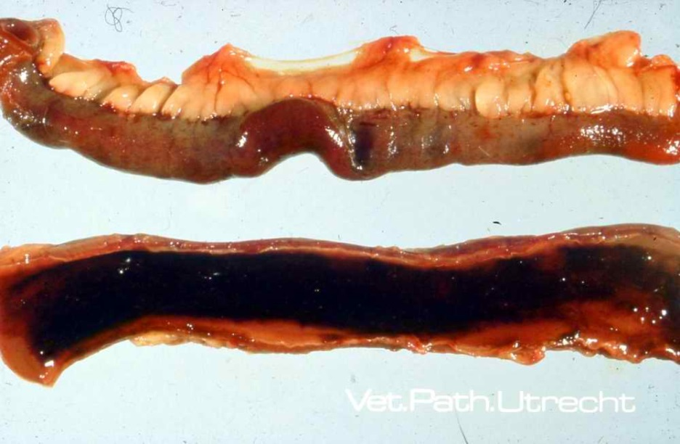
Dilated and hemorrhagic small intestine
in feline panleukopenia.
(Couresy J. Cawell)
Intestinal damage as a consequence of feline
panleukopenia virus infection; sloughing
of gut epithelium and fibrinous
“casts” are prominent.
Vet.Pathol.Utrecht
Hemorragic enteritis as a consecuence of feline panleukopenia virus infection
(Vet.Pathol.Utrecht)

Slide 9
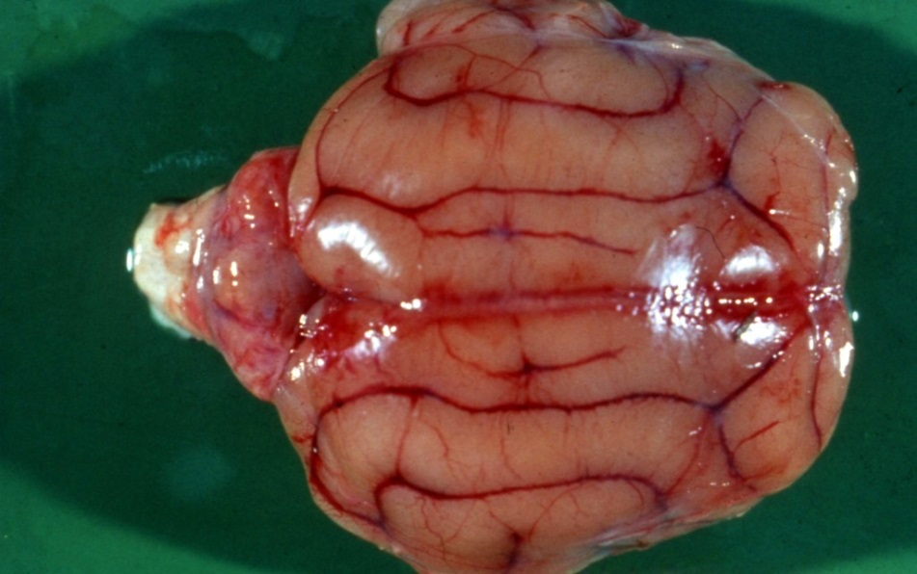
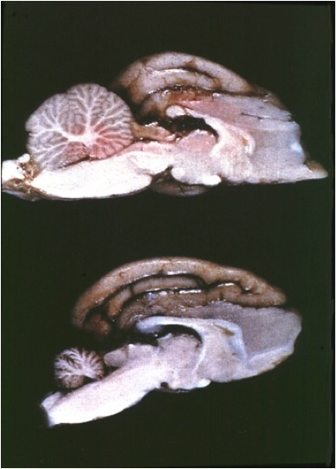
Cerebellar hypoplasia in a kitten infected
in utero with feline panleukopenia virus.
Marian C. Horzinek
Cerebellar hypoplasia (below) in a kitten infected in utero with feline panleukopenia virus; a normal brain is shown for comparison (above)
Diane Addie

Slide 10
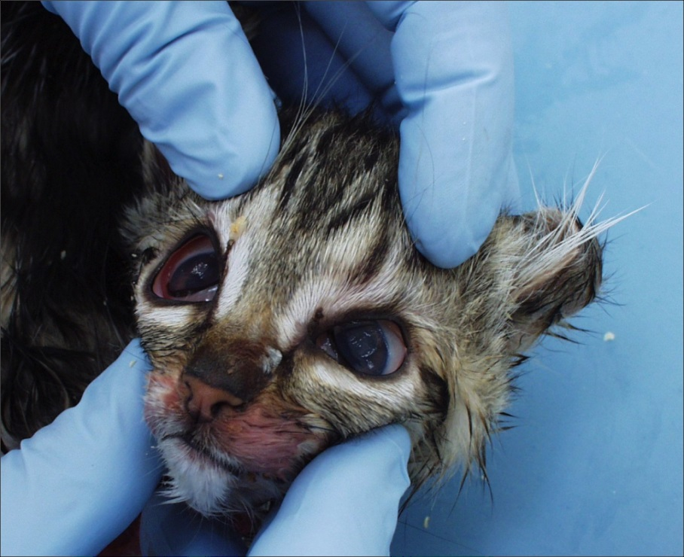
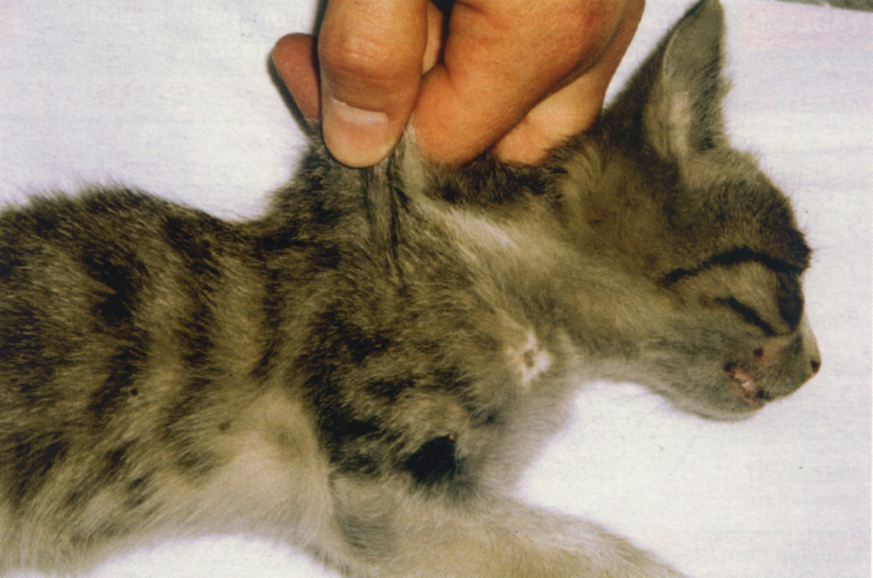
A kitten with severe signs of dehydration,
a result of electrolyte loss as a consequence
of feline panleukopenia.
Diane Addie

Slide 11
MICROSCOPIC LESIONS
Lesions in the intestinal tract vary with the severity and duration of the disease.
Usual in lymphoid organs and bone marrow
Crypt-lining epithelium is infected
Intranuclear inclusions may be found
Damaged epithelium containing inclusions exfoliates into the lumen of crypts.
Crypts are dilated
The lamina propia between crypts contains numerous neutrophils and eosinophils
The mucosa becomes thin and eroded or ulcerated, with effusion of tissue fluids, fibrin, and erythrocytes
Inflammatory cells and superficial masses of bacteria
Focal mucosal collapse and erosion or ulceration

Slide 12
Colonic lesions are present in about half of fatal cases of panleukopenia
Lesions of lymphoid organs during the early phase of the disease consist of lymphocytolysis in follicles and paracortical tissue in lymph nodes
Lymphoid necrosis has been associated with induced apoptosis of virus-infected lymphocytes
Follicular hyalinosis, the presence of amorphous eosinophilic material in the center of depleted follicles, may be seen
Severely depleted Peyer's patches may be difficult to recognize microscopically
Later in the course of clinical disease, corresponding to the period beyond 7-8 days after infection, prominent regenerative lymphoid hyperplasia may be found.
In severely affected animals with leukopenia proliferating elements in the bone marrow may be depleted.

Slide 13
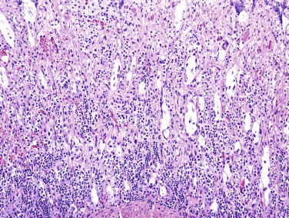
Necrosis and dilation of crypts of
Lieberkühn, caused by feline
panleukopenia virus infection in a cat
Histological section of feline small intestine diagnosed with feline panleucopenia.
Acute necrosis is identified of the mucosa, fusion and atrophy of villi and dilation of crypts.

Slide 14
Immunohistochemical examination of the small intestine of
feline with feline panleucopenia.
There is a positive
parvovirus in intestinal mucosal epithelial cells.
Positive marking for parvovirus in the lymphoid follicle of the
feline spleen with feline panleucopenia.

Slide 15
TREATMENT
Recovery from FP for infected kittens less than eight weeks old is poor.
Older cats have a greater chance of survival if adequate treatment is provided early.
There are no medications capable of killing the virus
Intensive care and treatment are critical to support the cat’s health with medications and fluids until its own body and immune system can fight off the virus. Without such supportive care, up to 90% of cats with FP may die.
Treatment focuses on correcting dehydration, providing nutrients, and preventing secondary infection
Strict isolation

Slide 16
PREVENTION
Cats that survive an infection develop immunity that likely protects them for the rest of their lives
Passive immunity: kittens receive temporary immunity through the transfer of antibodies in the colostrum
There are vaccines that offer the best protection from feline parvovirus infection.
Most young kittens receive their first vaccination between six and eight weeks of age and follow-up vaccines are given until the kitten is around 16 weeks of age.
Adult vaccination schedules vary with the age and health of the cat, as well as the risk of FP in the area.

Slide 17
BIBLIOGRAPHY
https://www.avma.org/public/PetCare/Pages/feline-panleukopenia.aspx
https://www.sciencedirect.com/topics/veterinary-science-and-veterinary-medicine/feline-panleukopenia
http://www.abcdcatsvets.org/abcd-guidelines-on-feline-panleukopenia-2012-edition/
https://www.sciencedirect.com/topics/neuroscience/feline-panleukopenia-virus

