Slide 1
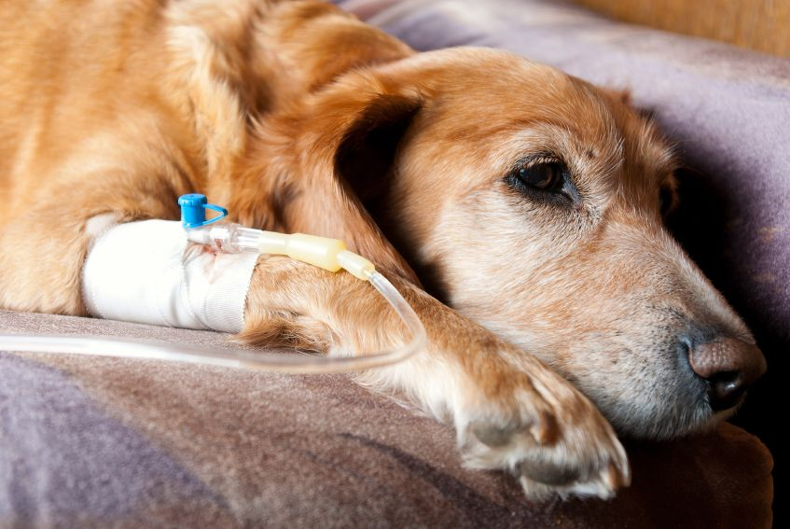
LeptospIrosIs In Dogs

Slide 2
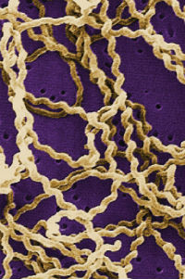
What is Leptospirosis?
Leptospirosis is a disease that infects both animals and humans which cause septicemia. The scientific name of the infecting organism is Leptospira interrogans sensu lato. There are many different strains (serovars). Around the world, there are more than 200 serovars of lepto. Of these different strains there are eight that are important for dogs and cats.
These different strains produce different levels and types of disease depending on the animals they infect. While cats can be infected, they rarely show signs of disease. The disease is much more of a problem in dogs, people, and livestock.

Slide 3
There are vaccines available, but usually only for one or two of the more common strains. Unfortunately, vaccination against one strain does not protect against the other strains. The current canine vaccines protect against the serovars canicola and icterohaemorrhagiae. These two serovars have been decreasing in total number of infections, but unfortunately, other serovars that infect dogs such as grippotyphosa, pomona, and bratislava have increased.

Slide 4
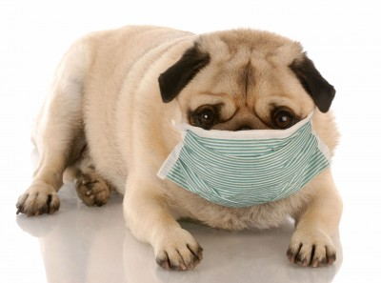
Lepto serovars are maintained in nature by "reservoir hosts" and shed the organisms for long periods of time. The host vary with the serovar as well as the geographic location.
Dogs can be reservoir hosts for the serovar L. canicola. Many academics consider L. canicola the least frequently isolated serovar in dogs. Once outside their host, leptospires do not replicate.

Slide 5
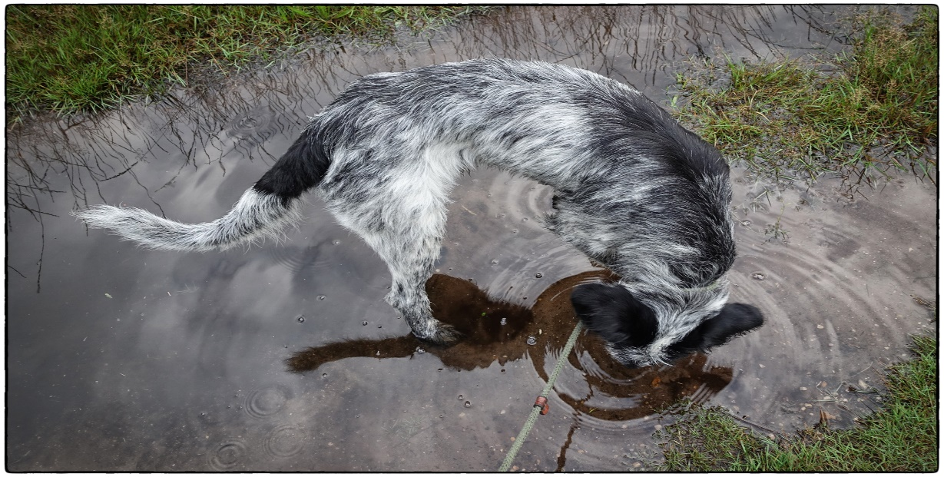
Epidemiology
Leptospires are transmitted among animals by direct contact (i.e., infected urine, venereal secretions, animal bites, ingestion of infected tissue) and indirect contact (i.e., contaminated water, soil, food, bedding). Crowding, as a kennel, can increase the spread of infection. Stagnant or slow moving water provides a suitable habitat for Leptospira. As a result, disease outbreaks often increase during periods of flooding. In dry areas infections are more common around water sources.
Freezing greatly reduces the survival of the organism in the environment. This explains why infections are more common in summer and fall and why the infection is more prevalent in temperate areas.

Slide 6
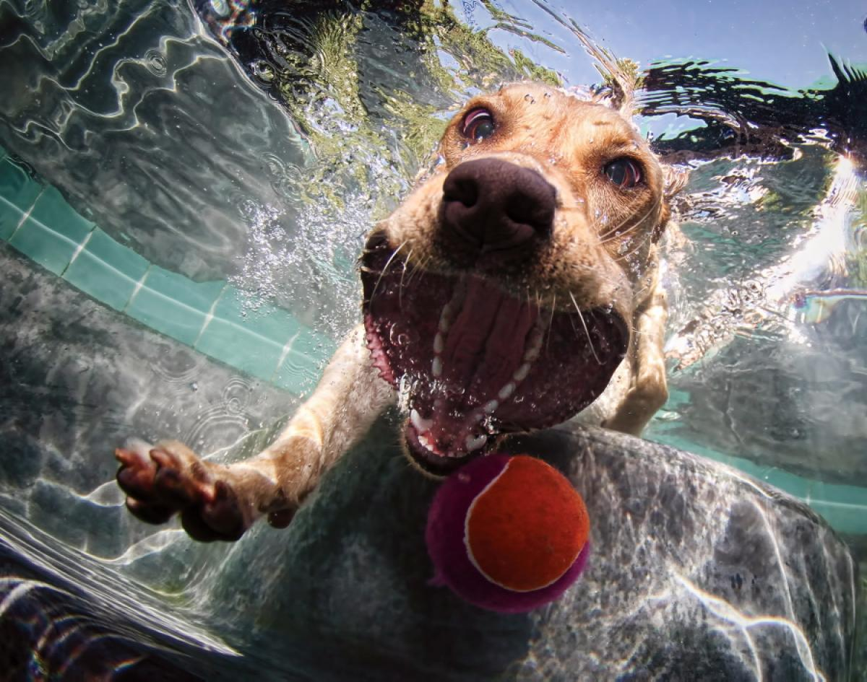
Lepto has been diagnosed in all types of dogs. All breeds and sizes of dogs are at risk. Lepto can be a very serious disease and can be fatal if not diagnosed and treated early.
It generally attacks a dog's liver and kidneys and can lead to organ damage or failure. However, if lepto is caught early, it responds well to antibiotics. Preventative measures, such as vaccinations, are available too.

Slide 7
The Leptospira infection mainly occurs in subtropical, tropical, and wet environments.
They are more prevalent in marshy/muddy areas which have stagnant surface water.
Heavily irrigated pastures are also common sources of infection.
The infection rate for domestic pets has been increasing in the U.S. and Canada, with infections occurring most commonly in the fall season.
Dogs will typically come into contact with the leptospira bacteria in infected water, soil, or mud, while swimming, passing through, or drinking contaminated water, or from coming into contact with urine from an infected animal.
Hunting and sporting dogs, dogs that live near wooded areas, and dogs that live on or near farms are at an increased risk of acuiring this bacteria. Also dogs that have spent time in a kennel are at increased risk.

Slide 8
Most dogs are infected by direct contact with infected urine, or by contact with water or soil contaminated with infected urine. Leptospira can penetrate the lining of the nose, mouth and eyelid, and can also enter the body through scratches or open sores on the skin.
Infection often causes serious damage to the kidney and liver, and can be fatal in severe cases. The organism is transmitted in the urine of infected animals and can survive in the environment for long periods of time, especially in warm stagnant water or moist soil. Wild animals, including the skunk, raccoon, opossum, rat, wolf, and deer, are an important source of infection.

Slide 9
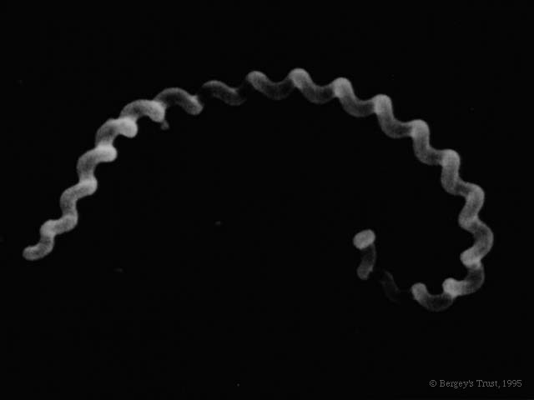
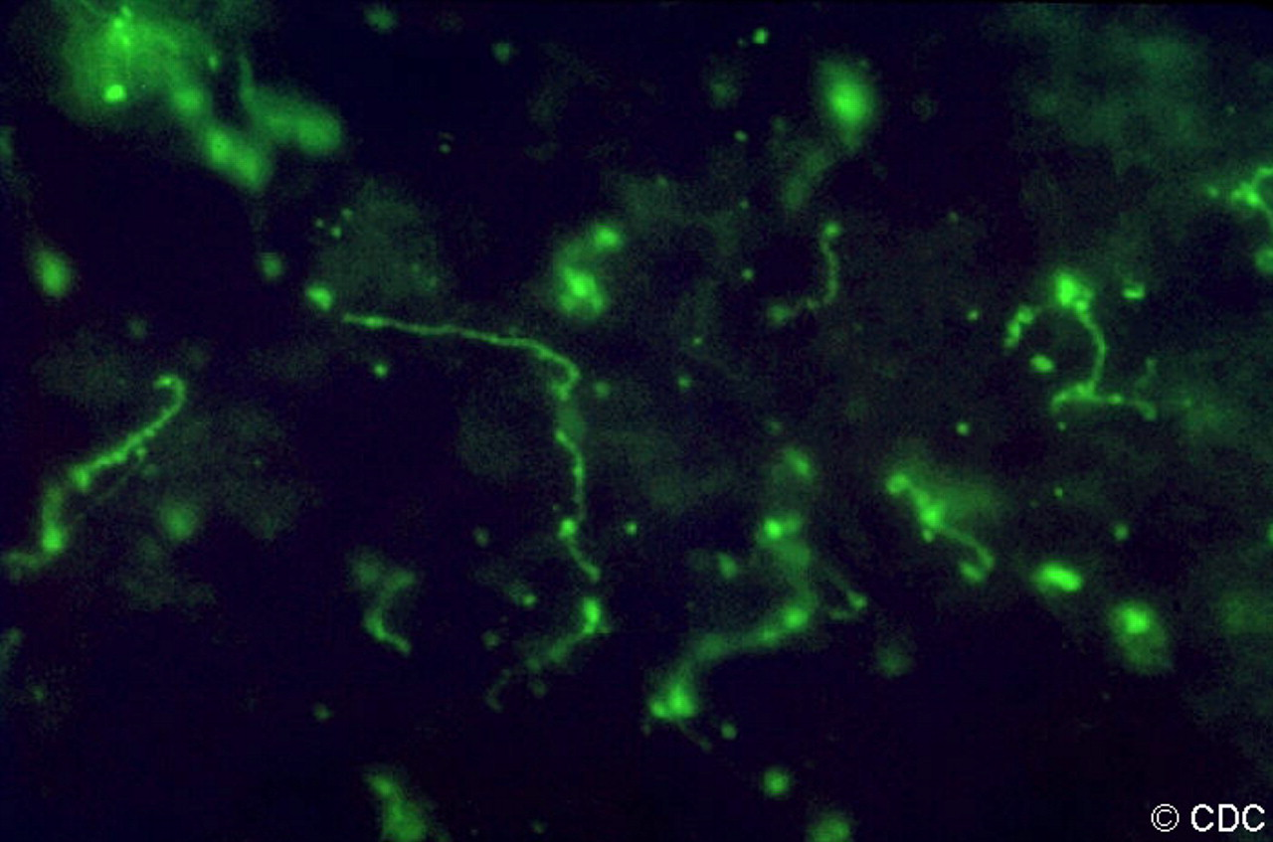
Morphology
✓ The Leptospira appear tightly coiled, thin, flexible.
✓ Spirochetes 5-15 microns long.
✓ One end appears bent, forms a hook.
✓ Actively motile.
✓ Seen best with dark field Microscopy.

Slide 10
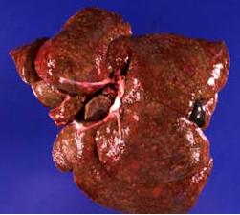
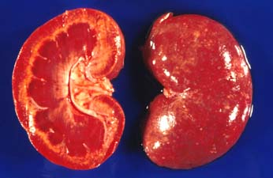
Pathogenesis
Leptospira bacteria penetrate mucous membranes or abraded skin and rapidly entering the blood system. From there they spread to other tissues including the kidneys, liver, spleen, nervous system, eyes, and genital tract. The amount of damage done to the internal organs is depending on the serovar and the host it infects.
Liver of a dog that died of leptospirosis. Multifocal hepatic necrosis is associated with a mottled appearance of this organ.
Kidney of a dog that died of leptospirosis. Multifocal interstitial nephritis and renal tubular necrosis are associated with a spotted appearance of the renal parenchyma.

Slide 11
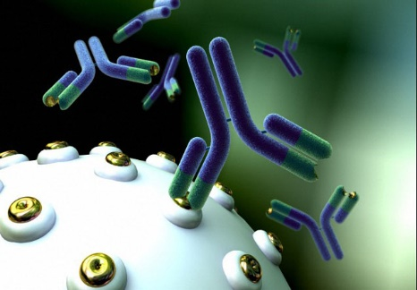
About 8-10 days after infection, the dog's immune system responds to the infection and produces antibodies that quickly clear the Leptospira from the blood. However, in spite of this immune response, some bacteria are able to survive in the kidney, resulting in long-term infection and ongoing shedding of organisms in the urine. Dogs that have recovered but that still carry Leptospira in their kidneys are said to be in the 'carrier state'.

Slide 12
Tissue edema and disseminated intravascular coagulation (DIC) may occur in rapid and severe leptospirosis that results in acute endothelial injury and hemorrhage.

Slide 13
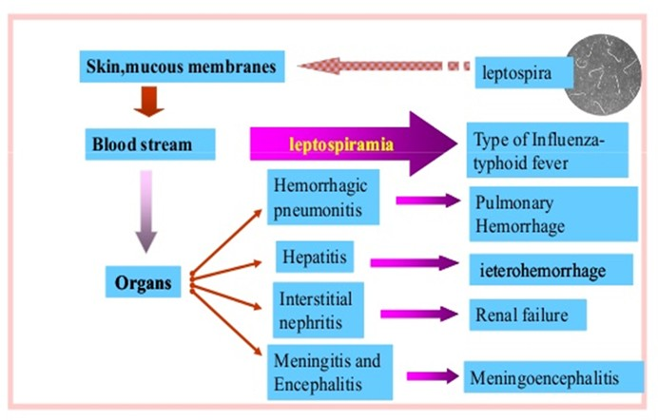
Infections in dogs with the serovars canicola and grippotyphosa have been associated with kidney infections with minimal liver involvement. Whereas, the serovars pomona and icterohaemorrhagiae produce liver disease. Dogs younger than 6 months tend to develop more cases of liver disease regardless of the serovar.

Slide 14
Acute Leptospirosis:
Liver; macroscopic picture:
The liver is enlarged and yellow in color.
Yellow colour due to icterus.
Small hemorrhages on the pleura, pericardium and peritoneum.
Liver; microscopic picture:
Coagulative necrosis in hepatic cells.
Dissociation of the hepatic cells
Hemolytic jaundice with dilation of the bile.
Hemosiderosis are seen in the kupffer cells.

Slide 15
Yellow liver due to icterus.
Macroscopic Picture

Slide 16
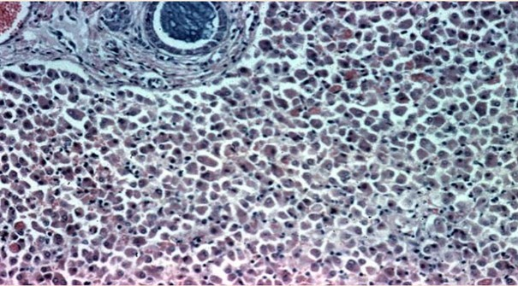
Dissociation and individualisation in hepatic cells.
Microscopic Picture

Slide 17
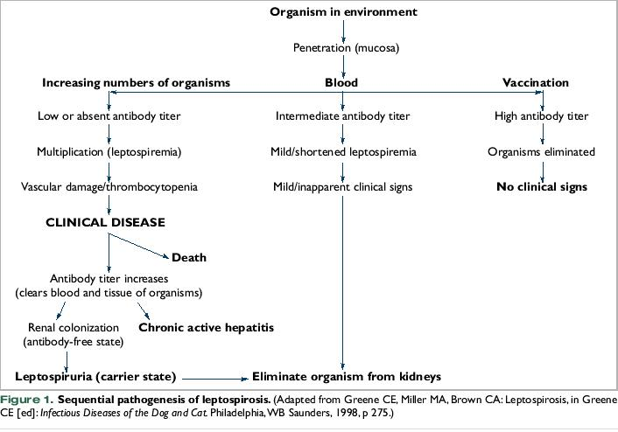

Slide 18
Clinical Signs
The clinical signs of canine leptospirosis depend on the age and immunity of the host, environmental factors affecting the bacteria, and the virulence of the infecting serovar. Young animals are more severely affected than adults.
In peracute infections, leptospirosis can be associated with massive leptospiremia. Death may occur rapidly with few premonitory signs.
In acute infections a fever of 103-104°, shivering, and muscle tenderness are the first signs. Severely infected dogs may develop hypothermia and become depressed and die before kidney or liver failure has a chance to develop.

Slide 19
In subacute infections, the animal usually develops a fever, anorexia, vomiting, dehydration, and increased thirst. The dog may be reluctant to move due to muscle or kidney pain. Animals with liver involvement may develop jaundice. Dogs that develop kidney or liver problems may begin to show improvement in organ function after 2 to 3 weeks or they may develop chronic renal failure.
Despite the possibility of severe infection and death, the majority of leptospiral infections in dogs are chronic or subclinical. Dogs that become chronically infected may show no outward signs, but may intermittently shed bacteria in the urine for months or years.

Slide 20
Sudden fever and illness
Sore muscles, reluctance to move
Shivering
Depression
Lack of appetite
Increased thirst and urination, may be indicative of chronic renal failure
Rapid dehydration
Vomiting, possibly with blood
Diarrhea - with or without blood in stool
Bloody vaginal discharge
Dark red speckled gums
Yellow skin and/or whites of eyes – anemic symptoms
Swelling of the mucous membrane
Possible symptoms.

Slide 21
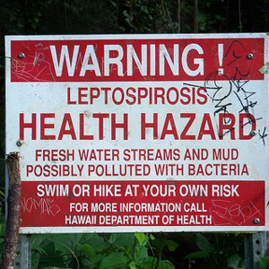
Diagnosis
Diagnosis of leptospirosis is based on a combination of suggestive historical information, physical findings, nonspecific laboratory findings, and confirmatory testing.
A positive diagnosis can be made through a blood test. A blood sample of the suspected animal is drawn and sent into the laboratory where a microscopic agglutination test is performed.
It can test the individual serovars (strains) and the level of antibody (titer) against these strains. Depending on the level of the titer, a positive diagnosis to the specific serovar can be made. Titers may be negative in the first 10 days after initial infection, additional samples must be drawn and tested to get a positive diagnosis.
Previous vaccination can give a high titer level and this must be taken into consideration when evaluating the titers.
It is possible to culture a urine sample and get a positive diagnosis. However, because of intermittent shedding and bacterial contamination, this is not always the best way to diagnose the disease.

Slide 22
Because leptospirosis is a zoonotic disease, your veterinarian will be especially cautious when handling your pet, and will strongly advise you to do the same. Protective gloves must be worn all the time, and all body fluids will be treated as a biologically hazardous material. Urine, semen, post-abortion discharge, vomit, and any fluid that leaves the body will need to be handled with extreme caution.
You will need to give history of your dog's health, including a background history of symptoms, recent activities, and possible incidents that might have precipitated this condition. The history you provide may give your veterinarian clues as what stage of infection your dog is experiencing, and which organs are being most affected.

Slide 23
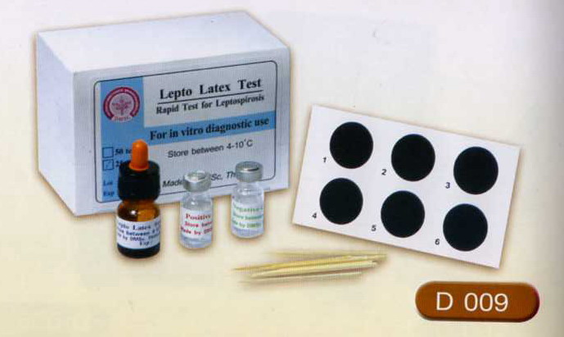
Your veterinarian will order a chemical blood profile, a complete blood count, a urinalysis and a fluorescent antibody urine test. Urine and blood cultures will also be ordered for examining the prevalence of the bacteria. A microscopic agglutination test, or titer test, will also be performed to measure the body's immune response to the infection, by measuring the antibodies in the bloodstream. This will help to identify leptospira and the level of systemic infection.

Slide 24
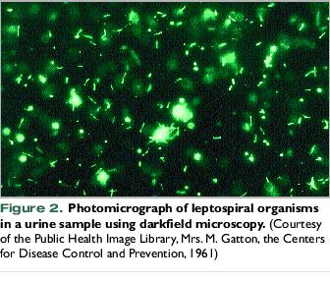
☺ The serovars most commonly incriminated in canine infection and their common reservoirs include L. canicola (dog), L. icterohaemorrhagiae (rodents), L. gryppotyphosa (raccoon, skunk, opossum, vole), L. pomona (cattle, swine, skunks, opossum), and L. bratislava (rodents, swine).

Slide 25
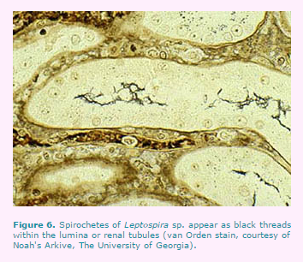
Often, serovars canicola and gryppotyphosa are described in association with renal dysfunction and minimal hepatic disease, while serovars icterohaemorrhagiae and pomona produce both hepatic and renal damage.
Any serovar is capable of producing endothelial damage, vasculitis, and acute complications including DIC and edema. Realistically, the clinical disease is similar enough that the serovar cannot be distinguished without confirmatory testing.

Slide 26
Confirmatory tests include serologic testing to detect antibody production for leptospira. Very high antibody titers are suggestive of infection, but paired serum titers produce more reliable prognostic information.
Direct detection of the bacterium may be done by urine or blood culture, polymerase chain reaction (PCR) identification of leptospiral DNA, or urine dark-field microscopy.
If the patient has been treated with antibiotics prior to collection of laboratory specimens for analysis, the number of bacteria in urine and blood may decrease in number rapidly. In such circumstances, the diagnostic tests may be negative because of poor sensitivity.

Slide 27
Treatment
Treatment consists of antibiotics, fluid replacement, and controlling the vomiting. Antibiotics dependent on the stage of infection will be prescribed by your veterinarian.
Penicillin, or one of its derivatives is the antibiotic of choice for treating the initial infection but they are not effective for eliminating the bacteria once it has reached the carrier stage. Tetracyclines, fluoroquinolones, or similar antibiotics will be prescribed for this stage, since they are better distributed into the tissue.
Antibiotics will be prescribed for a course of at least four weeks. Some antibiotics can have side effects that appear serious, especially those drugs that go deeper into the system to eliminate infection. Prognosis is generally positive, except severe organ damage.

Slide 28
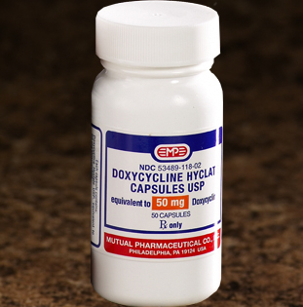
After the initial infection is controlled, doxycycline is often used to cure and prevent a potential long-term carrier state.
Intravenous or subcutaneous fluids are often given to correct dehydration while the corresponding liver or kidney problems are treated.
Dogs with acute severe disease should be hospitalized. Fluid therapy will be the first treatment, in order to reverse any effects of dehydration.
If your dog has been vomiting, an anti-vomiting drug, called an antiemetic, may be administered, and a gastric tube can be used to nourish your dog if its inability to eat or keep food down continues. A blood transfusion may also be necessary if your dog has been severely hemorrhaging.

Slide 29
Vaccination and Prevention
There are currently many different vaccines available for a wide variety of species and serovars. The ones currently available for dogs are chemically inactivated whole culture vaccine, which unfortunately make them much more likely to cause vaccine reactions as opposed to most viral vaccines. Leptospiral vaccines are blamed for many of the vaccine reactions we see in dogs. Due to the low infection rate in cats, there are currently no vaccines available for them.

Slide 30
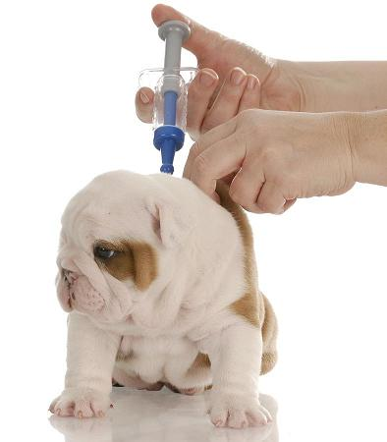
Leptospiral vaccines for dogs offer about 6 to 8 months of protection. Dogs that are at high risk of contracting Leptospiral infections should be vaccinated twice a year.
Vaccine manufacturers generally recommend that puppies less than 8 weeks of age should not be vaccinated with vaccines containing Leptospira. Many veterinarians recommend waiting until 12-16 weeks of age for the first vaccination against Leptospira.
Because of the high incidence of reactions and the need for frequent vaccination many veterinarians have begun to recommend leptospiral vaccinations only for those dogs at higher risk. Because this can potentially be a very serious disease.

Slide 31
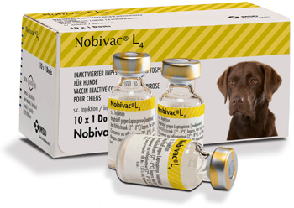
Living and Management
Make sure to inspect kennels before placing your dog in one, the kennel should be kept very clean, and should be free of rodents. Urine from an infected animal should not come into contact with any other animals, or people.
Activity should be restricted to cage rest while your dog recovers from the physical trauma of this infection. Leptospirosis is a zoonotic disease, transmissible to humans, and other animals via urine, semen, and post-birth or post-abortion discharge.
While your dog is in the process of being treated, you will need to keep it isolated from children and other pets, and you will need to wear protective gloves when handling your dog in any way, or when handling fluid or waste products from your dog. Areas where your dog has urinated, vomited, or has possibly left any other type of fluid should be cleaned and disinfected.

Slide 32
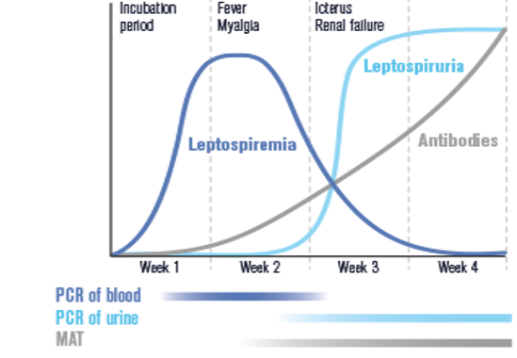
Finally, if you do have other pets or children in the home, they may have been infected with the leptospira bacteria and are not yet showing symptoms. It may be worthwhile to have them and yourself tested for the presence of the bacteria. And, it is important to keep in mind that leptospires may continue to be shed through the urine for several weeks after treatment and apparent recovery from the infection.

Slide 33
References
http://www.vetfolio.com/infectious-disease/canine-leptospirosis-epidemiology-pathogenesis-and-diagnosis
http://www.petmd.com/dog/conditions/infectious-parasitic/c_multi_leptospirosis?page=2
http://www.sweetshimas.com/index.php?main_page=page&id=45&chapter=0
http://www.vcahospitals.com/main/pet-health-information/article/animal-health/leptospirosis-in-dogs-testing/358
http://petfriends.social/bilgiler/Kopeklerde-Leptospirosis
http://www.whitneysvet.com/parasites/lepto.html

