Slide 1
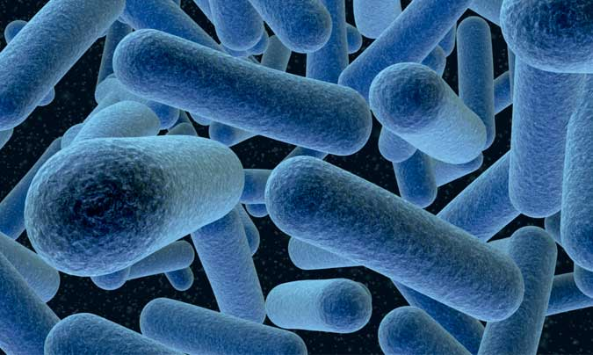
Listeriosis
UWM 2019

Slide 2
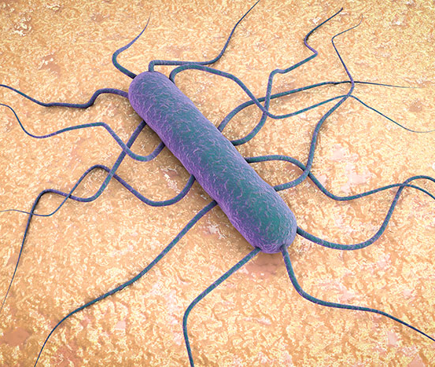
Index
Etiology
Characteristics
Geographic distribution
Transmission
Disinfection
Species affected
Incubation period
Clinical signs
Postmortem lesions
Diagnosis
Treatment
Prevention

Slide 3
Etiology
Listeriosis usually results from infection by Listeria monocytogenes, a Gram positive rod in the family Listeriaceae. This organism is a facultative intracellular pathogen.
There are 13 serovars of L. monocytogenes. Although all are considered to be potentially virulent, serovars 4b, 1/2b, and 1/2a cause most animal and human disease.
L. ivanovii (formerly known as L. bulgarica or serovar 5 of L. monocytogenes) is occasionally associated with abortions in sheep and cows, or septicemia in sheep.
Rare infections with L. ivanovii and L. seeligeri have been reported in humans. L. innocua, L. welshimeri and L. grayi have not been associated with human disease.

Slide 4
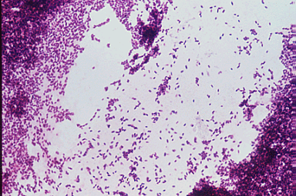
Characteristics
L. monocytogenes is relatively resistant to freezing, drying and heat.
It will grow at temperatures from 1°C to 45°C and can proliferate at refrigeration temperatures on contaminated foods.
It can tolerate a pH from 3.6 to 9.5, or a sodium chloride content of 20%. A pH of greater than 5 (e.g. spoiled silage) favors the growth of this organism, but it has also been found in silage with a pH less than 4.

Slide 5
Geographic Distribution
L. monocytogenes is found worldwide and is widely distributed in the environment.

Slide 6
Transmission
The reservoirs of infection are the soil and the intestinal tracts of asymptomatic animals, including wild and feral mammals, birds, fish and crustaceans.
Infected animals can shed L. monocytogenes in the feces, milk and uterine discharges. It is also found in aborted fetuses and occasionally in the nasal discharges and urine of symptomatic animals.
Soil or fecal contamination results in its presence on plants and in silage.
Most infections are acquired by ingestion, but Listeria can also spread by inhalation or direct contact. Venereal transmission might also be possible. In ruminants, listeriosis typically occurs after the consumption of contaminated silage or other feed.

Slide 7
Disinfection
L. monocytogenes is susceptible to 1% sodium hypochlorite, 70% ethanol or glutaraldehyde. It can also be killed by moist heat (121°C for a minimum of 15 min) or dry heat (160-170°C for 1 hour).
In foods, L. monocytogenes is usually killed by cooking or pasteurization. It can survive some forms of pasteurization, particularly if the bacterial count is high.
Population numbers on produce can be reduced by exposure to ozone, chlorine dioxide, chlorinated trisodium phosphate, or peroxyacetic acid, as well as 1.5% lactic acid plus 1.5% hydrogen peroxide for 15 minutes at 40°C.
Listeria contamination can also be reduced with a combination of pH 10.5 and 10% NaCl plus monolaurin or lauric acid.

Slide 8
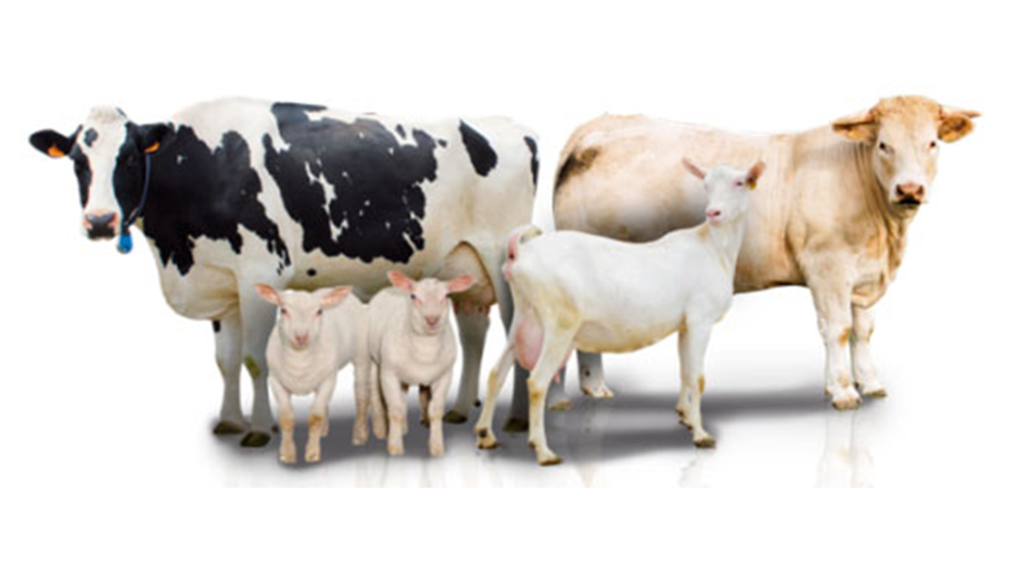
Species affected
A wide variety of domestic and wild mammals, birds, fish and crustaceans carry L. monocytogenes asymptomatically in the digestive tract.
Clinical disease is seen most often in ruminants. Occasional cases occur in rabbits, guinea pigs, pigs, dogs, cats, poultry, canaries, parrots and other species.

Slide 9
Incubation period
The incubation period for encephalitis in ruminants is usually 10 days to 3 weeks. Septicemia and abortions can appear after one day or more. The incubation period in turkeys is 16 hours to 52 days.

Slide 10
Clinical signs
Listeriosis is usually characterized by encephalitis, abortions or septicemia.
Ruminants
Can cause encephalitis, abortions and septicemia in sheep, cattle and goats. In the encephalitic form, the initial symptoms of depression and anorexia are followed by neurologic signs, which may include facial paralysis with profuse salivation, torticollis, strabismus, circling, incoordination, and head pressing or turning of the head to one side.
The neurologic signs are often unilateral. Animals become recumbent during the final stages of the disease, and may make involuntary running movements or characteristic chewing motions.
The course of the disease is usually short, from one to four days, in sheep and goats, with death as soon as one or two days.
Listeriosis is more chronic in cattle, with animals typically surviving for 4 to 14 days. Abortions and stillbirths mainly occur late in gestation.
The dam usually has no other clinical signs, with the exception of a fever and anorexia in some cases. If the placenta is retained, the animal may develop metritis. Septicemia occurs most often in newborns and young ruminants; older animals are rarely affected. Typical symptoms may include fever, depression, inappetence and death. Localized infections can also be seen, including subclinical, acute or chronic mastitis in cattle, and ophthalmitis in sheep.

Slide 11
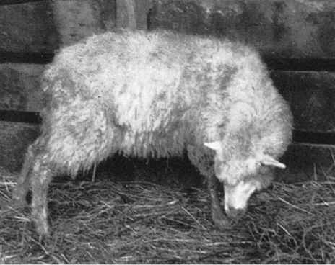
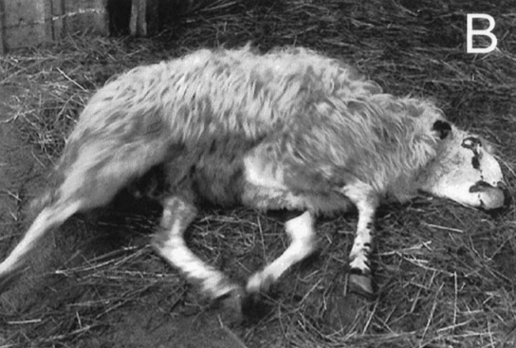
Typical clinical manifestation of meningoencephalitis caused by
L. monocytogenes in sheep In the first stage involuntary torticollis and walking in circles
In a phase subsequent to the previous image, we observe prostration, incoordination and pedaling. The prognosis in these cases is fatal

Slide 12
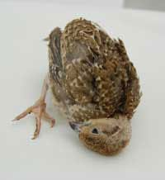
Birds
Clinical listeriosis is rare in birds, with most cases occurring in young animals. Septicemia is the most common syndrome; the symptoms may include depression, listlessness, diarrhea and emaciation. Peracute deaths can be seen, sometimes without other clinical signs. Meningoencephalitis is occasionally reported, and is characterized by torticollis, stupor, tremors and paresis or paralysis. In young geese, both encephalitis and septicemia can be seen concurrently.
Affected red-legged partridges exhibited neurological signs including torticollis, head tilt and incoordination

Slide 13
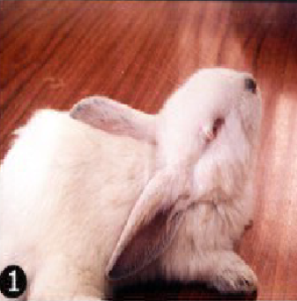
Rabbits
In rabbits, L. monocytogenes usually causes abortion, neurological signs or sudden death. Most cases occur in does during late pregnancy. Encephalitis is rare. Infected rabbits may also have nonspecific clinical signs including anorexia, depression and weight loss.
Bunny with purulent conjuntivitis and nervous signs.

Slide 14
Swine
Listeriosis is uncommon in swine. The most common form is septicemia in young piglets, with death within 3 to 4 days.
Encephalitis and abortions are also seen occasionally.
Cats and dogs
Rare cases of encephalitis or septicemia occur in cats. Typical symptoms may include depression, inappetence, abdominal pain, vomiting and diarrhea.
Septicemia and neurologic signs resembling rabies have been reported in dogs.

Slide 15
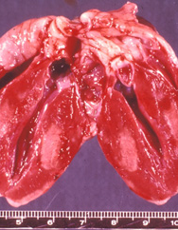
Post mortem lesions
Ruminants
The post-mortem lesions vary with the clinical presentation. Gross lesions are absent or minimal in animals with Listeria encephalitis and are usually limited to turbid CSF, areas of softening in the medulla oblongata, and congested meningeal vessels.
The septicemic form is typically associated with necrotic foci in the internal organs, particularly the liver. Aborted fetuses may be slightly to significantly autolyzed. There can be clear or blood-tinged fluid in the serous cavities, and shallow erosions in the mucosa of the abomasum.
Foci of necrosis may be found in the liver and sometimes the lung, spleen or other organs. In cattle, the liver may be shrunken and gray. In some cases, the fetus may have few gross lesions. The placental cotyledons and intercotyledonary areas can also be necrotic.
Birds
The characteristic lesions in birds with Listeria septicemia are areas of myocardial necrosis and degeneration, and serofibrinous pericarditis. There may also be petechial hemorrhages in the proventriculus and heart, as well as splenomegaly, hepatomegaly, bile retention, and focal hepatic necrosis. There are no gross brain lesions in the encephalitic form.
Avian, heart. There are multiple pale foci of purulent myocarditis.

Slide 16
Diagnostic tests
Listeriosis can be diagnosed by isolating L. monocytogenes from the placenta, fetus or uterine discharges after an abortion.
Blood or cerebrospinal fluid (CSF), respectively, can be cultured in animals with septicemia or encephalitis.
At necropsy, the liver, kidneys and spleen can be cultured in septicemic animals, or the pons and medulla in animals with encephalitis.
L. monocytogenes has also been isolated from the nasal discharges, urine, feces or milk of affected animals.
Samples from animals are traditionally plated directly on blood agar or other media, and simultaneously cultured with a cold enrichment technique. In the cold enrichment procedure, growth may take up to 3 months. Colonies are identified with biochemical tests.
L. monocytogenes can be identified in tissues with a variety of commercial rapid identification methods, based on biochemical tests and enzyme reactions.
It can also be detected with enzyme-linked immunosorbent assay (ELISA), immunofluorescence, immunochromatography and PCR techniques. Serology is not routinely used for diagnosis.

Slide 17
Treatment
Listeriosis can be treated with a variety of antibiotics. High doses and early treatment are required for animals with encephalitis; animals with severe neurologic signs usually die despite treatment. Ampicillin represents the drug of choice in the treatment of listeriosis
Supportive treatment may also be required.

Slide 18
Prevention
The risk of listeriosis can be decreased in ruminants by feeding good quality silage with a low pH. Spoiled or moldy silage should be avoided, as well as silage from the superficial few inches exposed to air.
Any leftover silage should be removed after feeding.
Rodents should be controlled.
New animals added to the herd should be quarantined, and animals with clinical listeriosis isolated.
The placenta and fetus should be removed after an abortion.
There is no vaccine for listeriosis.

Slide 19
Bibliography
https://www.academia.edu/9856092/Listeria_Infection_in_Rabbits_at_Ismailia_Province
http://www.colvema.org/PDF/5667Listeria.pdf
https://journals.sagepub.com/doi/pdf/10.1177/030098588502200217
https://www.ncbi.nlm.nih.gov/pmc/articles/PMC3910207/
http://lrd.spc.int/ext/Disease_Manual_Final/c611__listeriosis.html

