Slide 1
MAEDI VISNA DESEASE

Slide 2
WHAT IS MAEDI-VISNA DISEASE?
Maedi-visna is an economically important viral disease of sheep that occasionally affects goats. The maedi-visna virus (MVV), a lentivirus; infects its hosts for life. Although most infections are subclinical, a minority of animals develops progressive, untreatable disease syndromes including dyspnea (maedi) or neurologic signs (visna). Both maedi and visna are eventually fatal.

Slide 3
ETIOLOGY
Maedi-visna results from infection by the maedi-visna virus, a member of the genus Lentivirus in the family Retroviridae (subfamily Orthoretrovirinae). This virus becomes integrated into leukocyte DNA; infected animals become chronic carriers. Several genetically distinct isolates circulate in sheep.

Slide 4
SPECIES AFFECTED
Maedi-visna affects sheep and, to a lesser extent, goats. Breed susceptibility varies. Texel, Border Leicester, and Finnish Landrace sheep appear to be relatively susceptible to disease; Columbia, Rambouillet, and Suffolk sheep seem to be relatively resistant. Serological evidence of SRLV infections has also been reported in wild ruminants including moufflin, ibex and chamois; however, preliminary evidence suggests that these viruses may be distinct from CAEV and MVV.

Slide 5
GEOGRAPHIC DISTRIBUTION
Maedi-visna has been found in most sheep-raising countries other than Australia and New Zealand. MVV has been reported from most of continental Europe, the United Kingdom, Canada, the United States, Peru, Kenya, South Africa, Israel, India, Myanmar and the southern regions of the former U.S.S.R.

Slide 6
TRASMISSION
Most animals become infected early in life, from drinking infected colostrum or milk. The virus can also be spread during close contact, probably by the respiratory route. Coinfection with pulmonary adenomatosis (Jaagsiekte) virus increases MVV titers in the respiratory tract, increasing contact transmission between sheep. Transmission has been reported from water contaminated with feces, but indirect spread is generally thought to be rare. Intrauterine spread is thought to be negligible or minor. MVV infects sheep or goats for life, but viral burdens vary between individual animals. Both asymptomatic and symptomatic animals can transmit this virus. Sheep can be a source of SRLV transmission to goats, and vice versa. There is little information on the route(s) of transmission between sheep and goats, but the ingestion of contaminated colostrum or milk, or close contact between the two species in crowded barns have been suggested. Under experimental conditions, lambs that have nursed from infected goats can become persistently infected with SRLV.

Slide 7
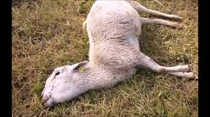
INCUBATION PERIOD
The incubation period for maedi is usually more than two years; clinical signs typically develop when animals are three to four years old. The incubation period for visna is somewhat shorter, and symptoms can appear in sheep as young as two years.

Slide 8
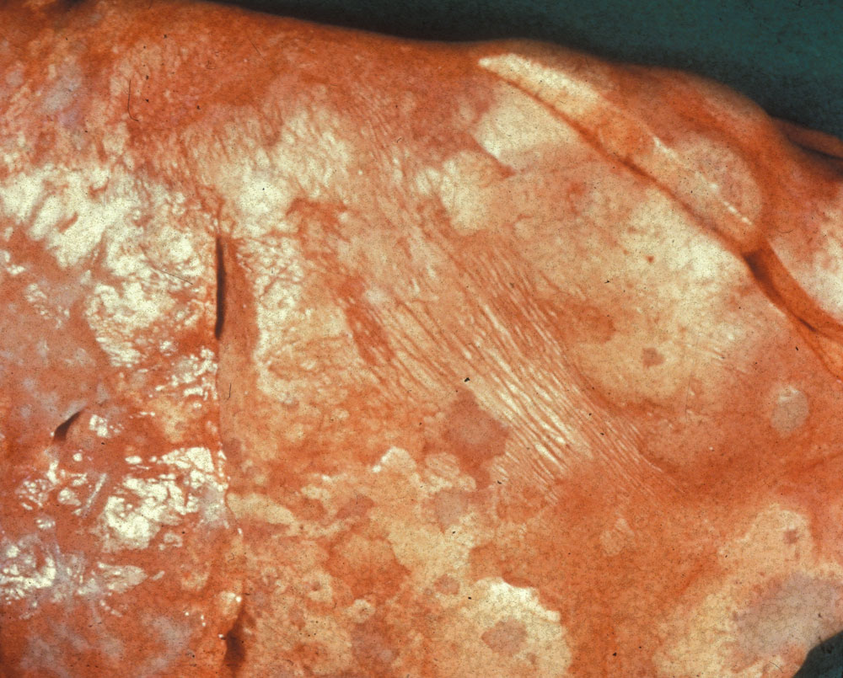
CLINICAL SIGNS
Most MVV infections are asymptomatic. In animals with clinical signs, the disease can take several forms. Sheep with maedi, the most common form, experience wasting, progressive dyspnea and sometimes a dry cough. Fever, bronchial exudates and depression are not usually seen. Maedi is eventually fatal; death results from anoxia or secondary bacterial pneumonia.
Visna occurs less frequently than maedi in sheep, although it is the more common form reported in goats. Visna usually begins insidiously, with subtle neurologic signs such as hindlimb weakness, trembling of the lips or a head tilt, accompanied by loss of condition. The symptoms gradually progress to ataxia, incoordination, muscle tremors, paresis and paraplegia. Other neurological signs, including rare instance of blindness, may also be seen. The clinical course can be as long as a year. Unattended animals usually die of inanition.

Slide 9
CLINICAL SINGS
MVV can also cause slowly progressive arthritis with severe lameness, or chronic indurative mastitis with decreased production of normal-appearing milk. Weight gain in lambs may be decreased, possibly due to lower milk yields from dams with indurative mastitis.

Slide 10
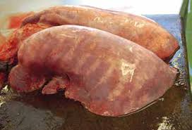
POST-MORTEM LESIONS
In maedi, the lungs are enlarged, abnormally firm and heavy, and fail to collapse when the thoracic cavity is opened. They are typically emphysematous and mottled or uniformly discolored, with pale gray or pale brown areas of consolidation. Mottling may not be obvious in the earliest stages of the disease.
Nodules may be found around the smaller airways and blood vessels, and the mediastinal and tracheobronchial lymph nodes are usually enlarged and edematous.
On histological examination, lung lesions may include chronic, diffuse interstitial pneumonia, perivascular and peribronchial lymphoid hyperplasia, and hypertrophy of the smooth muscle throughout lungs.

Slide 11
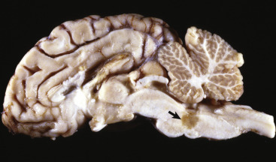
POST-MORTEM LESIONS
Apart from wasting of the carcass, the only gross lesions seen in visna occur in the brain and spinal cord. Focal, asymmetric, brownish pink areas may be found in the white matter of the brain and spinal cord, as well as on the ventricular surfaces. The meninges may be cloudy and the spinal cord may be swollen. On microscopic examination, the typical CNS lesion is meningoleukoencephalitis with secondary demyelination. In some cases, the inflammatory cell aggregates may be nodular or granulomatous, and necrotic centers may be noted in severe cases.

Slide 12
POST-MORTEM LESIONS
In ewes with indurative mastitis, the udder is diffusely indurated and the associated lymph nodes may be enlarged. Histologically, the udder is characterized by mononuclear infiltration of the periductular stroma; these cells obliterate the normal mammary tissue.
Arthritis may also be seen in some animals, and the kidneys may have microscopic evidence of vasculitis.

Slide 13
MORBIDITY AND MORTALITY
MVV is widespread among sheep in many parts of the world. In the United States, the prevalence varies with the region. Infection rates in sheep are highest in the Western and Midwestern States, and can reach nearly 50% in some areas. Control programs have reduced the incidence of MVV in some countries.
Maedi-visna is uncommon in goats; clinical cases have mainly been reported as visna in adult dairy goats.
Most infections are asymptomatic, but once clinical signs appear, the disease is progressive and usually fatal. When MVV is introduced into a new area, the mortality rate may reach 20-30%. The mortality rate is low in regions where maedi visna is endemic; annual losses rarely exceed 5% in a flock, even when nearly 100% of the flock is infected. Co-infection with Jaagsiekte virus, the retrovirus that that causes ovine pulmonary adenocarcinoma, results in more severe symptoms and increased transmission.

