Slide 1
MAEDI-VISNA

Slide 2
INDEX
Importance
Etiology
Species affected
Geographic distribution
Transmission
Disinfection
Incubation period
Clinical signs
Post Mortem Lesions
Diagnostic tests
Treatment
Control
Bibliography

Slide 3
IMPORTANCE
Maedi-visna and caprine arthritis and encephalitis are economically important viral diseases that affect sheep and goats.
however, some animals develop one of several progressive, untreatable disease syndromes.
Additional economic losses may occur due to marketing and export restrictions, premature culling and/or poor milk production. Economic losses can vary considerably between flocks.

Slide 4
ETIOLOGY
Small ruminant lentiviruses (SRLVs) belong to the genus Lentivirus in the family Retroviridae (subfamily Orthoretrovirinae). Two of these viruses have been known for many years: maedi-visna virus (MVV), which mainly causes the diseases maedi and visna in sheep, and caprine arthritis encephalitis virus (CAEV), which primarily causes arthritis and encephalitis in goats.

Slide 5
SPECIES AFFECTED
SRLVs cause disease in sheep and goats. Classical strains of MVV mainly occur in sheep, but some other genotype A variants infect both species. Genotype C viruses also affect both sheep and goats, while classical CAEV isolates (genotype B), and genotypes D and E mainly occur in goats.
The host specificity of SRLVs is not absolute: viruses transmitted from sheep to goats (or vice versa) sometimes adapt to and persist in the new species.
ZOONOTIC POTENCIAL: there is no evidence that humans are susceptible to any SRLVs.

Slide 6
GEOGRAPHIC DISTRIBUTION
SRLV genotypes A and B, which contain the classical MVV and CAEV isolates, respectively, are widely distributed.
MVV has been found in most sheep-raising countries other than Iceland, where it was introduced but eradicated, and Australia and New Zealand.
CAEV has been detected in most industrialized countries. Genotypes C (Norway), D (Spain and Switzerland) and E (Italy) appear to be limited to small geographic areas in Europe, at present.

Slide 7
TRANSMISSION
MVV and CAEV can be transmitted to lambs, kids or other susceptible species in milk or colostrum. Lactogenic transmission was once thought to be the major route by which SRLVs spread.
SRLVs have been found in respiratory secretions and feces, and infections have been demonstrated by intranasal or intraconjunctival inoculation, and via fecally-contaminated water.

Slide 8
TRANSMISSION
SRLVs can be found in semen and the female reproductive tract (e.g., uterus) of both sheep and goats, but they do not appear to directly infect oocytes or sperm. Sexual transmission is at least theoretically posible.

Slide 9
DISINFECTION
Lentiviruses can be destroyed with most common disinfectants including lipid solvents, periodate, phenolic disinfectants, formaldehyde and low pH (pH < 4.2).
Phenolic or quaternary ammonium compounds have been recommended for the disinfection of equipment shared between seropositive and seronegative herds.

Slide 10
INCUBATION PERIOD
The incubation period for SRLV-associated diseases is highly variable, and usually lasts for months to years.
Sheep typically develop the clinical signs of maedi when they are at least 3-4 years of age.
Visna seems to appear somewhat sooner, with clinical signs in some sheep as young as 2 years.
CAEV-associated encephalitis usually occurs in kids 2 to 6 months of age, although it has also been reported in younger and older animals.

Slide 11
CLINICAL SIGNS
MAEDI IN SHEEP: progressive dyspnea, fever, bronchial exudates and depression are not usually seen. Genotype C viruses can also cause lung lesions (chronic interstitial pneumonia) in sheep.
VISNA IN SHEEP: ataxia, incoordination, muscle tremors, paresis and paraplegia, usually more prominent in the hindlegs. Other neurological signs, including rare instance of blindness, may also be seen.
ARTHRITIS IN SHEEP: One genotype B virus (CAEV) caused an outbreak characterized by enlargement almost exclusively of the carpal joint. Pain and lameness occurred in a minority of the affected sheep.

Slide 12
CLINICAL SIGNS
ENCEPHALOMYELITIS IN GOATS.
POLYARTHRITIS IN GOATS.
DYSPNEA IN GOAT.
MASTITIS IN SHEEO AND GOATS.
OTHER EFFECTS IN SHEEP AND GOATS: Some studies, but not others, have reported decreased fertility in SRLV-infected animals and lower birth weights in their offspring. Weight gain may be decreased in young animals, possibly due to lower milk yields from dams with indurative mastitis.
INFECTIONS IN WILD OR CAPTIVE WILD SPECIES: Captive Rocky Mountain goats infected with CAEV developed signs of chronic pneumonia and wasting, with neurological signs and /or joint lesions in some animals.

Slide 13
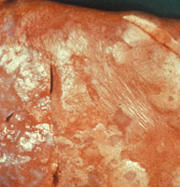
POST MORTEM LESIONS
MAEDI: In sheep with maedi, the lungs are enlarged, abnormally firm and heavy, and fail to collapse when the thoracic cavity is opened. Nodules may be found around the smaller airways and blood vessels, and the mediastinal and tracheobronchial lymph nodes are usually enlarged and edematous.
Description: Sheep, lung. Lung fails to deflate and contains coalescing multifocal gray-white nodules/plaques (proliferative lymphocytes and pneumocytes) with adjacent atelectatic depressed parenchyma (red-pink).

Slide 14
POST MORTEM LESIONS
NEUROLOGICAL FORMS: Apart from wasting of the carcass, the gross lesions of visna or the encephalitic form of caprine arthritis and encephalitis are usually limited to the brain and spinal cord. The meninges may be cloudy and the spinal cord may be swollen.
MASTITIS: In animals with indurative mastitis, the udder is diffusely indurated and the associated lymph nodes may be enlarged.

Slide 15
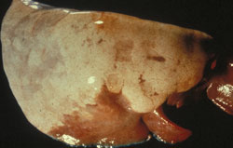
POST MORTEM LESIONS
ARTHRITIS: The lesions mainly affect the carpal joints, and to a lesser extent the tarsal joints. The joint capsules, tendon sheaths and bursae may be calcified.
Description: Sheep, lung. Lung fails to deflate with pale gray coalescing proliferative areas and cranioventral atelectasis (reddish área).

Slide 16
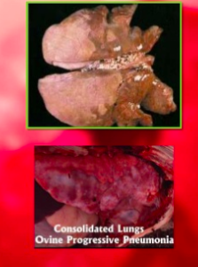
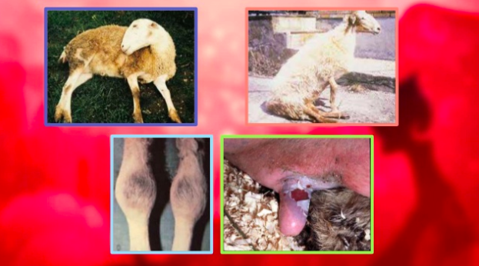
MACROSCOPICAL LESIONS

Slide 17
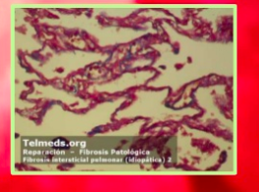
MICROSCOPICAL LESIONS

Slide 18
DIAGNOSTIC TESTS
Diseases caused by SRLVs can be diagnosed by both virological and serological methods.
Antibodies to SRLVs are usually diagnosed by various enzyme-linked immunosorbent assays (ELISAs) or agar gel immunodiffusion (AGID) tests, using either serum samples or milk.
Polymerase chain reaction (PCR) assays or virus isolation can also be used for diagnosis. These tests may be particularly useful before the animal seroconverts.

Slide 19
DIAGNOSIS TESTS
At necropsy, SRLVs can be found in affected tissues, such as lung, mediastinal lymph node and spleen (maedi); brain and spinal cord (visna); choroid plexus, udder or synovial membrane.
Histology of affected tissues, using biopsy or necropsy samples, can help confirm the diagnosis in symptomatic animals.

Slide 20
TREATMENT
There is no specific treatment for diseases caused by SRLVs. Supportive therapy may be helpful in individual animals, but it cannot stop the progression of disease.
Antibiotics may be used for secondary bacterial infections in cases of mastitis or pneumonitis. High-quality, readily digestible feed may delay wasting.

Slide 21
CONTROL
DISEASE REPORTING: Veterinarians who encounter or suspect a reportable disease should follow their national and/or local guidelines for informing the proper authorities.
PREVENTION:
Uninfected herds should also be kept from contact with untested or seropositive herds. Mixing sheep and goats, or feeding milk or colostrum from one species to another, can lead to the transfer of viruses between species. There are currently no vaccines for SRLVs.
The discovery of genes associated with increased susceptibility to SRLVs may make it possible to produce disease-resistant flocks by selective breeding.

Slide 22
BIBLIOGRAPHY
The Merck Veterinary Manual
http://www.merckmanuals.com/
World Organization for Animal Health (OIE)
http://www.oie.int
OIE Manual of Diagnostic Tests and Vaccines for Terrestrial Animals http://www.oie.int/international-standard-setting/terrestrial- manual/access-online/
OIE Terrestrial Animal Health Code
http://www.oie.int/international-standard-setting/terrestrial- code/access-online/

