Slide 1
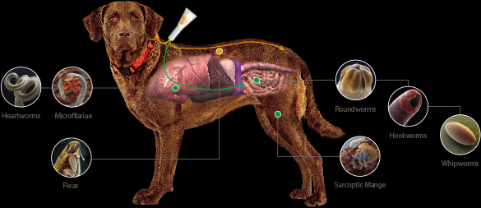
NEMATODE IN LUNGS AND HEART IN DOGS AND CATS

Slide 2
INTRODUCTION
Cardiopulmonary nematodes of dogs and cats cause parasitic diseases of central relevance in current veterinary practice.
Distribution of canine and feline heartworms and lungworms has increased in various geographical areas, including Europe.
This has been the case of the metastrongyloids Aelurostrongylus abstrusus, Angiostrongylus vasorum and Crenosoma vulpis, the filarioid Dirofilaria immitis and the trichuroid Eucoleus aerophilus (syn. Capillaria aerophila).
Global warming, changes in vector seasonal population dynamics and movements in animal populations, play a role in the recent rise in reports of infection.

Slide 3
DISTRIBUTION IN EUROPE
The occurrence of canine and feline heartworms(A. vasorum and D. immitis) and lungworms (A. abstrusus, C. vulpis and E. aerophilus) in different geographical areas is mainly influenced by the presence of competent gastropod and culicid species.
The development and survival of the gastropod and insect vectors is mainly influenced by temperature, moisture and water availability.
Therefore, changes in climate are likely to have a strong impact on parasite distribution, development and transmission patterns.

Slide 4
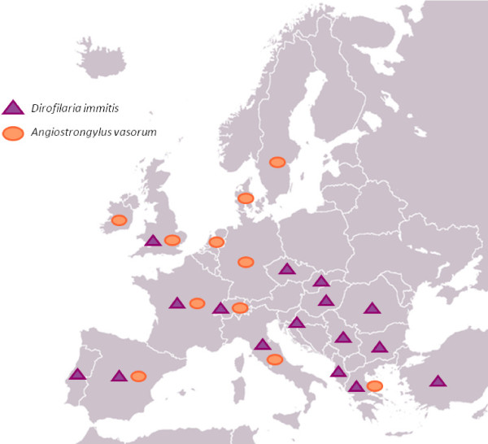
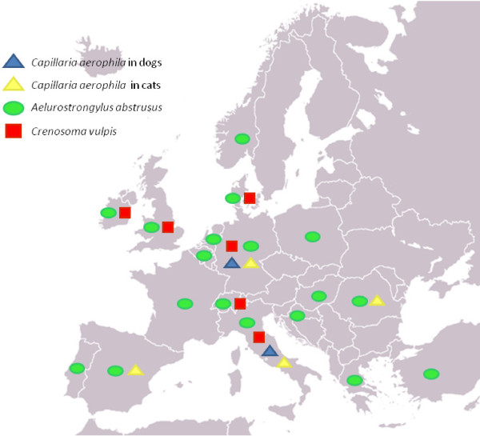

Slide 5
Examples of prevalence rates/ranges (%) or single report/s (S) for Angiostrongylus vasorum (Av)
andDirofilaria immitis (Di)
in some European countries.
C:cats; D:dogs.
Country | Av% | Di%
Italy | S | 0.6-80; S(C)
France | S | 0.6-6.8
Switzerland | S | 1.6
Spain | S | 0.6-58.8
Portugal | - | S
Great Britain | S | S
Irland | S | -
Denmark | 2.2 | -
Netherland | 0.8 | -
Sweden | S | -
Germany | 0.3-7.4 | -
Czech Republic | - | S
Slovakia | - | S
Hungary | - | S
Croatia | - | S
Serbia | - | 6.2
Romania | - | S
Bulgaria | - | S
Albania | - | S
Greece | 1.1 | 10-34
Turkey | - | S

Slide 6
Examples of prevalence rates/ranges (%) or single report/s (S) for Aelurostrongylus abstrusus (Aa),
Crenosoma vulpis (Cv) and
Eucoleus aerophilus (Ea) in some European countries.
C:cats; D:dogs; *The nematode was identified as Capillaria spp.
Country | Aa% | Cv% | Ea%
Italy | 24.4 | S | 2.8(D)-5.5(C)
France | S | - | -
Switzerland | S | S | -
Spain | 1 | - | 1.3(C)*
Portugal | 17.4 | - | 0.3(D)
Great Britain | S | S | -
Denmark | S | 1.4 | -
Holland | 2.6 | - | -
Ireland | S | S | -
Germany | 0.7-6.5 | 0.9-6 | 0.2(C, D)*
Belgium | S | - | -
Norway | S | - | -
Poland | S | - | -
Hungary | S | - | -
Croatia | 0.38-22 | - | -
Greece | S | - | -
Romania | 5.6 | - | 3.1(C)
Turkey | S | - | -

Slide 7
Angiostrongylus vasorum
Angiostrongylus vasorum, also known as French heartworm, is a species of parasitic nematode in the family Metastrongylidae.
Lives in the pulmonary vessels and the heart of canids.
It causes the disease canine angiostrongylosis in dogs.
All dog breeds and ages can be infected as long as they scavenge outside, although young dogs seem to be predisposed to clinical infection.

Slide 8
Angiostrongylus vasorum: life cycle

Slide 9
Angiostrongylus vasorum: pathogenesis and clinical signs
The clinical presentation is highly variable: from subclinical disease to sudden death.
Respiratory symptoms are frequently, but neurologic signs and coagulopathy are also possible.
Respiratory disease: history of gagging, coughing, exercise intolerance and tachy- or dyspnea with or without cyanosis.
An acute respiratory crisis may occur and is frequently accompanied by lung bleeding or a hemothorax.

Slide 10
Angiostrongylus vasorum: pathogenesis and clinical signs
A second manifestation: bleeding abnormalities.
Many types of bleeding : petechiae and ecchymoses, extensive hematomas and bleedings in abdominal and thoracic cavities.
Coagulation pathway can be disturbed.
Bleeding in the brain or spinal cord cause neurologic symptoms. Craniotentorial bleeding: epileptic seizures, paresis and abnormal postural reactions.
If cerebellar bleeding: hypermetria, vestibular symptoms and opisthotonus.

Slide 11
Angiostrongylus vasorum: diagnosis
Auscultation: a systolic murmur can be heard over the tricuspid valve.
Thoracic radiographs: multifocal/peripheral bronchointerstitial pattern with alveolar patches.
High resolution computed tomography: lung lesions.
If neurological signs, magnetic resonance imaging or myelography are useful diagnostic tools.
Cardiac ultrasonography and Doppler

Slide 12
Angiostrongylus vasorum: diagnosis
Blood and cerebrospinal fluid (CSF) analysis.
Bronchoalveolar lavage
Regenerative anemia, eosinophilia, thrombocytopenia and, less frequently, leucocytosis and neutrophilia.
Faecal examination: A. vasorum L1 larvae can be detected.
First stage larva (L1) visualized by light microscopy

Slide 13
Angiostrongylus vasorum: necropsy findings
Lungs show granulomatous pneumonia with suppurative and eosinophilic inflammation with vascular changes (thrombosis and fibrosis).
Adult worms present in the pulmonary arteries and right heart, surrounded by fibrin.
Larvae found in the smaller vessels of the lungs and cause inflammation. This causes the formation of caseogranulomas at the periphery of the lungs and pleura.
Migration of larvae cause caseogranulomas in: kidney, brain, spleen, adrenals and tracheobroncheal lymph nodes.

Slide 14
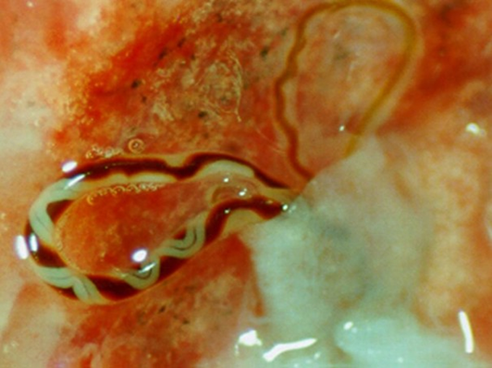
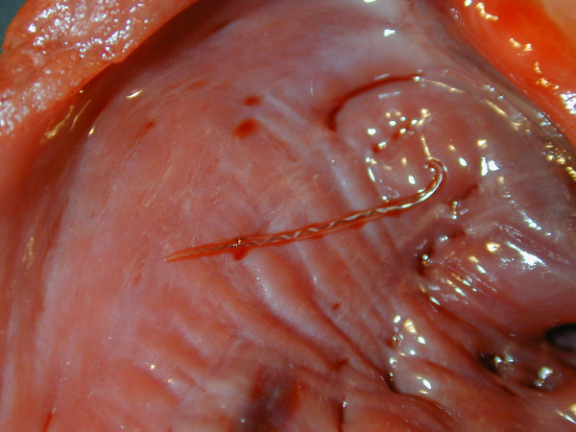
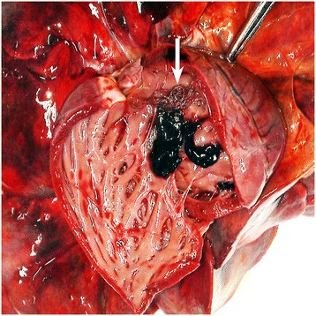

Slide 15
Angiostrongylus vasorum: treatment
Treatment of two parts: anthelmintic therapy and supportive care.
Supportive care depends on the severity of the symptoms and consists of cage rest and hospitalization.
Life threatening DIC or bleeding problems: transfusions with blood.

Slide 16
Dirofilaria immitis
Dirofilaria immitis, the heartworm or dog heartworm, is a parasitic roundworm.
Heartworm is a type of filaria, a small thread-like worm, that causes filariasis.
Definitive host is the dog, but it can also infect cats, wolves, coyotes, foxes, ferrets, sea lions and under very rare circumstances, humans.
Adults reside in the pulmonary arterial system (lung arteries) as well as the heart.

Slide 17
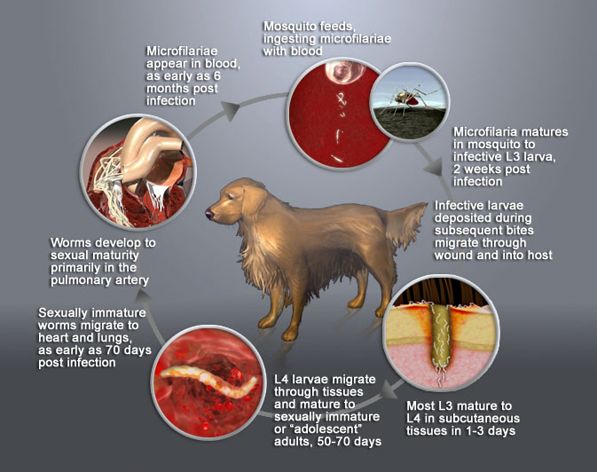
Dirofilaria immitis: life cycle

Slide 18
Dirofilaria immitis: clinical signs
No indication of heartworm infection during the six-month prepatent period.
Little or no sign of infection even after the worms become adults.
Early signs: cough, especially on exercise and early exhaustion upon exercise.
Most advanced cases: severe weight loss, syncope, coughing up blood, abnormal lung sounds, hepatomegaly, ascites, abnormal heart sounds, congestive heart failure and death.

Slide 19
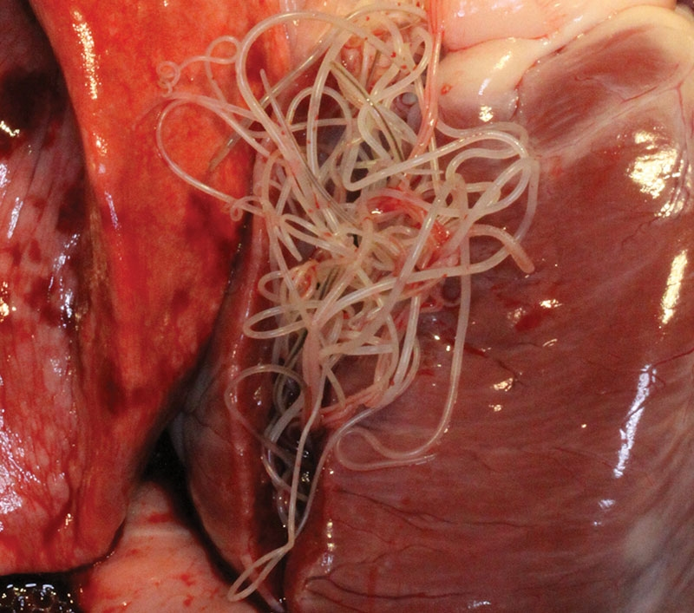
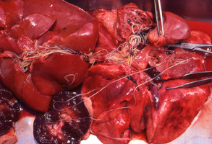
Dirofilaria immitis: necropsy findings
Pulmonary endothelial damage, thrombosis, granulomatous.
Pulmonary vessels: thickened and tortuous.
Heartworms are found in the right ventricle of the heart or in the major pulmonary arteries. Also in the farthest branches of the pulmonary arteries.

Slide 20
Dirofilaria immitis: diagnosis
Microfilarial detection by the microscopic identification of microfilariae on a direct blood smear, above the buffy coat in a microhematocrit tube.
Antigen testing, has supplanted or supplemented microfilarial detection.
Immunodiagnostics (ELISA, lateral flow immunoassay, rapid immunomigration techniques)
X-rays used to evaluate the severity of the heartworm infection: enlargement of the main pulmonary artery, the right side of the heart, and the pulmonary arteries in the lobes of the lung. Inflammation of the lung tissue.
Angiography and Ultrasonography: rarely used

Slide 21
Dirofilaria immitis: treatment
Most dogs infected with heartworm can be successfully treated.
Currently 2 drugs approved by the FDA for use in dogs. Both drugs are organic arsenical compounds.
Melarsomine dihydrochloride: Melarsomine (Immiticide®; Merial). Administered by deep IM injection into the lumbar muscles.
Thiacetarsamide sodium: Thiacetarsamide (Caparsolate®; Merial). Administered by intravenous injection.
Primary post-adulticide complication: severe pulmonary thromboembolism.
Strict reduction in exercise and anti-inflammatory doses of corticosteroids.

Slide 22
Aelurostrongylus abstrusus
A. abstrusus are small parasites of the family Angiostrongylidae.
terminal bronchioles and the alveolar ducts inside the lungs.
Aelurostrongylosis is the disease caused by the cat lungworm.
Intermediate hosts: Molluscs, including snails and slugs.
Paratenic hosts including rodents, birds, amphibians, and reptiles.
Definitive host: Cat.

Slide 23
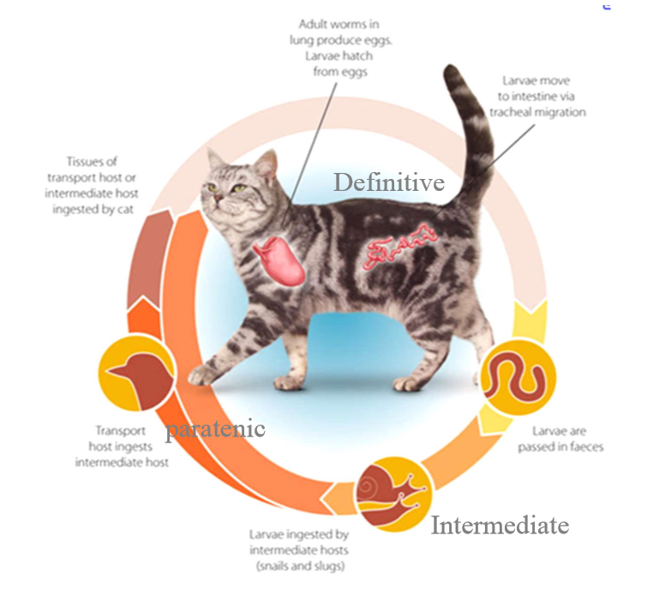
Aelurostrongylus abstrusus: life cycle

Slide 24
Aelurostrongylus abstrusus: Clinical signs
The disease is often asymptomatic.
Massive infections: chronic cough, sneezing, nasal and eye discharge, weakness, loss of appetite…
Very severe cases can cause bronchial pneumonia having rapid, open-mouthed abdominal breathing.

Slide 25
Aelurostrongylus abstrusus: microscopy and macroscopic findings
Alveolitis with larval accumulation, bronchiolitis and bronchiectasis in the lung of a cat with aelurostrongylosis
Multifocal subpleural nodules and
haemorrhages in a severe case of aelurostrongylosis.

Slide 26
Aelurostrongylus abstrusus: diagnosis
Radiography: diffuse interstitial pattern with focal peribronchial densities. An alveolar pattern in severe cases.
Bronchial lavage: coiled larvae with an undulating tail and spine and eosinophilic inflammation.
Haematology: eosinophilia.
Detection of larvae (about 400 micrometers long) in the feces.
Post mortem examination: greenish nodules in the lungs.

Slide 27
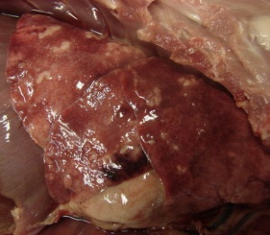
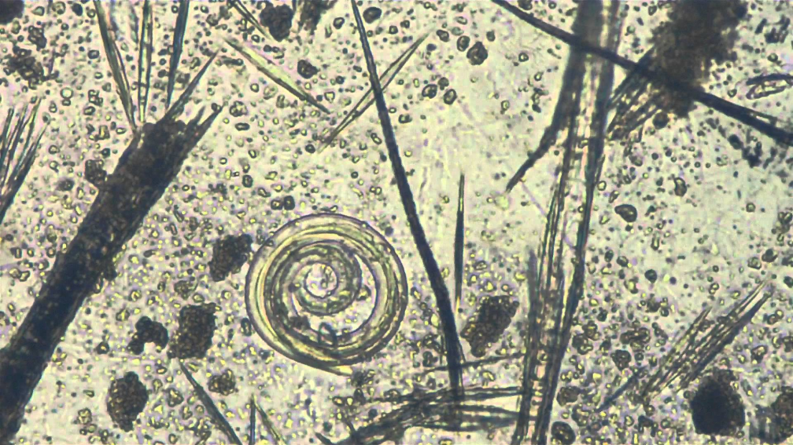
Aelurostrongylus abstrusus: treatment
Fenbendazole for 21 consecutive days is usually effective.
Imidacloprid with moxidectin, emodepsid, and selamectin are also effective.

Slide 28
Eucoleus aerophilus (syn. Capillaria aerophila).
Capillaria aerophila is a Trichuroidea nematode parasite.
Pulmonary capillariasis, is a parasitic disease that typically occurs in wild carnivores.
Can also infest dogs and cats and, sporadically, humans.
Adult stages of the parasite: mucosa of the trachea, bronchi, bronchioles and, sometimes, nasal and frontal sinuses of the host.

Slide 29
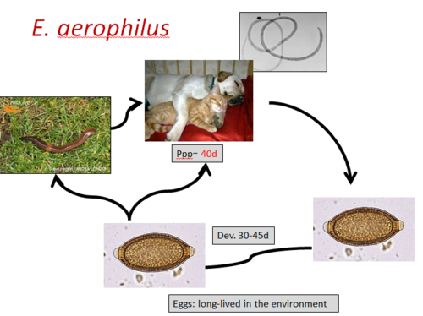
Eucoleus aerophilus: life cycle
Earthworms may act as intermediate hosts, however they are not necessary for completion of the cycle.
Eggs mature in the external environment .

Slide 30
Eucoleus aerophilus: clinical signs and pathogenic role
The pathogen stimulates an inflammatory process in the respiratory tissues.
Rhinitis, tracheitis and/or bronchitis which, in most cases, become chronic. Secondary bacterial infections of the respiratory tract: bronchopneumonia
The signs range from minimal respiratory disturbances to a catarrhal nasal discharge and dry cough.
Chronic bronchitis with bronchovescicular breath sounds (whistling sound), wheezing and sneezing.

Slide 31
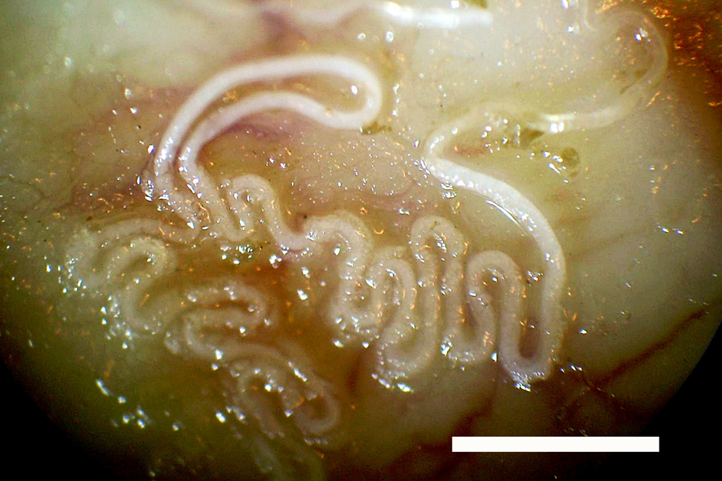
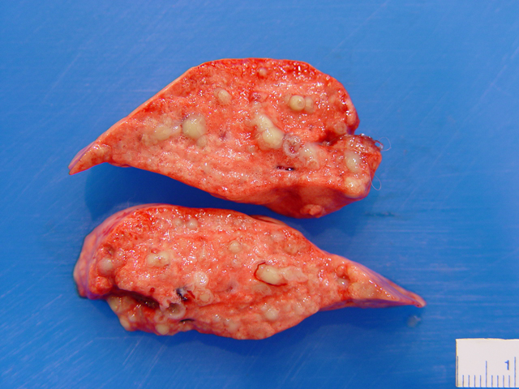
Eucoleus aerophilus: macroscopy/necropsy findings
Damage to the epithelium and lung parenchyma
Mucus in the lumen of the trachea and bronchi decreases and areas of emphysema appear.
If parasite load is high: abscesses of pulmonary parenchyma.
Adult forms can be found on the surface of bronchioles, bronchi and the trachea, fixed completely or partially to the mucosa.

Slide 32
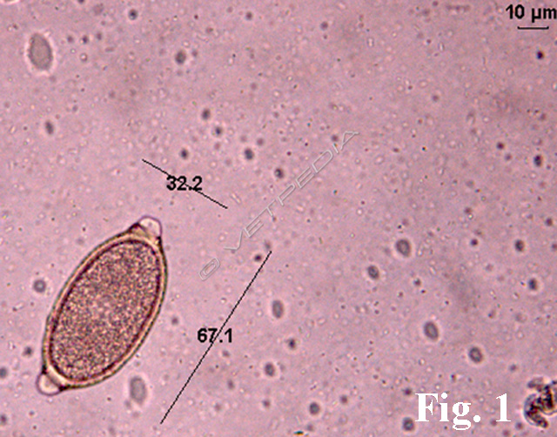
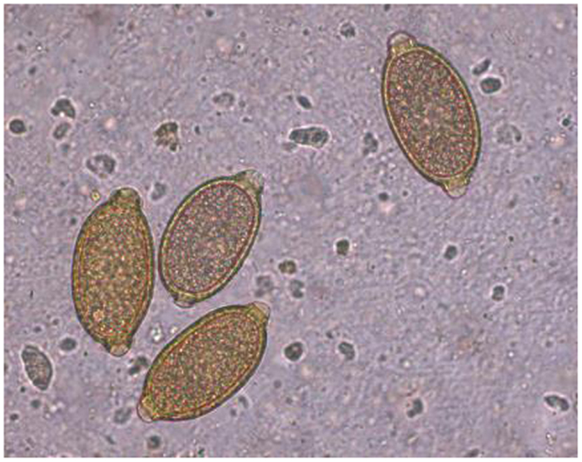
Eucoleus aerophilus: diagnosis
Diagnostic imaging is not useful. Clinical signs can not be distinguished from other parasitosis.
Recognition of the typical eggs of the parasite in the mucus, bronchial lavage fluid or faeces of an infected animal.
Operculated, lemon-shaped eggs.

Slide 33
Eucoleus aerophilus: treatment
Standard anthelmintics, such as ivermectin or fenbendazole, are recommended for treatment of dogs.
Levamisole has been successfully used to treat infected cats.
Two doses of subcutaneous, administered 2 weeks apart, has also been used in cats.

Slide 34
REFERENCES
http://www.capcvet.org/capc-recommendations/canine-heartworm
https://msu.edu/~silvar/heartworm.htm
http://www.ncbi.nlm.nih.gov/pmc/articles/PMC2923136/
https://en.wikipedia.org/wiki/Dirofilaria_immitis
https://orbi.ulg.ac.be/bitstream/2268/187958/1/456.pdf
http://www.aavp.org/wiki/nematodes/strongylida/metastrongyloidea/aelurostrongylus-abstrusus/
https://en.wikivet.net/Capillaria
http://www.vetpedia.net/siteen/node/247
https://en.wikipedia.org/wiki/Capillaria_aerophila
http://www.aavp.org/wiki/nematodes/aphasmidida/eucoleus-aerophilus/

