Slide 1
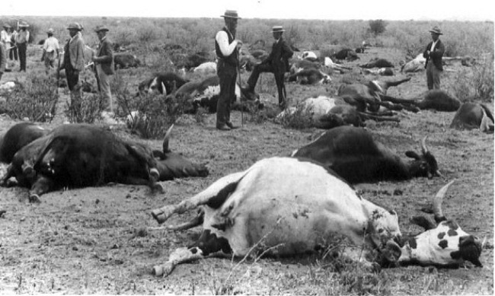
PESTIS BOVINE, RINDERPEST (CATTLE PLAGUE)
PATHOMORPHOLOGY III

Slide 2
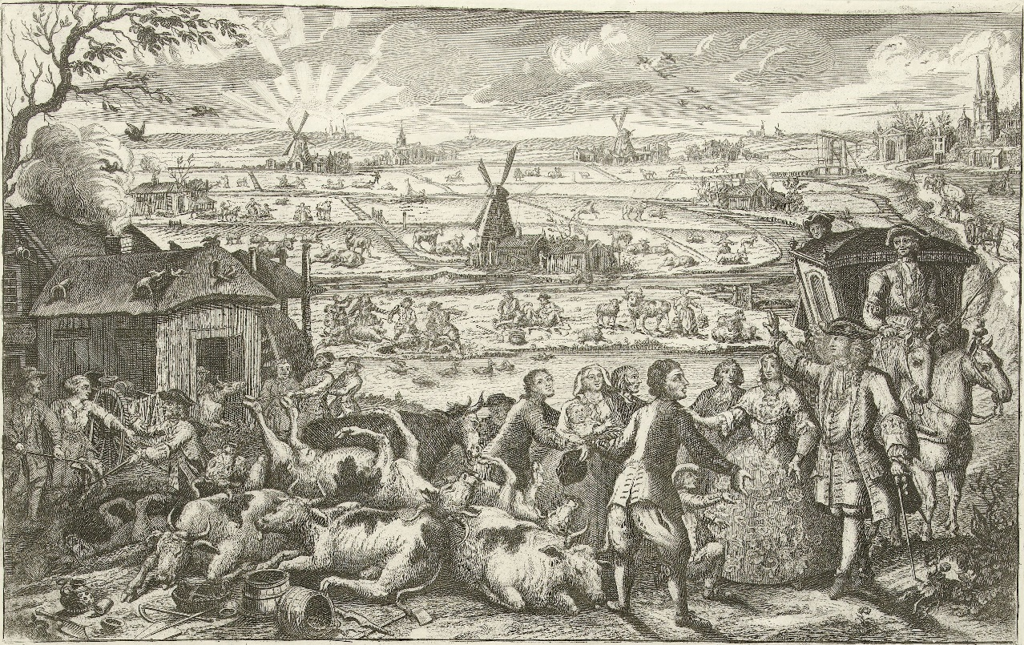
INDEX
HISTORY
ERRADICATTION PROGRAMMES
ETIOLOGY
SPECIES AFFECTED
TRANSMISSION
CLINICAL SIGNS
POST MORTEM LESIONS
DIAGNOSIS
TREATMENT
PREVENTION
BIBLIOGRAPHY

Slide 3
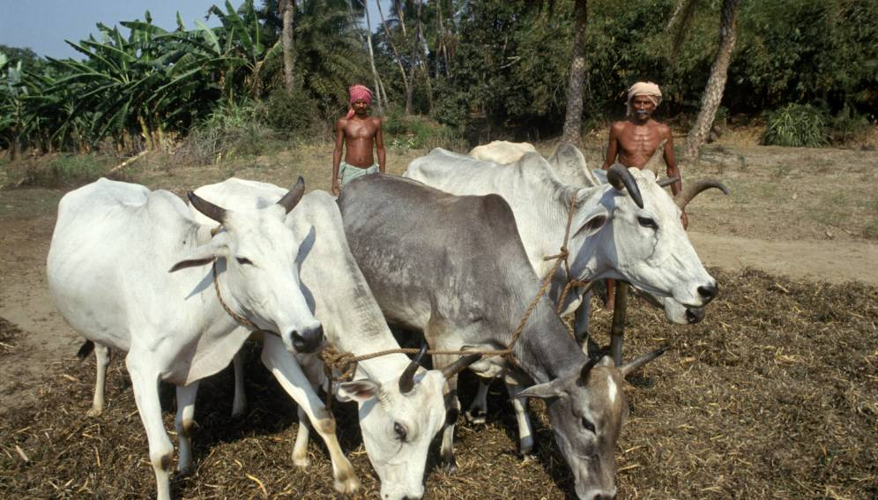
HISTORY
Rinderpest is a highly contagious disease that had been known since humans initiated the domestication of livestock.
Before its eradication in 2011, rinderpest was the most impactful of all cattle diseases, since it could be 100% fatal in some herds, rapidly transmissible and affected cattle, buffaloes, yaks and many other domesticated and wild even-toed ungulates.
It is reported to have had originated in Central Eurasia, and later spread to Europe and Asia, according to trade and migration routes. The disease was also reported in the Americas and Australia in a lower prevalence.
Efforts to understand the pathogeny of the disease and to provide adequate treatment and prevention were the driving force for scientific breakthroughs in the 18th and 19th centuries.
The vast repercussions of the disease at social and economic levels led in 1924 to the creation of the OIE, seeking for controlling infectious animal diseases at an international level and then to the creation of several Veterinary Medicine schools across Europe and Asia.

Slide 4
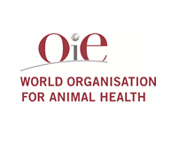
ERRADICATION PROGRAMMES
In the 1960s, mass vaccination campaigns in the Member Countries concerned, accompanied by movement control and stamping out measures, led to a substantial decline in the disease, which made a devastating reappearance on the African continent 20 years later, in the 1980s, due to the interruption of vaccination programmes.
The international response to this resurgence of the disease was led by OIE's action, in particular through the publication of recommended standards for the establishment of epidemiological surveillance systems and official free status recognition for rinderpest.
This contained an OIE programme for eligible Member Countries to be officially recognised as enjoying rinderpest-free status.

Slide 5
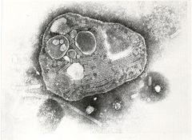
ETIOLOGY
Rinderpest virus
- Genus: Morbilivirus
- Family: Paramyxoviridae
Negative-strand RNA virus. There is just one serotype of this virus but three genetically distinct lineages:
Lineage 1
Lineage 2
Lineage 3
Rinderpest virus DOES NOT cause disease in humans.
Temperature: small amounts of virus resist 56ºC/60 minutes or 60ºC/30 minutes.
pH: stable between pH 4 and pH 10.
Susceptible to lipid solvents and most commmon disinfectants.
Quickly inactivated in environment as RPV is sensitive to light, drying and UV radiation. Can remain viable for long periods in chilled or frozen tissues.

Slide 6
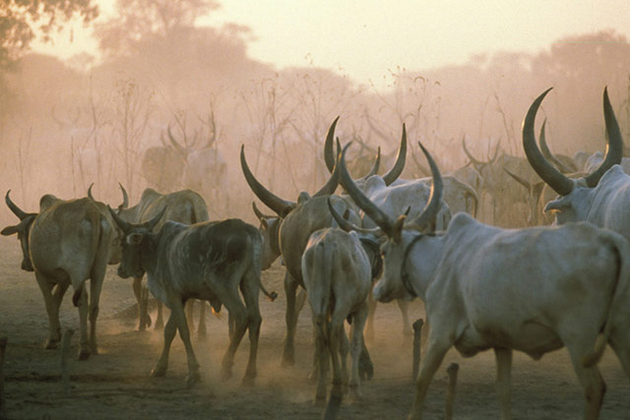
SPECIES AFFECTED
Mainly a disease of cattle and domestic buffalo, including wáter buffalo.
Most wildand domestic cloven-footed animals can become infected.
Zebu, sheep and goats, pigs and wild ungulates in contact with cattle.

Slide 7
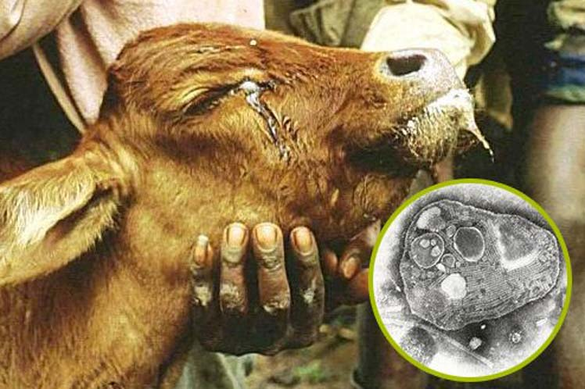
TRANSMISSION
DIRECT CONTACT
Nasal/ocular secretions
Feces, urine, saliva and blood
CONTAMINATED FOOD OR WATER
INDIRECT CONTACT
Fomites

Slide 8
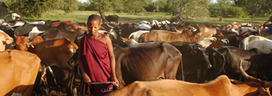
Infected animals do not become carriers; the virus maintains itself by passing from animal to animal in a large, susceptible population.
Vertical transmission does not occur.
Although fomites can spread rinderpest virus, this virus is readily inactivated by sunlight and drying, and fomite-mediated transmission is relatively unimportant.
Because rinderpest virus is inactivated quickly by autolysis and putrefaction, this virus is destroyed within 24 hours in carcasses; however, freezing or chilling of the carcass in some climates could slow these processes and allow the virus to survive longer.

Slide 9
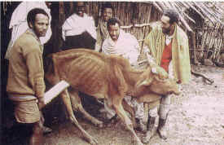
CLINICAL SIGNS
The incubation period as well as clinical disease varies with the strain of virus, dosage, and route of exposure.
Following natural exposure, the incubation period ranges from 3 to 15 days but is usually 4 to 5 days.
Clinically, RPV can occur in four different forms: the classical form, the peracute form, the subacute form, and the atypical form.

Slide 10
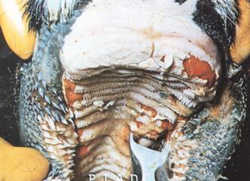
CLINICAL SIGNS
CLASSIC FORM
Fever, depression, anorexia
Constipation followed by hemorrhagic diarrea
Serous to mucopurulent nasal/ocular discharge
Necrosis and erosion of the oral mucosa
Enlarged lymph nodes
Dehydration and eath in 6-12 days

Slide 11
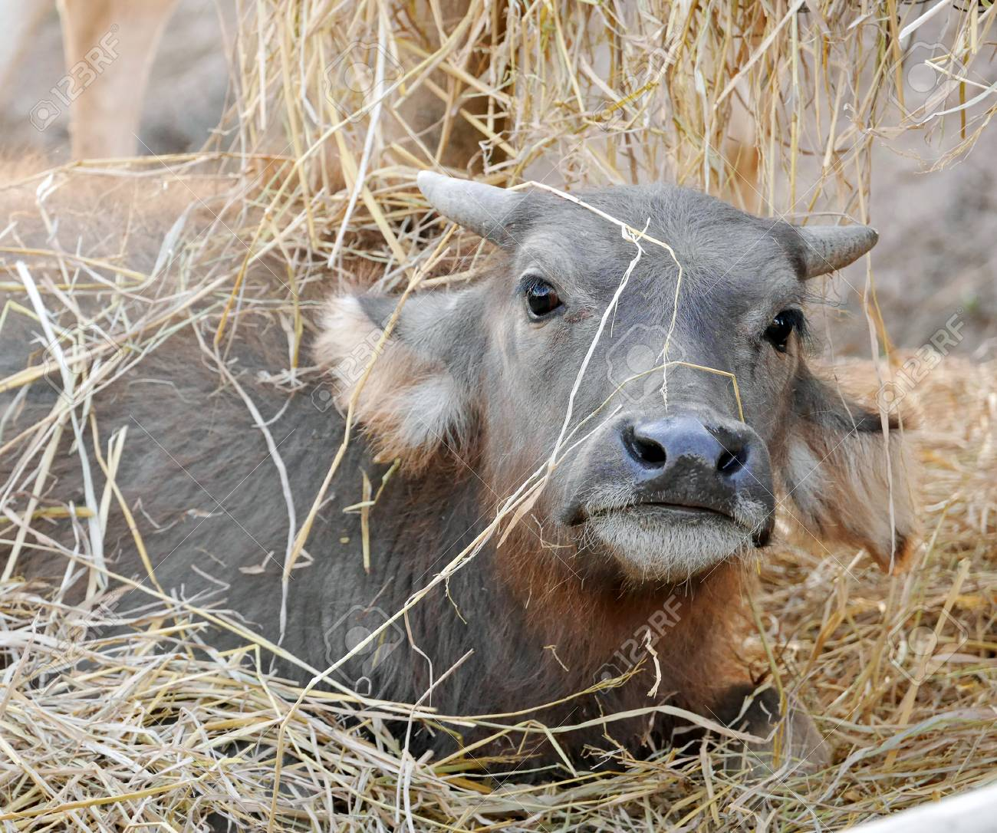
PERACUTE
Young animals, high fever with congested mucous membranes, death in 2-3 days.
SUBACUTE
Mild clinical signs with low mortality
ATYPICAL
Irregular fever, mild or no diarrhoea
Immunosupression leading to secondary infections

Slide 12
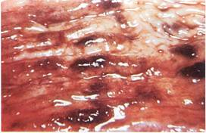
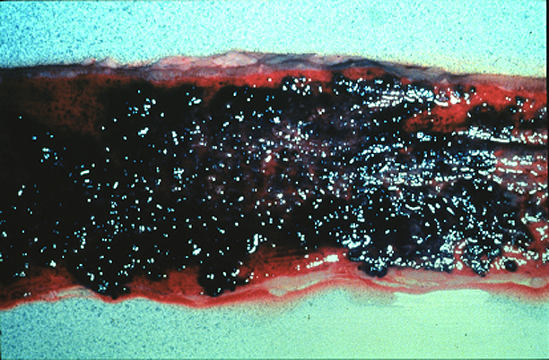
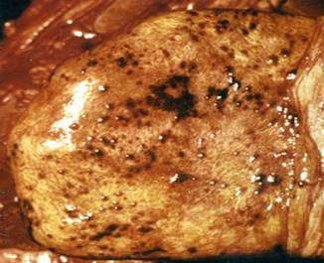
POST MORTEM LESIONS
ESOPHAGUS
Brown and necrotic foci
OMASUM
Rare erosions and hemorrhage
SMALL INTESTINE, ABOMASUM, CECUM AND COLON
Necrosis, edema and congestion
“Tiger striping”
LYMPH NODES
Swollen and edematous
GALL BLADDER
Hemorrhagic mucosa
LUNGS
Emphysema, congestion and áreas of pneumonia

Slide 13
Bovine, oral mucosa. There are numerous small gingival erosions.
Bovine, oral mucosa. There are numerous coalescing erosions on the ventrolateral lingual mucosa.

Slide 14
Bovine, oral mucosa. There is severe diffuse necrosis/coalescing ulceration of the dental pad; mandibular mucosa contains smaller erosions.
Bovine, gingiva. There are a few small erosions.

Slide 15
Bovine, oral mucosa. There are numerous erosions on and between the buccal papillae.
Bovine, hard palate. The mucosa contains many small, coalescing, pale to dark red erosions or foci of necrosis.

Slide 16
Bovine, hard palate. Palate erosion.
Bovine, trachea. The mucosa is hyperemic and covered by abundant mucopurulent exudate.

Slide 17
Bovine, ileum. Peyer's patches are depressed and covered by fibrinonecrotic exudate.
Bovine, colon. There are many petechiae on the crests of the mucosal folds, and there are several small blood clots on the mucosal surface.

Slide 18
Bovine, ileum. The mucosa is hemorrhagic and edematous, and the Peyer's patch is depressed (necrosis).
Bovine, colon. The mucosa contains multiple longitudinal linear hemorrhages.

Slide 19
Bovine, colon. The mucosa is edematous and contains many small hemorrhages and shallow erosions.
Bovine, intestine. Erosions with ulceration; dark areas of mucosal necrosis and hemorrhage.

Slide 20
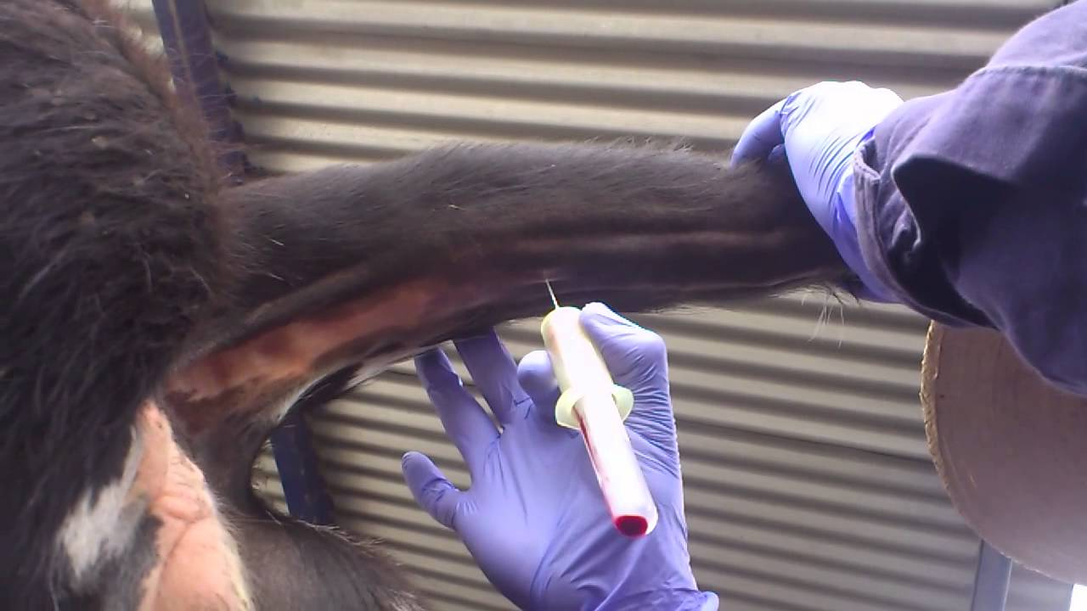
DIAGNOSIS
CLINICAL
Rapidly spreading acute febrile illness in all ages of animals.
Accompaning clinical signs consistent with rinderpest virus
LABORATORY TESTS
Isolation and confirmation of virus
SAMPLES TO COLLECT
Live animals
Viremia drops when fever falls and diarrhoea begins
Blood sample
Swabs of lacrimal fluid
Necrotic tissue of oral cavity
Aspirations of superficial lymph nodes
Dead animals
Spleen, lymph node, tonsil

Slide 21
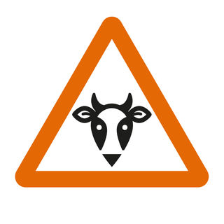
TREATMENT
NOT KNOWN TREATMENT
Diagnosis of RPV usually means slaughter of the affected animals and significant economic loss.
In rare cases, supportive care and antibiotic therapy can help in the treatment of especially valuable animals.
Because of the lack of effective treatment, preventative measures are of key importance.
If RPV is suspected authorities should be contacted immediately.
The State Veterinarian and Federal Area Veterinarian in Charge for each specific area can be found at the above web site. If an outbreak occurs, the area should be quarantined.

Slide 22
PREVENTION
At one time, rinderpest was controlled by annual vaccination of all cattle and domesticated buffalo more than a year of age. Maternal antibodies to rinderpest can persist for 6-11 months.
Outbreaks can be controlled with quarantines and movement controls, euthanasia of infected and exposed animals, decontamination of infected premises, and intensive focal vaccination.
Vaccination for one strain is protective against all strains of the virus.
Vaccinated animals should be marked.
The FAO recommends that the premises, equipment and clothing be cleaned, then decontaminated with oxidizing agents such as sodium or calcium hypochlorite, or alkalis such as sodium hydroxide or sodium carbonate.
Feces and effluents should be treated with sodium carbonate, before they are burned or buried. Pasteurization or heat treatment can inactivate the virus in milk.
During an outbreak, carcasses from infected or exposed animals should be burned or buried.

Slide 23
BIBLIOGRAPHY
http://www.fao.org/ag/againfo/programmes/en/rinderpest/home.html
http://www.cfsph.iastate.edu/DiseaseInfo/disease-images.php?name=rinderpest&lang=en
http://www.oie.int/en/for-the-media/rinderpest/what-is-rinderpest/
http://www.oie.int/en/for-the-media/editorials/detail/article/the-odyssey-of-rinderpest-eradication/
Spickler A.R. & Roth J.A. (2006). - Emerging and Exotic Diseases of Animals. Iowa State University, College of Veterinary Medicine, Ames, Iowa
Coetzer J.A.W. & Tustin R.C. Eds. (2004). - Infectious Diseases of Livestock, 2nd Edition. Oxford University Press.
Barrett T., Pastoret P.-P. & Taylor W.P., Eds (2005). Rinderpest and Peste des Petits Ruminants Viruses, a volume in the series Biology of Animal Infections, Elsevier,

