Slide 1
Porcine Reproductive & Respiratory Syndrome (PRRS)

Slide 2
Etiology
RNA- Virus
Family Arteriviridae
Gener Arterivirus
Susceptible to the enviroment:
Temperature
PH
Exposition to detergents
Virus with envelope
50-65 nm
Temperature
Survives > 4 month → -70°C to -20°C
Temperature → Viability
PH
Survives 6,5- 7,5
Less contagious PH< 6 and PH> 7,65
Exposition to detergents:
clorophorm or ether

Slide 3
Etiology
RNA- Virus
Family Arteriviridae
Gener Arterivirus
Virus 15kb
NON Structural Proteins (infection proteins)
- NSP9 – NSP10 → virulence
NSP2 → mutation hability
Structurals Proteins
Protein N in the nucleo capsid
Less variability
Important for diagnosis → ELISA and RT-PCR
ORF5 ( VP5) → most external protein
Usefull for molecular epidemiology → philogenetic trees
ORF2, ORF3, ORF4
Hipervariability → heterogeity of the virus → non vaccinations protection

Slide 4
Variability of the virus
Genomic Variability of the virus
European isolated - Lelystad virus
Norteamerican – VR 2332
2 Prototypes
Inside those prototypes → Genetic variability
-Mutation
-Random Recombination
Pathogenic Variability of the virus
Difference on the clinic:
Low virulence strains: positives farms without clinic symptoms
Moderate virulence strains: positives farms with expected symtomatology
Hight virulence strains: unexpected symptomatology + mortality of 40%

Slide 5
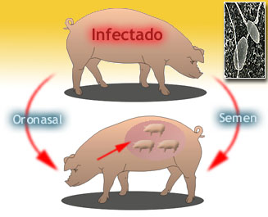
Epidemiology
Excretion:
nasal secretion
Saliva
Colostrum
Milk
Urine
Faeces
Semen
Transmission → DIRECT contact
Aerogene diffusion → depends on the virulence
Semen → Natural service and IA
No continous
Few amount
Direct elimination 20-39 days post- infection
First eyaculation
Is acantoned: tonsils and retropharyngeal lymphnodes
being able to produce a recirculation
reaching the testicle again

Slide 6
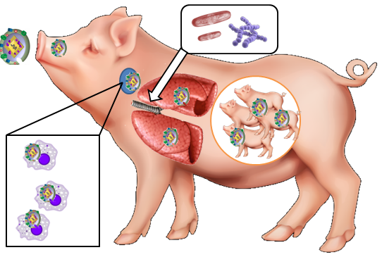
Pathogeny
5 Important Factors:
Infective dose
Level of previous inmunity
Estress Factors
Virulence of the strain
Age of the animal
Virus enters → orally or through the nasal route
Research the tonsils → First replication
Passing through the lymphatic system → retropharyngeal lymphnodes
From the retropharyngeal lymph nodes → blood → infecting monocytes
Distributing throughout the organism
Lung
Uterus of a pregnant female
Notes:
The virus enters orally or through the nasal route. If it enters through the nasal route (in an individual without prior contact with the virus), the virus reaches the tonsils, where it multiplies, then passing through the lymphatic system to the retropharyngeal lymph nodes. It can pass from the lymph nodes to the blood, infecting the monocytes, thus distributing throughout the organism, where two areas stand out: lung or in the uterus of a pregnant female. It can also replicate in the epithelial tissue of the pharynx and larynx. It can cause disease both respiratoryly and reproductively.

Slide 7
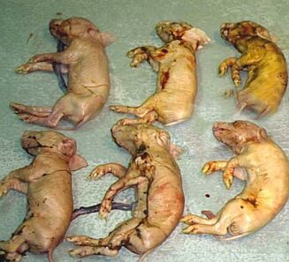
Reproductive Pathogeny
Pregnant females
Depends on the time of the gestation
→0-10 days :
There are not changes
Pellucid zone protect
→10-30 days:
Is able to infect the embrion (1,4% )
Reabsortions and irregular repetition of zeal
→30-70 days **
Abortion of all fetuses
Inmunocompetents
Factors – immunitary system
– virulence of strain
-Low/moderate virulence → survive (PI)
-Hight virulence → anyone survive
→ >75 days (inmunocompetents)
Late abortion→ big size
→95 days (immunocompetents)
No time for virus actuation
Some big mumified fetuses
Some weak animals

Slide 8
Reproductive Pathogeny
Females
Reduces appetite
Fever 3-4 post-infection → 39,9° - 40,1°
Premature farrowing and Abortion (end of the gestation)
Repetition of zeal 21-35 days post- cubrition
Mummified pigs
Variably sized weak-born pigs
Dead born rate
Males
Loss of appetite & lethargy
Fever 3-4 post-infection → 39,9° - 40,1°
Loss of libido
Decrease of semen production
Alteration of the spermatic quality
Altering the acrosome
Abnormal forms
Distal cytoplasmic drops
Notes:
and is located in attached glands (prostate) producing alteration of the spermatic quality (altering the acrosome) and abnormal forms, distal cytoplasmic drops, etc. If it were natural, the virus is transmitted via semen, giving acyclic repetitions (due to the infection of the female) or cyclic repetitions (by not fertilizing the female, by AI).

Slide 9
Respiratory Pathogeny
Lynphonodes → blood→ organs
Lungs→ replication in alveolars macrophages → destroying 40-60%
→ pneumocytes type I and II
Lungs without protection:
- Intersticial pneumony
Secondary pathogen: Pasterurellas, Streptococcus, Staphylococcus
Low airways damaged
Fibrinous. - Suppurative: Streptococcus. - Hemorrhagic: Actinobacillus pleuroneumonie that produces hemolytic toxins. - Polyserositis: Haemophilus parasuis.
bronchopneumonia
Symptoms:
Cought
Dyspnea,
Orthopnea
Decrease in the number of macrophages.

Slide 10
Injures
PRRS virus → multisystemic infection
Gross lesions - are usually only observed in
- are most marked in neonatal and young pigs
Respiratory tissues
Lynphoid tissues.
Severe disease
Lungs:
-Mottled : tan and red
-Fail to collapse
-Cranioventral lobes are most affected
Diffuse fibrous adhesions
(pleura,lungs,pericardium)
Interstitial pneumonia
Lymph nodes
moderately to severely enlarged and tan in colour
some strains of virus,→haemorrhagic
Co- infection compicates the diagnosis
Notes:
Gross lesions
PRRS virus produces a multisystemic infection in pigs, but gross lesions are usually only observed in
respiratory and lymphoid tissues. Both gross and microscopic lesions are most marked in neonatal and young
weaned pigs. The gross pathology observed after uncomplicated infection of PRRS virus in finishing pigs may
be anything from severe to unremarkable.
In severe disease, lungs are mottled, tan and red, and fail to collapse; the cranioventral lobes are most affected.
Lymph nodes are moderately to severely enlarged and tan in colour and, for some strains of virus, may be
haemorrhagic. Under field conditions, most PRRS virus infected pigs are co-infected with one or more
pathogens, which complicates the diagnosis of PRRS based on pathology.

Slide 11
Microscopic Injures
Microscpic analysis of tissues from necropsied animal
Best tissues samples:
Lungs
Lymph nodes
Tonsils
Spleen
Possibly brnochoalveolar lavage
Hematoxylin and eosin stained lung
showing severe diffuse edema
interstitial fibrinosupporative pneumonia
with increased numbers of alveolar macrophage
H&E stained lymph node
lymphoid depletion
severely decreased numbers of lymphoid follicies

Slide 12
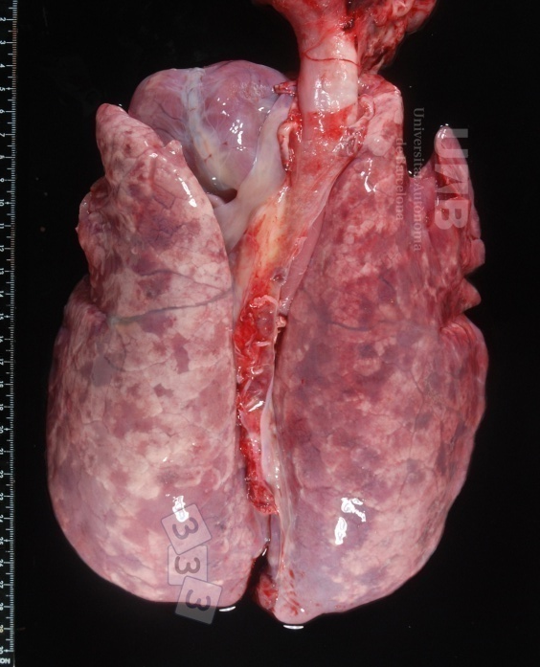
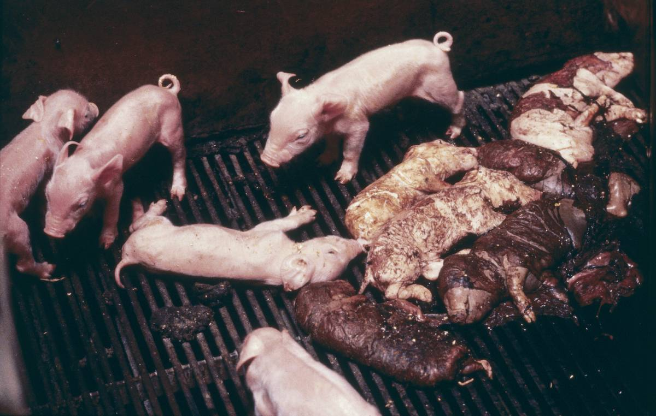
Diagnosis
Clinical diagnosis
Reproductives and Respiratory symptoms
Epidemiologic diagnosis
- All the farms are postives → vaccinations ( homolog strains )
Biosecurity
Anatomophatologic diagnosis

Slide 13
1. Clinical diagnosis
Females
Reduces appetite
Fever 3-4 post-infection → 39,9° - 40,1°
Premature farrowing and Abortion (end of the gestation)
Repetition of zeal 21-35 days post- cubrition
Mummified pigs
Variably sized weak-born pigs
Dead born rate
Males
Loss of appetite & lethargy
Fever 3-4 post-infection → 39,9° - 40,1°
Loss of libido
Decrease of semen production
Alteration of the spermatic quality
Altering the acrosome
Abnormal forms
Distal cytoplasmic drops
Respiratory Symptoms:
Cought
Dyspnea,
Orthopnea
Decrease in the number of macrophages.
Notes:
and is located in attached glands (prostate) producing alteration of the spermatic quality (altering the acrosome) and abnormal forms, distal cytoplasmic drops, etc. If it were natural, the virus is transmitted via semen, giving acyclic repetitions (due to the infection of the female) or cyclic repetitions (by not fertilizing the female, by AI).

Slide 14
Diagnosis
Clinical diagnosis
Reproductives and Respiratory symptoms
Epidemiologic diagnosis
- All the farms are postives → vaccinations ( homolog strains )
Biosecurity
Anatomophatologic diagnosis

Slide 15
4. Anatomophatologic diagnosis
PRRS virus → multisystemic infection
Gross lesions - are usually only observed in
- are most marked in neonatal and young pigs
Respiratory tissues
Lynphoid tissues.
Severe disease
Lungs:
-Mottled : tan and red
-Fail to collapse
-Cranioventral lobes are most affected
Diffuse fibrous adhesions
(pleura,lungs,pericardium)
Interstitial pneumonia
Lymph nodes
moderately to severely enlarged and tan in colour
some strains of virus,→haemorrhagic
Co- infection compicates the diagnosis
Notes:
Gross lesions
PRRS virus produces a multisystemic infection in pigs, but gross lesions are usually only observed in
respiratory and lymphoid tissues. Both gross and microscopic lesions are most marked in neonatal and young
weaned pigs. The gross pathology observed after uncomplicated infection of PRRS virus in finishing pigs may
be anything from severe to unremarkable.
In severe disease, lungs are mottled, tan and red, and fail to collapse; the cranioventral lobes are most affected.
Lymph nodes are moderately to severely enlarged and tan in colour and, for some strains of virus, may be
haemorrhagic. Under field conditions, most PRRS virus infected pigs are co-infected with one or more
pathogens, which complicates the diagnosis of PRRS based on pathology.

Slide 16
4. Anatomophatologic diagnosis
Microscpic analysis of tissues from necropsied animal
Best tissues samples:
Lungs
Lymph nodes
Tonsils
Spleen
Possibly brnochoalveolar lavage
Hematoxylin and eosin stained lung
showing severe diffuse edema
interstitial fibrinosupporative pneumonia
with increased numbers of alveolar macrophage
H&E stained lymph node
lymphoid depletion
severely decreased numbers of lymphoid follicies

Slide 17
Diagnosis- Laboratory tests
For virus isolation and RT-PCR (affected animal)
Whole blood (EDTA)
Serum
Lungs
Respiratory tract
Spleen
Tonsils
Samples from mummified or aborted litters are unlikely to yield virus
Isolation → Cytopathic effects are evident in 1–4 days
2. For antibody testing ( serology) → ELISA and IPMA and IFA
Serum from up to 20 exposed animals
IgM→ within 7 days
IgG→ 14 days
Humoral antibody titres reach a maximum → 5-6 weeks after infection
Antibody levels can drop quite quickly in the absence of circulating virus.
Notes:
IgM can be detected within 7 days of infection and IgG can be detected within 14 days. Humoral
antibody titres reach a maximum about 5–6 weeks after infection. Antibody can be detected by ELISA
and by the indirect staining of pre-prepared monolayers of infected cells (IPMA and IFA). Antibody
levels can drop quite quickly in the absence of circulating virus.

Slide 18
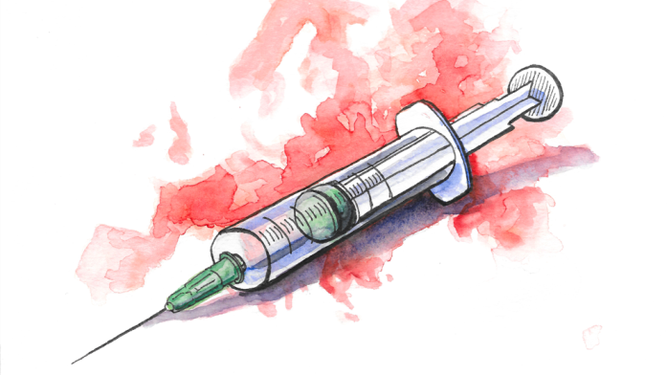
Prevention
Hygienic sanitary measures
- Biosecurity
Avoid the entrance of a different strain → infected animals
Quarantine Period + Period for be infected with the local strain
Vaccination:
All the animals will be vaccinated
Dead vaccines
Secure → Not replication
Less efficient → less immunological answer
Live attenuated vaccines
More efficient → replication
Immunological answer - higher vs homologous
- partial versus heterologous
Abortion in pregnant females

Slide 19
Thanks for your attention!

