Slide 1
SWINE SALMONELLOSIS

Slide 2
Salmonella is widely extended in humans and animals. From all the Salmonella serotypes (more than 2400), the more important ones causing clinical disease in pigs are Salmonella Choleraesuis and Salmonella Typhimurium.
S. Choleraesuis is the specific serotype adapted to swine, and can produce a severe disease widespread in sows (fever, depression, septicemia, pneumonia, meningitis, arthritis and diarrhea), but does commonly not affect humans. The most commonly found serotype in pigs, however, is Salmonella Typhimurium which sometimes is associated with diarrhea in young pigs, and is a common source of food intoxication in humans. Pigs can be subclinical carriers of S. Choleraesuis for long periods of time because the organism survives in the mesenteric lymph nodes, located in the intestine. Many of these carriers do not excrete the bacteria in feces, unless they are under stressing conditions. Some pigs might excrete the organism in feces in a continuous or intermittent way. The disease depends on the strain and the dosage, meaning there is a need for a relatively high number of organisms to produce clinical signs.

Slide 3
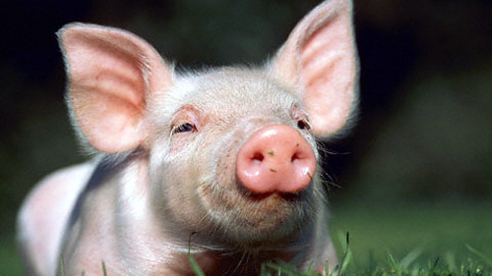
Salmonella might occur at any age, but is more frequent in growing pigs 8 weeks or older. The salmonella present in the pig’s gut can contaminate the carcass during slaughter, which is a potential risk for human health.

Slide 4
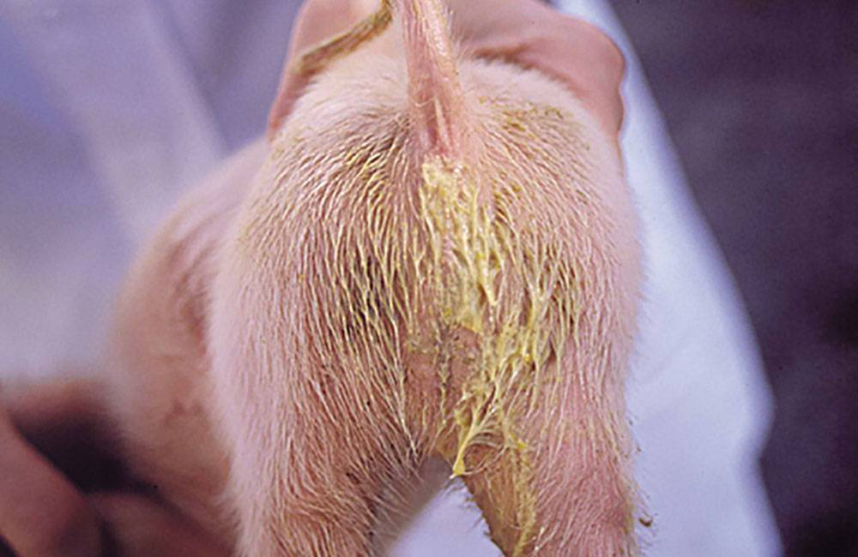
Symptoms
Sows
High temperature.
Depression.
Loss of appetite
Ears, nose and tail congestion (septicemia).
Pneumonia.
Coughing.
Nervous signs (rare).
Smelly diarrhea, which sometimes can have blood and mucus.
Might die in the acute phase of the disease.
Lactating piglets
The disease is not frequent in piglets due to the passive immunity of colostrum.
Weaners and growers
Same clinical signs than sows.

Slide 5
LESIONS
Piglets infected with S.typhimurium show inflammation and slight thickening of the ileum and colon, and necrotic debris usually appears on the surface of the mucosa. The mesenteric lymph nodes are enlarged, edematous, and sometimes red. The ulceration of the mucosa may or may not be evident.
In acute cases, a small hemorrhagic component can be observed. Sometimes rectal strictures may occur. Other enteropathogenic salmonellae, except S. typbisuis, cause lesions similar to those of S. typbimurium, although less severe. The lesions of enteritis caused by S. typbisuis are characteristic and are typically yellow and round (button) ulcers in colon, caecum and, less frequently, ileum.

Slide 6
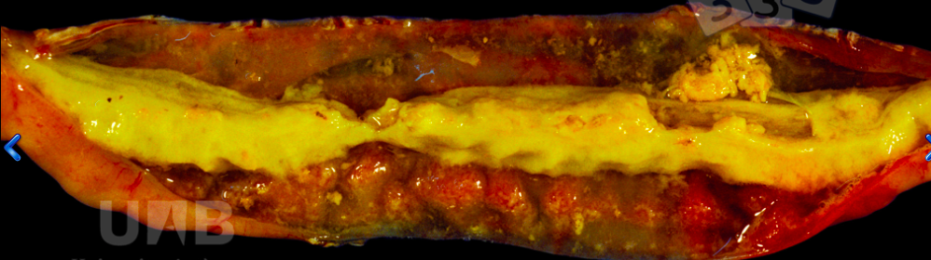
Fibrous enteritis
The presence of a yellowish, proteinaceous material in the intestinal lumen is indicative of a fibrinous exudate. In the small intestine, observation of fibrin in the lumen, or adhering to the mucosa, is highly suggestive of Salmonella typhimurium infection

Slide 7
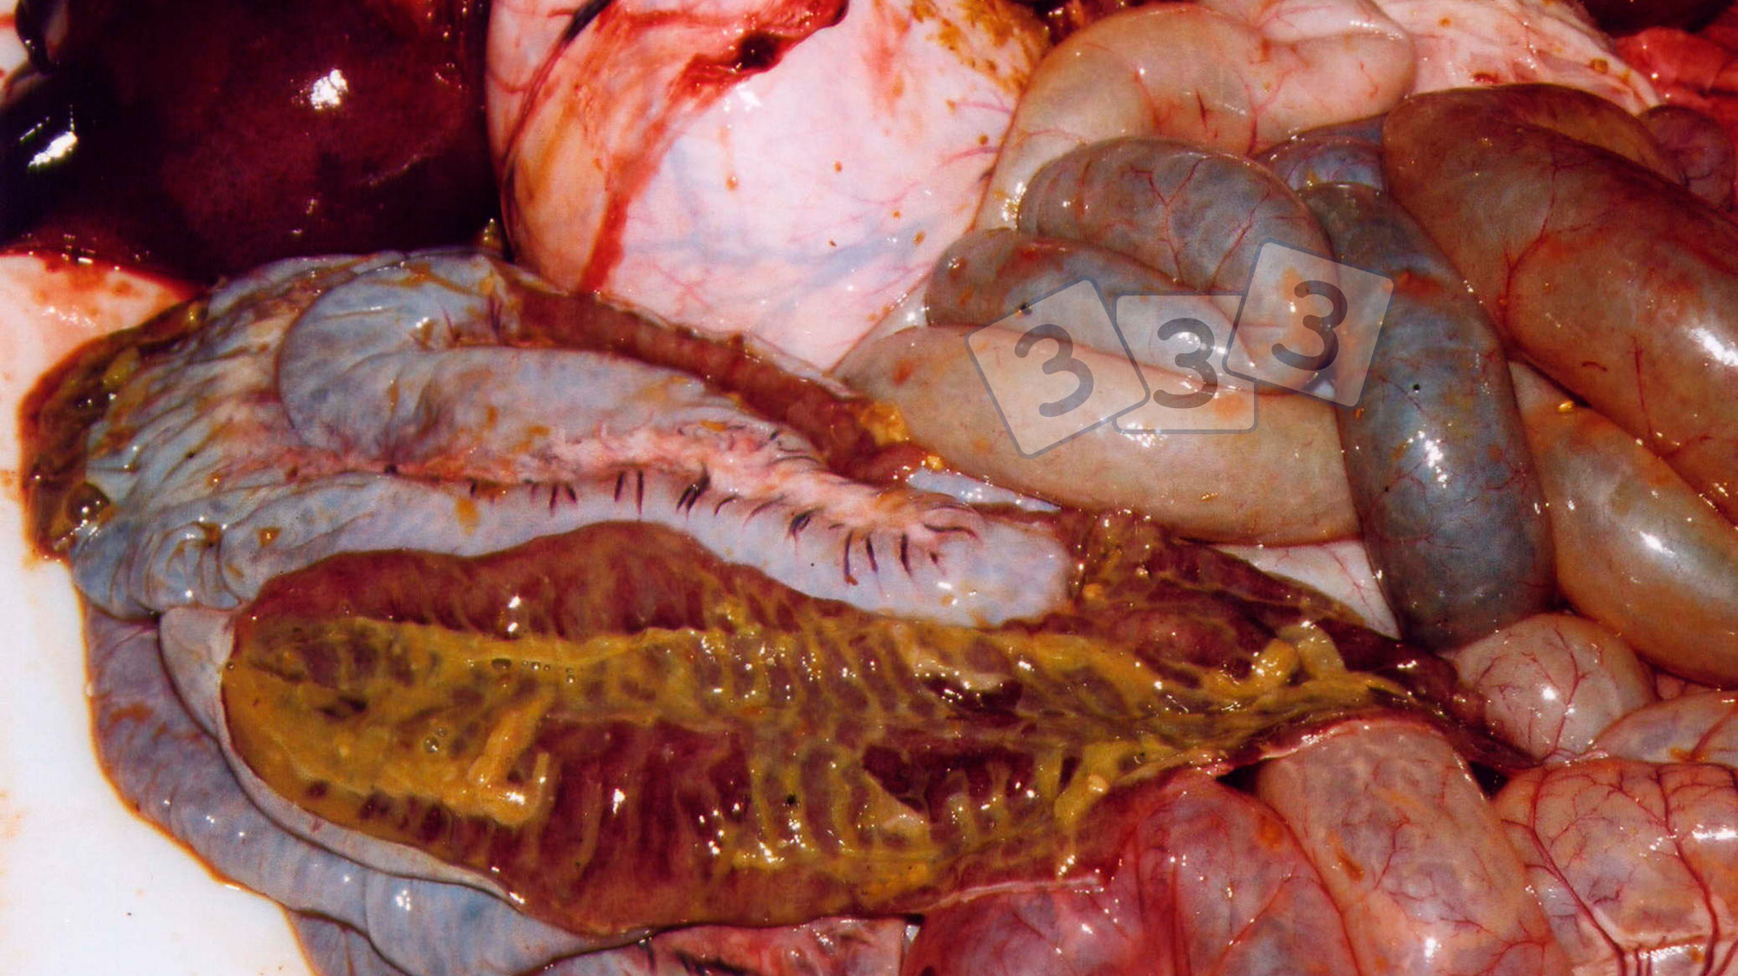
enteritis

Slide 8
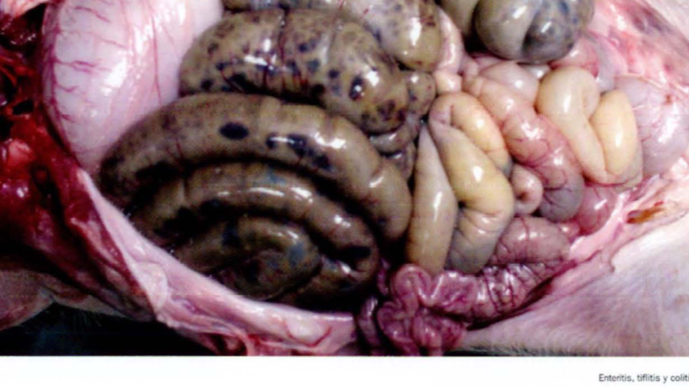
Enteritis, tiphitis and necrotic colitis

Slide 9
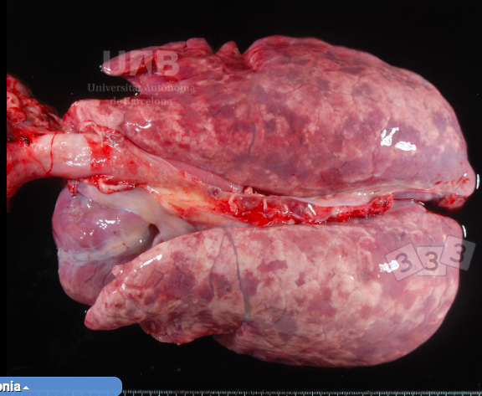
Interstitial pneumonia
in pigs is characterized by heavy and non-collapsed lungs with rubbery texture. The multifocal reddish areas are typical of this lesion and correspond to different degrees of severity among pulmonary lobules. This lesion is highly indicative of viral pulmonary infection, and can be due to the septicemia.

Slide 10
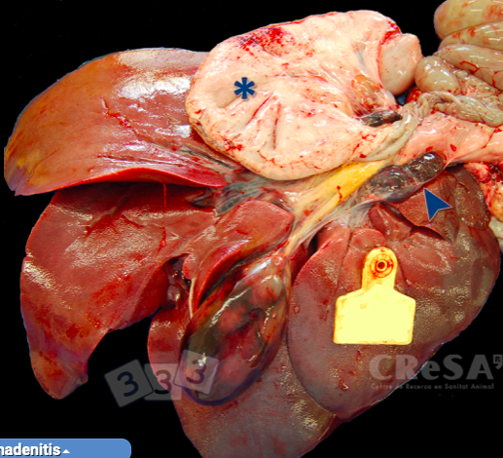
haemorrhagic lesions in the gastrohepatic lymph nodes
In the image the peritoneum has been removed to expose the hemorrhagic lymph nodes.

Slide 11
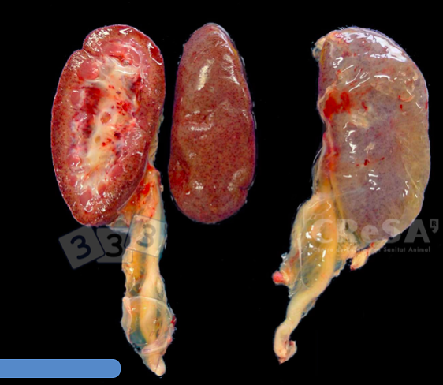
perirenal oedema and different patterns of renal hemorrhages
In the image petechiae (hemorrhages measuring less than 3 mm) can be observed in the renal cortex and in the renal pelvis. Differential diagnose must include anticoagulant toxicity and non-specific septicemia.

Slide 12
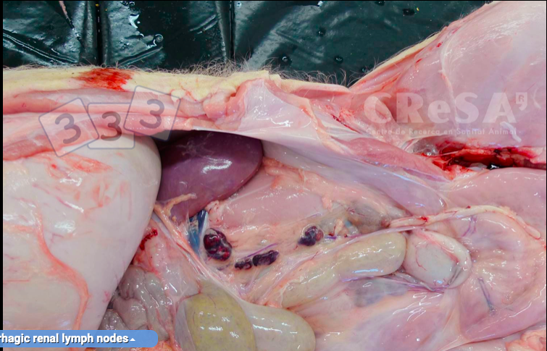
haemorrhagic lesions in the renal lymph nodes
In the image the peritoneum has been removed to expose the hemorrhagic lymph nodes. Differential diagnose must include anticoagulant toxicity and non-specific septicemia.

Slide 13
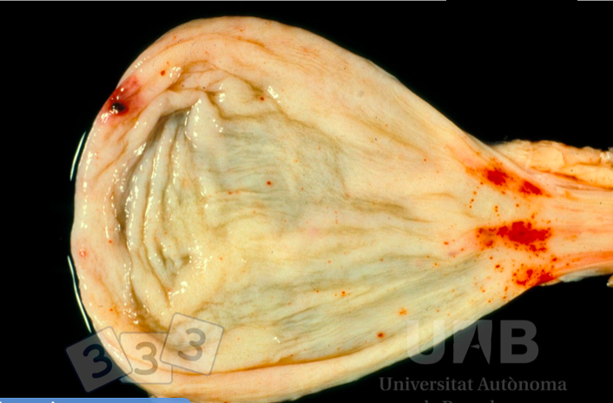
Hemorrhages in the urinary bladder
are multifactorial, but in general are associated to coagulation disorders, septicemia or viral infections (ASF, CSF).

Slide 14
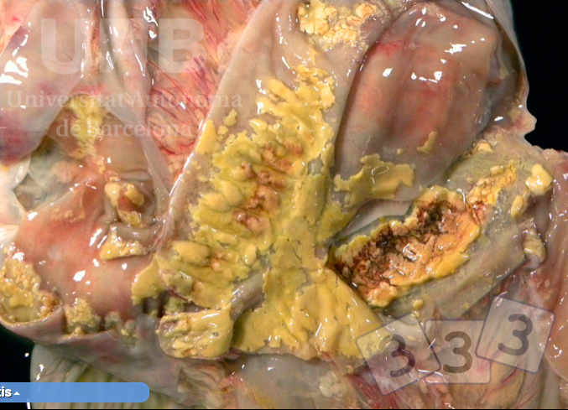
Fibrinous exudation in the small intestine and colon
are usually associated with Salmonella spp. infection (as it is this case). Swine dysentery (caused by Brachyspira hyodysenteriae) can also produce fibrinous or ulcerative lesions, but usually restricted to colon. Fibrin adhered to the mucosa surface implies necrosis of the mucosa.

Slide 15
Causes / Contributing Factors
Poor hygiene.
Crowding.
Stress produced when moving and mixing animals.
Barns used continuously.
Contaminated boots and clothes.
Mechanical transmission through feces and movement of contaminated material.
Worms and flies.
Feed contamination made by birds, rats and mice.
Contamination of feed ingredients (especially animal fat).

Slide 16
Diagnosis
Clinical signs (may be similar classical swine fever or other septecemias).
Necropsy (Interstadial edema, congested liver, spleen, and gastrohepatic lymph nodes).
Bacterial culture (organs, feces, blood).
PCR.
Serology.
Serotyping isolate is important.

Slide 17
Control/Prevention
Improve hygiene by ensuring proper cleaning and disinfection (disease is dose dependent).
All-in-all-out pig flow.
Purchase animals (including breeding stock replacements) from known negative sources.
Vaccines can be very effective (do have some cross protection between S. Choleraesuis and Typhimurium).
Antibiotics can control disease but will not eliminate the pathogen.
Do not use animal fat in diets.
Control rodents.

Slide 18
bibliography
http://www.fao.org/3/a-as540s.pdf
https://www.msdvetmanual.com/digestive-system/salmonellosis/overview-of-salmonellosis
https://www.3tres3.com/enfermedades/salmonelosis_105
http://www.cfsph.iastate.edu/DiseaseInfo/disease.php?name=salmonella-abortusovis&lang=en

